Slide 1
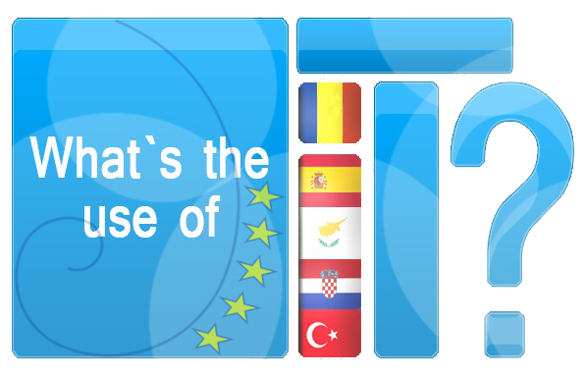
Application in agriculture
What’s the Use of It?

Slide 2

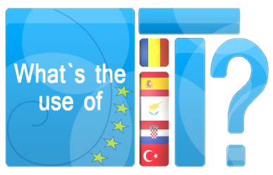

Table of Contents
  Objectives
  Competences
  Understanding the Moon Phases
  Visible Part of the Moon
  Lunar Planting Calender
  The Beetroot Problem
  The Spinach Problem
  The Average Monthly Temperature
  Tasks
  Bibliography/Sources

Slide 3
Objectives
Develop a positive attitude towards learning Mathematics
Identify, concretise, symbolise and use mathematical relationships in everyday life.
Communicate mathematical ideas.
To help students meet the requirements of preparing for careers in fields other than matematics.

Slide 4
Competences
Determine the equation of a sinusoid from given data.
Modeled agricultural problem by using a sinusoid.
Validating the model, internally and externally – analysing and criticising the model, in itself and vis-a-vis possible alternatives.
Representing mathematical, understanding and utilising different sorts of representations of mathematical objects and situations.

Slide 5
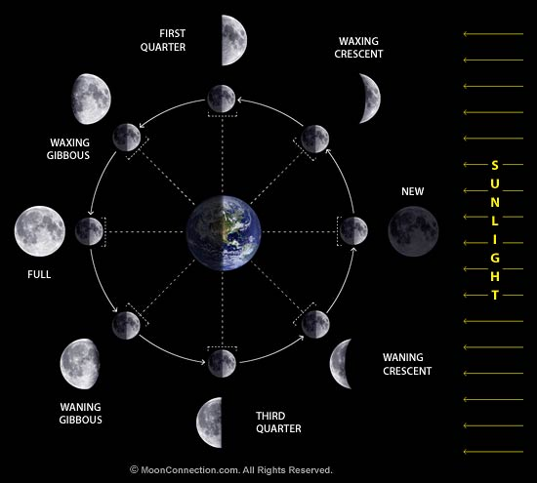
Understending the Moon Phases
Have you ever wondered what causes the Moon phases? We all know that its appearance changes over time. But why? The good way to understand the phases of the Moon is to examine an Earth-Moon-Sun diagram.
We give the parts of the Moon cycle different names, according to how the Moon appears to us. In order of appearance:

Slide 6
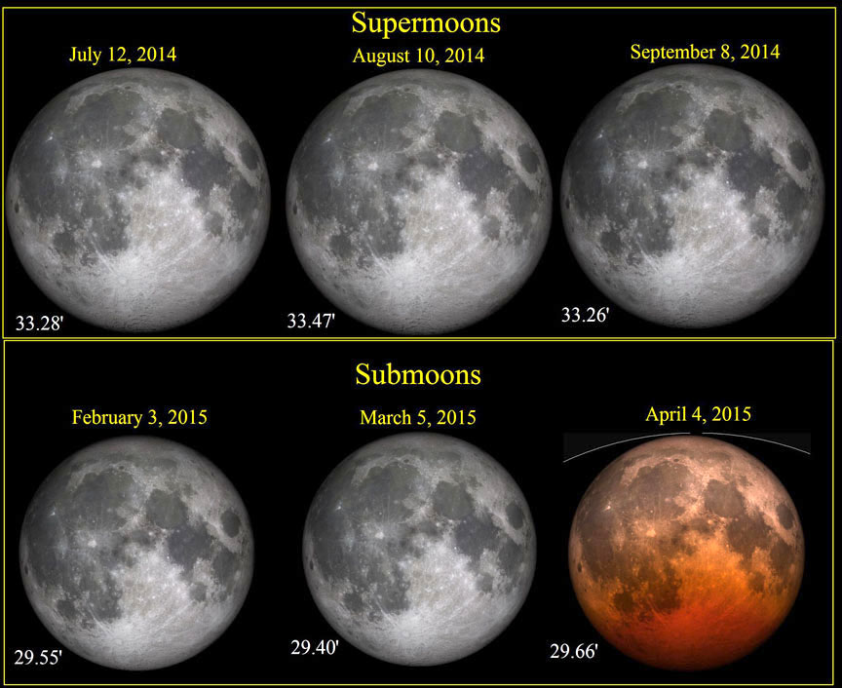
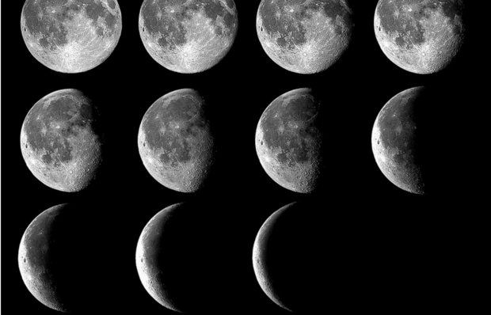
Understending the Moon Phases
New (also called the Dark Moon) - not visible
Waxing Crescent
First Quarter - commonly called a "half Moon"
Waxing Gibbous
Full - we can see the entire illuminated portion of the Moon
Waning Gibbous
Third Quarter - another "half Moon", but the illuminated part is opposite of the First Quarter
Waning Crescent
New - back to the beginning
This complete lunar cycle (New Moon to New Moon) is also called a "lunation". During this time the Moon will completely circle the Earth. That's the scientific definition, but you can take any phase; for instance a so-called "full Moon cycle" would be from Full Moon to Full Moon.

Slide 7
Visible Part of the Moon
The following table provides information about the visible part of the Moon during the first three months of 2015.(http://aa.usno.navy.mil/data/docs/MoonFraction.php)
date | 5.1. | 10.1. | 15.1. | 20.1. | 25.1. | 30.1. | 4.2. | 9.2. | 14.2. | 19.2. | 24.2. | 1.3.
visible part - Moon | 1.00 | 0.80 | 0.35 | 0.01 | 0.26 | 0.78 | 1.00 | 0.79 | 0.31 | 0.00 | 0.32 | 0.81
date | 6.3. | 11.3. | 16.3. | 21.3. | 26.3. | 31.3. | 4.4.
visible part - Moon | 1.00 | 0.77 | 0.26 | 0.01 | 0.37 | 0.83 | 1.00

Slide 8
Visible Part of the Moon
date
Moon
The data from the table is displayed in the coordinate plane. On the x axis there are days counting from 1.1. 2015, and on the y-axis visible part of the Moon.
5 | 1
10 | 0,8
15 | 0,35
20 | 0,01
25 | 0,26
30 | 0,86
35 | 1
40 | 0,79
45 | 0,31
50 | 0
55 | 0,32
60 | 0,81
65 | 1
70 | 0,77
75 | 0,26
80 | 0,01
85 | 0,37
90 | 0,83
94 | 1
Draw a curve connecting the plotted points.
Which function can be approximated by the visible part of Moon?

Slide 9

Visible Part of the Moon
The visible part of the Moon can be approximated by trigonometric function:
In this example, we'll take the function
$$f(t)=AcosB(t−C)+D$$
From the graph we can see A = 0.5 i D = 0.5
Function period of the lunar month is about 29.53 days
C= 5 , because on January 5, the visibility of the Moon is 1.

Slide 10
Lunar Planting Calender
Lunar planting calendar
In ancient times when man had no idea about the wristwatch, the most reliable source of telling the time was the Sun, Moon, and stars. There seems to have been several opinions of who came up with the Moon planting calendar first. Was it the Egyptians or the Babylonians? It is more likely that each and every farmer had a planting calendar based on the Moon phases, and there would be different variations depending on the geographical location. As their calendars where passed on through the generations they have evolved to cover the different crops they tried to grow and the more productive farming techniques used.
It was noticed that different plants grow better when they are planted during different phases of the Moon. Each of these phases imparts an influence on the way vegetation grows on the planet through the rising and falling of the amount of moisture in the ground and in the plants.
There are three methods for planting due to the Moon. The Synodic, or waxing and waning cycle, the Sidereal, and the Biodynamic cycle.

Slide 11
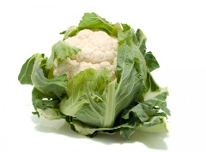
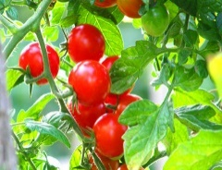
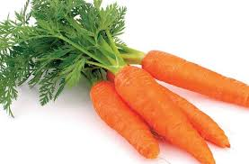
Lunar Planting Calender
Waxing Crescent
It is the best time for planting / seeding plants whose fruit is above ground and the seeds are not found in the fruit (lettuce, spinach, cabbage, cauliflower ...)
First Quarter
It is the best time for planting / seeding plants whose fruit is above ground and the seeds are in the fruit (beans, peas, peppers, tomatoes, melon ...)
Waning Gibbous
It is the best time for seeding / planting plants whose fruit is underground (beetroot, carrots, onions, potatoes ...)
Third Quarter
The last quarter of the standstill period. If you want to slow down the growth of grass, it is a good period for mowing.

Slide 12
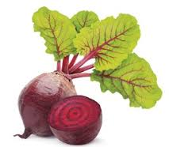
The Beetroot Problem
According to the lunar calendar favorable period for sowing beetroot is a week after the full Moon. If we know that the recommended period for seeding beetroot is from 15 April to 30 June, determine possible suitable dates of planting.
Solution:
How beetroot should be sown in the period between 15 April to 30 June, to the 105th and 181st day of the year, which means
Draw a graph of lunar phases

Slide 13
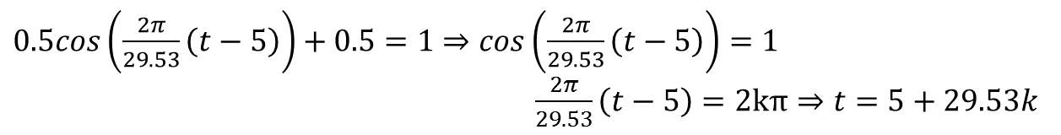
The Beetroot Problem
According to the lunar calendar, the perfect time for seeding beetroot is a week after the full Moon. This interval is the number of functions which perform the maximum $t_{1}$ to number $t_{1}+7$
Determine the point where
the function has a maximum.
$0.5cos\left(\frac{2π}{29.53}\left(t−5\right)\right)+0.5=1$ $⇒cos\left(\frac{2π}{29.53}\left(t−5\right)\right)=1$
$\frac{2π}{29.53}\left(t−5\right)=2kπ⇒t=5+29.53k$
As $105≤t≤181⟹105≤5+29.53k≤181⟹3.4≤k≤5.9,k∈Ζ,⟹k=4,k=5$
$$t_{1}=123,t_{2}=153$$
Suitable intervals for seeding are $\left[123,130\right],\left[153,160\right]$. Determine the dates of the year as determined by the intervals. Suitable dates are from 3 May to 10 May and from 3 June until 10 June.

Slide 14
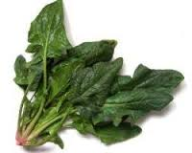
The Spinach Problem
The recommended period for sowing spinach is from 15 March to 21 June. If we know that by the lunar calendar sowing is best to be done during the new Moon, determine favorable dates.
Solution:
How should spinach be sown in the period between 15 March to 21 June, to the 74th and 172nd day of the year, which means
Draw a graph of lunar phases.

Slide 15
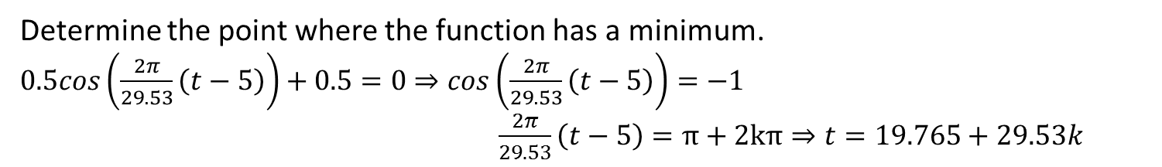
The Spinach Problem
According to the lunar calendar, the perfect time for seeding spinach is a week after the new Moon. This interval is the number of functions which perform the minimum $t_{1}$ to number $t_{1}+7$
Determine the point where the function has a minimum.
$0.5cos\left(\frac{2π}{29.53}\left(t−5\right)\right)+0.5=0$ $⇒cos\left(\frac{2π}{29.53}\left(t−5\right)\right)=−1$
$\frac{2π}{29.53}\left(t−5\right)=π+2kπ⇒t=19.765+29.53k$

Slide 16
The Spinach Problem
As $74≤t≤172, 74≤19.765+29.53k≤172⟹1.83≤k≤5.15,k∈Ζ,⟹k=2, 3, 4, 5$
$$t_{1}=79,t_{2}=108,t_{3}=138,t_{4}=167$$
Suitable intervals for seeding are $\left[79,86\right],\left[108,115\right],\left[138,145\right],\left[167,172\right]$.
Determine the dates of the year as determined by the intervals.
$$20.3−26.3, 18.4 −25.4,18.5−25.5, 15.6−21.6$$

Slide 17
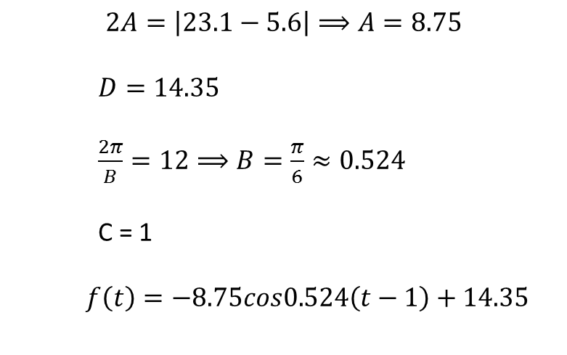

The Average Monthly Temperature
The table shows the average monthly temperature.
I. | II. | III. | IV. | V. | VI. | VII. | VIII. | IX. | X. | XI. | XII.
5.6°C | 6.2°C | 8.7°C | 12.3°C | 16.9°C | 20.5°C | 23.1°C | 22.9°C | 19.1°C | 14.4°C | 9.9°C | 6.9°C
Make a scatter plot of the data. Find a cosine curve that models the dana .
$$f(t)=AcosB(t−C)+D$$
$$2A=\left|23.1−5.6\right|⟹A=8.75$$
$D=14.35$
$\frac{2π}{B}=12⟹B=\frac{π}{6}≈0.524$
C = 1
$f\left(t\right)=−8.75cos0.524\left(t−1\right)+14.35$

Slide 18
The Average Monthly Temperature
Spinach is recommended to be sown if the average temperature is between 14 ° C and 16 ° C. Compare the graphs of average temperatures and recommended planting dates and answer when sowing is more favorable.

Slide 19
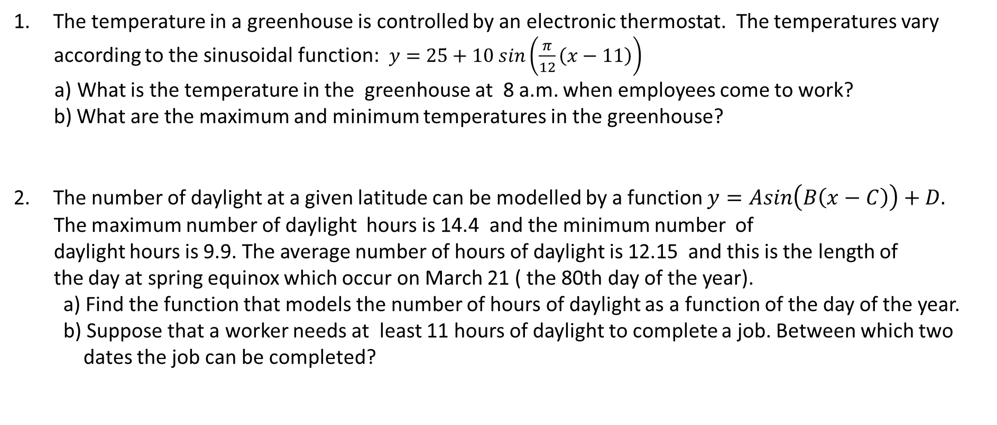
Tasks
The temperature in a greenhouse is controlled by an electronic thermostat. The temperatures vary
according to the sinusoidal function: $y=25+10 sin\left(\frac{π}{12}\left(x−11\right)\right)$
a) What is the temperature in the greenhouse at 8 a.m. when employees come to work?
b) What are the maximum and minimum temperatures in the greenhouse?
The number of daylight at a given latitude can be modelled by a function $y=Asin\left(B\left(x−C\right)\right)+D.$
The maximum number of daylight hours is 14.4 and the minimum number of
daylight hours is 9.9. The average number of hours of daylight is 12.15 and this is the length of
the day at spring equinox which occur on March 21 ( the 80th day of the year).
a) Find the function that models the number of hours of daylight as a function of the day of the year.
b) Suppose that a worker needs at least 11 hours of daylight to complete a job. Between which two
dates the job can be completed?

Slide 20
Tasks
3. The Earth rotates at a 23.5° tilt from the verical. As the Earth revolves around the Sun, the amount of sunlight that each
location receives changes based on its location and the relative position of the tilt to Sun. If the Earth wasn`t tilted, the
amount of daylight at every location would be equal year-round.
The following table displays the sunrise and sunset times of the 15th of every month in 2015 for Dubrovnik, Croatia.
The data were found on www.sunrisesunset.com.
Month | Sunrise time | Sunset time | Hours of Sunlight | Month | Sunrise time | Sunset time | Hours of Sunlight
1 | 7:15am | 4.38pm |  | 7 | 5:23am | 8:28pm
2 | 6:46am | 5.27pm |  | 8 | 5:53am | 7:51pm
3 | 6:09am | 5:53pm |  | 9 | 6:23am | 7:01pm
4 | 6:07am | 7:28pm |  | 10 | 7:00am | 6:04pm
5 | 5:20am | 8.08pm |  | 11 | 6:38am | 4:20pm
6 | 5:09am | 8:23pm |  | 12 | 7:10am | 4:15pm

Slide 21
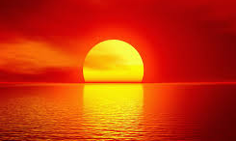
Tasks
Complete the table by calculating the number of hours of sunlight for 15th of every month.
Make a scatter plot of the length of the day .
What type of model, if any, do you think would fit the data? Write a function that approximates the length of the day?
What is the average amount of sunlight that Dubrovnik,received per day ?
During which day(s) of the year will Dubrovnik have a day where half of the day is sunlight and half of the day not?
How many hours of sunlight will Dubrovnik receive on your birthday?
Pick your favorite city and collect data on the length of the day for a certain year. Create a model of the data.

Slide 22
Bibliography/Sources
Books:
Špalj, Eva;Antončić, Nevenka;Matematika3,Zagreb; Školska knjiga,2005.
Šikić, Zvonimir;Bujan-Slamić,Ivanka;Jeličić, Ljiljana; Matematika 3, Zagreb; Profil,2014.
Web sites:
http://aa.usno.navy.mil/data/docs/MoonFraction.php , Web.April 2015.
The gardeners calendar, Moon planting, Web. April 2015.
http://www.the-gardeners-calendar.co.uk/
www.sunrisesunset.com, Web. April 2015.

