Slide 1


Osnovna škola Bartola Kašića
Vinkovci
Erasmus+ project 2020-2022
S.O.F.T. - Start our future today
ADVERTISING

Slide 2
Why do we have to advertise?
- to attract new consumers
- to increase sales of existing products
- to inform consumers about new products
or services
- to earn money
Notes:
Colours - gold - success, high quality, money

Slide 3
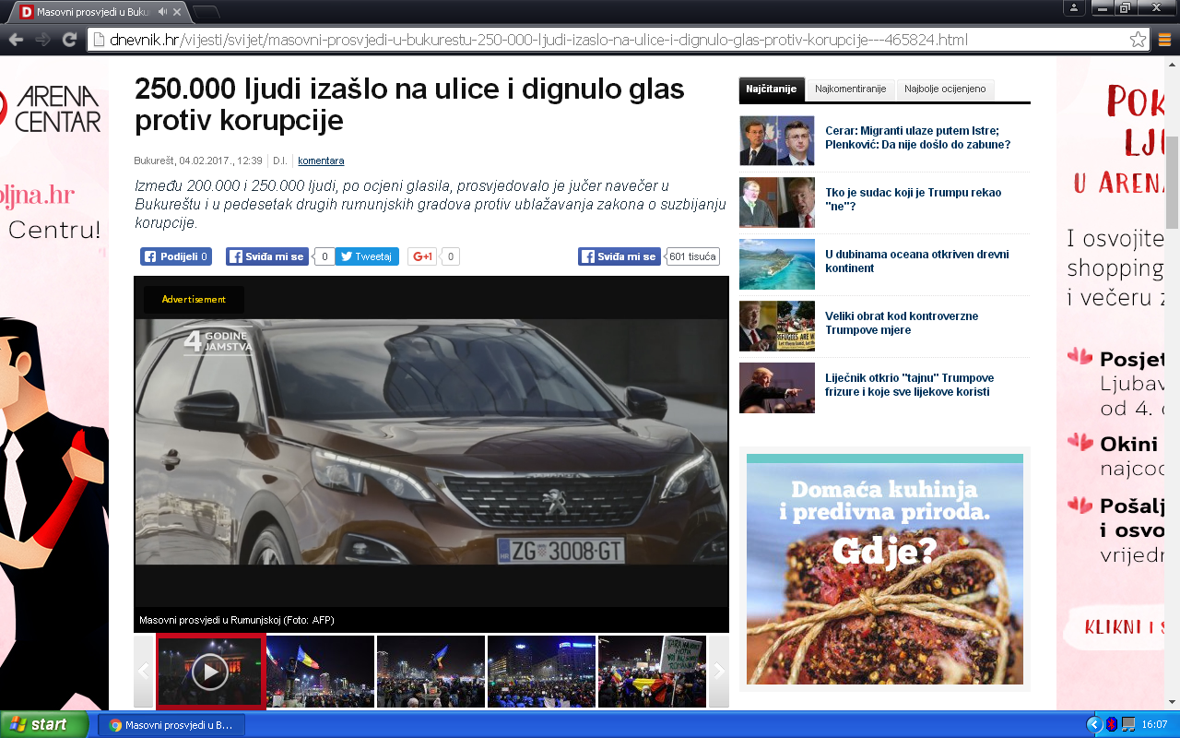
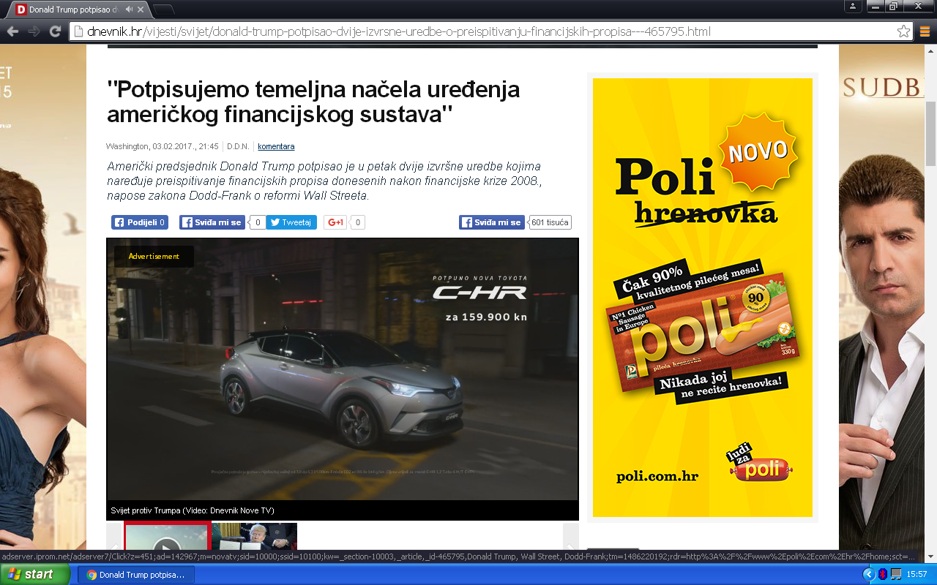
Advertisements in magazines, leaflets, brochures, bilboards, internet
Commercials: advertisements on the radio, TV, internet
commercial
ad

Slide 4



Scientific approach

Slide 5
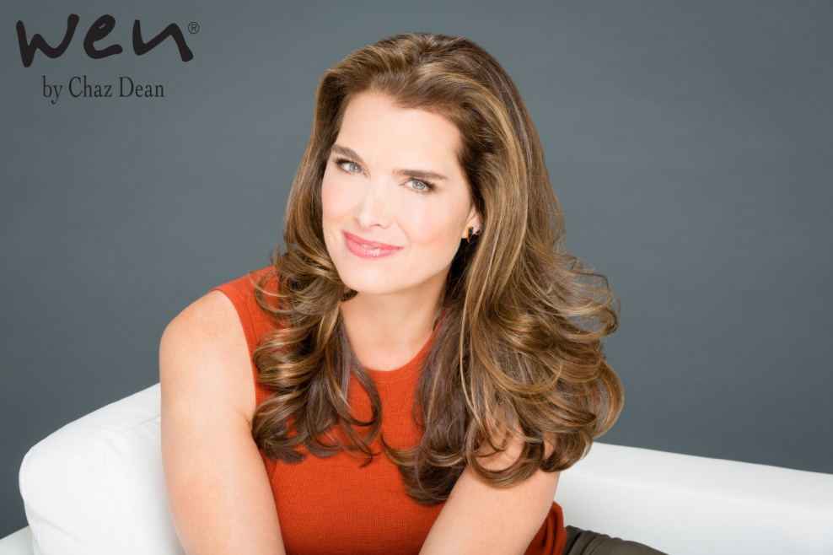

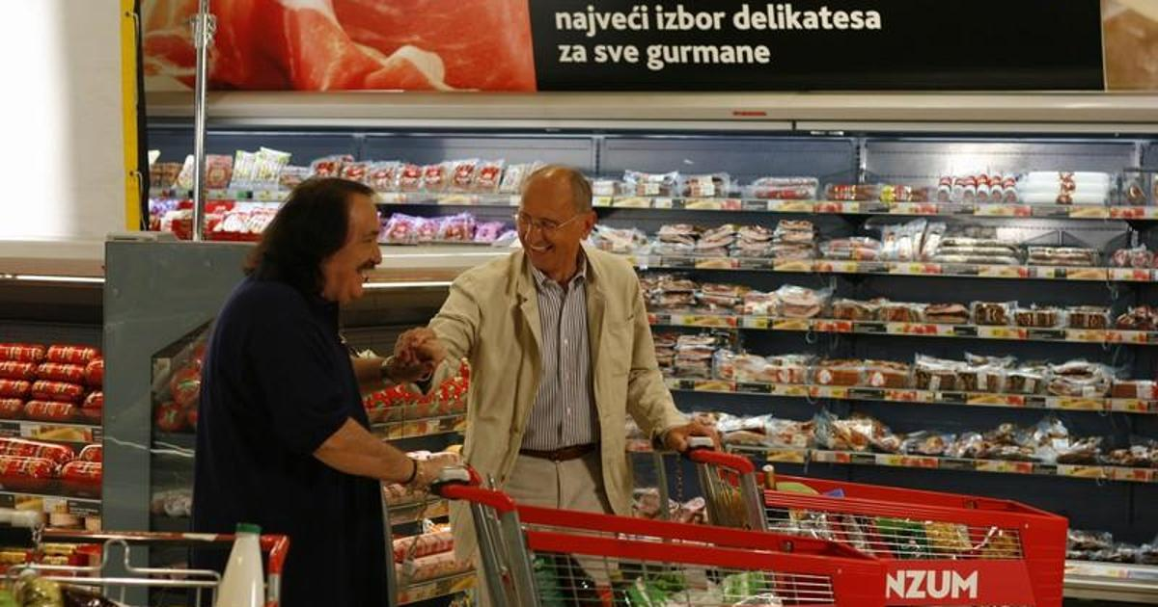
Famous persons’ recommendations

Slide 6

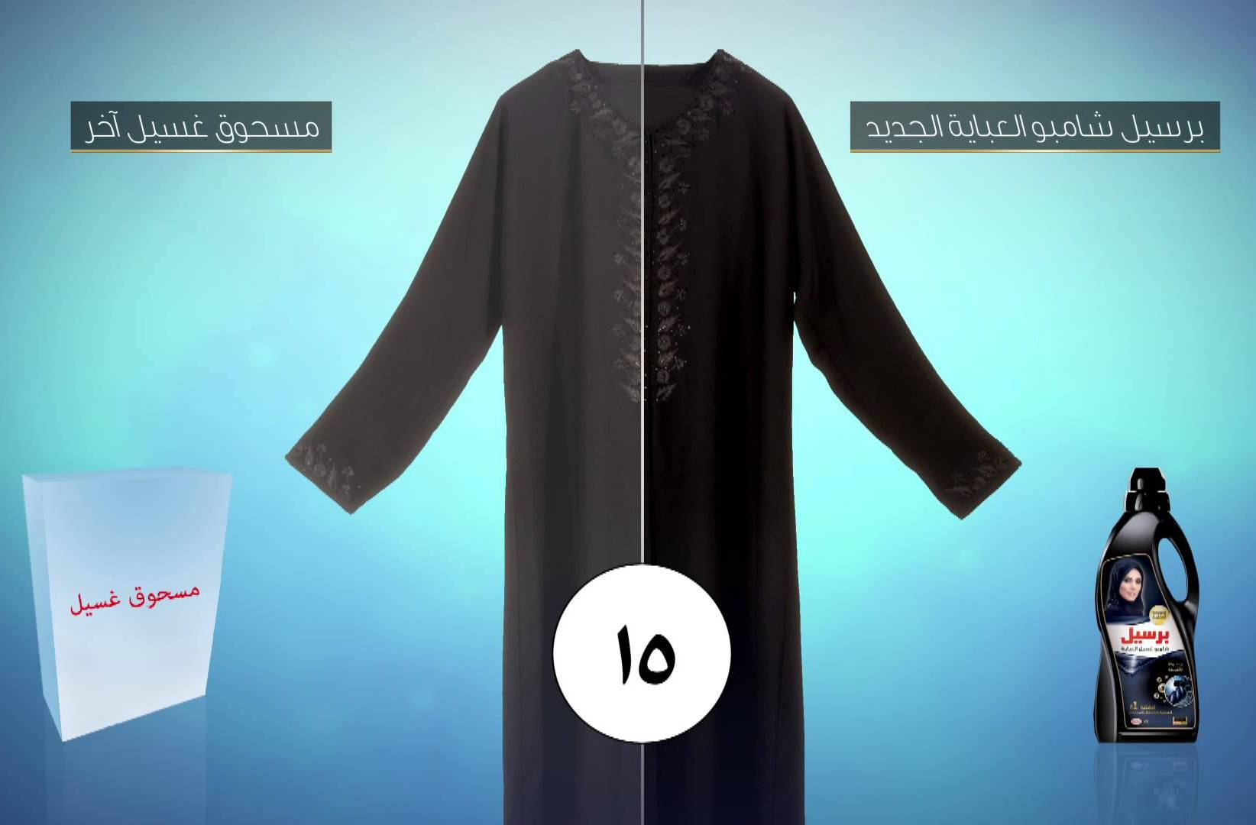
Comparison

Slide 7
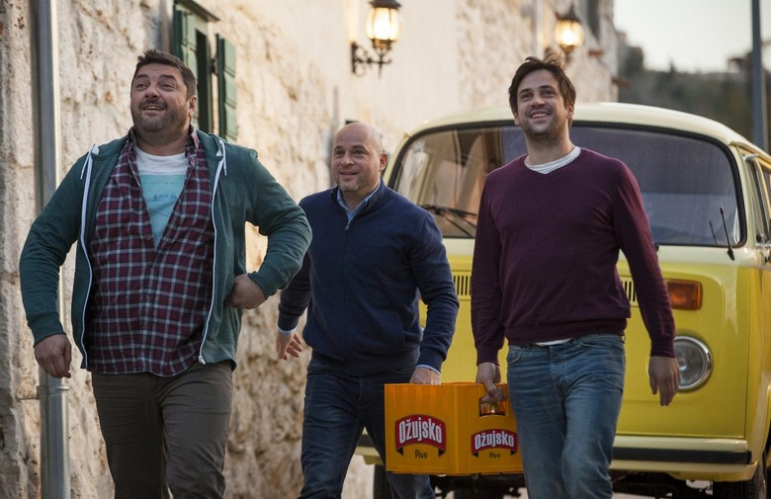
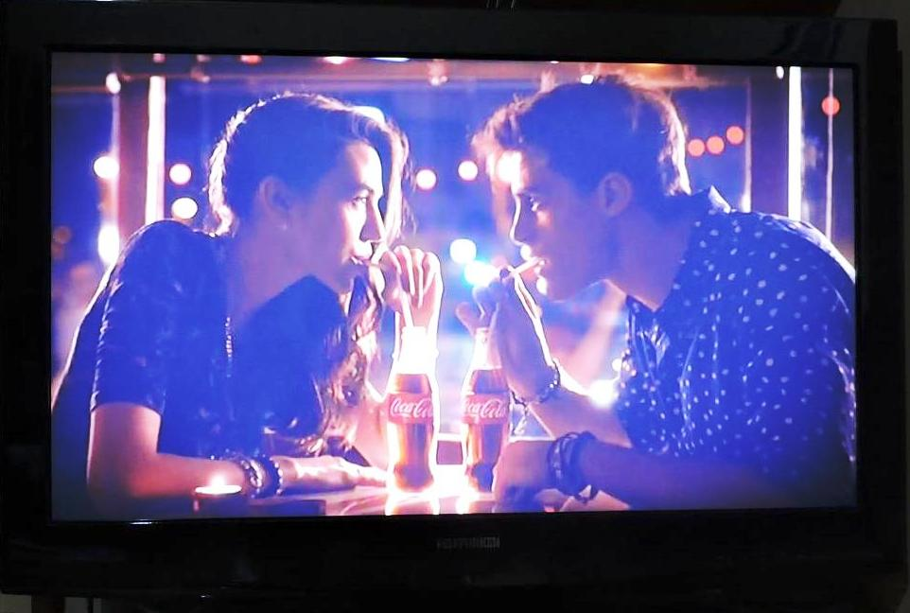
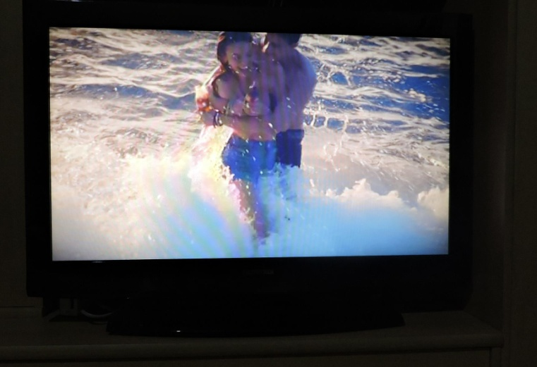
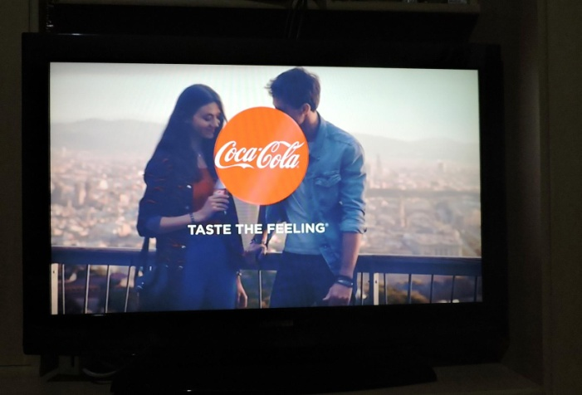
A story around the product

Slide 8


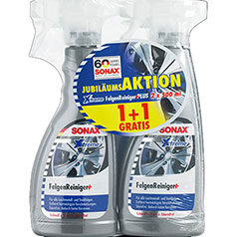

A free gift

Slide 9
A catchy slogan
Match the slogan to the product
Slogan: Connecting people. Life’s good.
Once you pop, you can’t stop. It gives you wiiings!
Take a deep breath. Just do it! No more tears.
I’m lovin’ it! Because I’m worth it.
Taste the rainbow. Loves the jobs you hate.
Finger lickin’ good
Products/brands: Nike Skype Red Bull Skittles
Mc Donald’s KFC Johnson’s Baby Nokia
Mr Muscle L’Oreal LG Pringles

Slide 10
Connecting people - Nokia
Life’s good. - LG
Once you pop, you can’t stop. - Pringles
It gives you wiiings. - Red Bull
Take a deep breath - Skype
Just do it! - Nike
No more tears. - Johnson’s Baby
I’m lovin’ it! - McDonald’s
Because I’m worth it. - L’Oreal
Taste the rainbow - Skittles
Loves the joby you hate - Mr Muscle
Finger lickin’good - KFC
https://www.shopify.com/tools/slogan-maker/
http://www.sloganmaker.com/

Slide 11
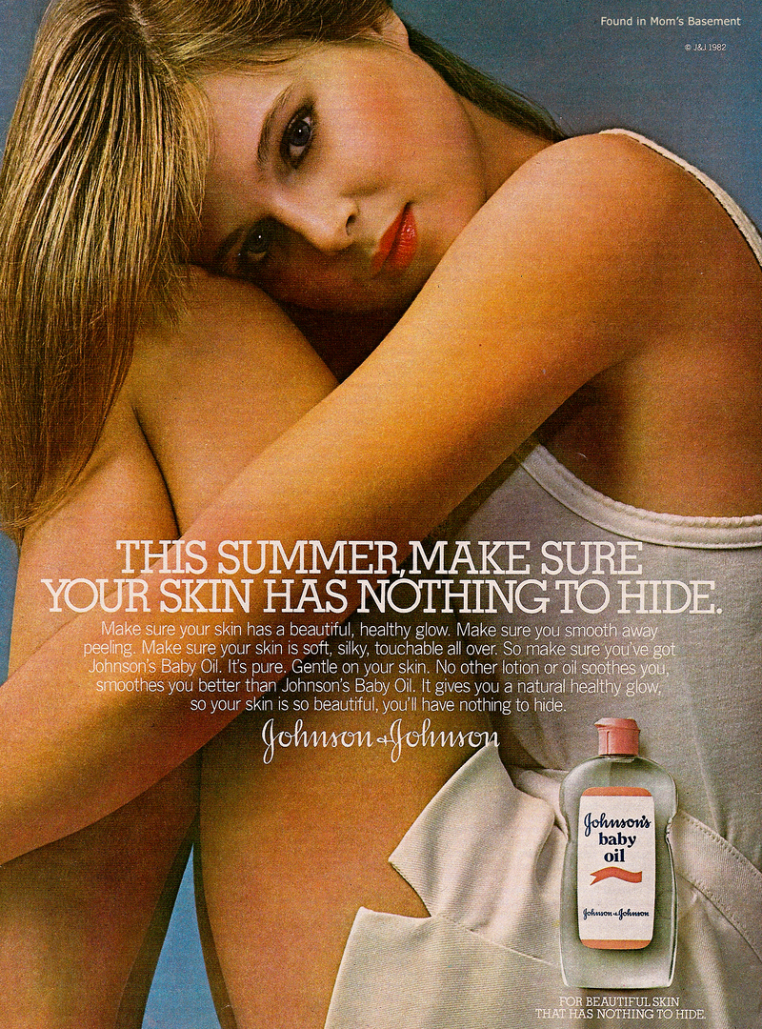
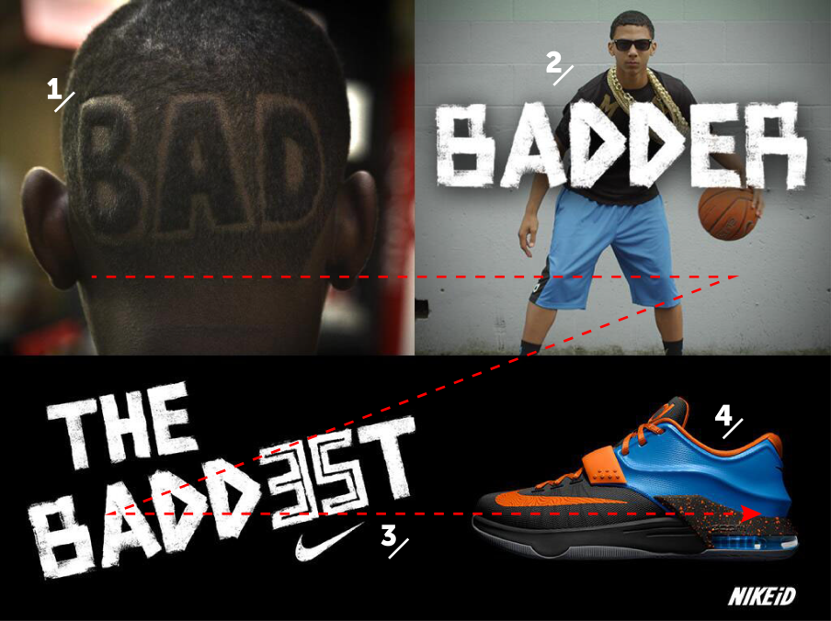
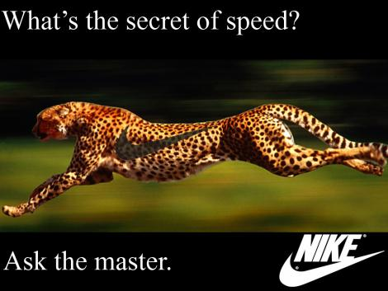
Z pattern advertising

Slide 12



Slide 13
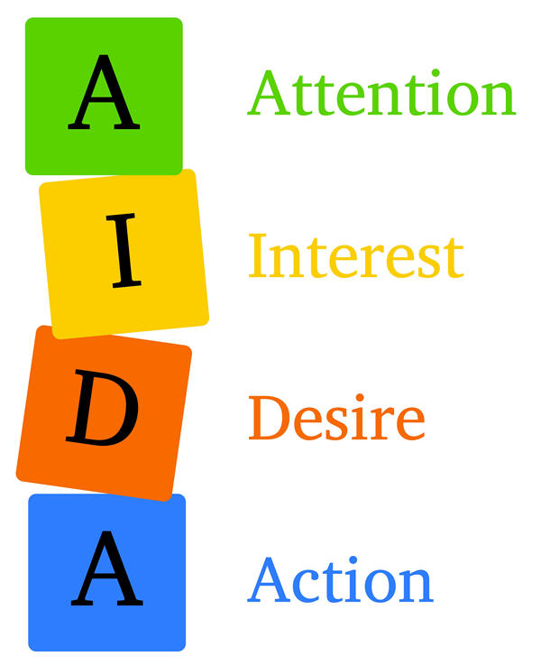
Something is used to attract our attention (photo, colour, size,...)
some information (price, availibility) create our interest
ad creates desire, we want the product
Something urges us to act now (limited supply,...)
Notes:
AIDA – an opera in 4 acts by Giuseppe Verdy, set in Egypt, first performed in 1871
- a musical based on the opera, music by elton John, lyrics by Tim rice, first pperformed on Broadway in 2000

Slide 14
Target groups
Sex: male , female
Marital status: married single
Age: 0-10, 12- 24, 18- 34, 18-49, 25- 54, 50+
children, teenagers, young adults, adults, senior citizens
Income:
Occupation: service, business, professional
Lifestyle
Geographic: urban, rural, suburban
Social status: upper, middle, lower

Slide 15
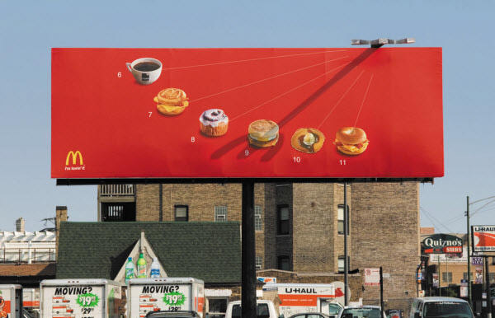
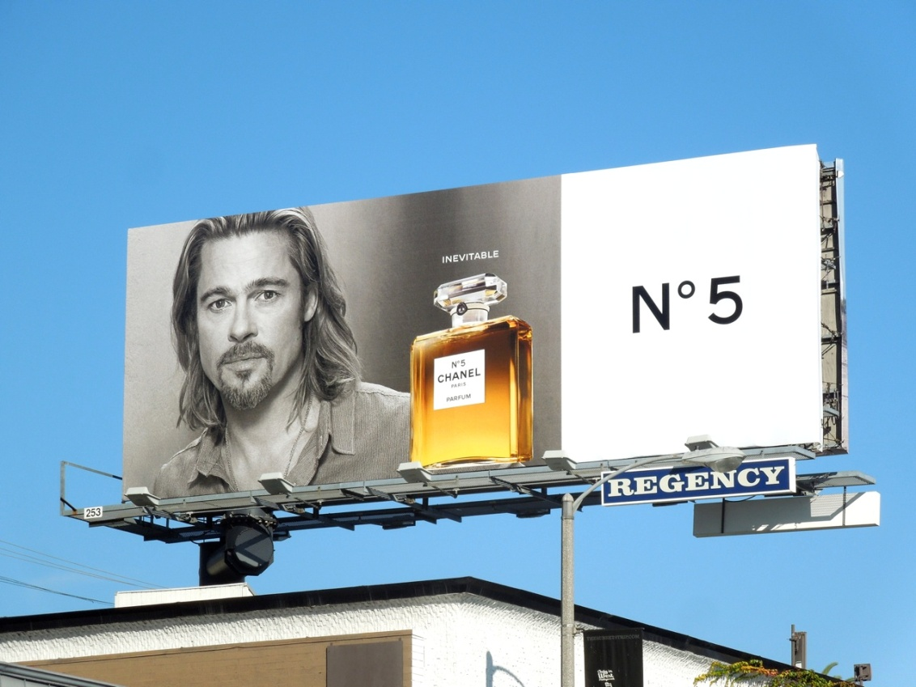

Slide 16
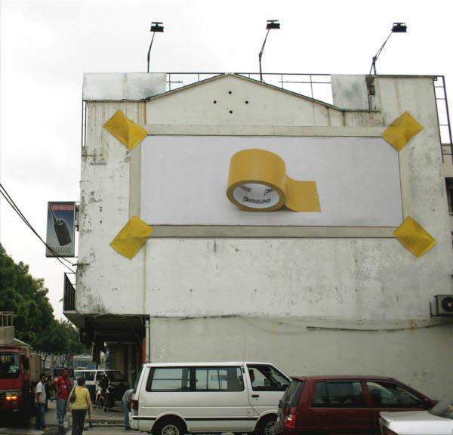
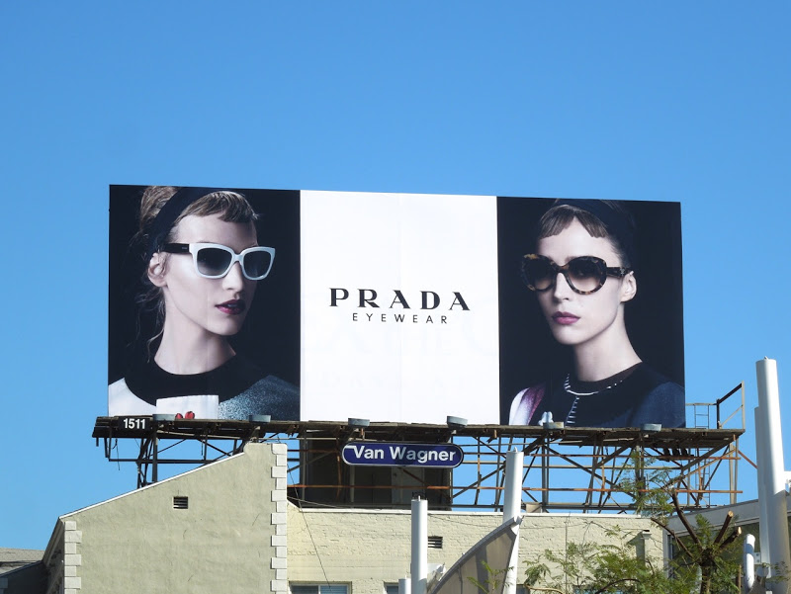

Slide 17


Slide 18


Slide 19

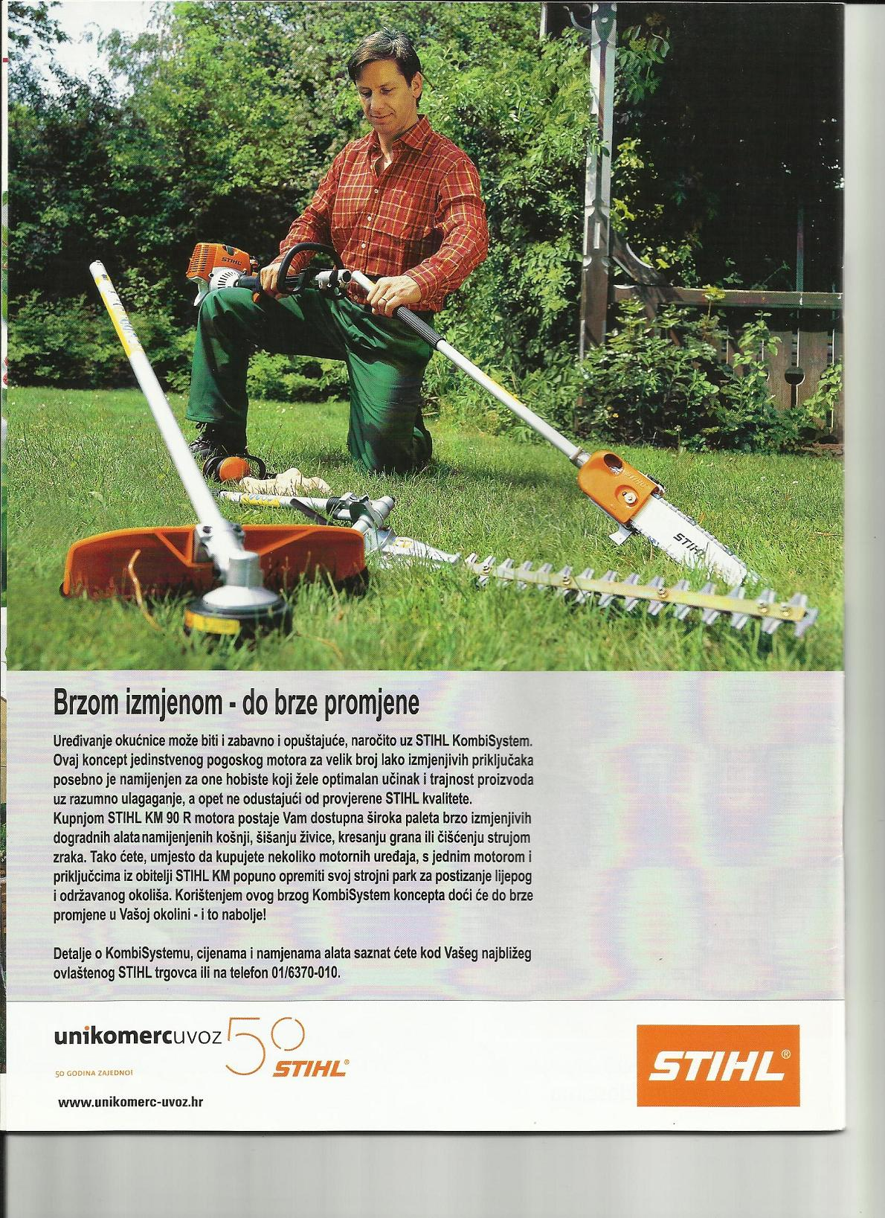


Slide 20



Slide 21


