Slide 1


Osnovna škola Bartola Kašića
Vinkovci
Erasmus+ project 2020-2022
S.O.F.T. – Start our future today
PERUNIKA
School cooperative

Slide 2
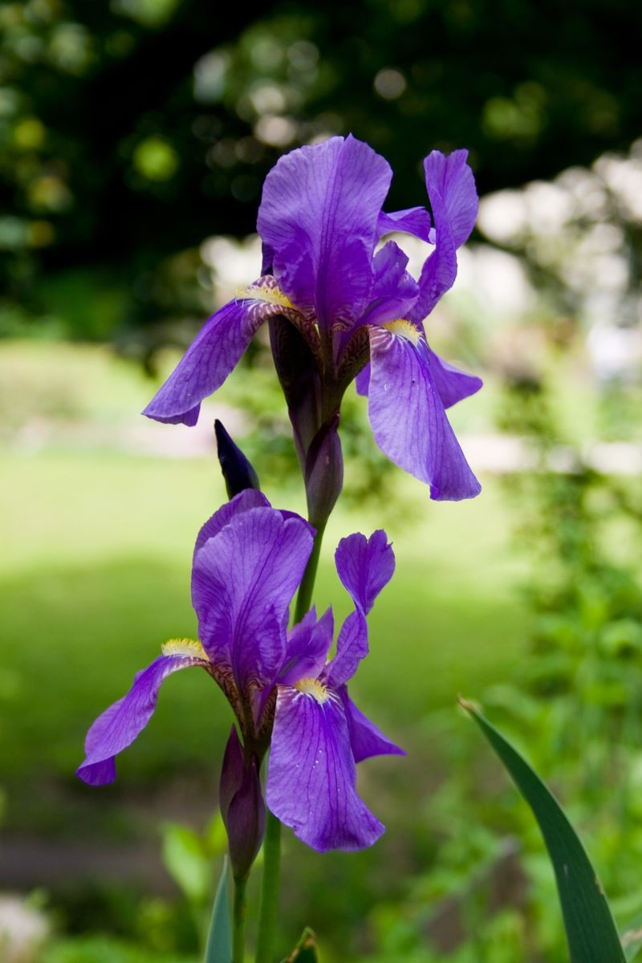
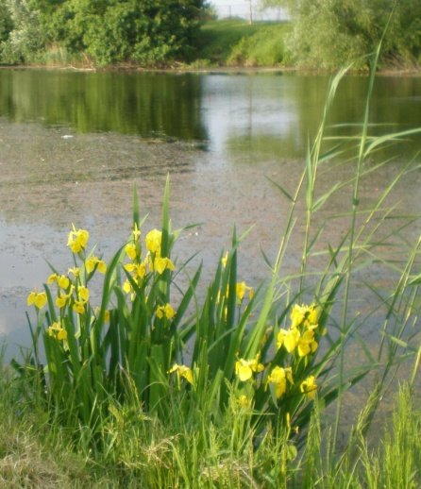
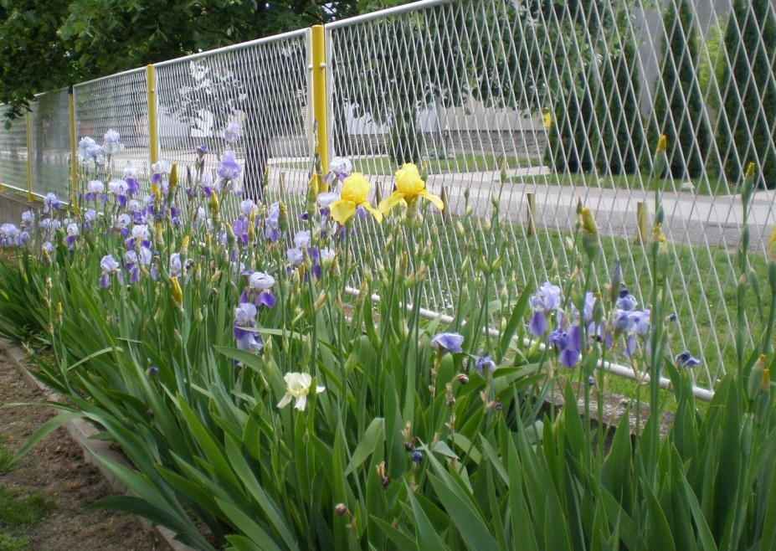
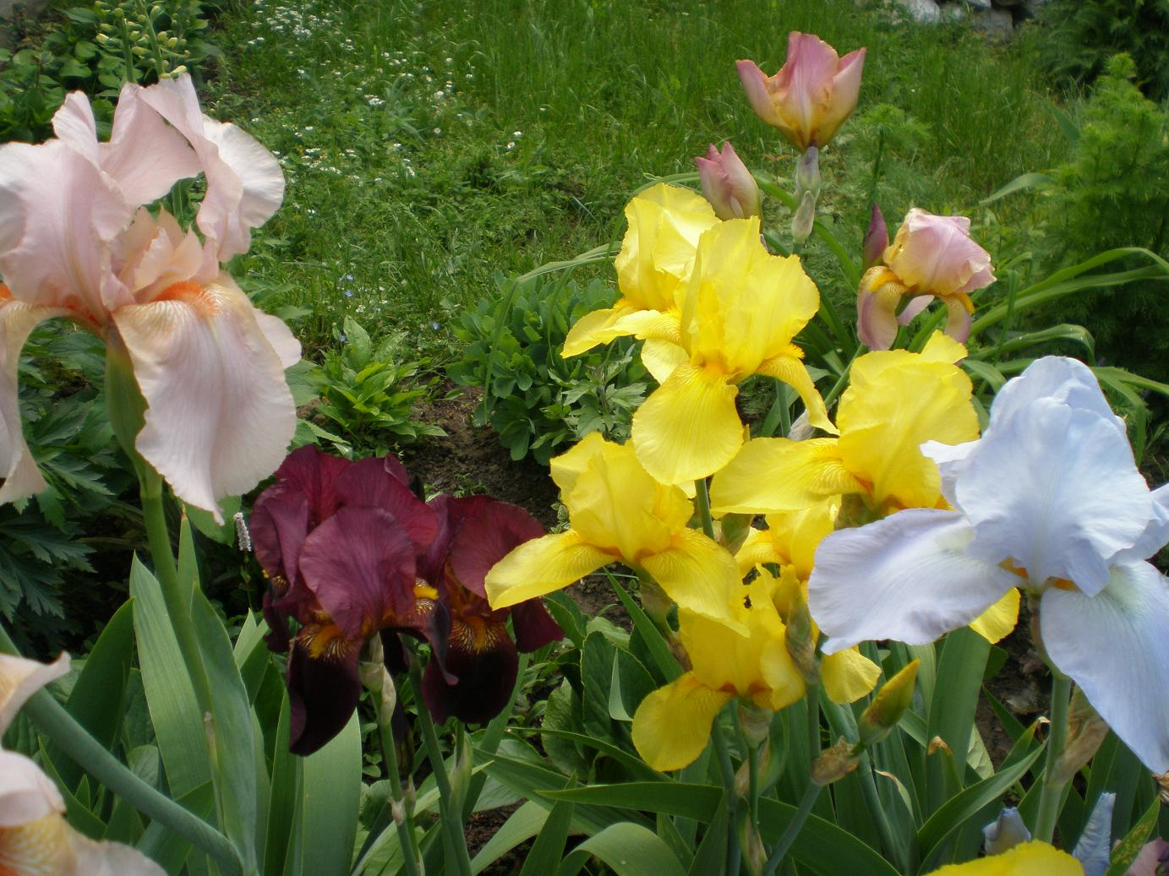
PERUNIKA (iris) has been Croatian national flower since 2000. Iris croatica grows in hilly parts of Croatia.
Yellow irises grow by river banks and you can see irises of different colours in almost every garden.

Slide 3

We chose the name Perunika for our school cooperative, which was established by the School Board on the 7th of April 2014. The cooperative is run by 3 teachers, a representative of Parents’ Board and a representative of local community. The number of students varies because students can plan and join the activities which they like.
The cooperative is a member of Croatian Association of School Cooperatives, which has about 500 members.

Slide 4
Taking part in activities of our school cooperative helps pupils to develop their skills:
communication skills
teamwork skills
creativity
responsibility
time management skills
conflict resolution skills

Slide 5
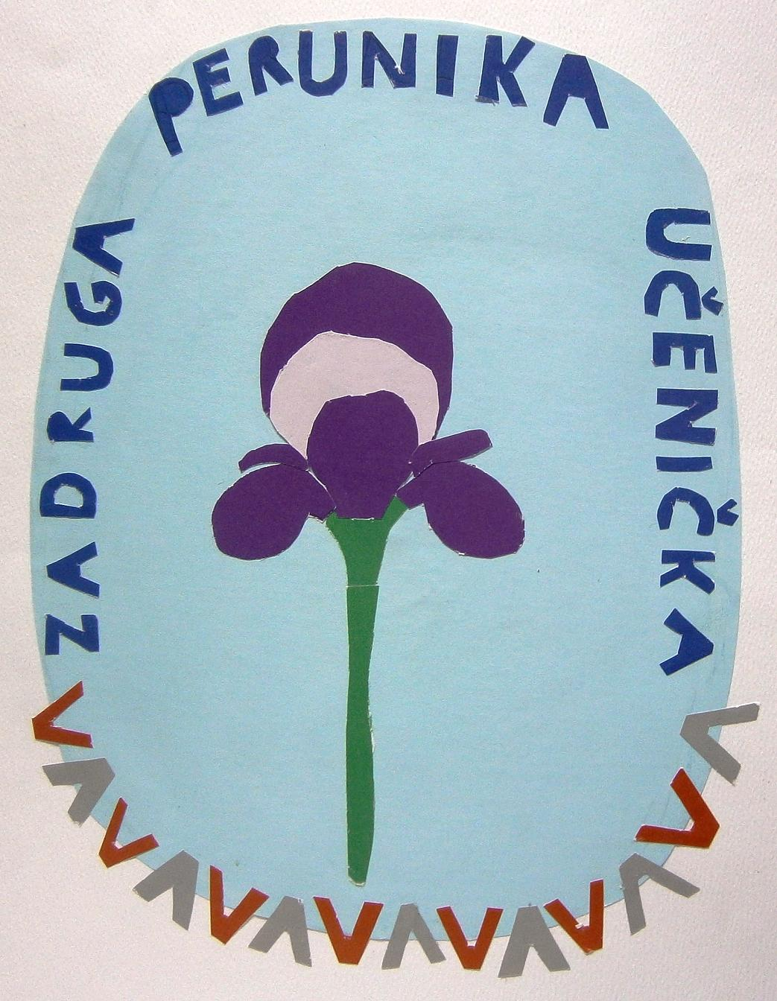
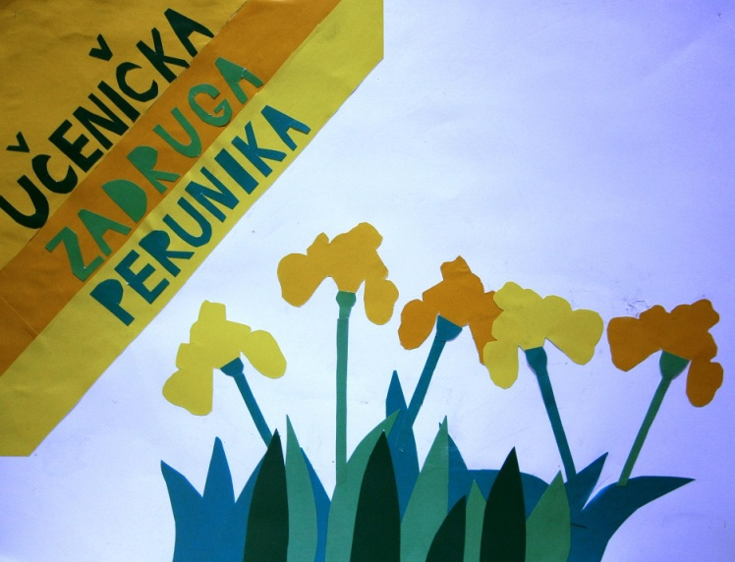
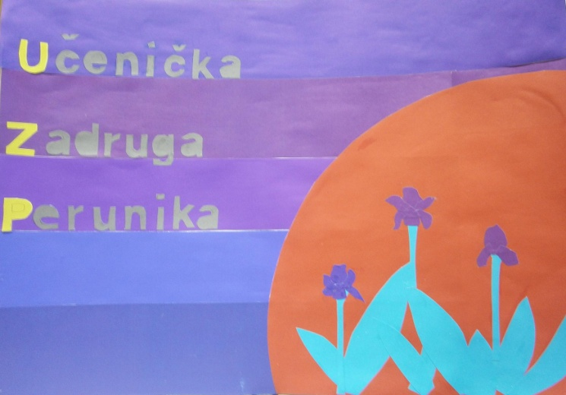
Our logo
Some works from the logo competition

Slide 6
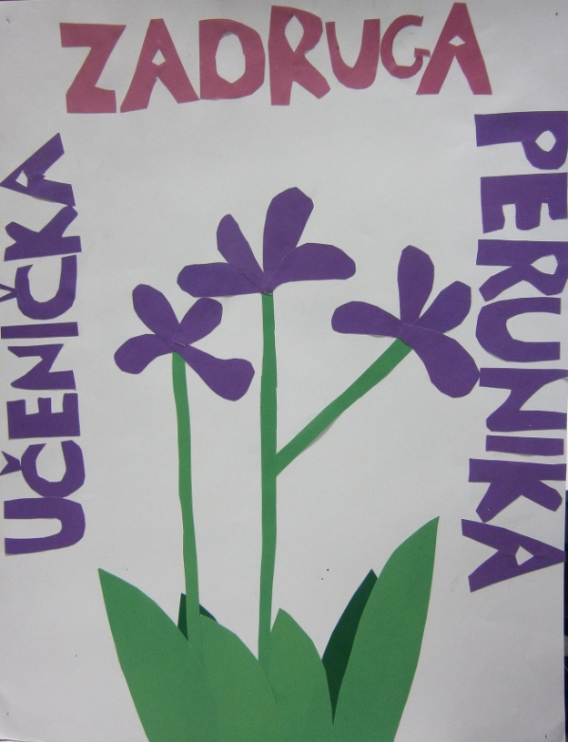
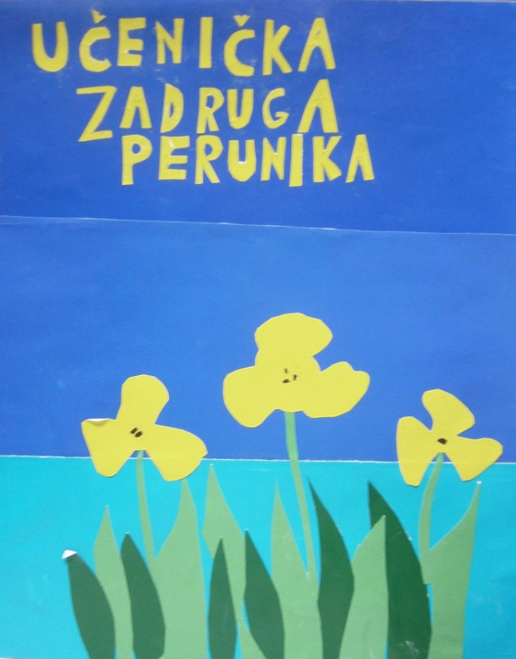
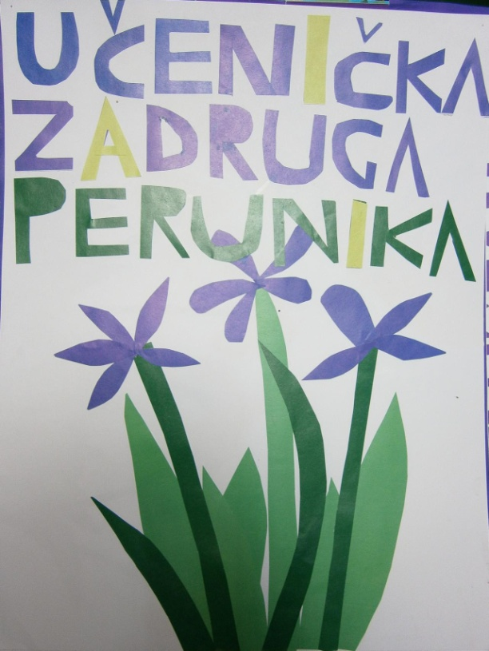
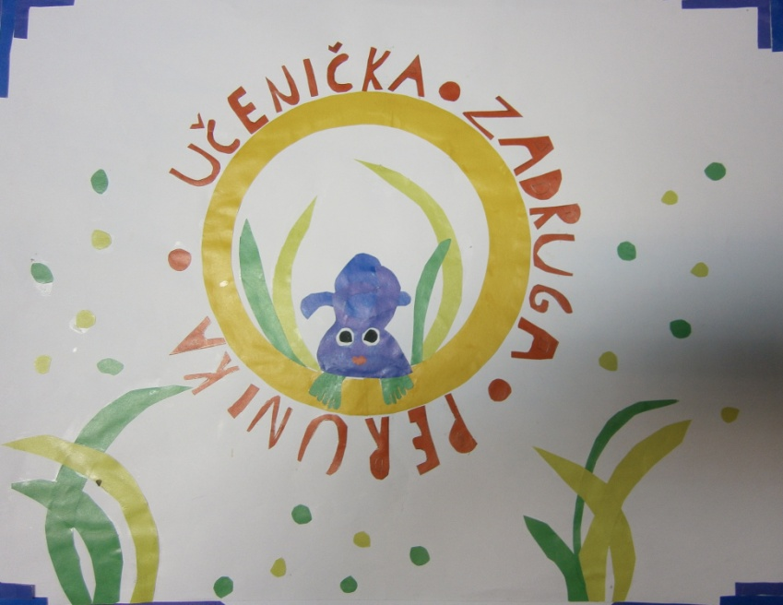
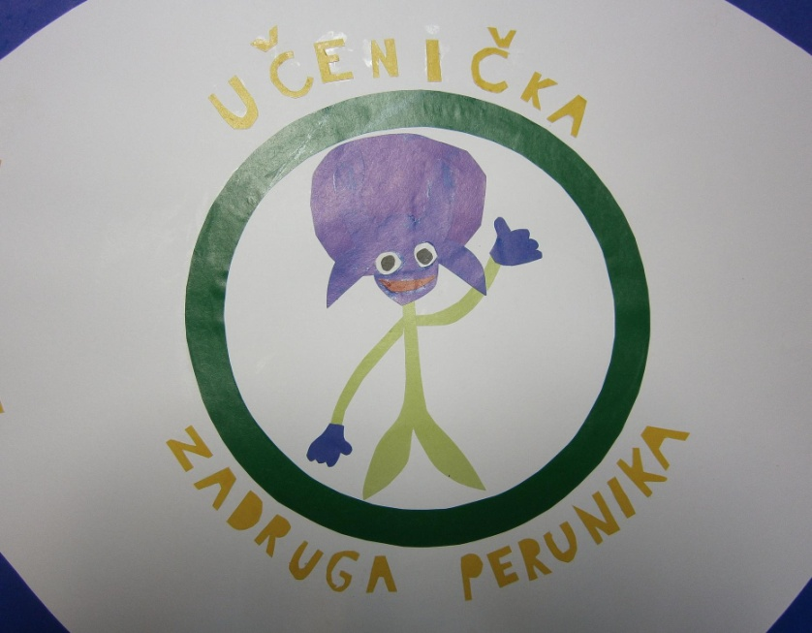

Slide 7
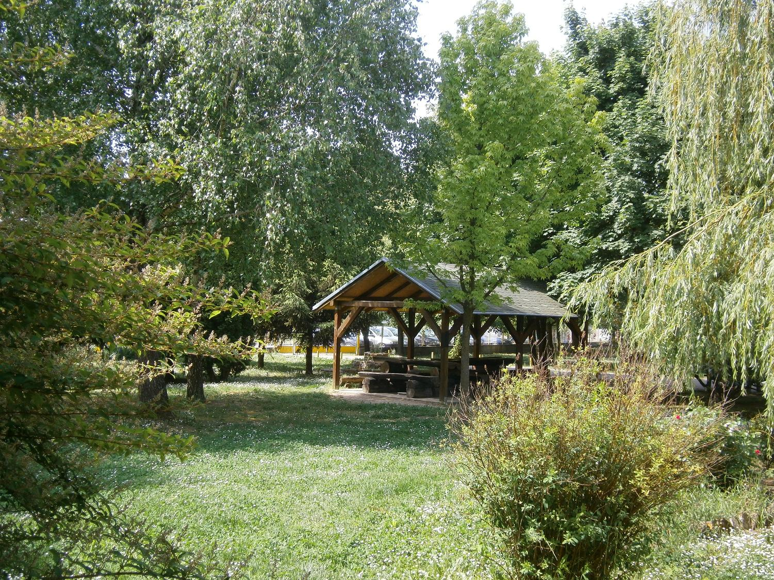
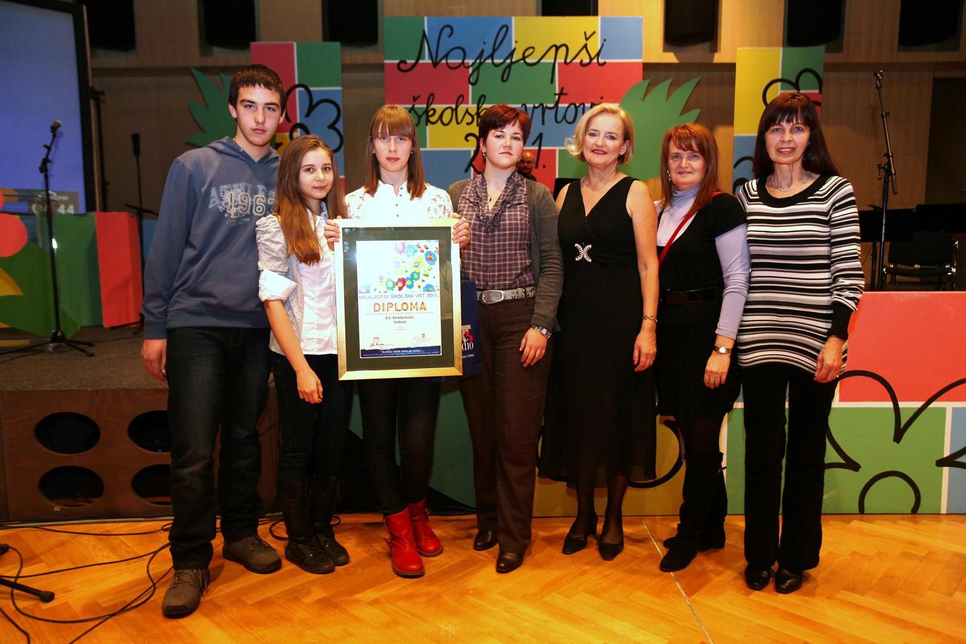
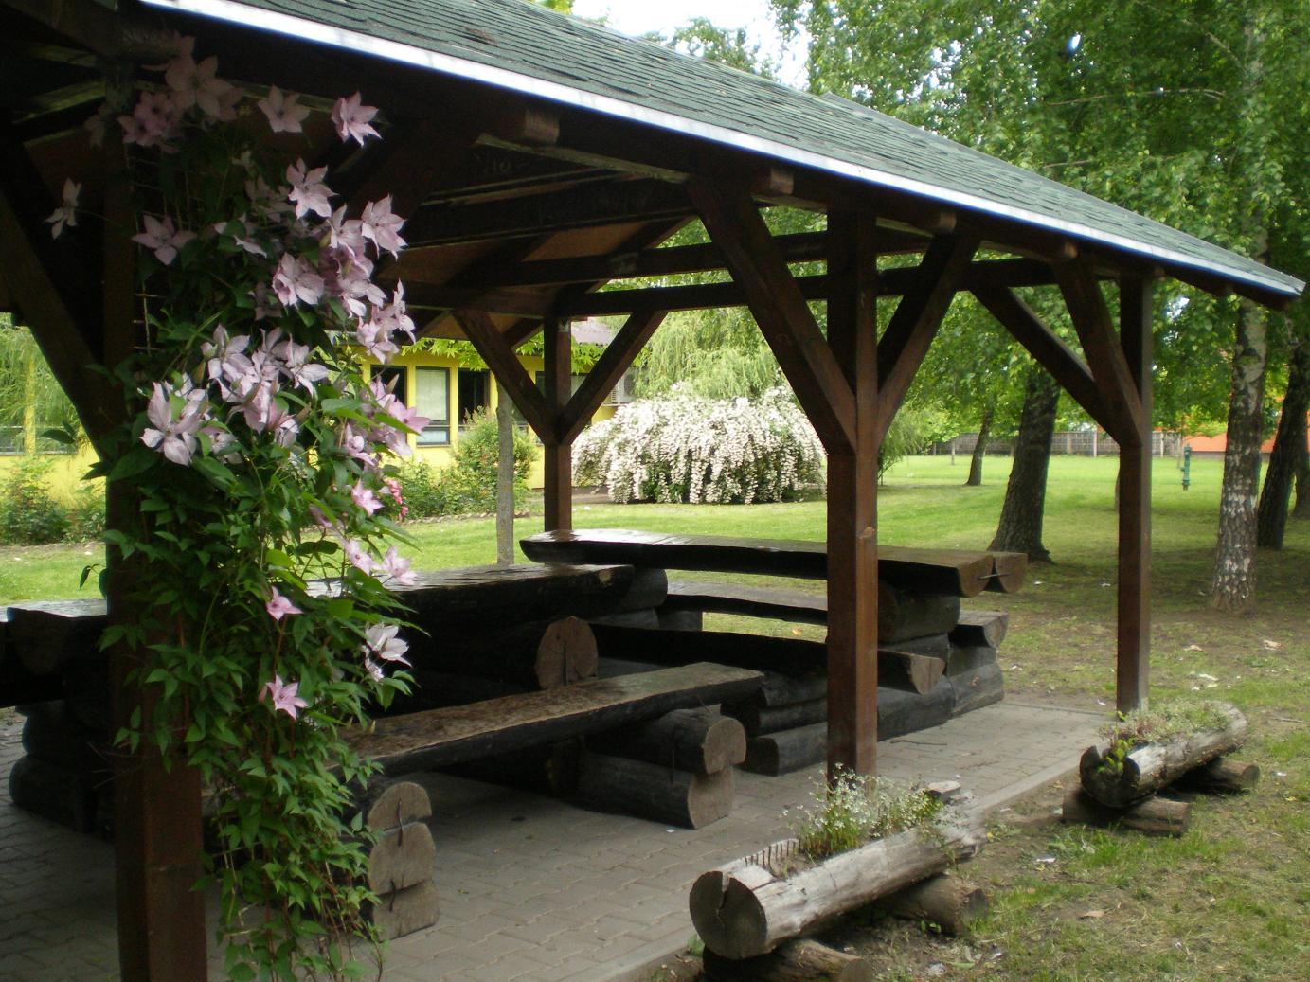
Our garden is one of the most beautiful school gardens in Croatia thanks to hard work of all students and teachers.

Slide 8
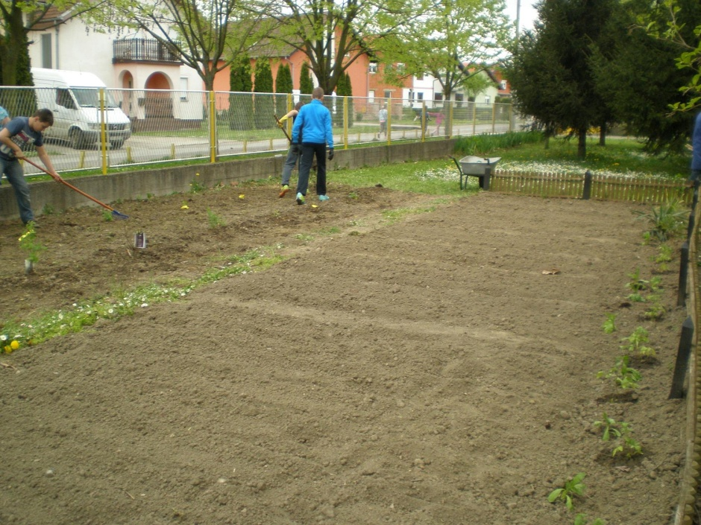
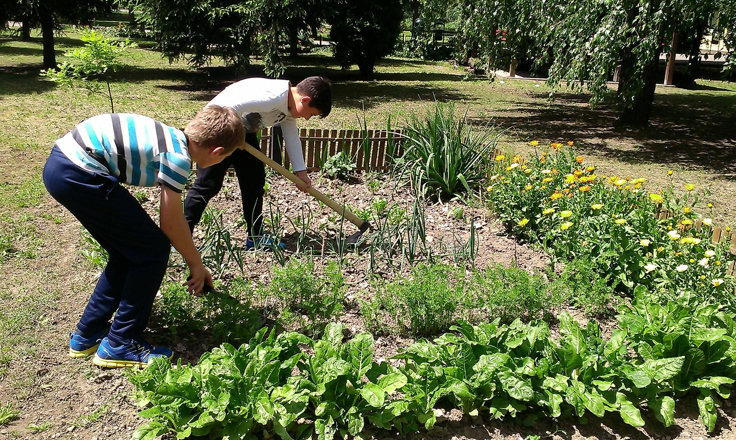
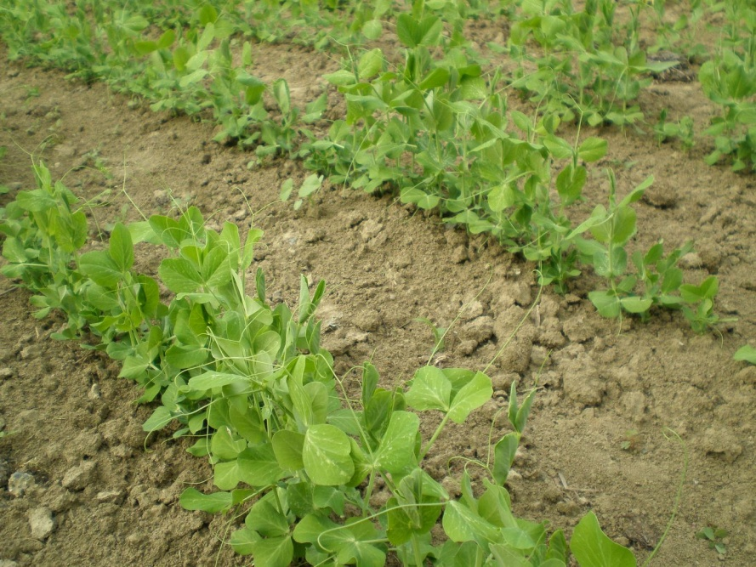
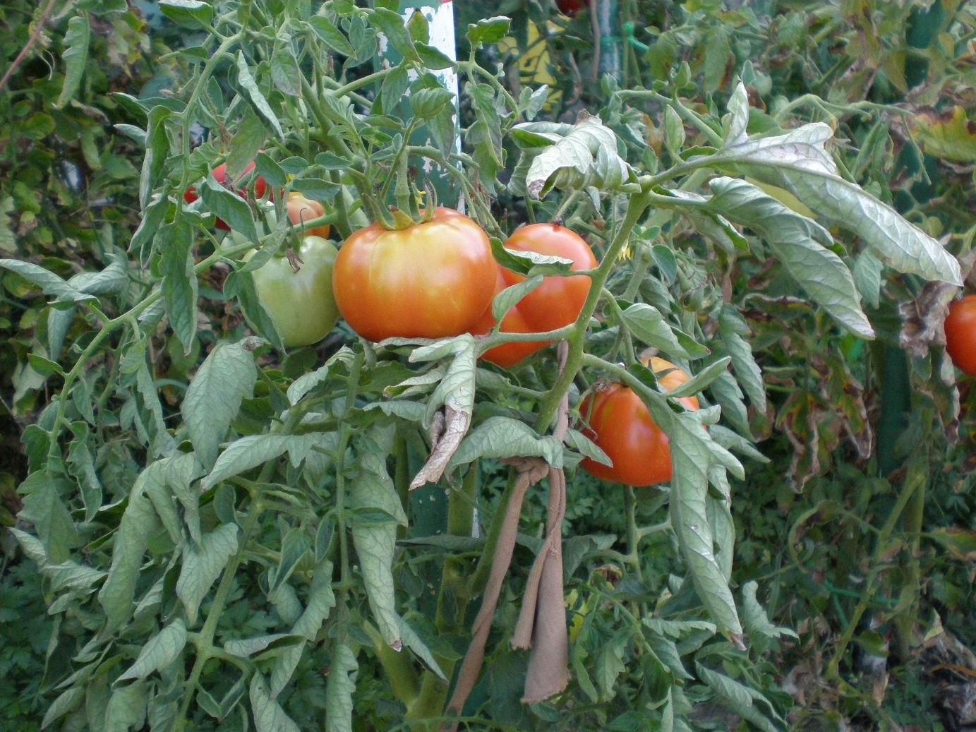
We decided to grow vegetables.

Slide 9
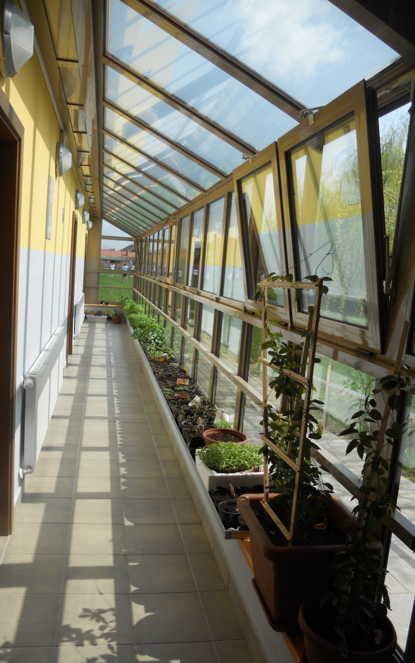
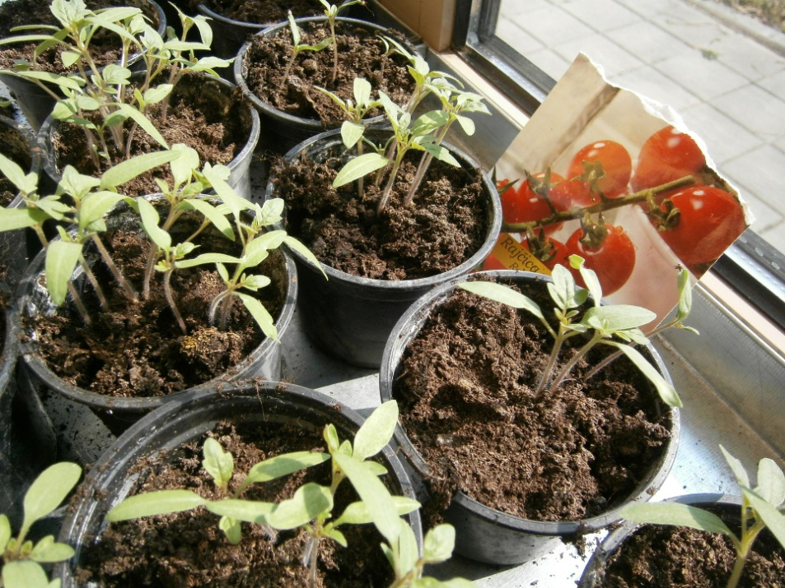
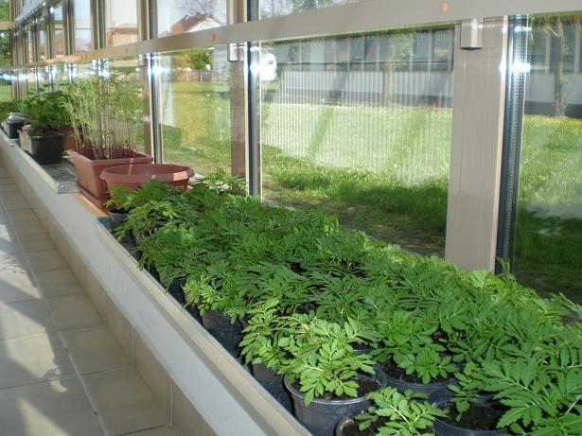
We do not have a greenhouse, so we grow flower and vegetable seedlings in the corridor of our gym.

Slide 10
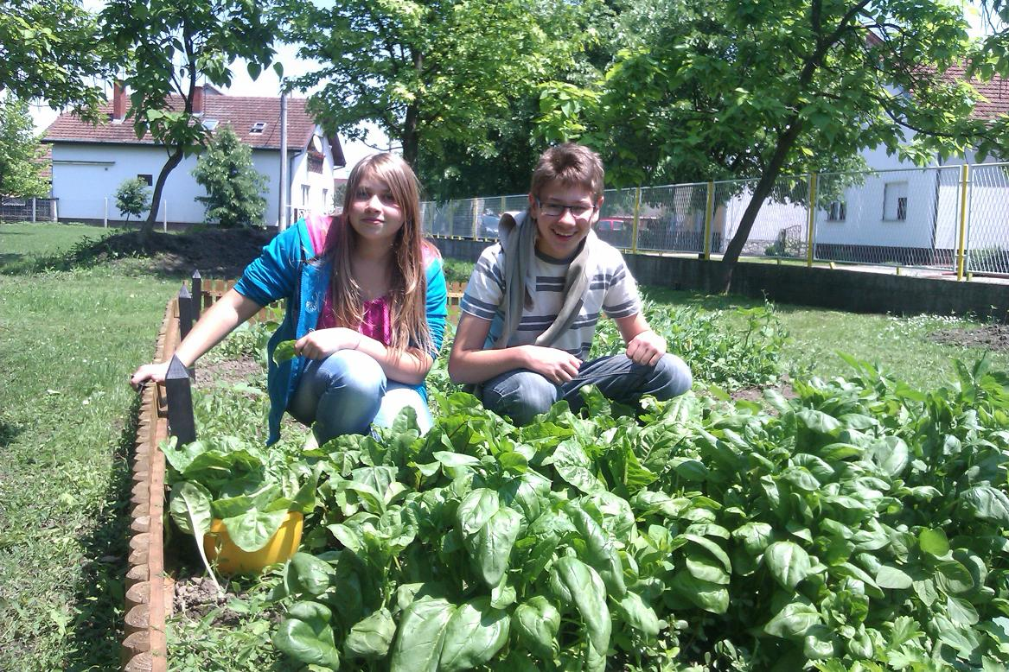
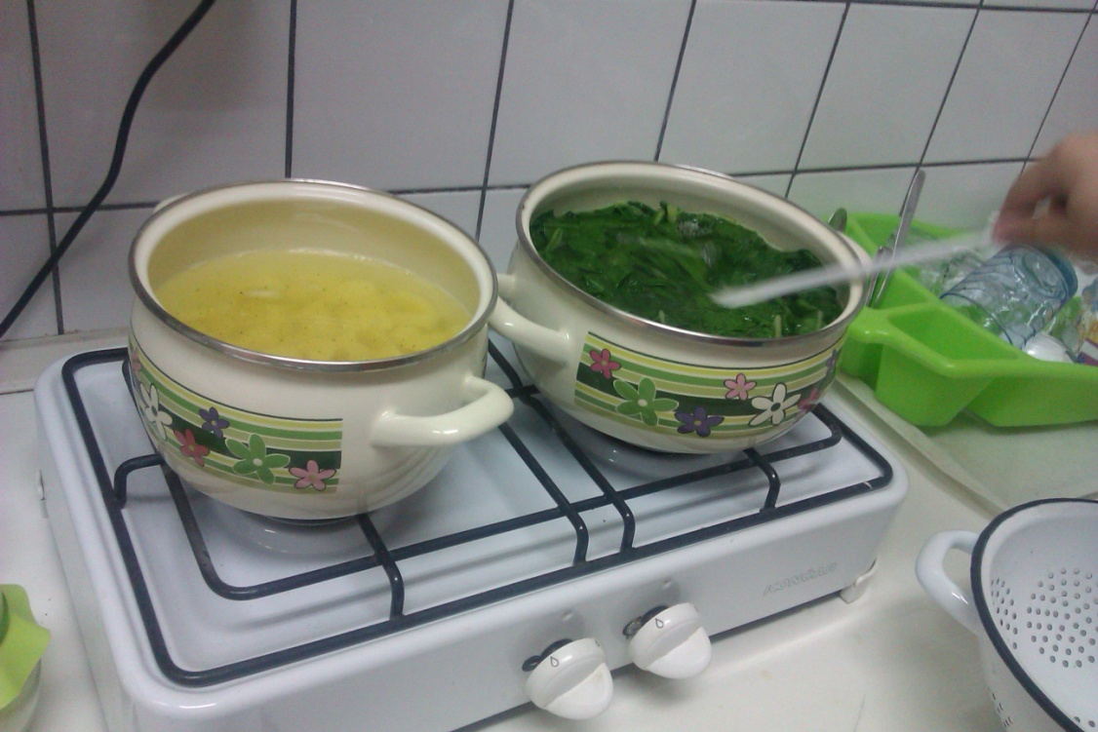
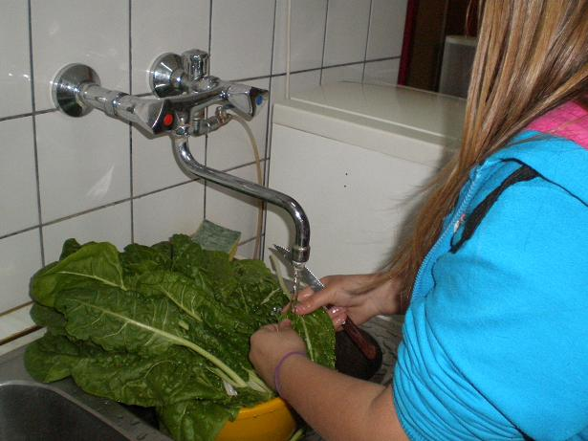
Vegetables are used for preparing healthy meals for our students.

Slide 11
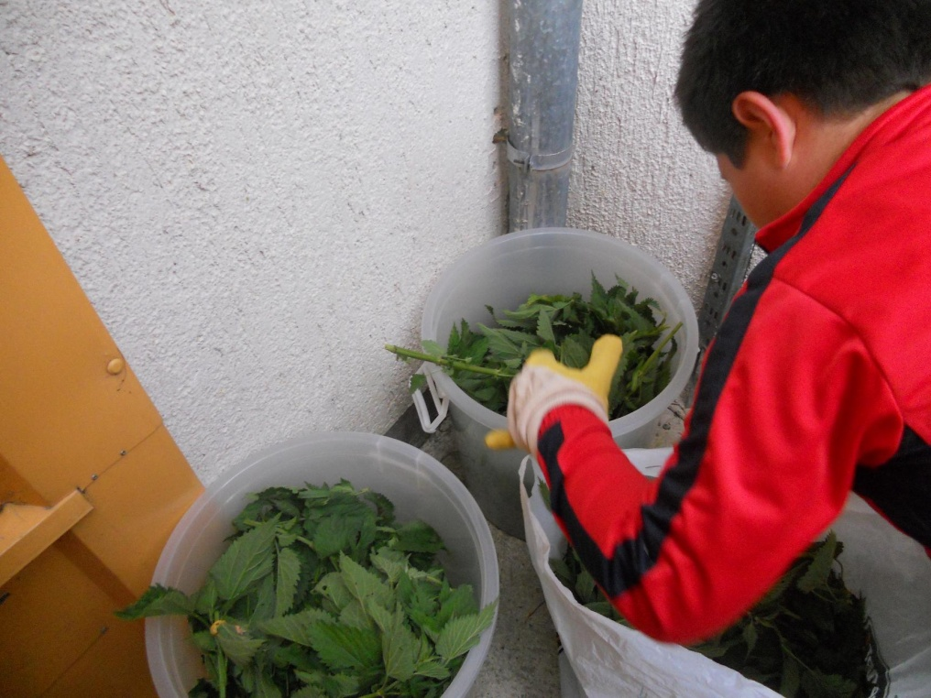
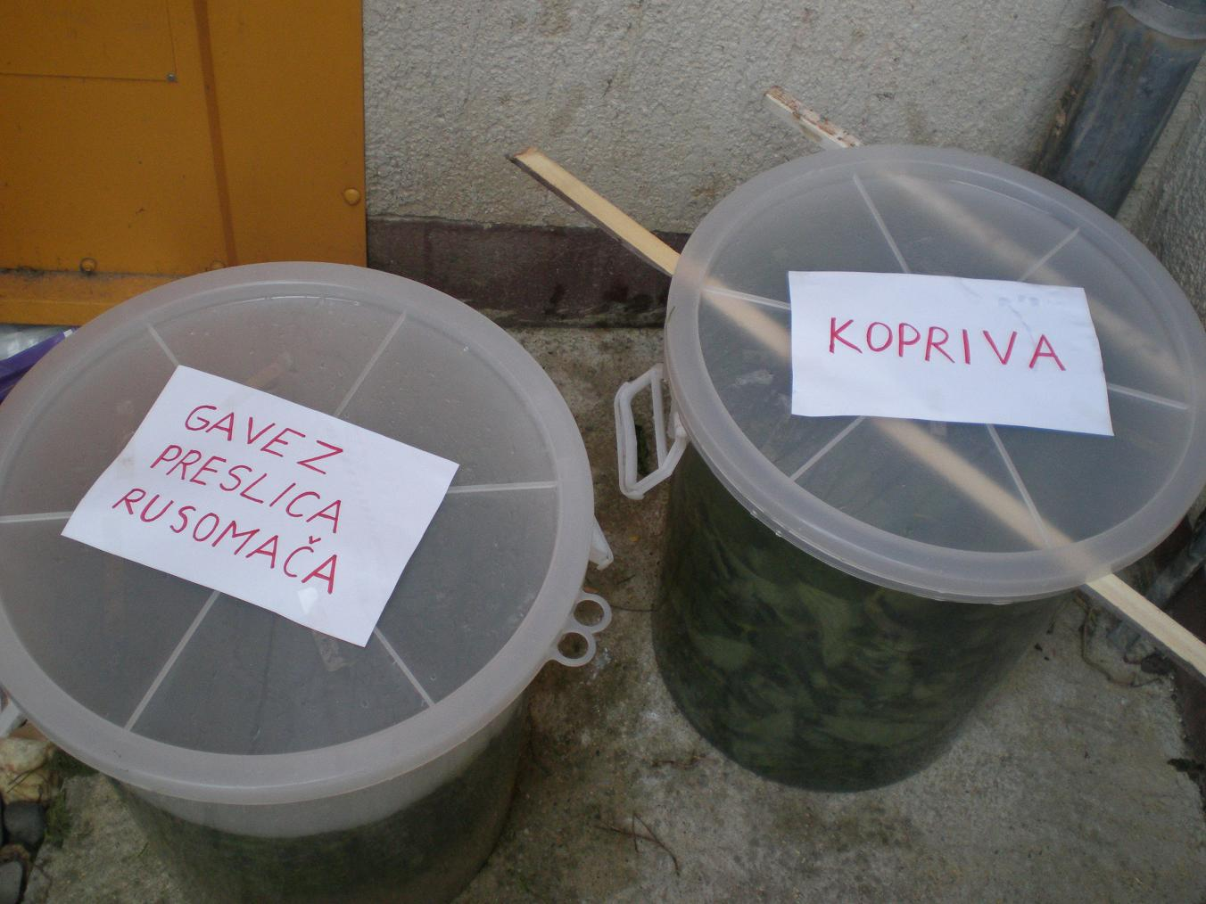
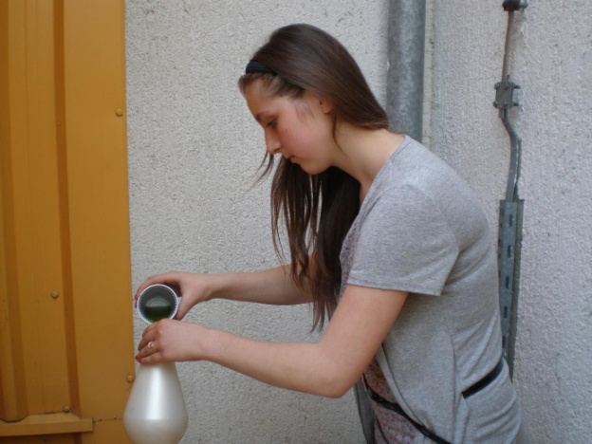
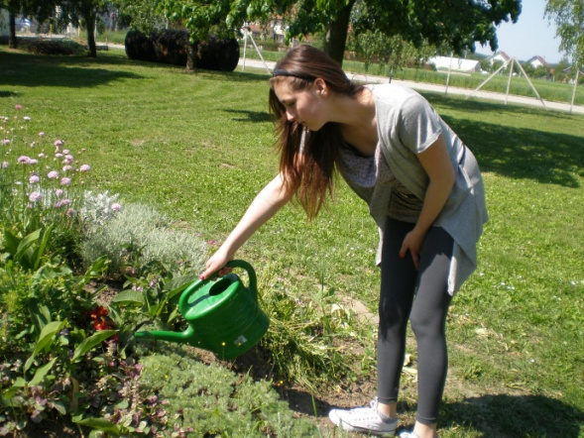
Students pick plants and make bio pesticide and bio fertilizer for the garden. We use nettle, comfrey, common horsetail and shepherd’s purse.

Slide 12
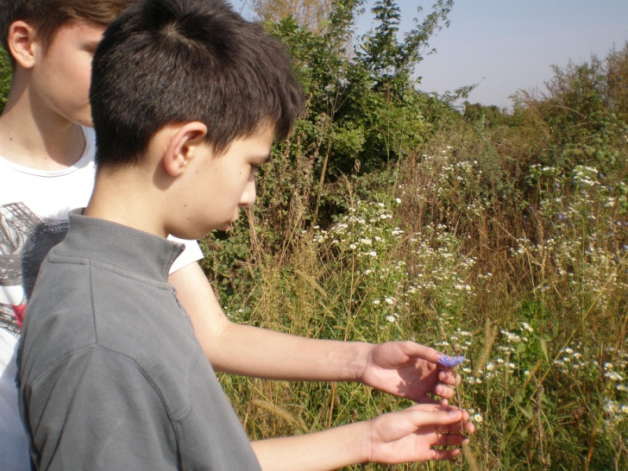
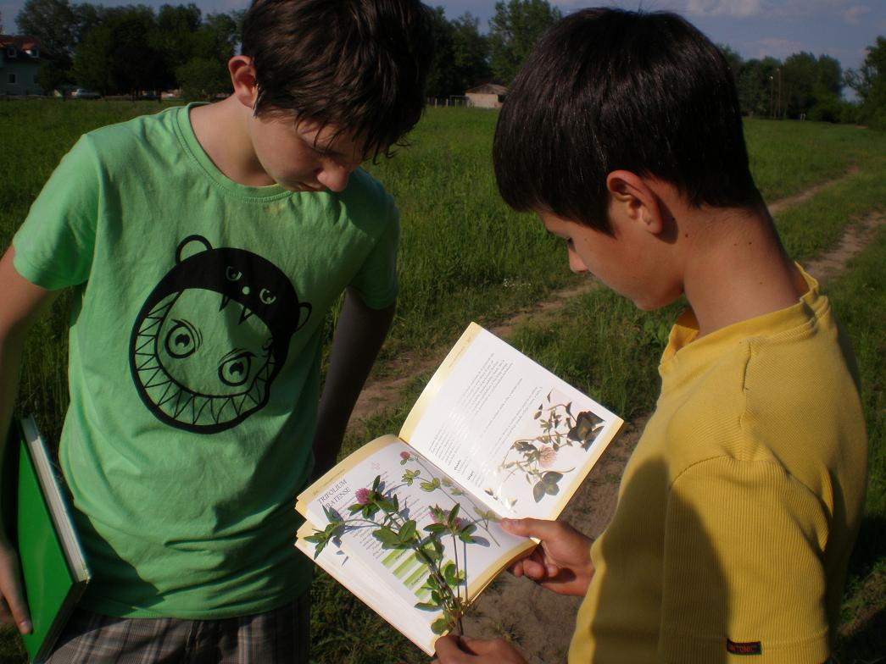
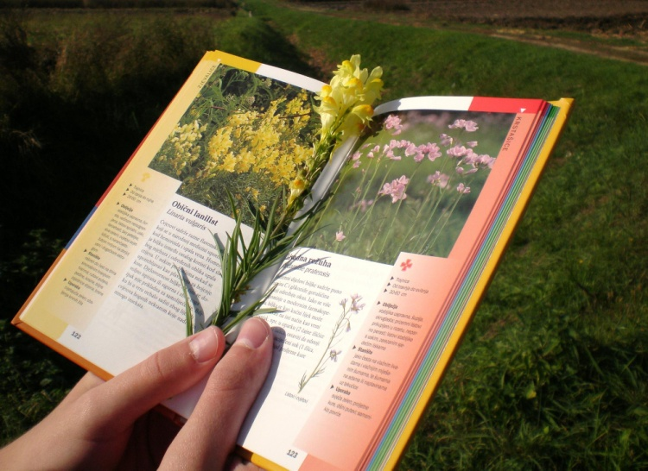
We do not have to grow healing plants in the garden as there are lots of them growing on meadows or by country roads near the school.
Students go for walks, take books about healing herbs with them and try to identify as many plants as possible. We learn about plants because there are some that are poisonous and we warn students not to pick or eat them. Plants that are well known and have lots of healing properties are picked and dried or used to make juice (elderberry).

Slide 13
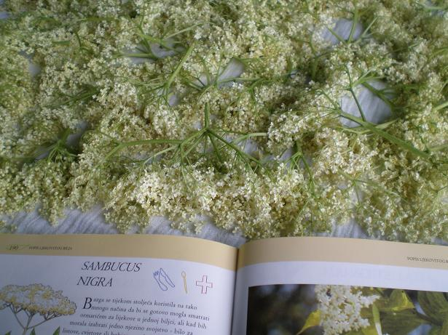
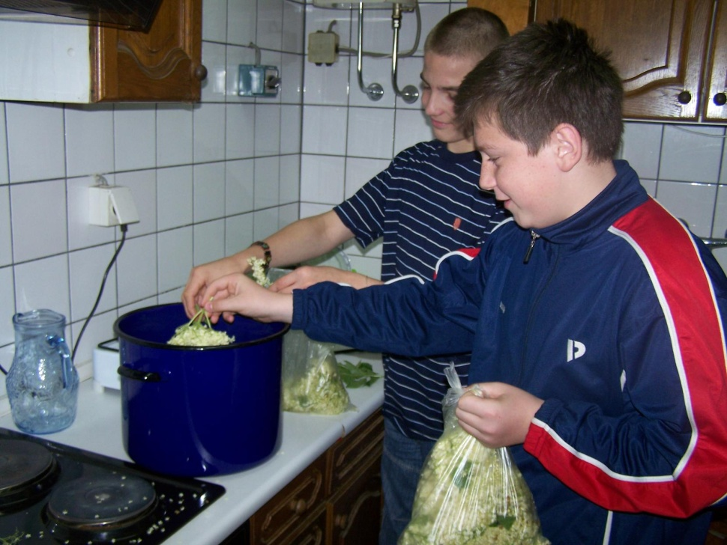
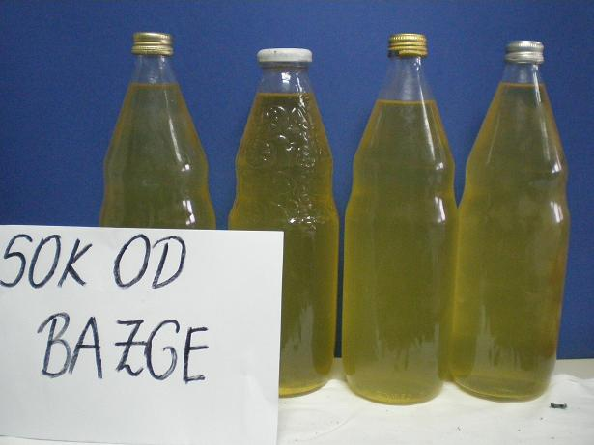
Elderberry syrup is very popular in our region.

Slide 14
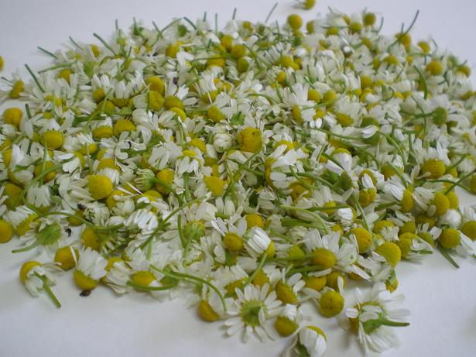
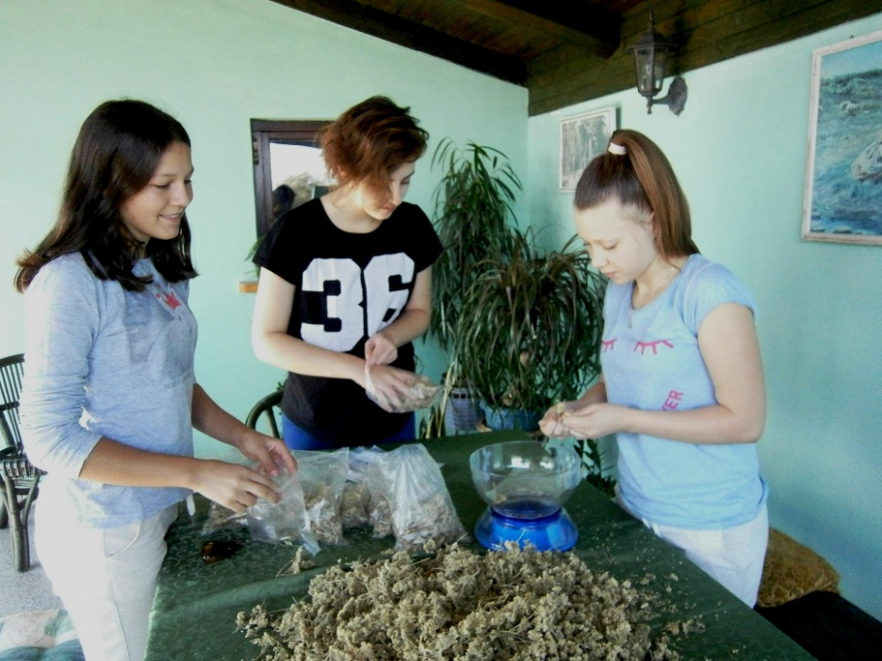
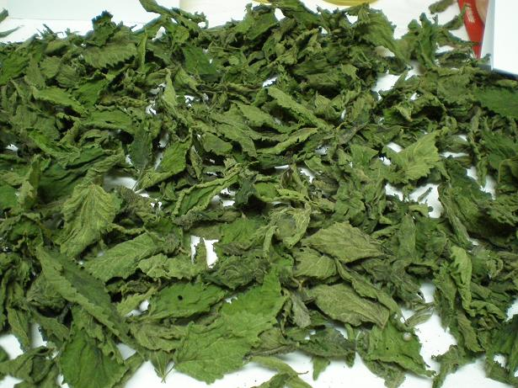
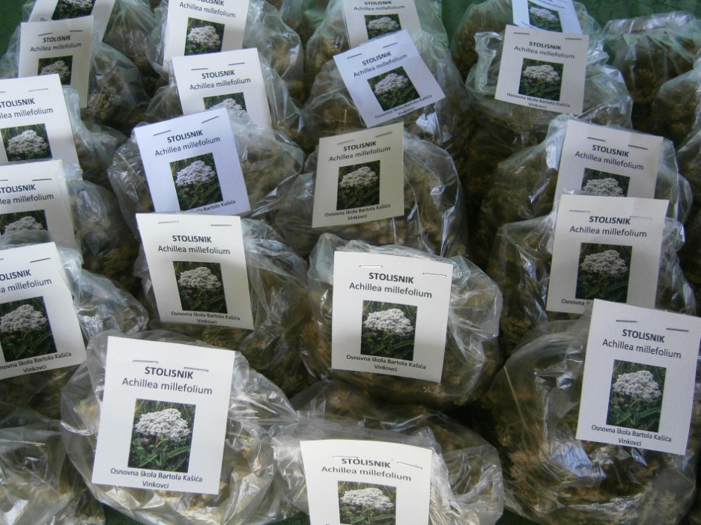
We pack and sell herbal tea.

Slide 15
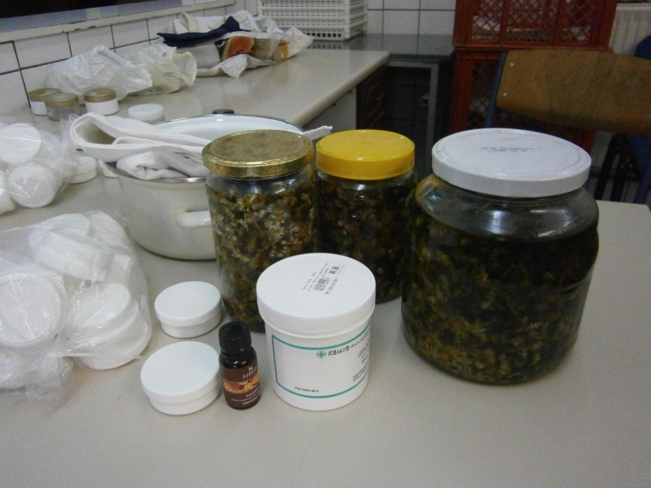
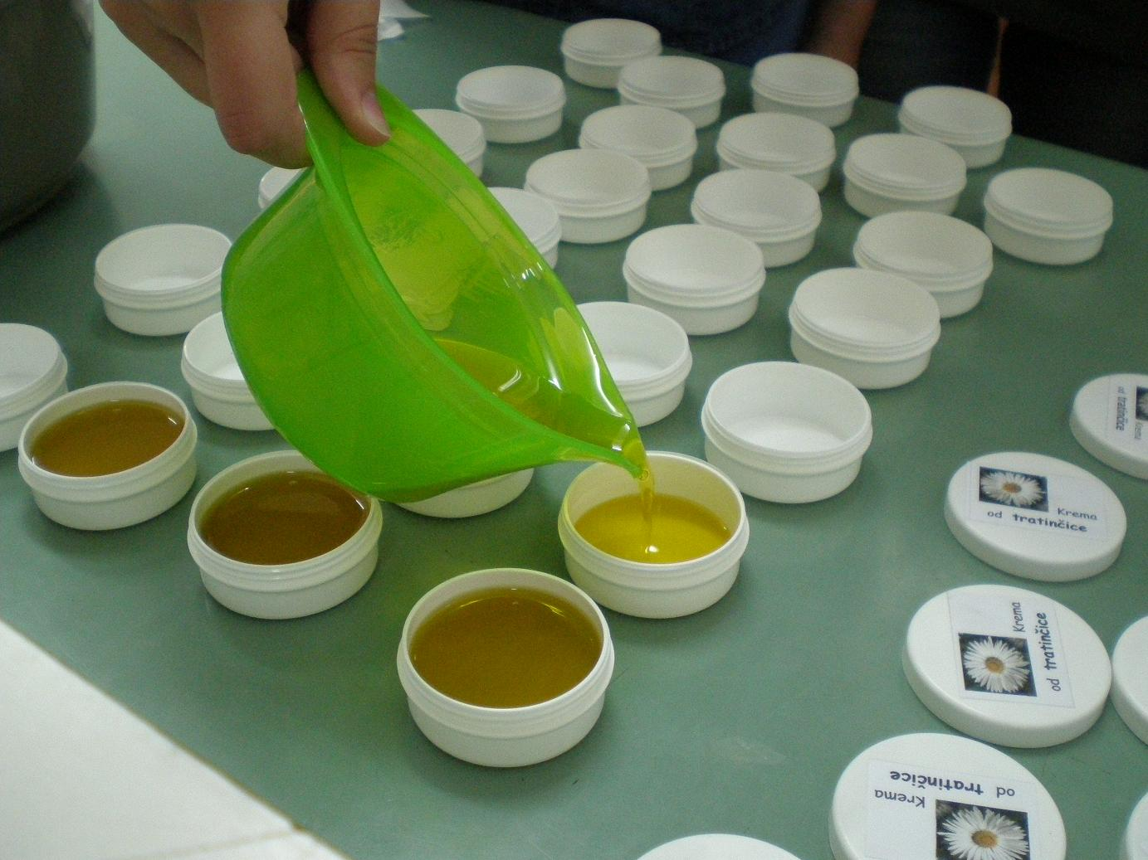
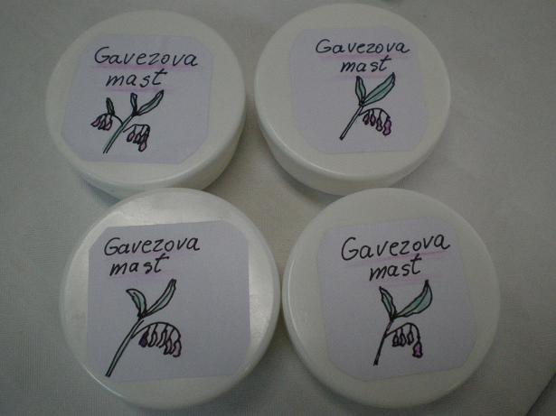
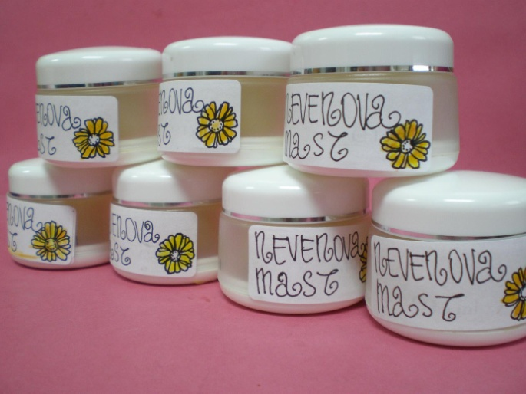
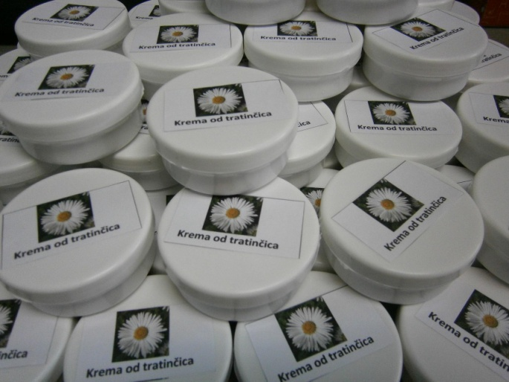
We also make creams and ointments: comfrey ointment, marigold cream and daisy cream. We use the best ingredients: flowers, olive oil and bee wax.

Slide 16
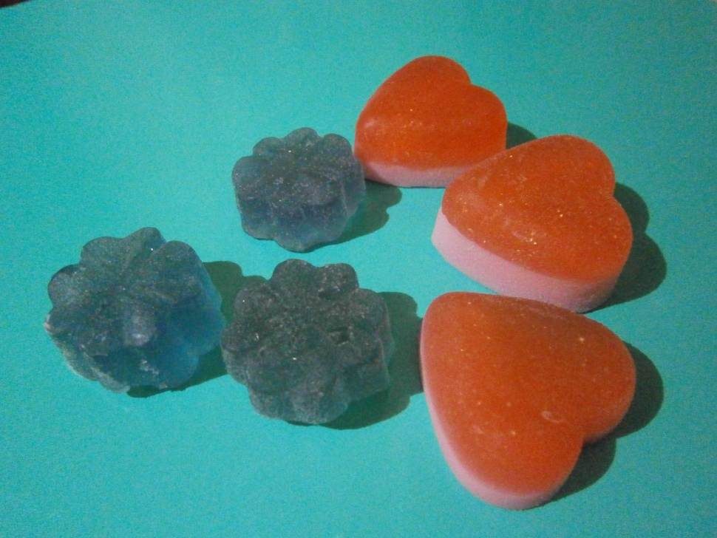
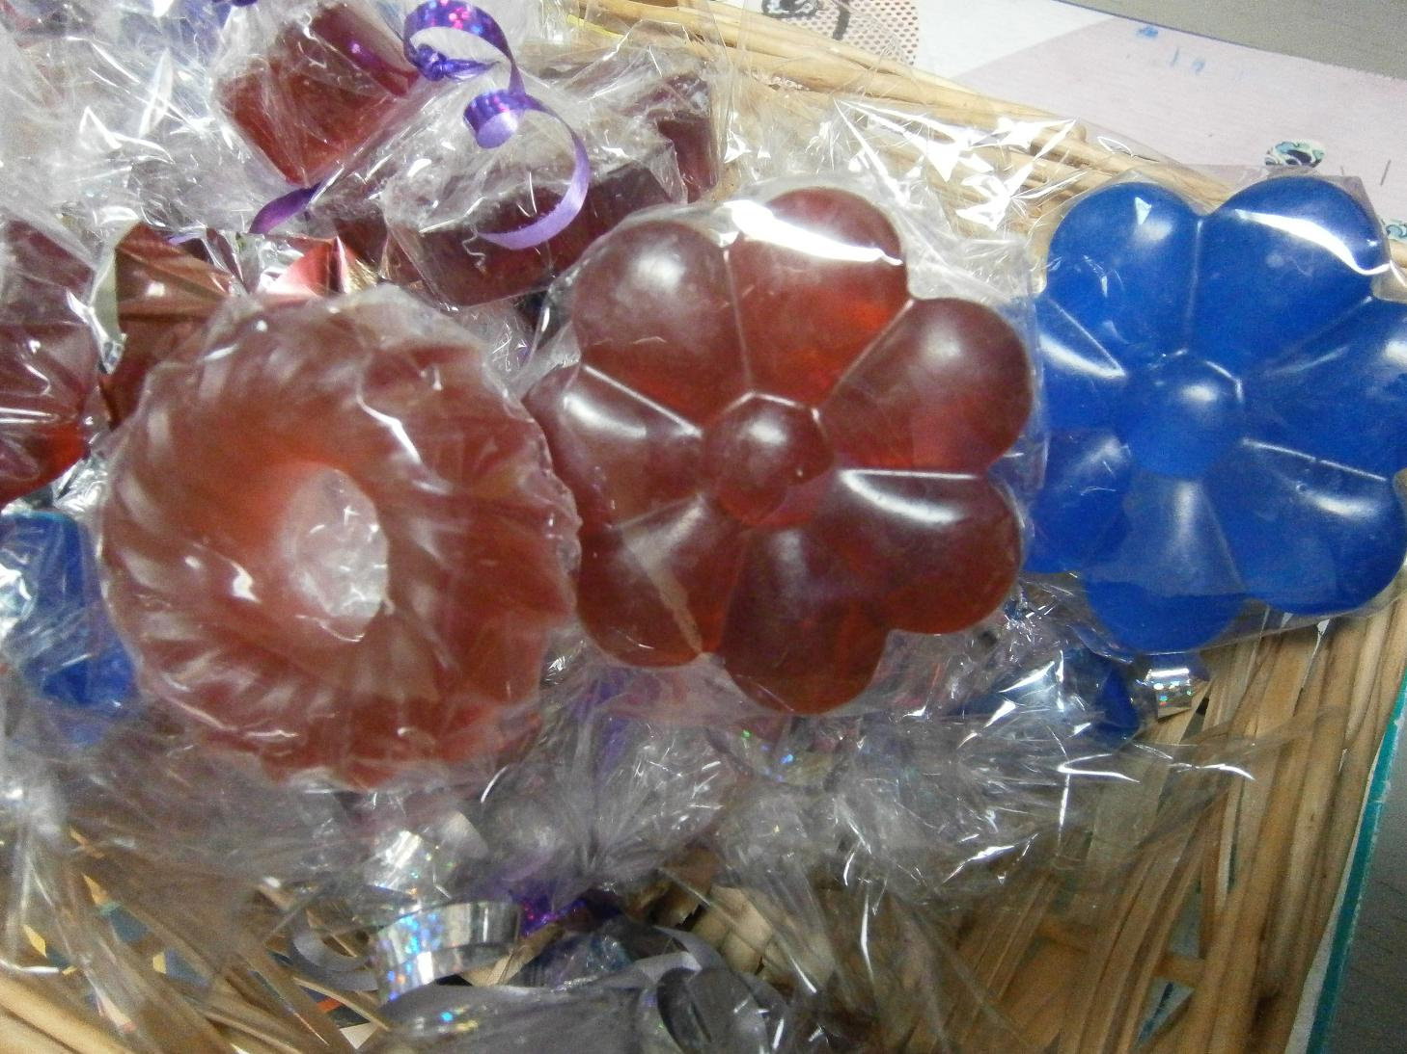
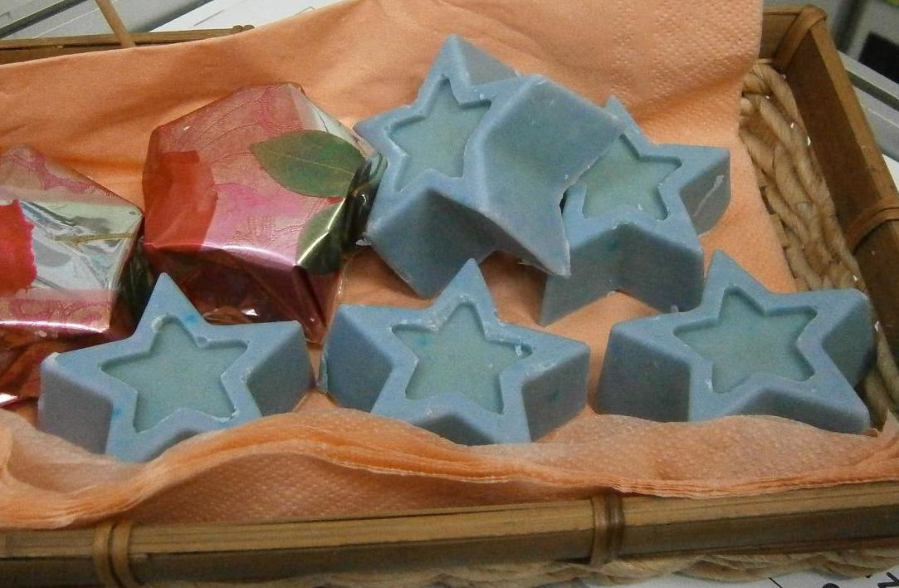
Soaps in different colours and shapes

Slide 17
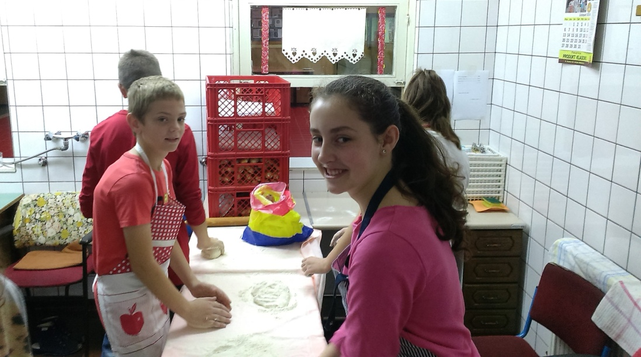
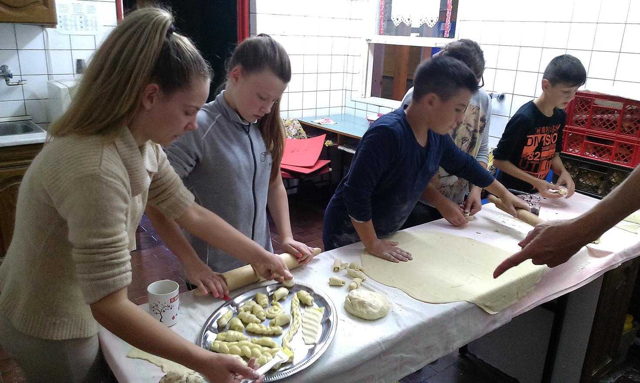
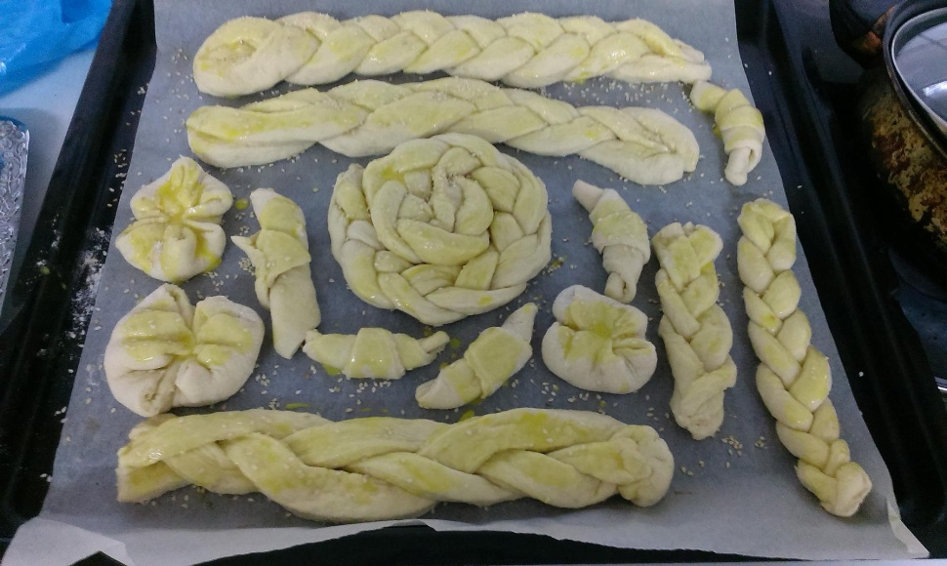

Some students like baking

Slide 18



Students also make different decorative objects and greeting cards.

Slide 19



Brooches and decorated bottles

Slide 20




Pottery

Slide 21

Pottery after baking in our kiln

Slide 22




Products are sold at school, at Health Fair and in the city centre.

Slide 23




Slide 24


Members of the school cooperative are also active in our local community, so they decorated Christmas trees in our neighbourhood and in the city centre.

