Slide 1


OŠ Bartola Kašića
Vinkovci
Erasmus + project 2020-2023
S.O.F.T. – Start our future today
WORLD CLEANUP DAY 2021
September 2021

Slide 2



World Cleanup Day is the world’s largest one-day civic action which engages volunteers from more than 180 countries to tackle global waste crisis. It is organised by Let’s Do It World. We all share the vision of the waste-free world and believe that together we can clean up the world from waste. The World Cleanup Day 2021 was held on 18th September. The action is called Zelena čistka in Croatia.
Our pupils decided to join. We cleaned our school garden and park, which is a place where not only pupils, but also people from the neighbourhood enjoy spending time.

Slide 3
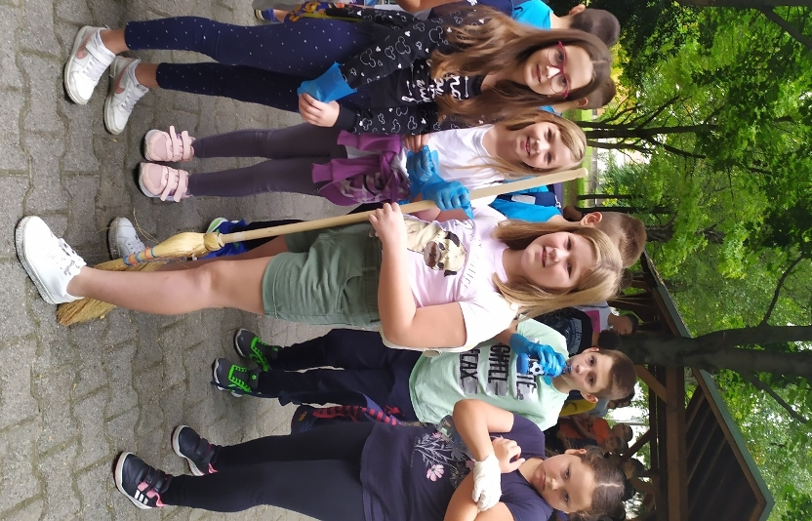
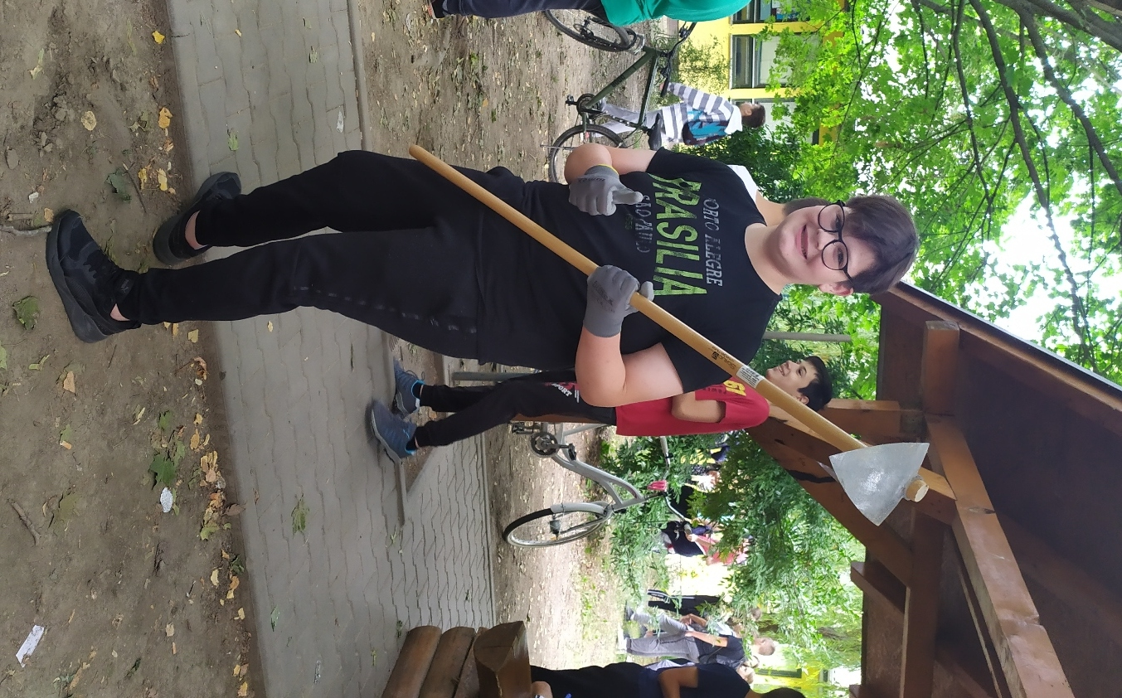
Pupils showed initiative and brought tools and flowers to plant.

Slide 4
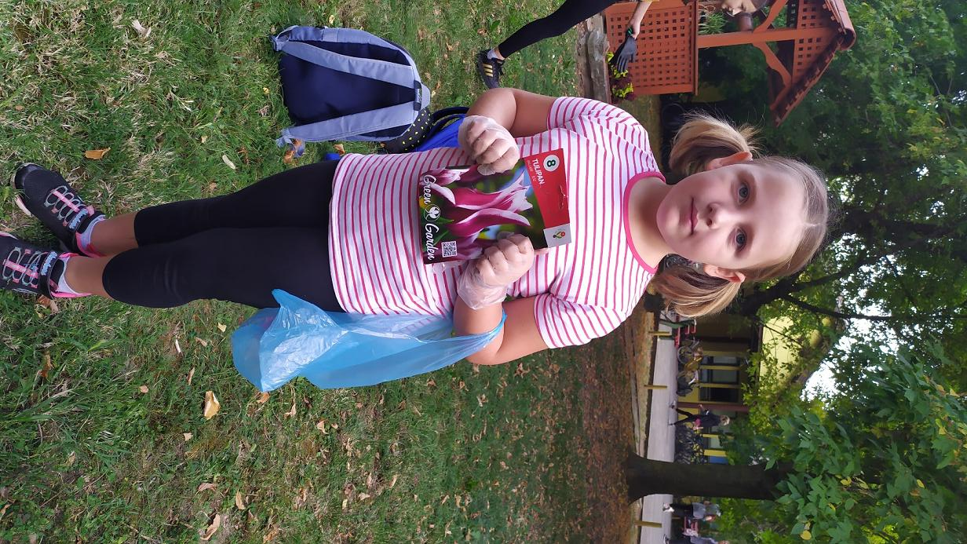
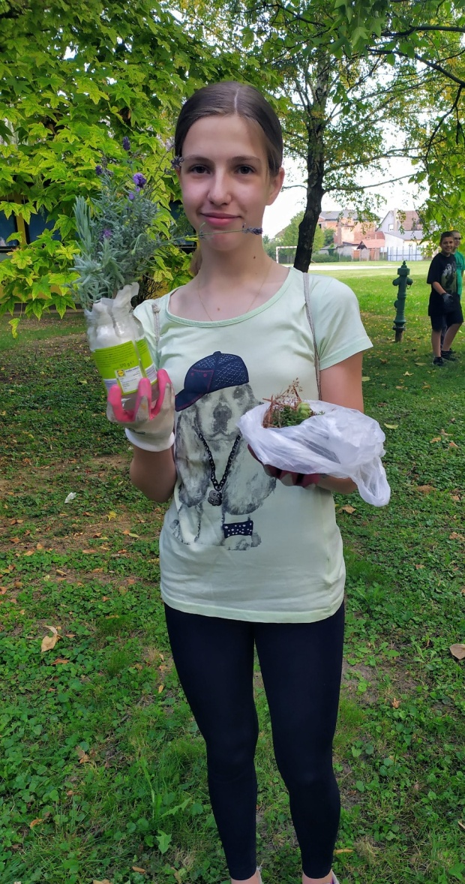
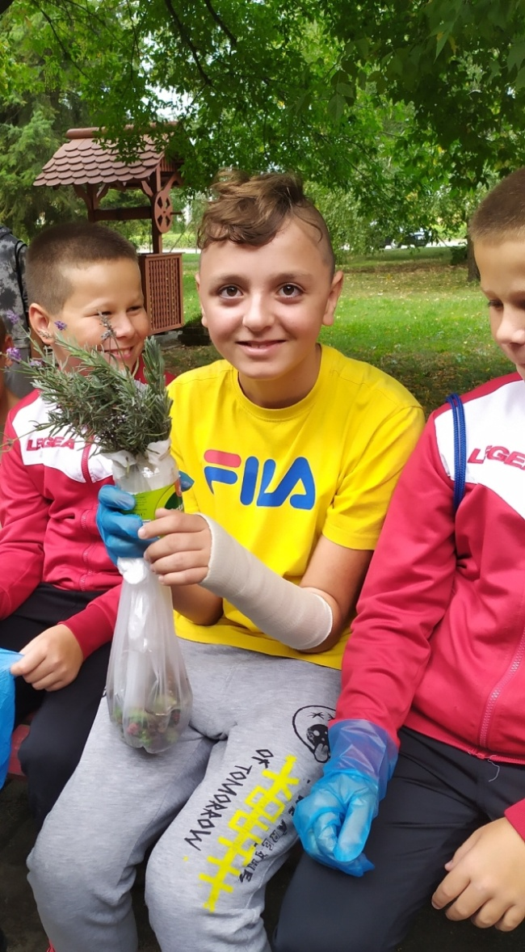

Slide 5
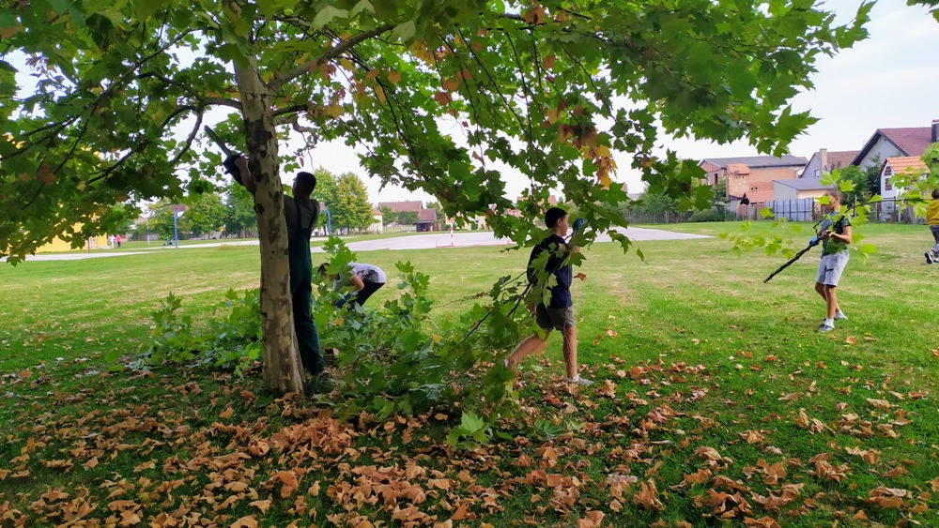
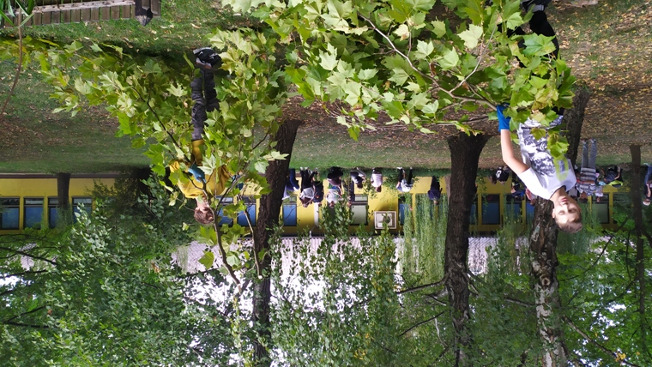
It was necessary to cut some branches with a chainsaw,
but it was an adult’s job.

Slide 6
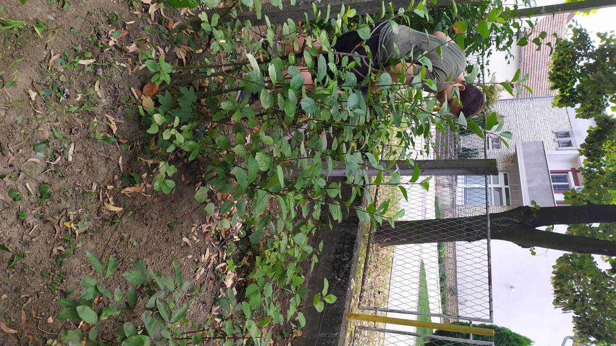
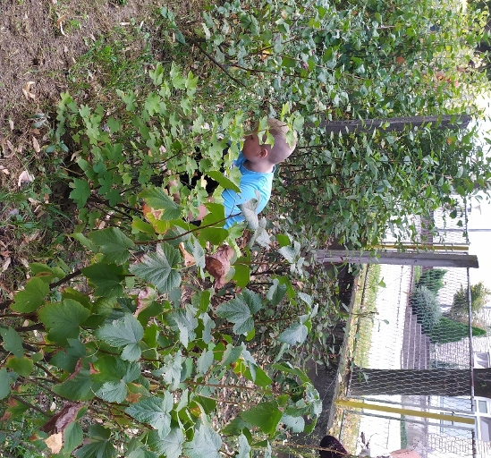
We weeded and celaned the flower beds, berry bushes and our small orchard in which we have quinces now.

Slide 7
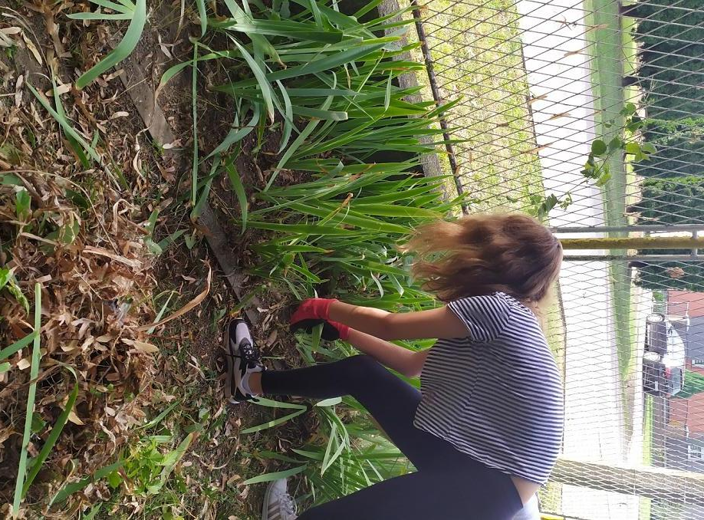
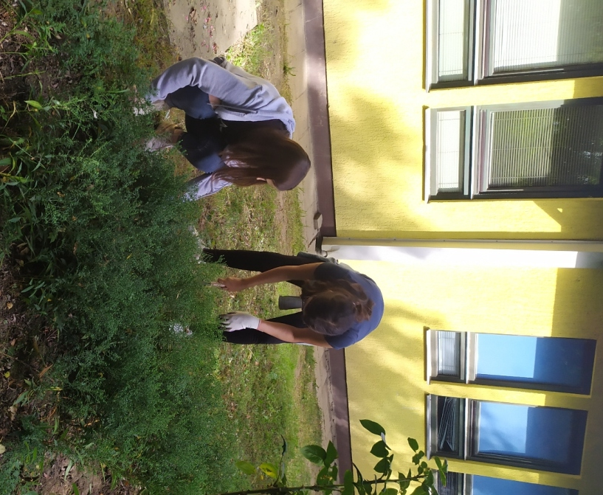
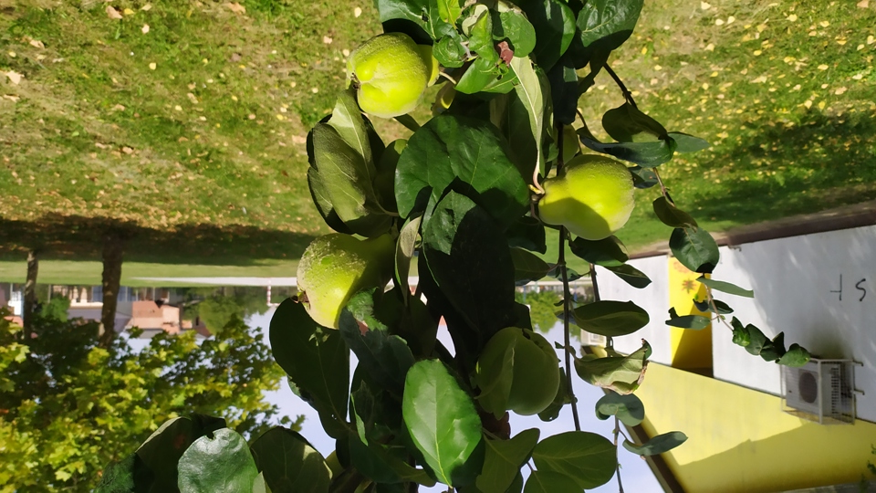

Slide 8
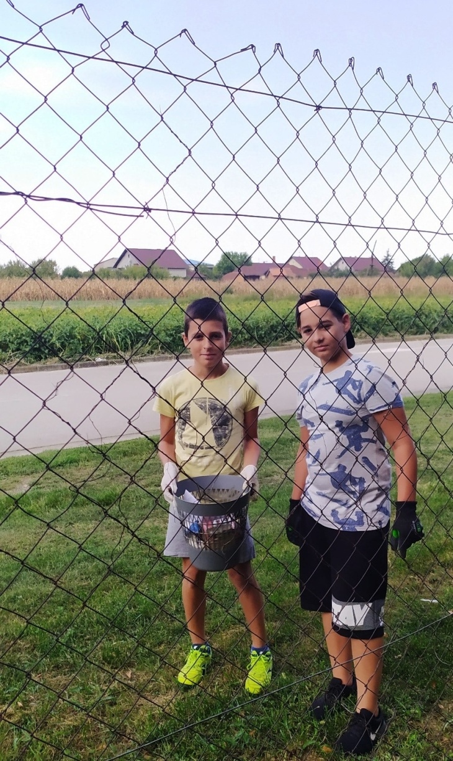
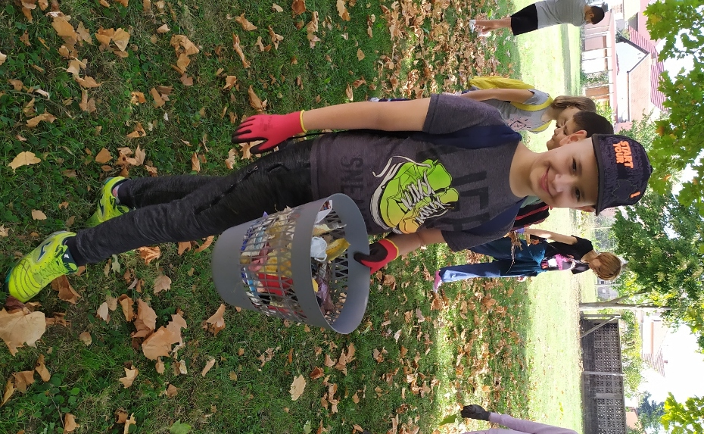
Pupils separated paper, metal and plastic in order not to put them to compost heap.

Slide 9
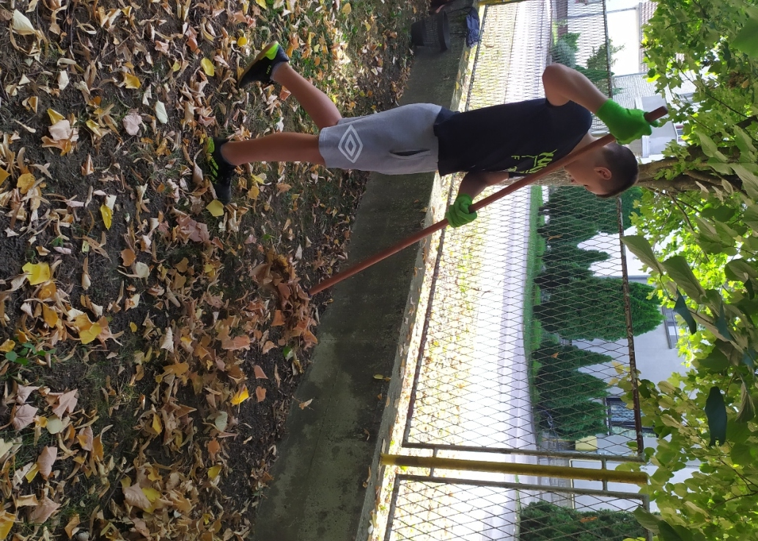
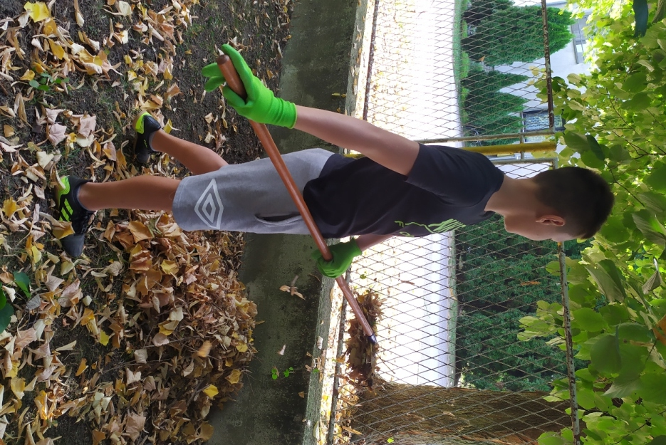
Leaves, twigs, weeds were raked and taken by wheelbarrows to the compost heap. It was not hard work and pupils had a lot of fun.

Slide 10
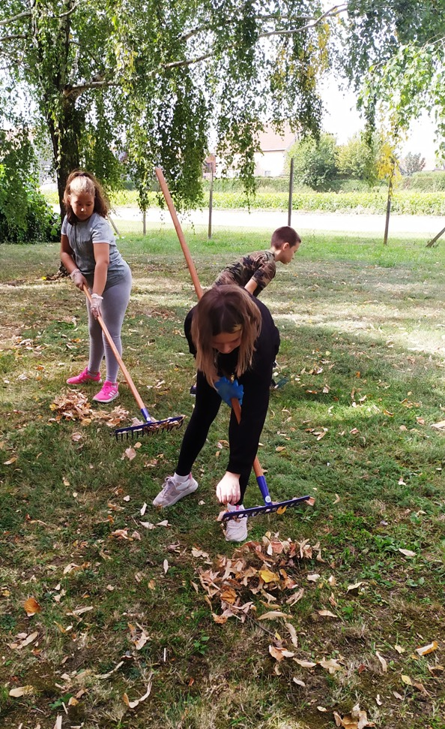
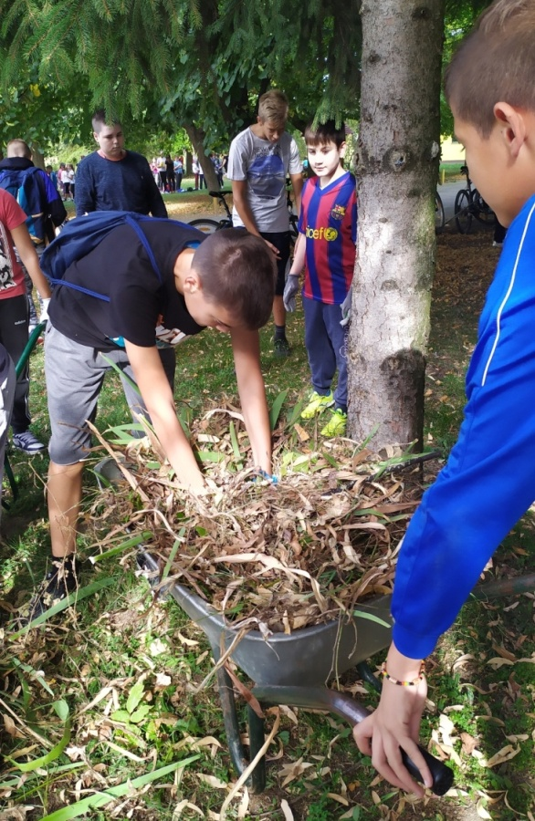
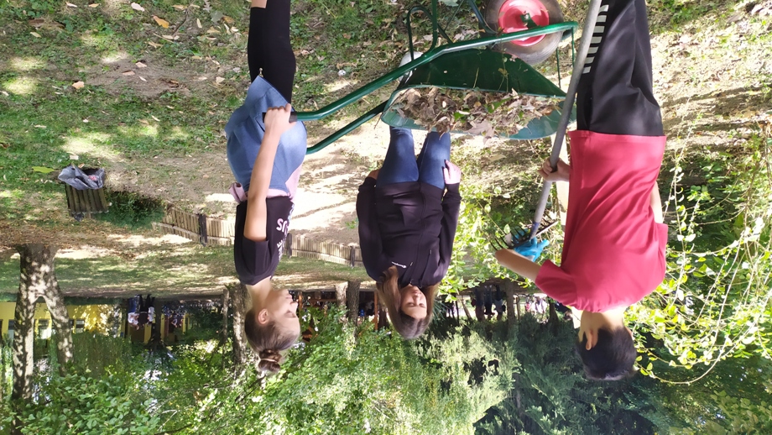

Slide 11
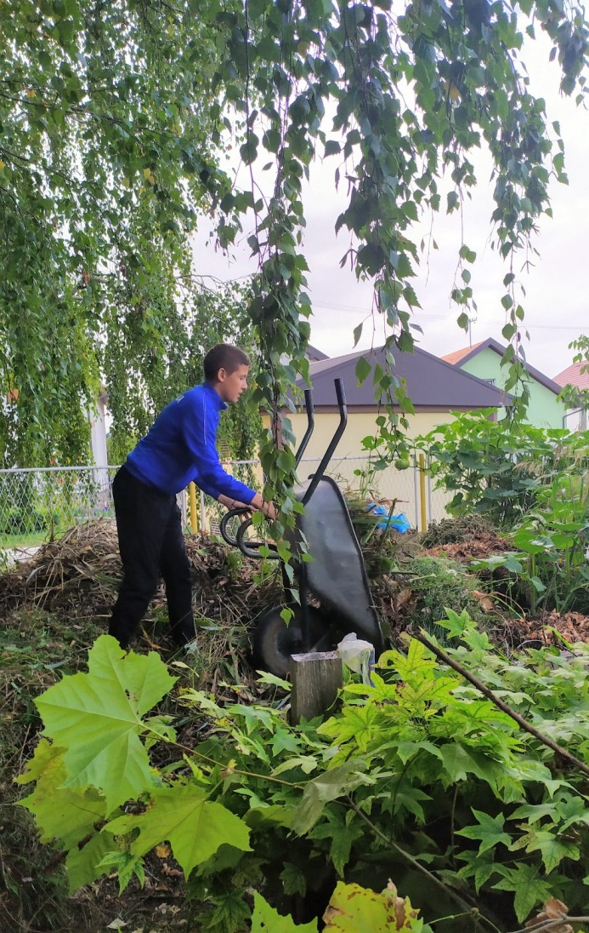
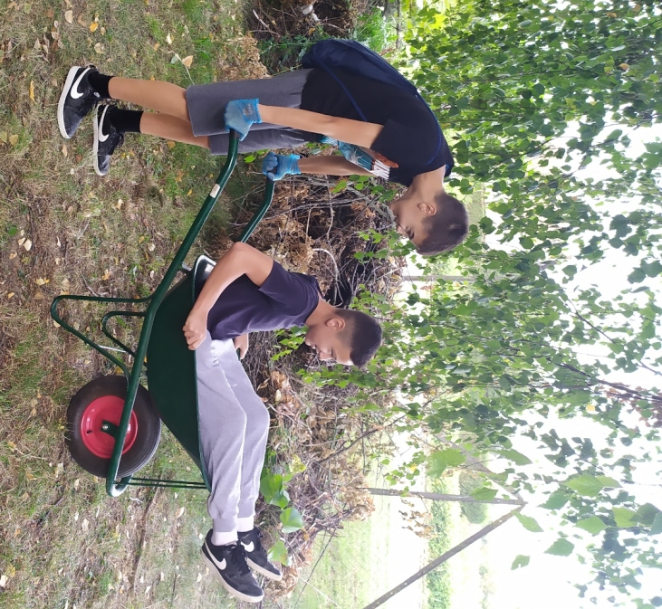
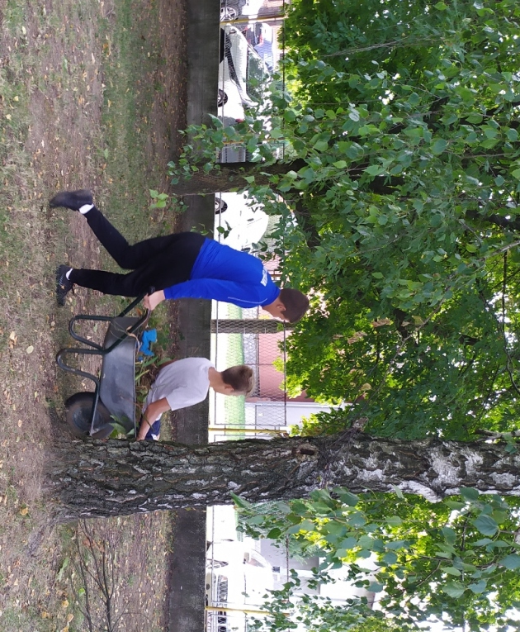

Slide 12
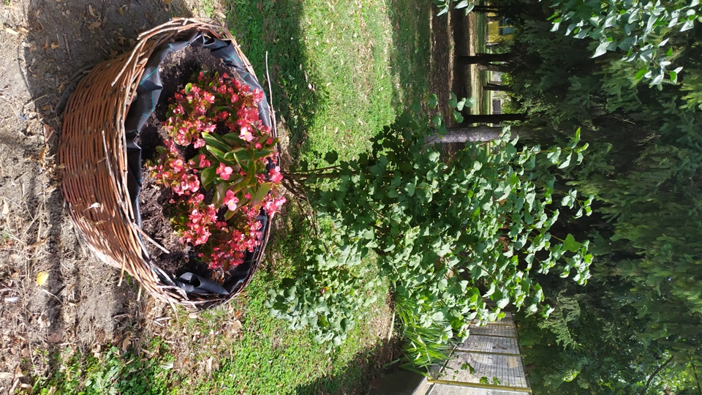
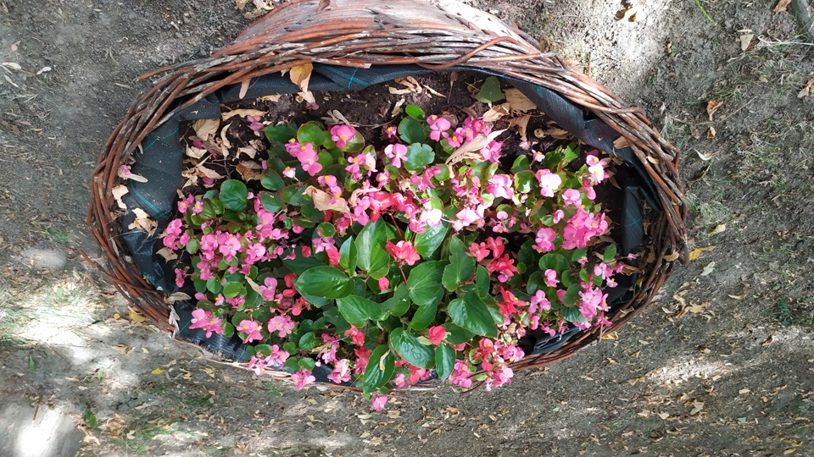
We also planted some flowers to add some colour before autumn when our park will have a beautiful golden colour.

Slide 13
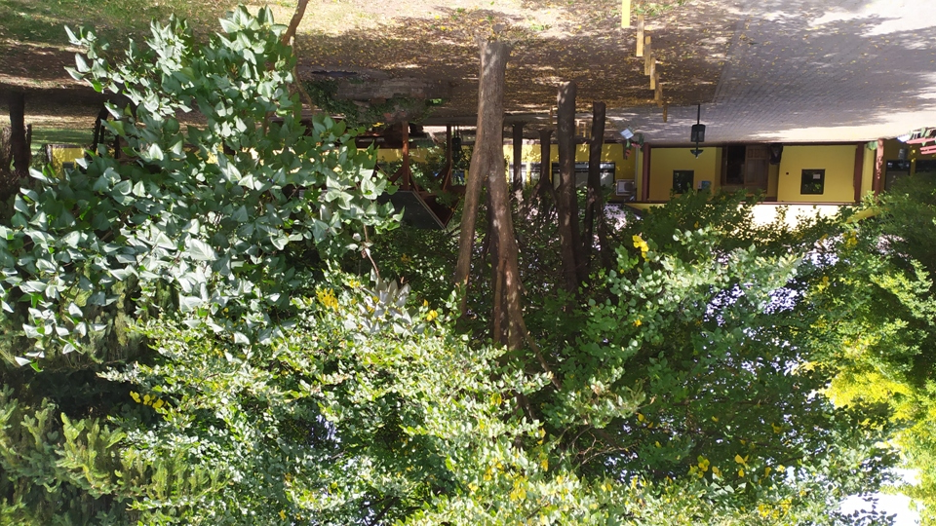
Now:

Slide 14
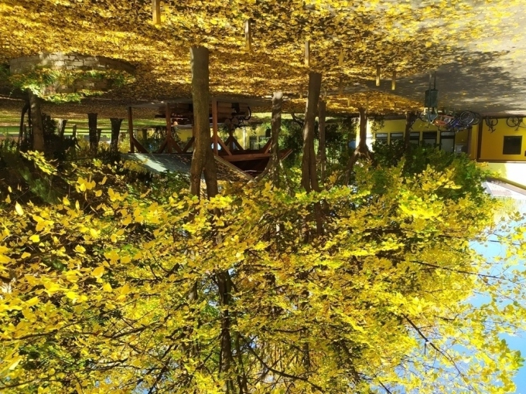
October:

