Slide 1
THINGS TO KNOW BEFORE GOING TO CROATIA
Osnovna škola Bartola Kašića Vinkovci Erasmus+ project 2020-2022 How Roman are you? 2020-1-DE03-KA229-077527_5

Slide 2
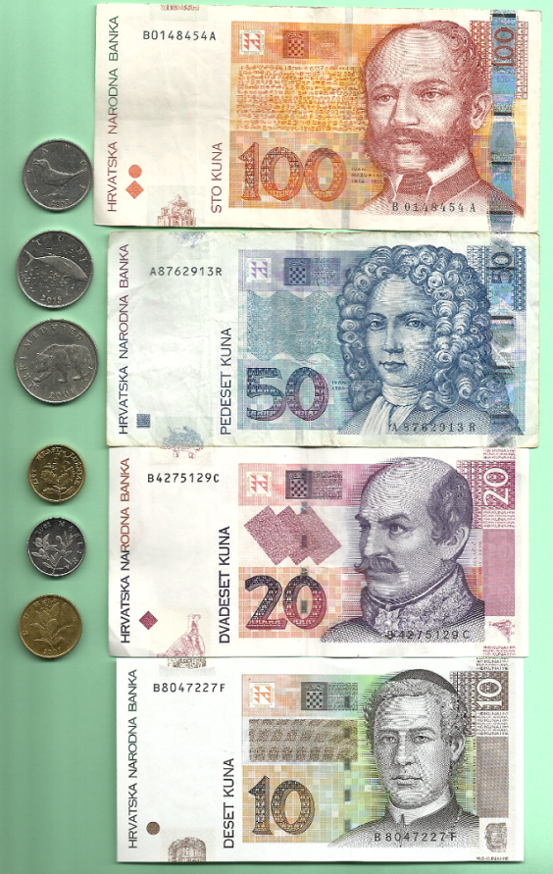
Currency – KUNA (has 100 lipa) If you pay in cash in a shop, don’t expect to get 5, 10 or 20 lipa change. There are no women on Croatian banknotes. Lipa coins have plants on them. Kuna coins have animals on them.

Slide 3
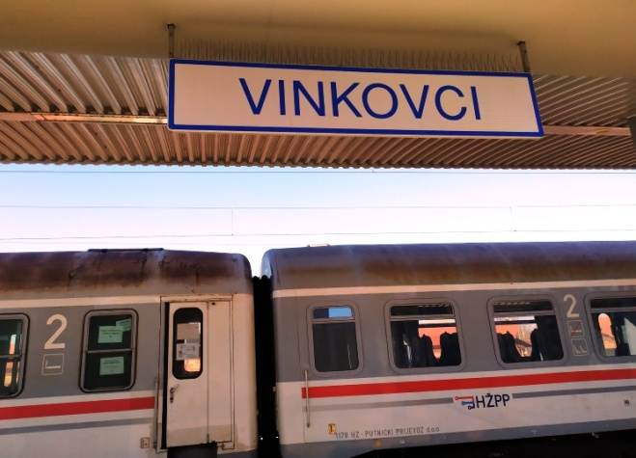
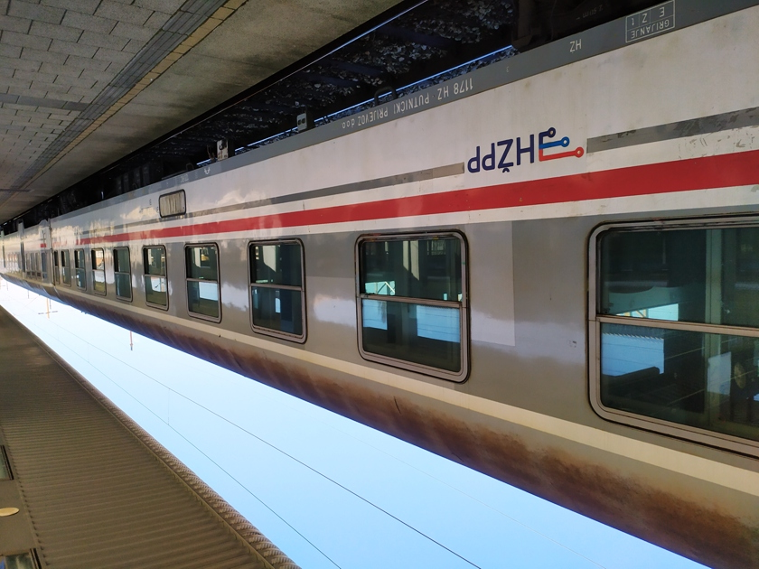
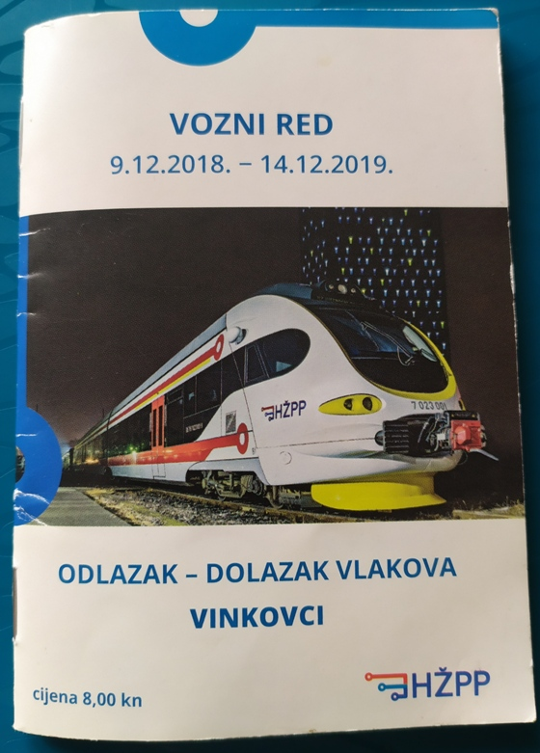
Trains are always late, very late.
We are used to it.

Slide 4
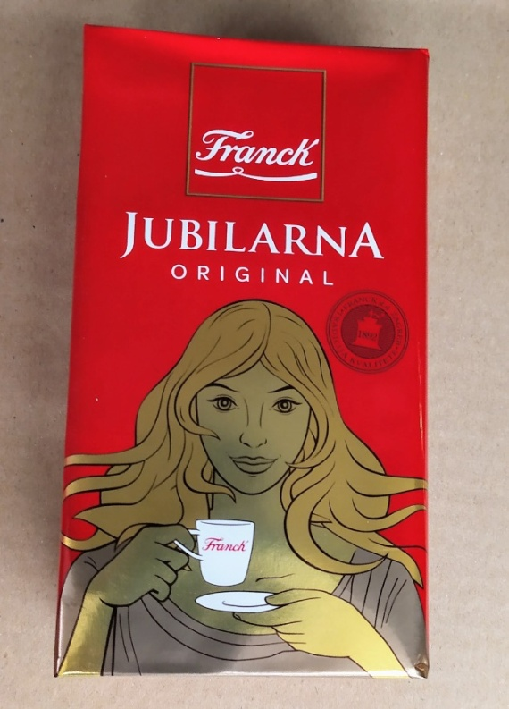
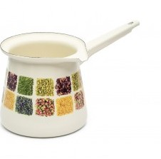
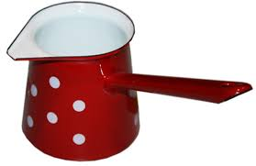
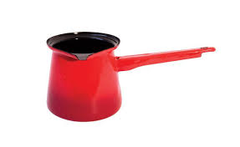
Gifts for hosts When visiting someone, you always bring a small present for hosts. It is customary to bring coffee, chocolate for children. You can also bring a bottle of wine or a house plant. The most common coffee is Croatian brand Franck, a 250 grams package, called “ciglica” (a small brick).
Coffee is made in džezva, a small traditional pot with a pouring lip and a long handle designed specifically to make Turkish coffee.

Slide 5
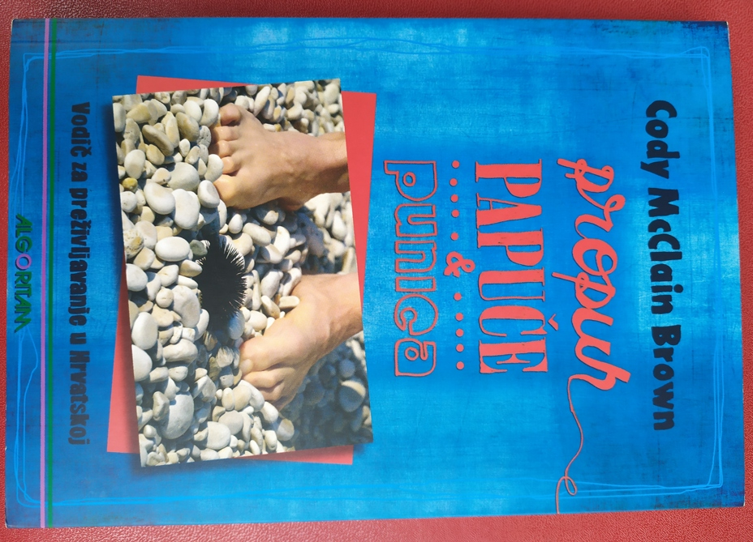
Cody McClain Brown is an American who married a Croatian girl and came to live in Croatia. He wrote a book “Propuh, papuče i punica” (Draft, slippers and mother-in-law ) about the differences between the USA and Croatia. ( The original title is Chasing a Croatian Girl: A Survivor’s Tale) propuh - draft
papuče - slippers
punica - mother-in-law

Slide 6
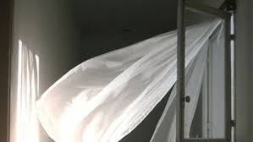
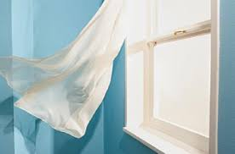
Draft/draught:
a flow of cool air in a room or other confined space (Oxford Advanced Learner’s Dictionary)
The popular belief is that draft (propuh, promaja) is very dangerous and can cause a number of diseases. According to our grandmothers, the draft is responsible for a number of health issues – headache, earache, cold, back pain and other more serious diseases. Younger generations still avoid draft, just in case.

Slide 7
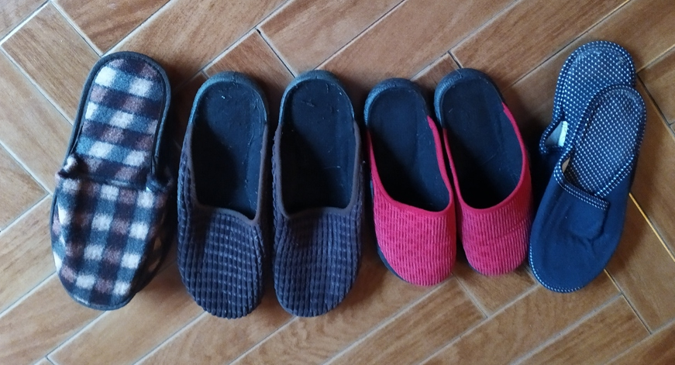
Guest slippers (papuče za goste)
In most houses you should take off your shoes when you enter. Each family has several pairs of slippers (papuče) just for guests.

Slide 8
Croatian language has insanely many words for relatives and in-laws. For example UNCLE can be UJAK, TETAK or STRIC, depending on if he is someone’s brother from mother’s or father’s side of the family. MOTHER –IN-LAW can be punica or svekrva, etc. Punica – wife’s mother There are not many people who really know all the words and know who is who. On the other side, in Croatia people have godfathers, confirmation sponsors and marriage witnesses - but they are all called KUM. Kum (female kuma) is a very important person, like a family member.

Slide 9
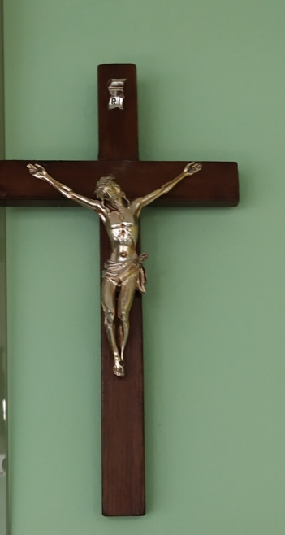
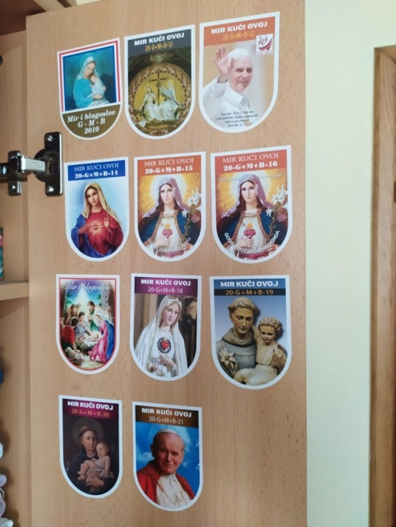
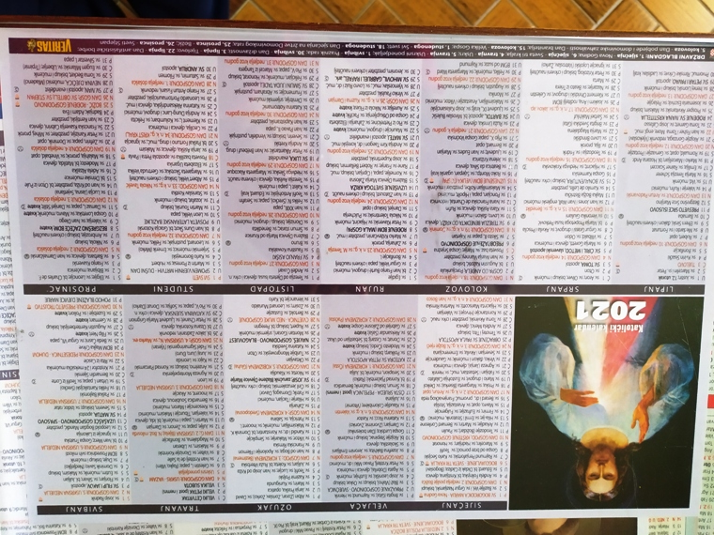
Catholic country Vast majority of the population identify themselves as Catholic and in many households you can see crucifix, blessing stickers (the sticker is given by the priest during the annual blessing of the house) and catholic calendar.
Many Croats are named after saints from the calendar and celebrate name days, which are just as important as birthdays.

Slide 10
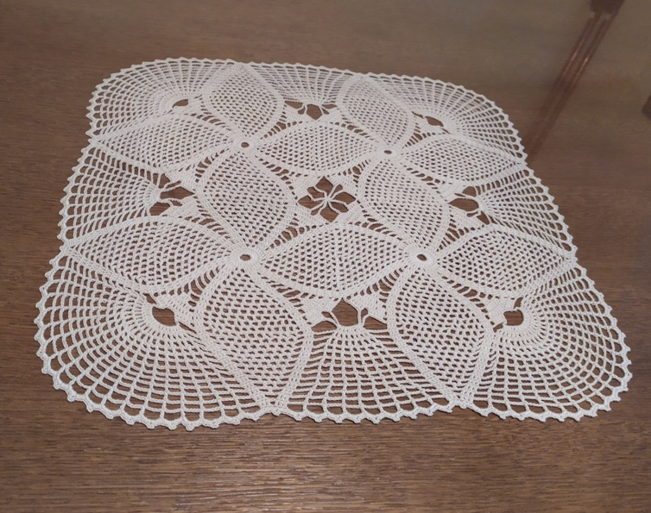
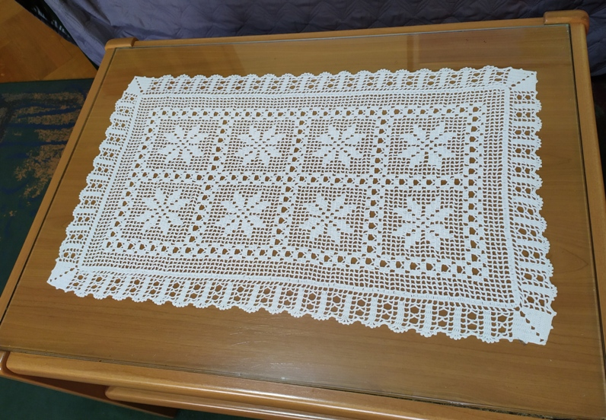
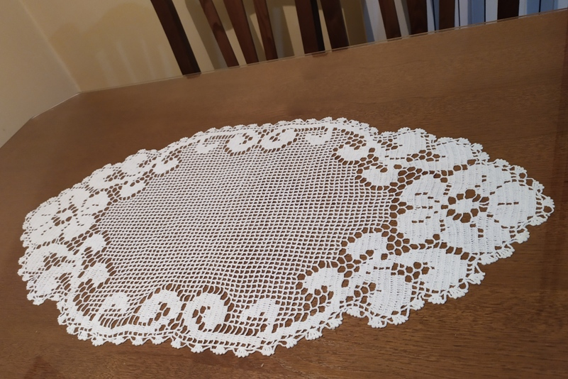
Crochet doilies
In all houses you can see lots of handmade doilies.
The younger generations crochet less, but lace decorations made by grandmothers are kept as a family treasure.

Slide 11
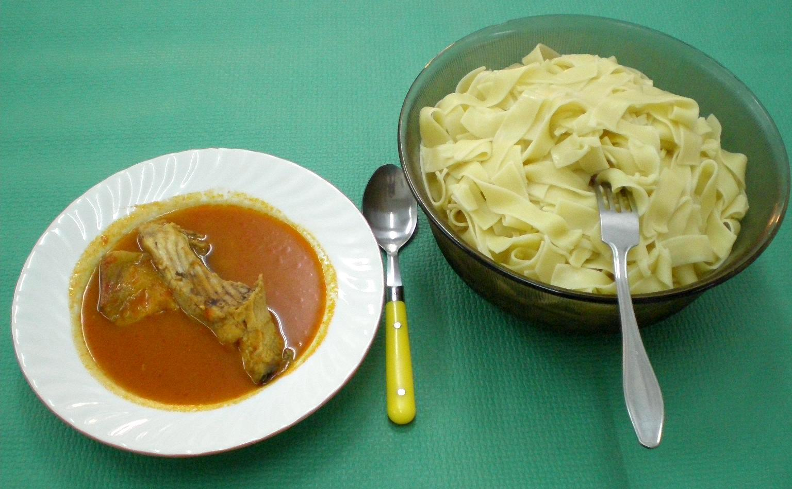
People in Croatia eat little fish (about 8,5 kg a year per person). In Slavonia (region that Vinkovci is in) freshwater fish is eaten, primarily carp, but catfish and perch are also eaten.
Riblji paprikaš , a popular dish

Slide 12
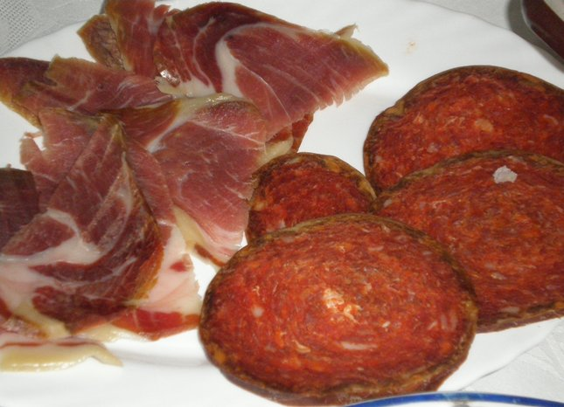
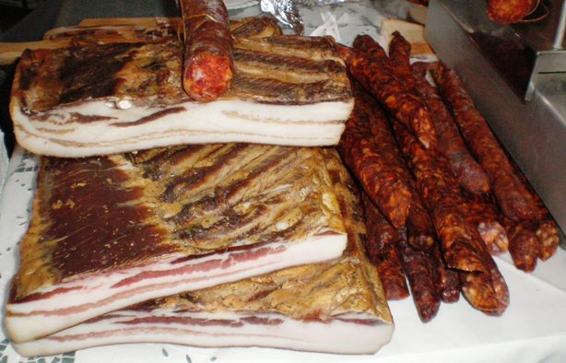
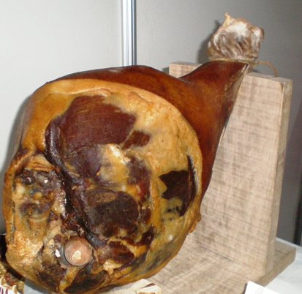
We eat a lot of meat, especially pork. It is important to have homemade dried pork delicacies: sausages, bacon, ham,...

Slide 13
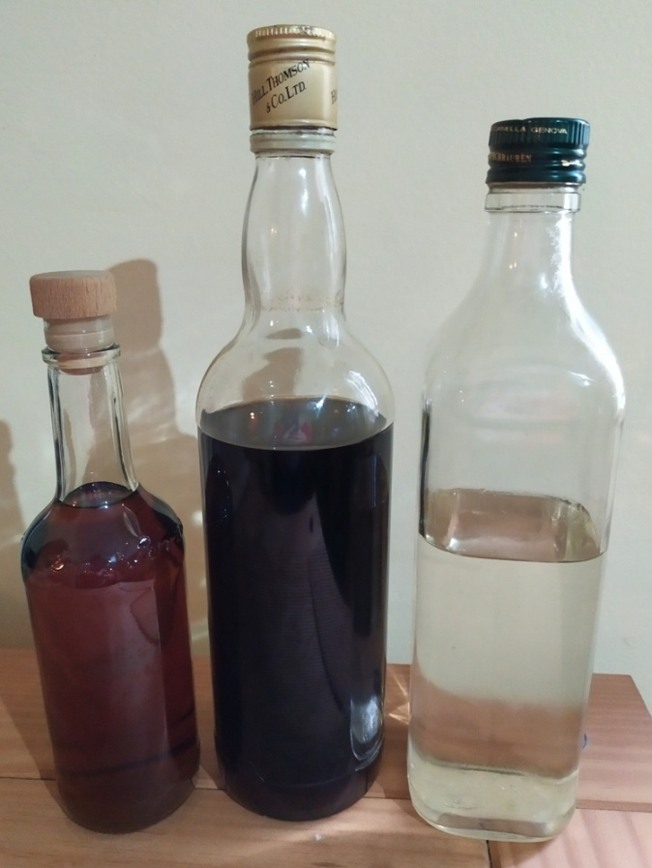
Brandy – it is important to have good homemade brandy (RAKIJA). The most popular kinds are plum brandy – šljivovica and grape brandy – lozovača, komovica
We use brandy as a basis for making liqueurs – the most popular liqueurs are walnut liqueur and cherry liqueur. Rakija is used as medicine:
Walnut liqueur helps if you have stomach pain, grape brandy can be used for linings for various purposes: lowering the temperature, if you have a rash,...

Slide 14
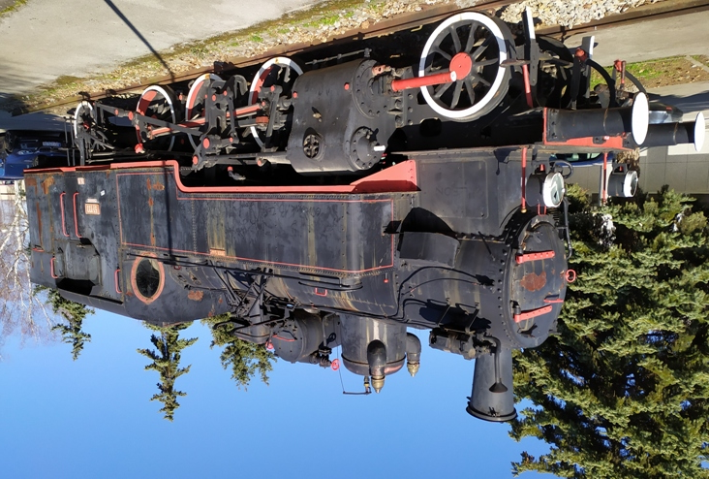
Vinkovci Murder on the Orient Express is one of Agathe Christie’s greatest novels. Vinkovci is mentioned in the novel (and films based on the novel, of course). When Hercule Poirot asks where the train had stopped (because of heavy snowfall), staff tell him: “Between Vinkovci and Slavonski Brod.”
Steam locomotive in front of the railway station

Slide 15
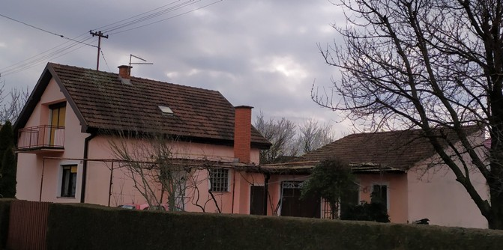
In Novo Selo, a part of Vinkovci with 4000 inhabitants, all families live in their own family houses. Men usually build houses by themselves, with the help of friends and relatives. After having built the house, they realize that they definitely must have a summer kitchen to keep the main house cool and free of strong odours by preparing meals elsewhere.
Summer kitchen

Slide 16
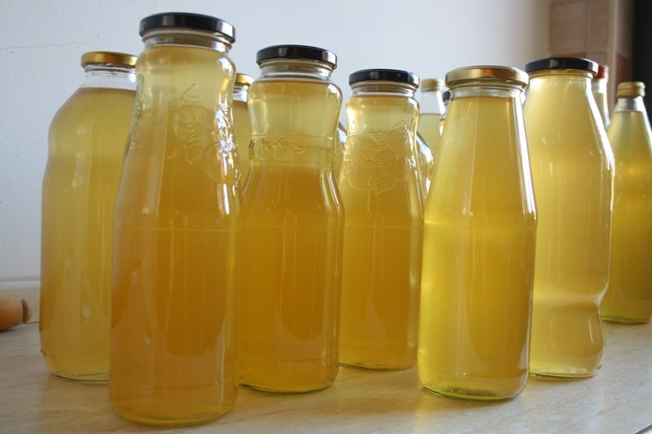
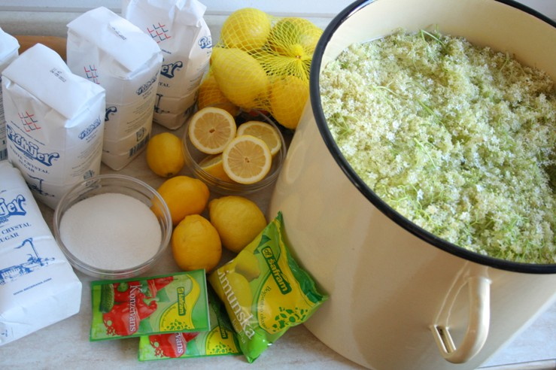
It is safe to drink tap water. One of the most popular soft drinks is elderberry juice. Every spring families make their own elderberry syrup.

Slide 17
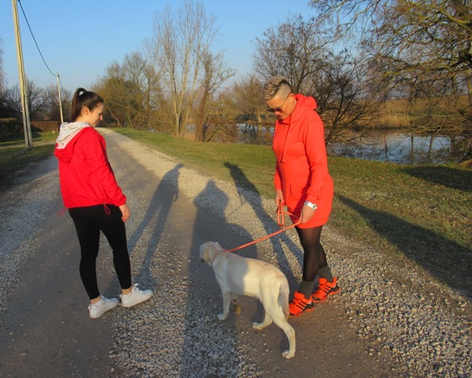
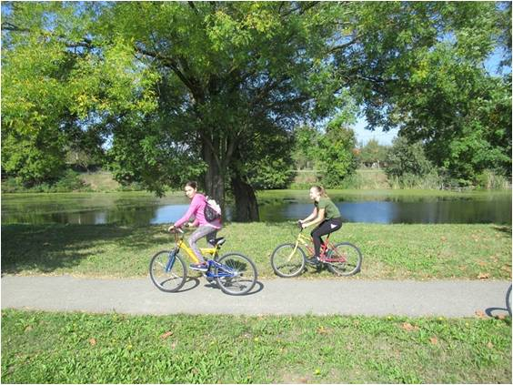
Most families have pets: dogs or cats Each family has more bicycles than family members. Children can play in the street or ride bikes with their friends and neighbours.

Slide 18
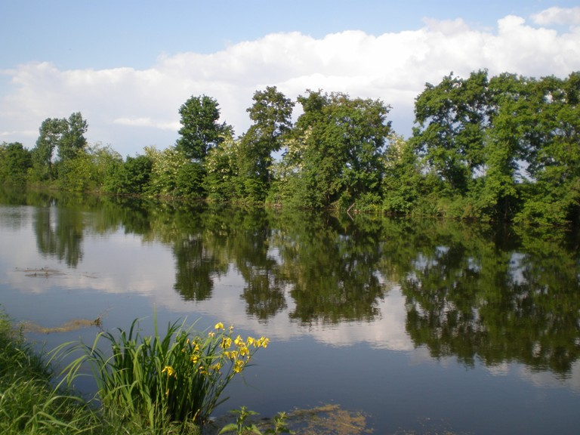
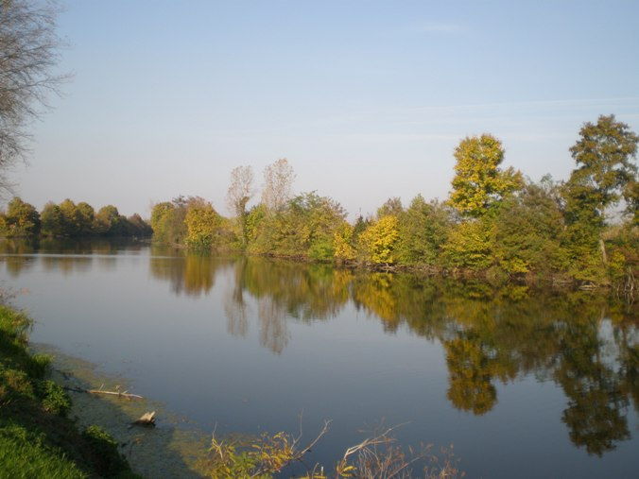
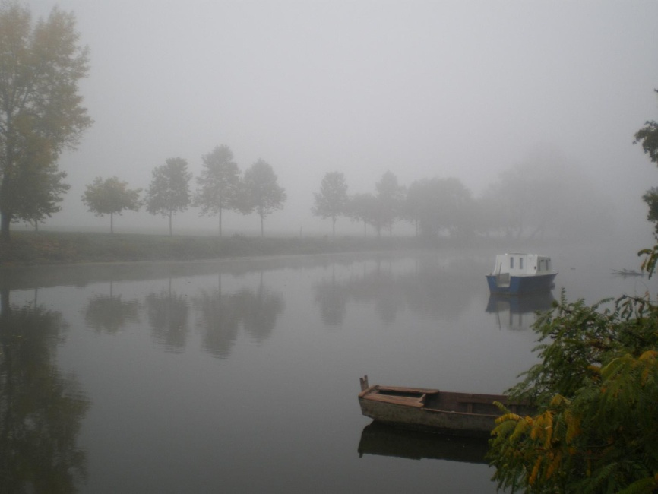
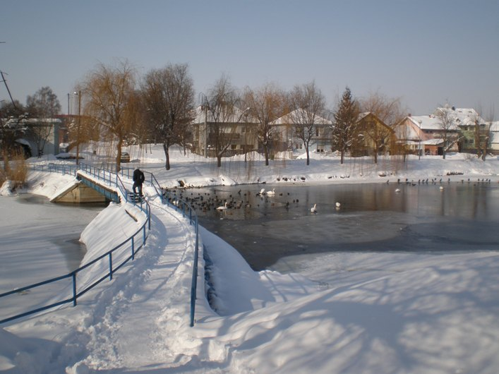
We love our river Bosut, any time of year.

Slide 19
There are many stereotypes about people from other countries, and these are the first thoughts of pupils in grades 7 and 8 about people from partner countries
GERMANY | have a lot of money drive good cars eat sausages and drink beer are fair-skinned
GREECE | have beautiful sea the state is heavily indebted know a lot about mythology and ancient gods have good dairy products, especially yogurt
ITALY | eat pizza, lasagna and spaghetti like football do not speak English Super Mario (is Italian) a boot- shaped country
PORTUGAL | dark complexioned people good sailors and explorers eat cod and sardines like football religious people
SPAIN | play football well cheerful have lots of festivals dance flamenco language of soap operas

