Slide 1
How Elementary School „Braća Seljan” got it’s name
N
15:53
History of the school
Writers:
Karlo Šipek i Vanja Mutić

Slide 2
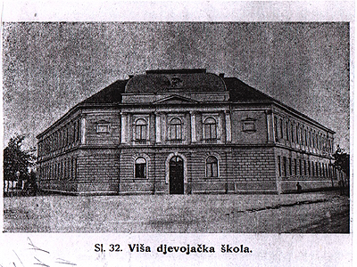
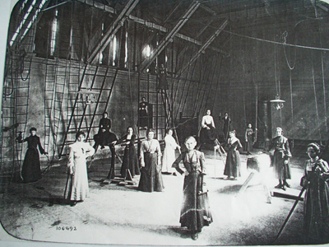
Chapter 1: The Beginning
N
-131 years ago in 1893., Elementary school „Centar grada” had just opened as a higher educational school for girls.
- In 1895. a gym was built for the students on Senjska road.
-On the 3.9.1915. the school was turned into a hospital due to WW1.
-A year after WW1 the school was rebuilt and as soon as the students saw the new school all of them erupted from happiness.

Slide 3
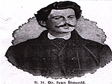
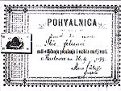
Chapter 2: A new era
N
-In 1937. boys start studying at the school.
-From 1941. to 1945. normal school life was interrupted by WW2, at the end of the war the school was destroyed and devastated.
-In 1946 the school was rebuilt and combined with another school.
-In 1949. Elementary school „Centar grada” changed Into elementary school „Ivo Lola Ribar".

Slide 4
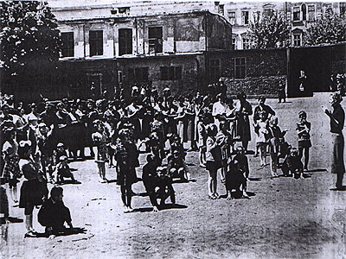
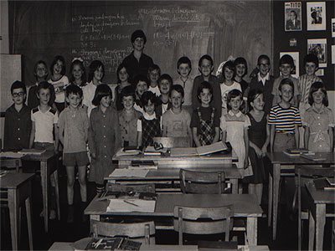
Chapter 3: The split and the rise
N
-In 1956. the school split into two schools with 8 year education.
-3 years after the split 5 classes are added.
-1971. the school for the first time lets students from the 1. to 4. grade stay after school to wait for their parents.
-In 1975. the gym on Senjska road is finally used again by the school.

Slide 5
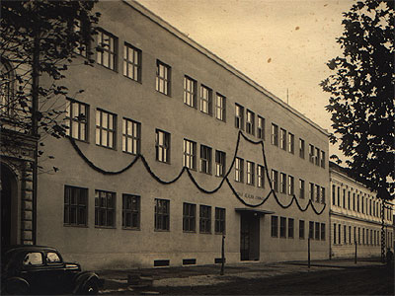
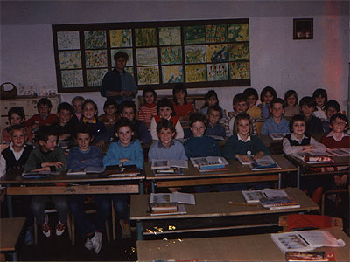
Chapter 4: Name changes
N
-In 1990. Elementary school „Ivo Lola Ribar” is renamed after ban Ivan Mažuranić.
-On the first year of the war (1991.) elementary school „Ivan Mažuranić” becomes elementary school „Braća Seljan”, named after the explorers Mirko and Stjepan Seljan.

Slide 6
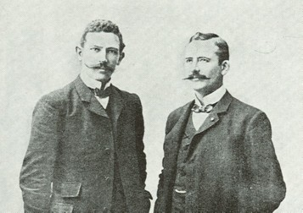
Chapter 4.5: Mirko and Stjepan Seljan
N
-Over the course of their life they have written multiple books about their expeditions.
-They have filled multiple museums with things they found in their expeditions.
-In 1903. they started their expeditons in South America where they investigated the waterfall „Sete Quedas” and the river „Aquapei”.
-8 years after that in 1911. they decided to go explore more places but first the Amazon.
-While investigating the Amazon, Mirko died with his brother soon to follow.

Slide 7
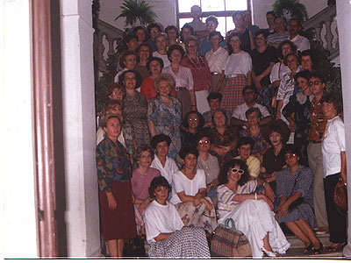
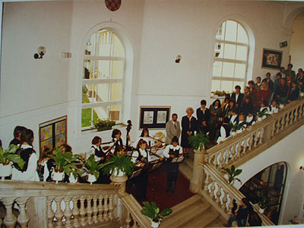
Chapter 5: After the war
N
-Finally after the war ended classes continued as normal and is named the oldest folk school.
-A gallery called „Butterfly” opens in the school on the 17.2.1997.
-In 2000. Hep Monatzeder vists the school and hands us a gift of 28 computers as a gift for the whole region of Karlovac.

Slide 8
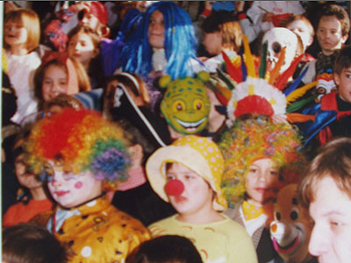
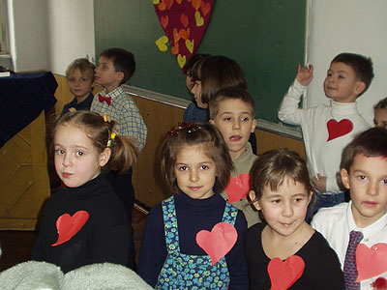
Chapter 6: Birthday and competitions
N
-Entering the 2000s, the school started doing projects with UNICEF to help kids study easier.
-In 2001. students got 2.place in „Sweet, Sweeter, Sweetest”.
-Finally in 2003. the school had its 110. birthday.

Slide 9
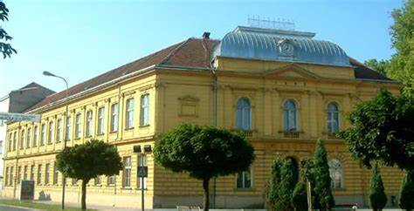
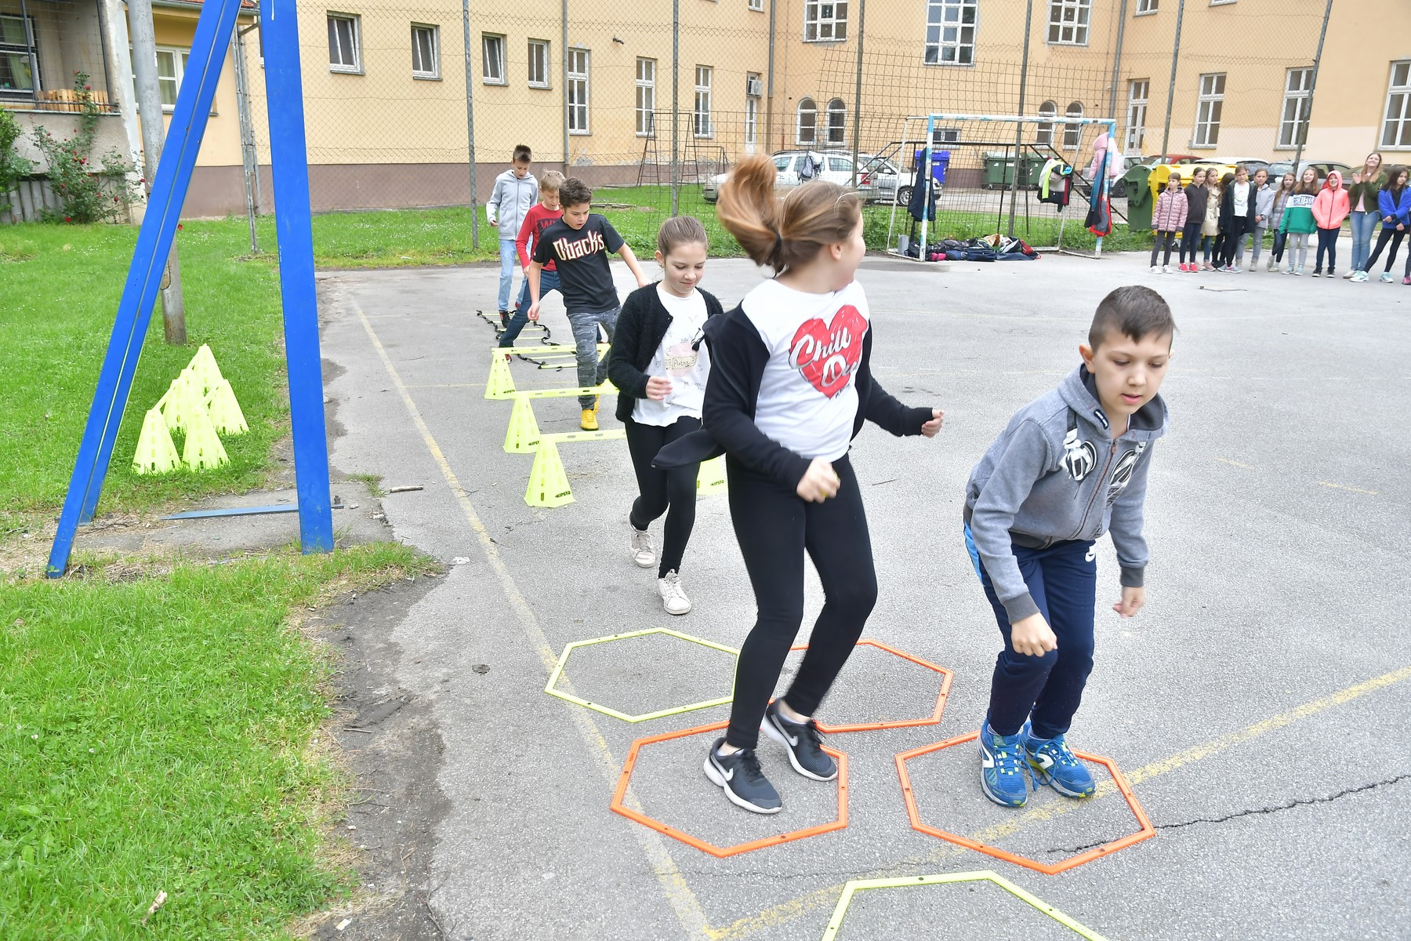
Chapter 7: The present
N
-The school in 2022. expanded so the 1. to 4. grade study the new area of the school.
-While 5. to 8. grade study in the old part of the school.
-A year ago the school had it’s 130. birthday where they organised a musical in the theatre „Zorin Dom”.

Slide 10
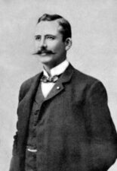
Thank you for listening
N

