Slide 1
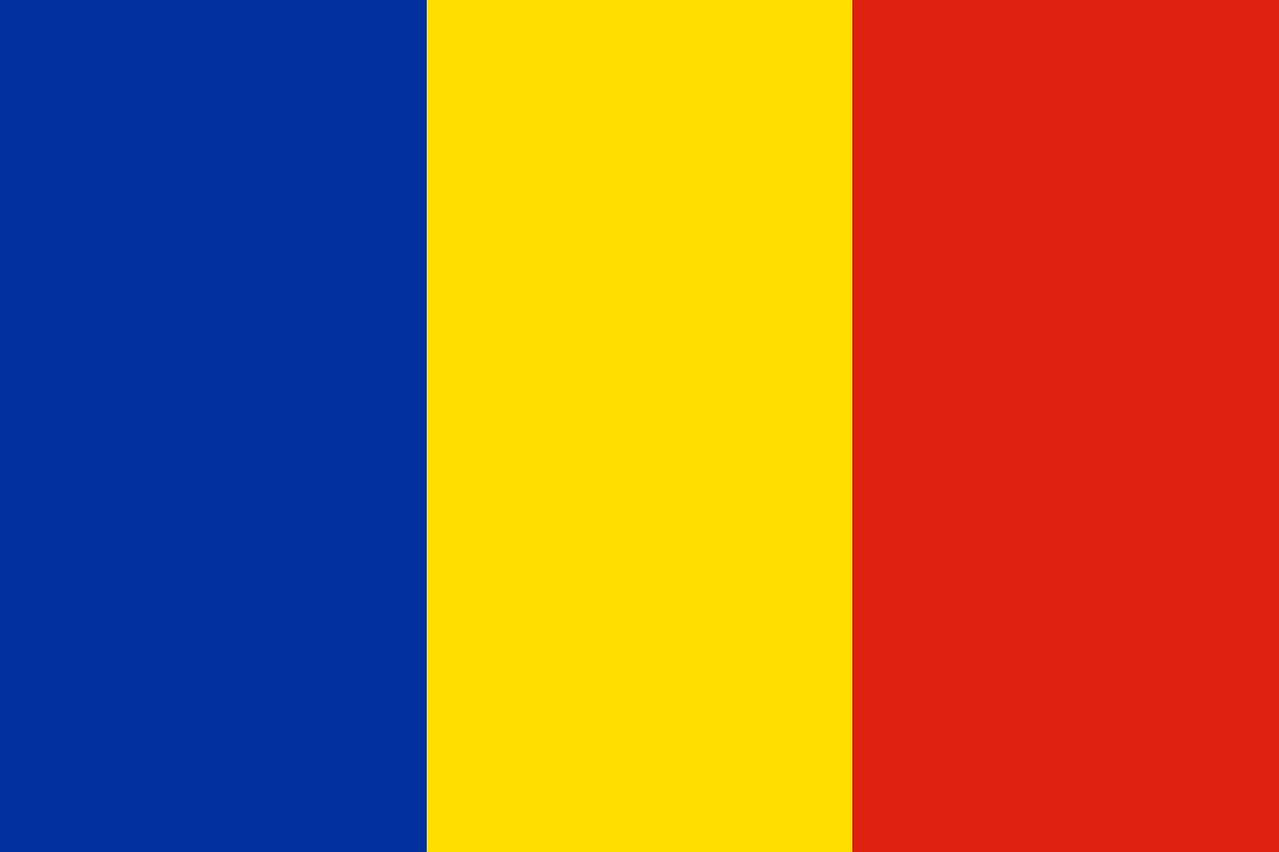
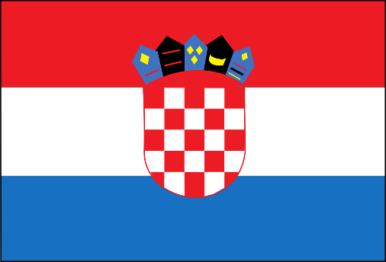
Erasmus+ 'Listen to my HERstory'

Slide 2
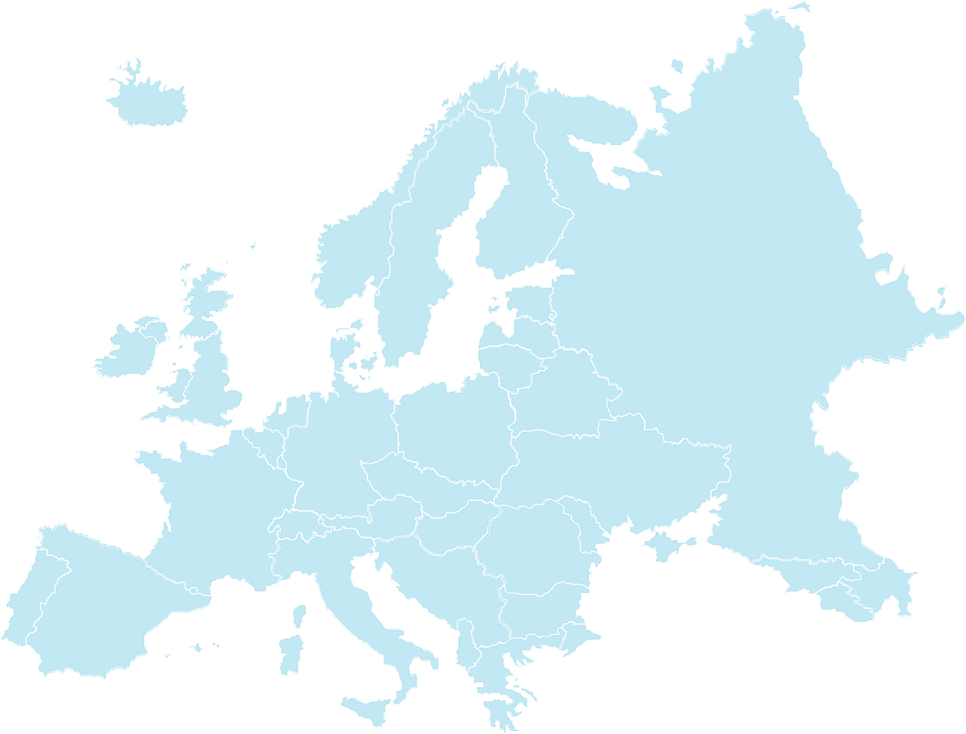
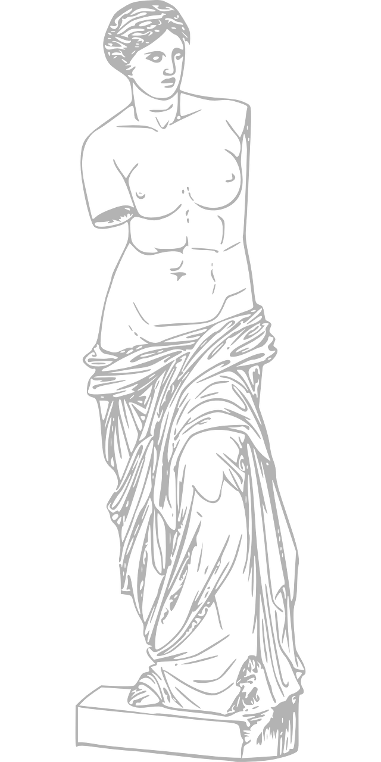
Europe was a woman ... In Greek mythology, she was famous for her extraordinary beauty, she gave birth to two sons: Minos and Radamantys. Enchanted by the beautiful landlady, the god Zeus kidnapped her and lifted her to the largest Greek island - Crete. When the name of the mythological heroine was first used to name our continent, it is not known. But she was certainly female. We would like to emphasize this fact when discussing other important women of our common continent. We dealt with the topic: "Women in beliefs and sources of European culture". We hope that our joint work - this multimedia presentation, will inspire you to deepen your knowledge and search for new curiosities about women.

Slide 3
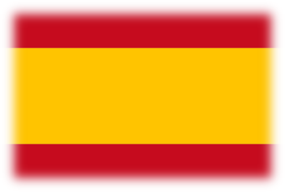
IN SPAIN

Slide 4
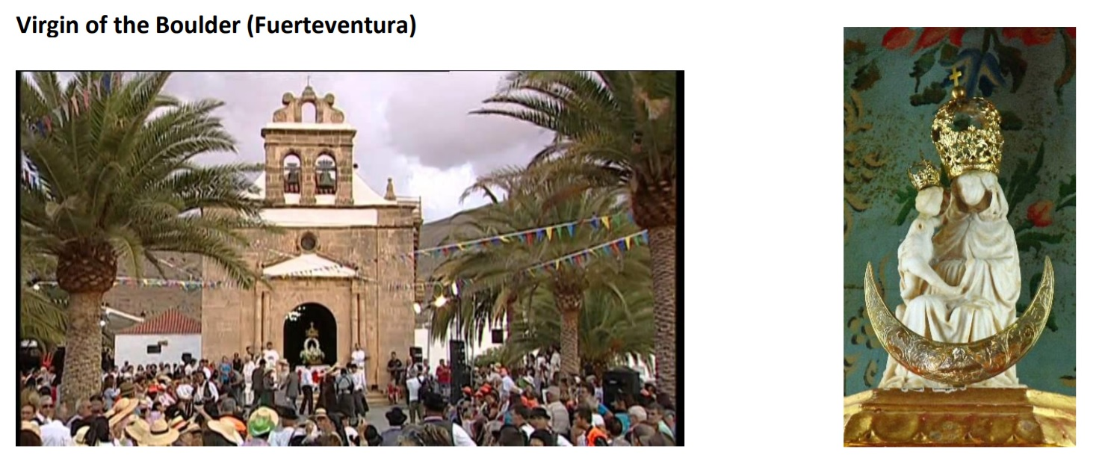
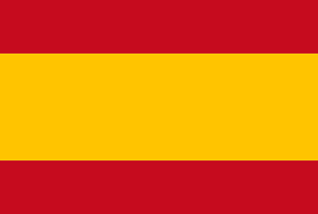
The Virgen de la Peña is the patron saint of the island of Fuerteventura. It is found enthroned in the Hermitage of Nuestra Señora de la Peña located in the Valle de la Vega de Río Palmas (Betancuria) Legend said that on a spring night Father Fray Juan de San Torcaz went out to look for medicinal herbs and, seeing that he was slow to return, San Diego went looking for him. He asked some shepherds about the friar and they told him that they had not seen him, but that there had been strange lights that night, and among them one of extraordinary brightness, that were moving towards the Barranco de Malpaso. San Diego and the shepherds went to the place and spotted Father San Torcaz's hat, inside a pool of water, which was located under a very steep rock, the friar was, at the bottom of the pool, bent on his knees with her rosary around her neck.

Slide 5
One of the shepherds jumped into the water to get Fray San Torcaz out, and he got him out unscathed and totally dry. The friar told San Diego and the shepherds that heavenly music and rays of light were coming out of a nearby rock. Without wasting time, they went looking for tools to break the rock, but the efforts did not yield any results and the tools were dented. Then, Saint Didacus showed the part of the rock that should be hit, when hitting at that point the rock broke and, inside, they found a white image representing the Virgin Mary with her son in her arms. Celebration: September (3rd Saturday).

Slide 6
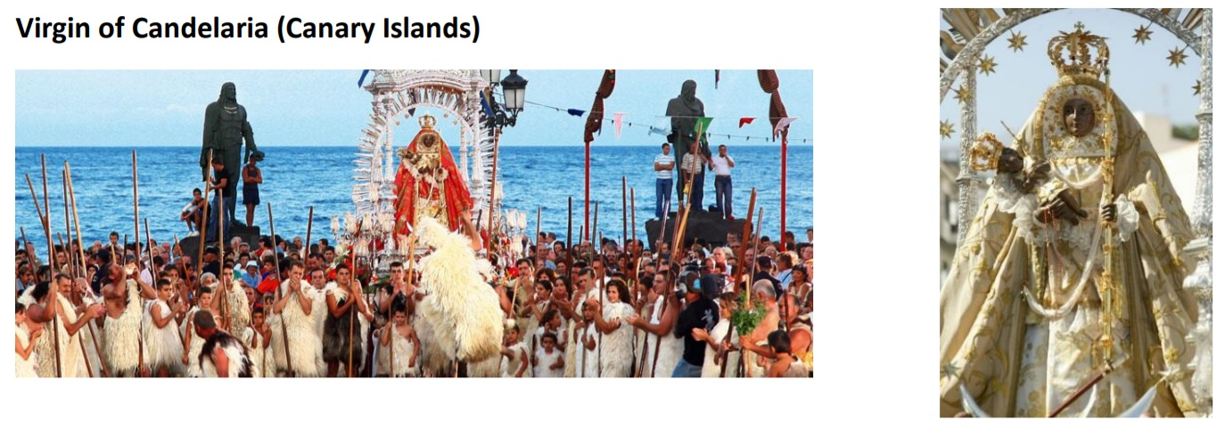
The Virgin of Candelaria or Our Lady of Candle (Spanish: Virgen de Candelaria or Nuestra Señora de la Candelaria), popularly called La Morenita, celebrates the Virgin Mary on the island of Tenerife, one of the Canary Islands (Spain). The center of worship is located in the city of Candelaria in Tenerife. She is depicted as a Black Madonna. The "Royal Basilica Marian Shrine of Our Lady of Candelaria" (Basilica of Candelaria) is considered the main church dedicated to the Virgin Mary in the Canary Islands and she is the patron saint of the Canary Islands. According to a legend recorded by Alonso de Espinosa in 1594, a statue of the Virgin Mary, bearing a child in one hand and a green candle in the other (hence "Candelaria"), was discovered on the beach of Chimisay (Güímar) by two Guanche goatherds in 1392. This was before the Castilian conquest of the island of Tenerife (the island was not fully conquered until 1496). One of the shepherds tried to throw a stone at the statue, but his arm became paralysed.

Slide 7
After the appearance of the Virgin and its iconographic identification with this biblical event, the festival began to be celebrated with a Marian character in the year 1497, when the conqueror Alonso Fernández de Lugo, celebrated the first Candlemas festival dedicated especially to the Virgin Mary, coinciding with the Feast of Purification, on February 2. She was declared patroness of the Canary Islands in 1559, by Clement VIII (and principal patroness in 1867 by Pope Pius IX).[1] The Virgin of Candelaria is widely petitioned to pray for the protection against epidemics, plagues, droughts and volcanic eruptions. Celebration: her feast is celebrated on February 2 (local) and August 15 (the patronal feast of the Canary Islands).

Slide 8
IN POLAND

Slide 9
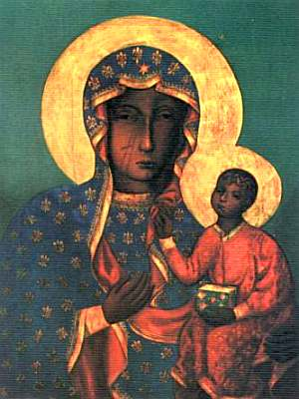
St Mary
The Most Holy Virgin Mary, Queen of Poland (also translated as Our Lady, Queen of Poland or Blessed Virgin Mary, Queen of Poland) is an honorary title for Mary, mother of Jesus, used by Polish Catholics. Christians commonly refer to her as the Virgin Mary, in accordance with the belief that the Holy Spirit impregnated her, thereby conceiving her first-born Jesus miraculously, without sexual relations with her betrothed/husband, until her son Jesus was born. Poland is a predominantly Catholic country. Although there may be somewhat fewer observant Catholics nowadays, most Poles still regularly go to mass, confession and partake in communion. Many also honour the saints.

Slide 10
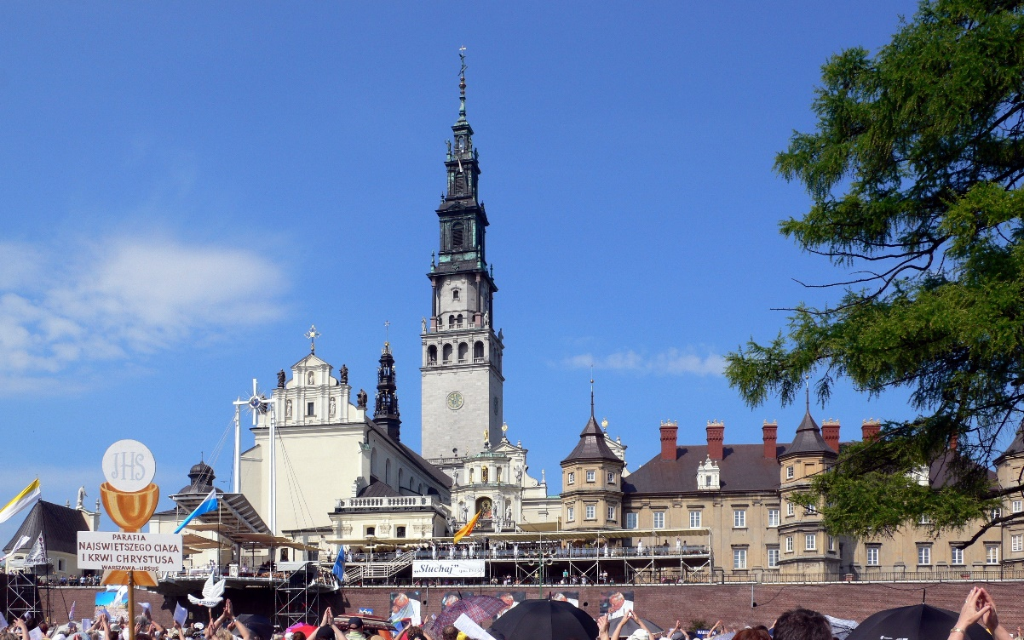
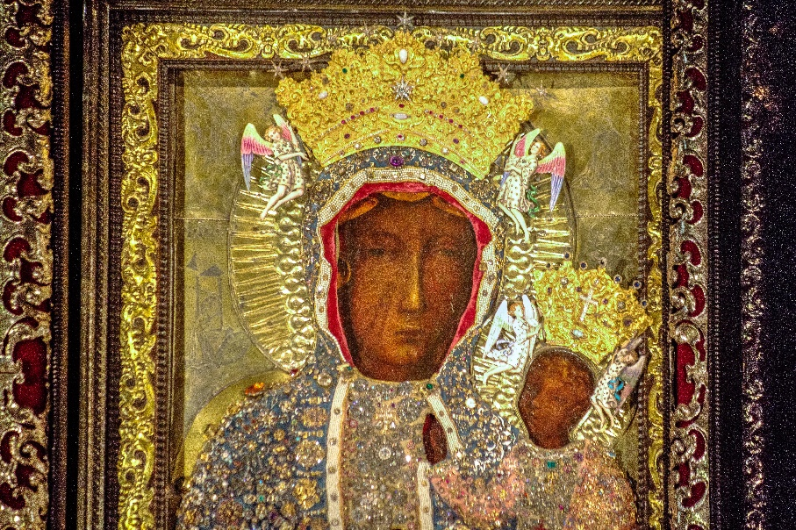
Mary is believed as the Patron and Protector of Poland. The Black Madonna of Poland, is a very famous painting of the Blessed Virgin holding the Child Jesus. Under this title, Mary is the Patron and Protector of Poland. Since the face of Mary is very dark, she is referred to as the Black Madonna. The picture follows the traditional form of an icon. Mary gestures toward Jesus, directing the attention away from her and pointing to Jesus as the source of salvation. The picture is located in Czestochowa- the city in the south of Poland, the place of pilgrimage and top tourist destination. Another place of worship of Mary is Mary’s Basilica in Cracow. After the Wawel Cathedral, St. Mary’s Basilica is the most important church in Cracow.

Slide 11
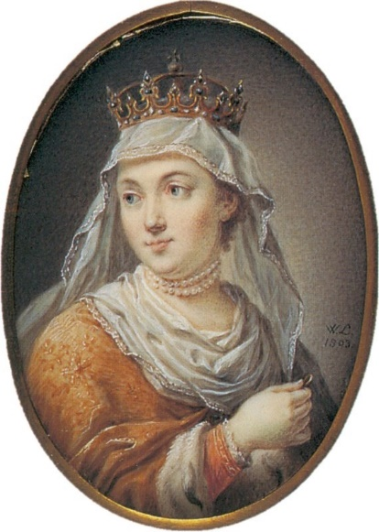
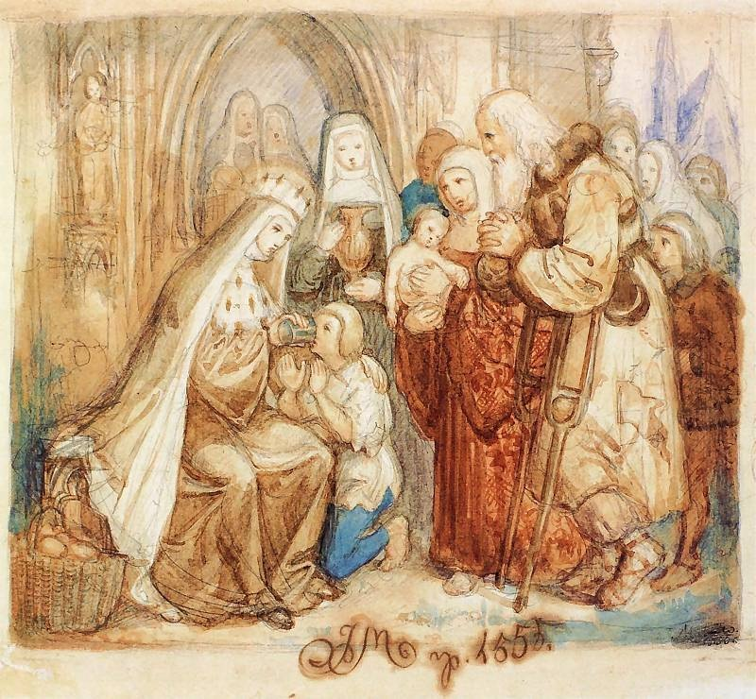
St Jadwiga
Saint Jadwiga was the queen of Poland from 1834. Jadwiga became the queen of Poland at age 11. When she was 12, she married the Lithuanian prince Jagiełło. Her life was very short – she died in childbirth at age 25. Over the years of her reign the girl became famous for her kindness and generosity. Jadwiga knew four languages: Polish, Hungarian, French and Latin. She was educated in music and the fine arts. Jadwiga donated money to the construction of churches, hospitals and dormitories for students. The cult of Jadwiga started in the 15th century, just after her death. People used to worship her, as a sign of gratitude to the saint they brought chains, rings and other jewellery to churches and hung them. Icons with her image were created on the walls. The Catholic Church canonised her in 1997. Saint Jadwiga is known as the patron saint of Poland.

Slide 12
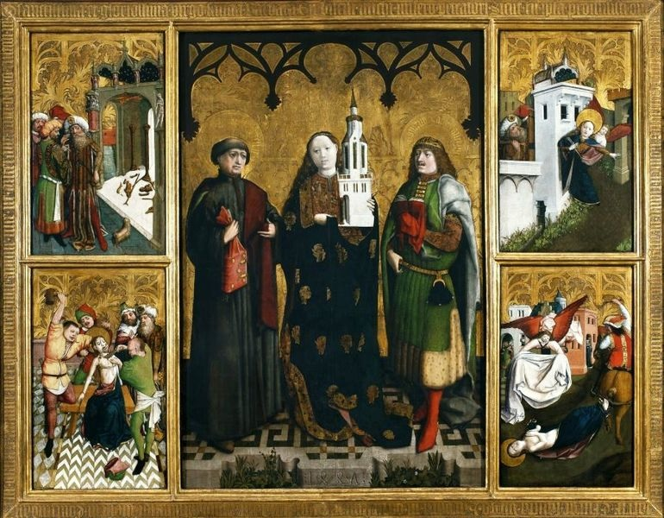
St Barbara
Saint Barbara, known in the Eastern Orthodox Church as the Great Martyr Barbara, was an early Christian Greek saint and martyr. In Poland Saint Barbara is the patron of miners. Her Feast Day is 4th December. On Saint Barbara’s Day, Poles celebrate faithfulness, feminine beauty, and miners. In fact, this holiday is also referred to as Miners’ Day! Miners' band, dressed in traditional uniforms, march through the towns in Silesia in Poland rousing residents from their beds and before attending church for a celebratory mass. According the story, a young woman named Barbara lived in a tower, where her father locked her away.

Slide 13
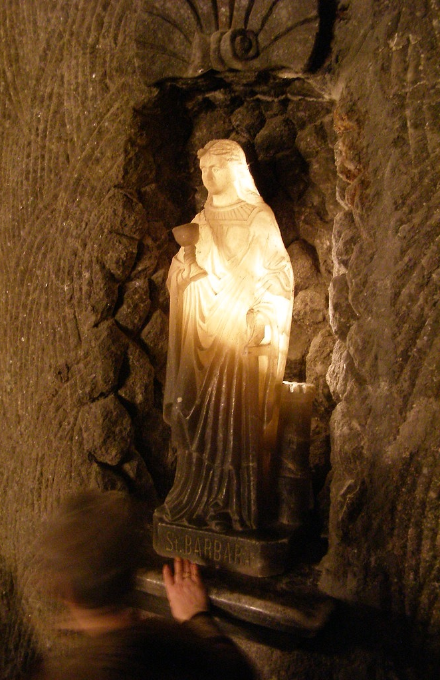
She was interested in Christianity. One day, her father came home and discovered that she had made three windows—representing the Holy Trinity—in the bath he had been building. Barbara admitted to him that she was now a Christian. Her father was angry and beat her before handing her over to authorities, as Christianity was illegal where they lived at the time. Her father wanted to behead her, but he was struck down by lightning. Today, Saint Barbara is portrayed as a prime example of genuine Christian faith and as the patroness of miners.

Slide 14
IN ROMANIA

Slide 15
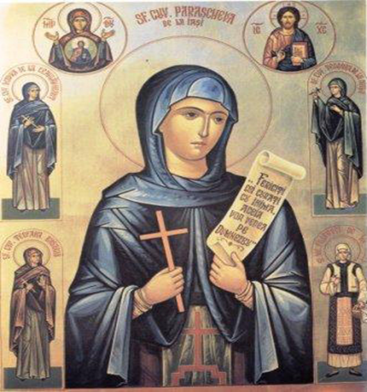
SAINT PARASCHEVA
Saint Parascheva was born in the village Epivat in Eastern Tracia, at the beginning of the XIth century, in a family who believed in God. Then, by the age of 15, she dedicated herself to the monachal life. Currently, she is recognized mostly by the Orthodox Churches from Romania, Greece, Bulgaria, Russia and Serbia. Saint Parascheva’s relics were brought to Iasi in 1641, during the reign of the ruler Vasile Lupu, and they were exposed in the Church of the Three Hierarchs (Trei Ierarhi Church). People also call her Saint Friday.
Saint Parascheva is considered the Protector of Moldavia and Bucovina, being the most popular of all the Saints whose relics are in Romania. Christians believe in the miraculous powers of the relics.

Slide 16
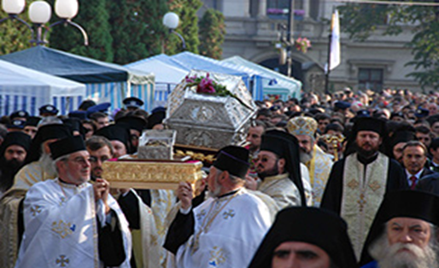
Every year, on the celebration of Pious Saint Parascheva, the shrine with her relics is carried out of the church and they are exposed on the esplanade of the Metropolitan Cathedral. Over a million persons come every year, from our country and from abroad, to worship Saint Parascheva’s Relics.

Slide 17
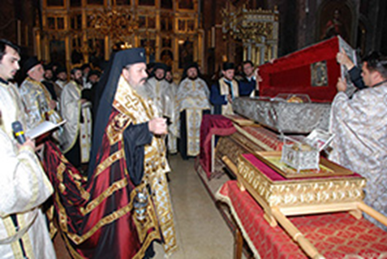
Saint Parascheva’s Dedication Day – 13 October and at the same time, the Feast of the Metropolitan Cathedral in Iasi, has become, these last 15 years, an important Christian manifestation for the region of Moldavia. On this occasion arrive in Iasi, in pilgrimage, about 1 million pilgrims, most of them waiting for hours in a line which covers 2-3 kilometers in order to reach the relics of the Saint
and pray. Generally, on the 12th of October the holly relics are brought out of the church and they are exposed on the esplanade of the Metropolitan Cathedral. Then, on the 13th of October, the feast day, a procession is being organised on the streets nearby. During the last years, besides the relics of Saint Parascheva, there have also been brought here the relics of other important Saints such as: Saint Ioan Gura de Aur, Saint Nectarie of Eghina and those of Saint Andrew. After the procession, the reliquary is exposed again in the courtyard of the Metropolitan Cathedral in order to allow the pilgrims to pray. Also, after the Feast’s religious service, the City Hall of Iasi organizes a lunch for the pilgrims, where they serve traditional meals.

Slide 18
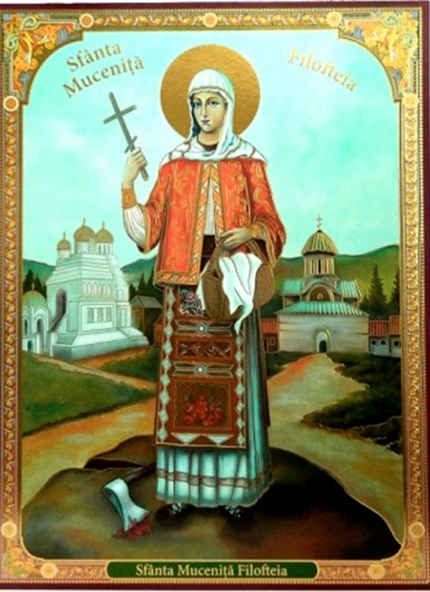
St. Philothea (Philofthea) of Argesh was born in Trnovo, the old capital of Bulgaria, around 1206. Her father was a farmer. Her mother died when Philothea was still a child, and her father remarried. The child was often punished by her stepmother, who accused her of being disobedient, and of giving their possessions away to the poor. Her father chastised her for this, but Philothea continued to attend church and do good to others, just as her mother had taught her. As she grew older, she was adorned with the virtues of prayer, virginity, and almsgiving. St. Philothea would bring food to her father, who was out working in the fields. However, not all of the food would reach him because she would give some of it to the poor children begging in the street. When he complained to his wife that she did not prepare enough food for him, she replied, “I send you plenty of food. Ask your daughter what she does with it.” Becoming angry with
Philothea, her father decided to spy on her to see what happened to the food. From a place of hiding, he saw her giving food to the poor children who came to her. In a violent rage, he took the axe from his belt and threw it at the twelve-year-old girl, hitting her in the leg. The wound was mortal, and she soon gave her pure soul into God’s hands. Her father was filled with fear and remorse, and tried to lift his daughter’s body from the ground, but it became as heavy as a rock. He then ran to the Archbishop of Trnovo to confess his sin and explain what had happened. The Archbishop and his priests went with candles and incense to take up the martyr’s body and bring it to the cathedral, but they were also unable to lift it.

Slide 19
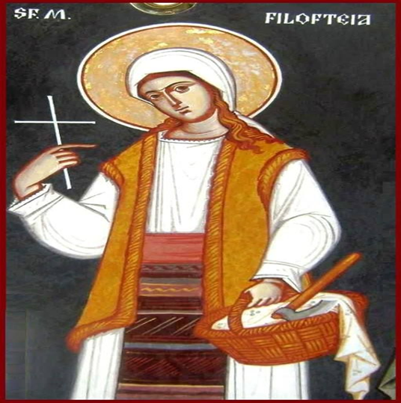
The Archbishop realized that St. Philothea did not wish to remain in her native land, so he began to name various monasteries, churches, and cathedrals to see where she wished to go. Not until he named the Monastery of Curtea de Argesh in Romania were they able to lift her holy relics and place them in a coffin. The Archbishop wrote to the Romanian Voievode Radu Negru, asking him to accept the saint’s relics. The Archbishop and his clergy carried the holy relics in procession as far as the Danube, where they were met by Romanian clergy, monastics, and the faithful. Her relics were then carried to the Curtea de Argesh Monastery and she is ommemorated on the 7th of December. Many people have been healed at the tomb of St. Philothea located in a small chapel in the belltower behind the monastery church. Those who entreat her intercession receive help from her. Each year on December 7 there is a festal pilgrimage to the Monastery, and people come from all over Romania. The relics of St. Philothea are carried around the courtyard in procession, and there are prayers for the sick.

Slide 20
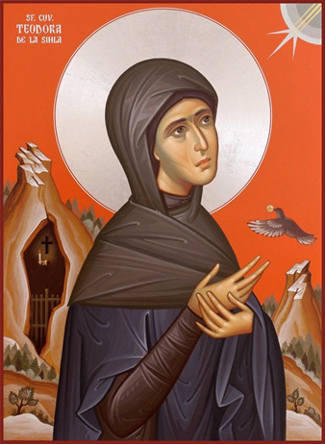
St. Theodora of Sihla (born c. 1650, Vânători-Neamț, Neamț) is a Romanian Christian Orthodox saint, commemorated on August 7. Born during the reign of Vasile Lupu, the daughter of the chief armourer of Neamț Citadel, the boyar Ștefan Joldea. In her youth, she was married off against her will. Being childless, both she and her husband decide to embrace monasticism, he withdrawing to Poiana Mărului monastery under the name Elfterie, and she to Vărzărești. Foreign invasions prompt her to retreat into the Buzău Mountains (she is said to have also passed through the woodland hermitage Fundătura), where she lives for nearly a decade (her name is mentioned in an inscription on the altar stone of the woodland hermitage at New Agaton). From here she goes firstly to Neamț monastery, where she is guided towards Sihăstria hermitage, in the Neamț mountain. With the guidance of Sihăstria's abbot, and with the blessing of the hermitage's egumen, she ascended the mountains to become an anchorite in the Sihla wilderness. The word "sihlă" means thick forest of young trees.

Slide 21
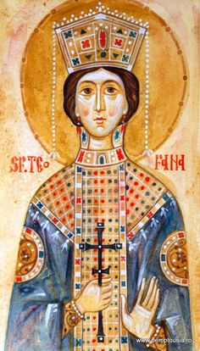
Theodora initially lived in a cottage in a rocky part of Sihla, left to her by an elderly monk. Oral tradition recounts that nuns fleeing from foreign invasions came across the saint's cottage, who relinquished it to move into a cave, even more remote than her initial abode. She spent the rest of her life here. After her death, the body of the St. Theodora remained in the cave in which she had spent the greater part of her hermitage. The knowledge of her life and death is said to have reached her husband, who left Poiana Mărului and came to spend the last decade of his life at Sihăstria, close to his wife's resting place. Around 1725, Sihla monastery was founded in her memory. She remained buried there until circa 1828-1834 when, during the Russian occupation of the Romanian Principalities, she was translated to Lavra Pecerska in Kiev. The Romanian writer Calistrat Hogaș wrote about her in his book "Pe drumuri de munte"("On mountain paths"): ,,Beautiful St. Teodora, the anchorite legend of these places, appeared in my imagination as a second Mary of Egypt, her life haunted by the same misfortunes. St. Teodora had also cast off, perhaps, the intoxicating pleasures of the world, contenting herself, at last, with the damp crevice of a rock, instead of the gilded palaces where luxury and indulgence reigned...” The Synod of the Romanian Orthodox Church proclaimed the canonization of St. Theodora of Sihla on June 20, 1992, establishing her commemoration on August 7.

Slide 22
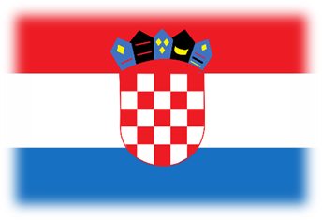
IN CROATIA

Slide 23
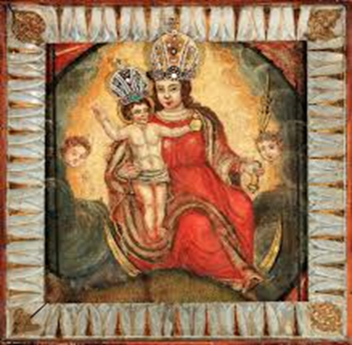
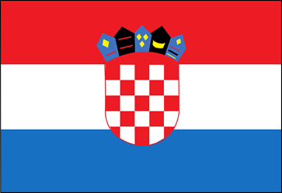
In Croatia, every town / village has its patron saint (religious) whom the citizens respect. Our Lady of the Stone Gate, patroness of Zagreb (capital), whose feast is celebrated on May 31.
The Stone Gate is best known as a votive chapel with the image of the Mother of God of the Stone Gate. Namely, in the great fire that broke out on May 31, 1731, the image of the Mother of God, which had previously stood above the city gates, was found intact and undamaged in the midst of fire and ashes, and only the frame burned. In the same year, the painting was placed in a baroque altar in the recess of the Stone Gate passage.

Slide 24
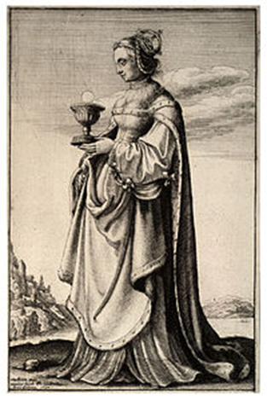
Saint Barbara , (grč. Αγία Βαρβάρα) a Christian saint, virgin and martyr, protector of miners and good deaths, one of the Fourteen Holy Helpers in distress. According to legend, she was the daughter of Dioscorus, a wealthy purple merchant and nobleman in the city of Nicomedia in Asia Minor. She captured attention with her beauty, intelligence and simplicity. Her father wanted to marry her to a rich suitor. As she was beautiful, he kept her as a jewel and before he went on a long journey, he locked her in a tower with two windows. When he returned, he found a third window broken on the tower, and on the threshold he hated the sign of the cross. Barbara bravely confessed to him that she had done both: three windows, to remind her of the mystery of the Most Holy Trinity, and the cross, to remind her of redemption. She secretly converted to Christianity, under the influence of Deacon Valentine. The father, who was a hard pagan, was furious with anger, when she wanted to convert him to Christianity, he wanted to kill her. She miraculously managed to escape to the mountains and hide in them, until she was betrayed by a shepherd. She was imprisoned and tortured, but her wounds miraculously healed each time. She was sentenced to death. By court order, her father personally beheaded her. Shortly afterwards, he was struck by lightning and died. Together with Barbara, the martyrdom was endured by St. Julian of Nicomedia. The undecomposed foot of St. Barbara is kept in the parish church in Vodnjan.

Slide 25
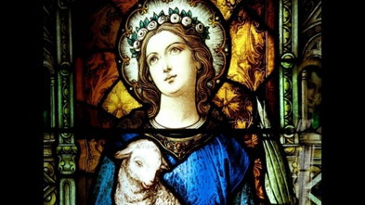
Saint Agneza , protector of all engaged couples. she wanted to live a clean and chaste life. One day another suitor appeared, this time the son of an influential Roman prefect. A proud young man, he was sure that Agnes would marry him, especially because of his high status. She turned him down twice. This angered his father who quickly informed the local authorities that Agnes was a Christian. Initially hindered by Roman law (which did not allow the execution of virgins) all attempts to harm its purity failed. A new verdict was handed down and officials sentenced her to a cruel death. The city was shocked by the news of the execution of such a precious little lamb and it is believed that her death contributed to the end of Christian persecution.

Slide 26
The presentation is the effect of international cooperation of students from
Spain, Poland, Romania and Croatia.
Thank you for your attention!

