Slide 1
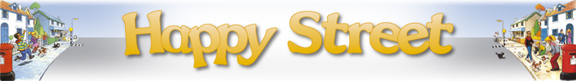
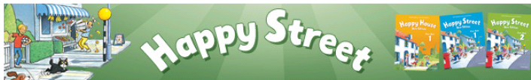

JAK SE UČIT ANGLICKÝ JAZYK
-pokyny k práci
Tanja Koči Valdgoni

Slide 2
Kako učiti
Redovito – svaki put poslije sata
  Ponoviti što smo radili
    Naučiti čitati(uz cd – slušati i ponoviti, zatim pročitati pa poslušati),
    prevesti,
    naučiti pjevati
  Napraviti slikovne kartice-nove riječi
  Prepisivati.......running dictation
  Redovito raditi domaće zadaće iz radne bilježnice (svaki put imaju!)
Bilo bi dobro još jednom kraće ponoviti i dan prije sata

Slide 3
OCJENJIVANJE
KRATKE PROVJERE – poslije svake obrađene cjeline (unit)
2.razred –prepisuju riječi
3.razred – dopunjavaju
TESTOVI
Nakon 2 ili 3 obrađene cjeline
Slušanje, pisanje

Slide 4
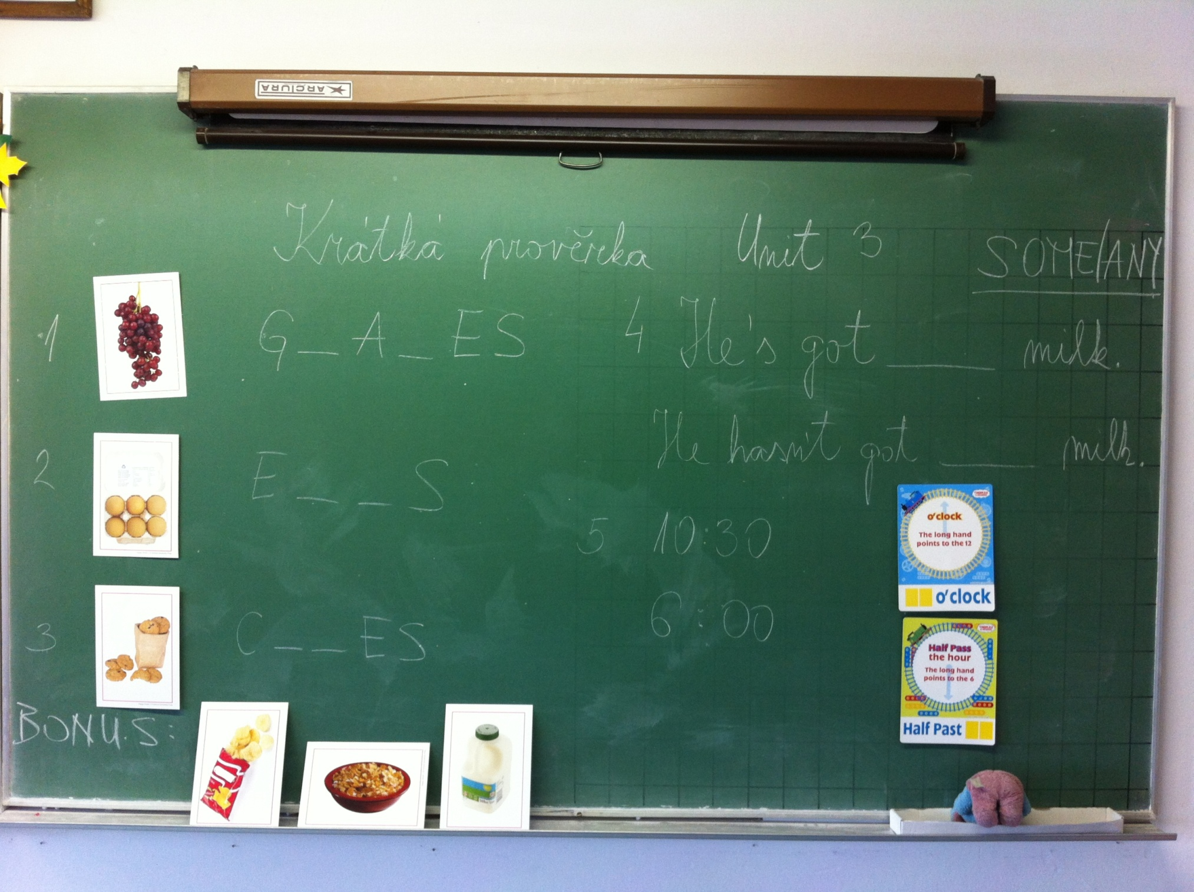

Slide 5
MultiROM u radnoj bilježnici
sadrži
igre kojima vaše dijete ponavlja gradivo,
animirane zadatke za utvrđivanje čitanja i pisanja,
pjesmice iz udžbenika u karaoke obliku,
animirane priče iz udžbenika.
Može se koristiti kao
audio CD
ili na računalu
idealan je način za zajednički rad roditelja i djeteta kod kuće.

Slide 6
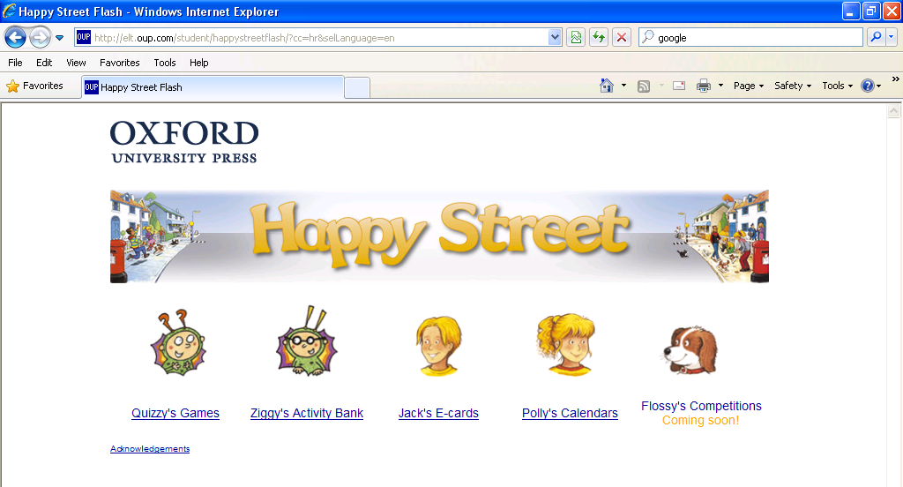
Happy Street web stranica za vaše dijete www.oup.com/elt/happystreet
koristan je alat koji vam pruža niz dodatnih aktivnosti za zajedničko ili samostalno zabavno učenje kod kuće.
Vaše dijete može
ponavljati naučene riječi i izraze kroz igre,
utvrđivati čitanje i pisanje kroz animirane zadatke,
izraditi i slati e-čestitke i kalendare.

Slide 7
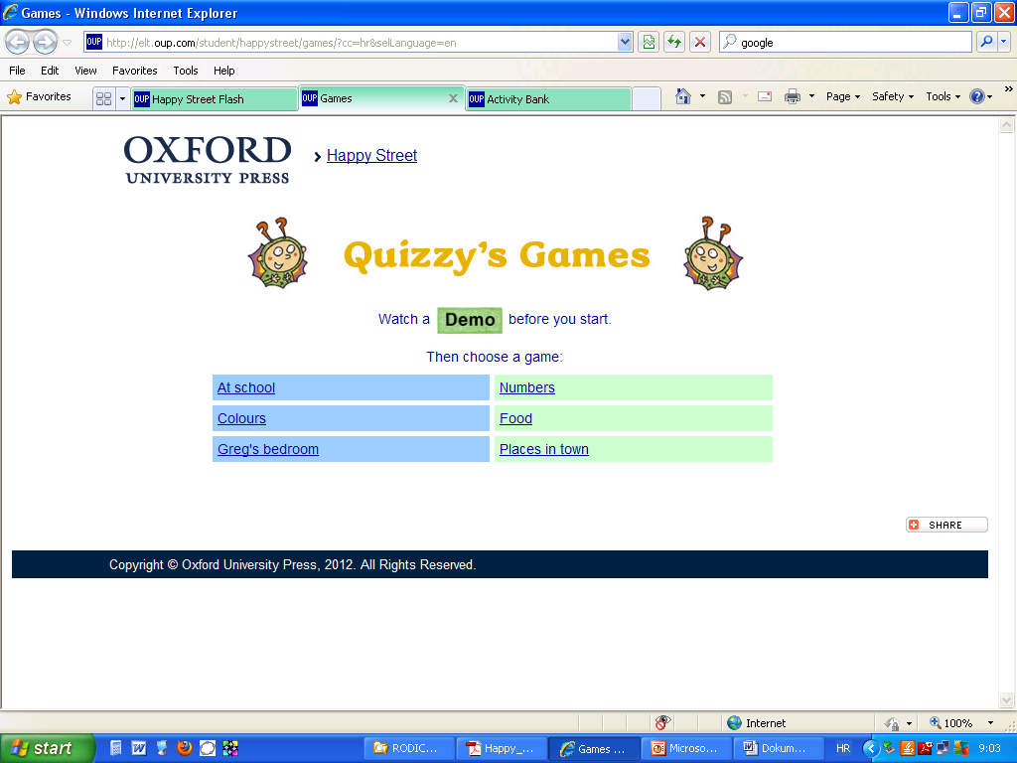

Slide 8
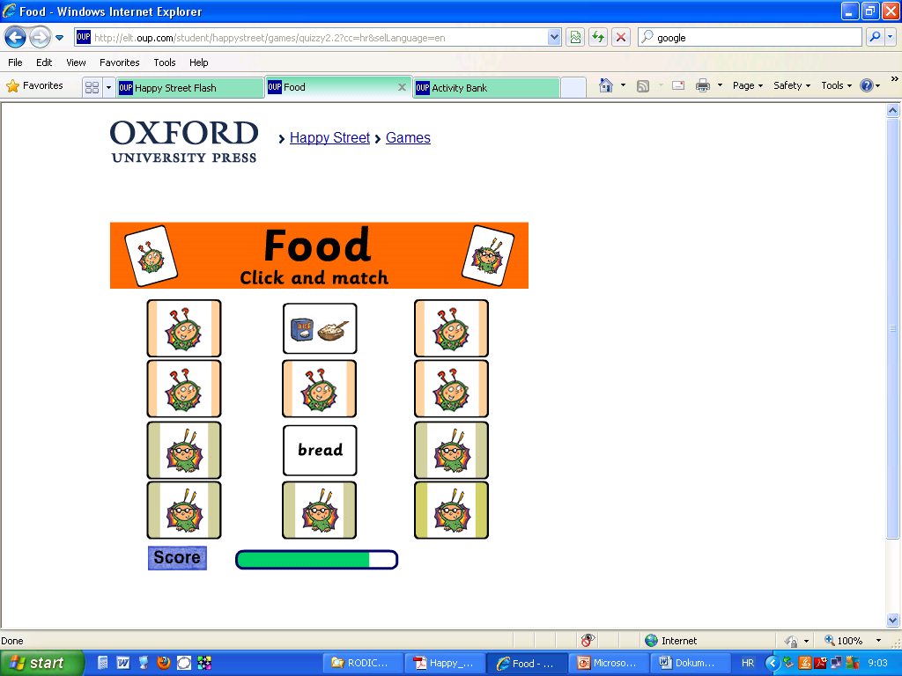

Slide 9
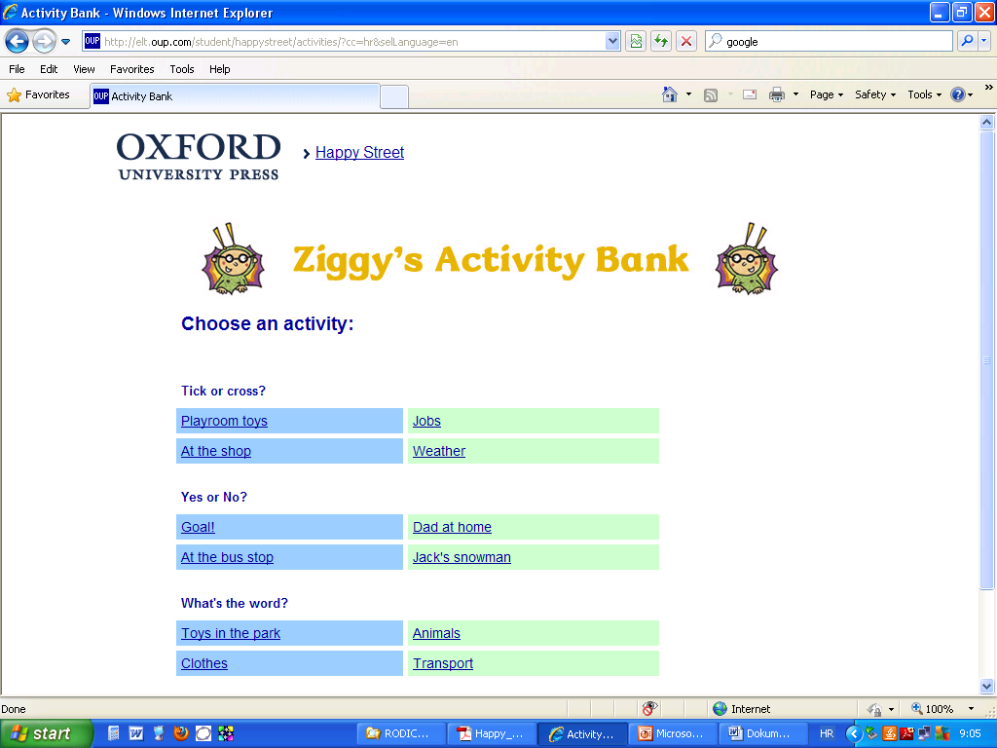

Slide 10
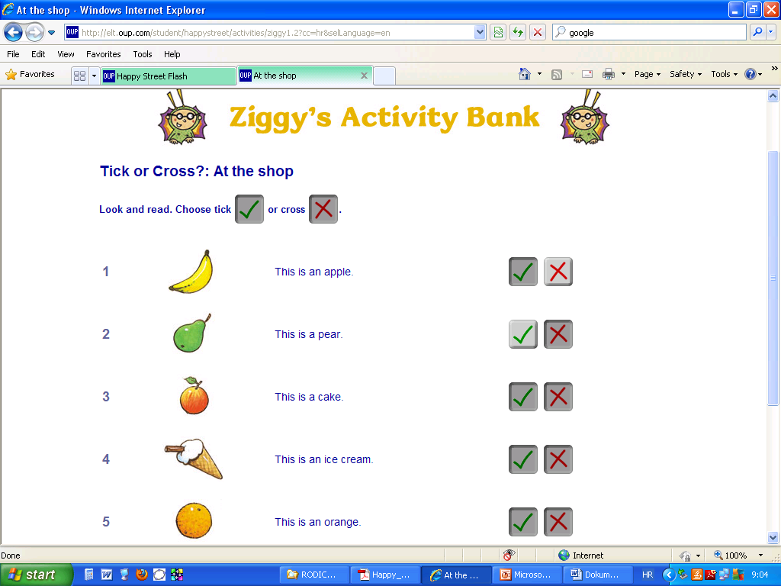

Slide 11
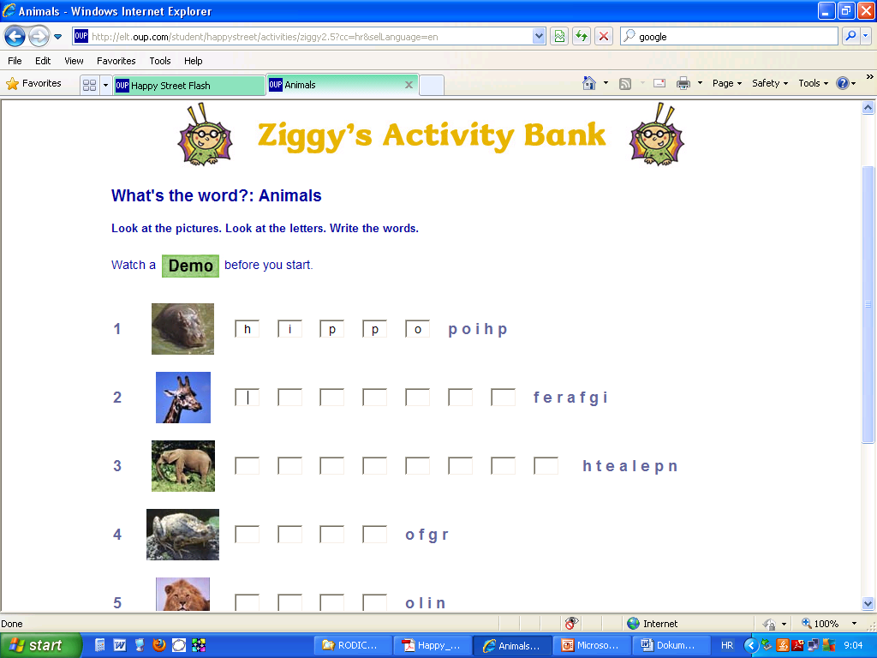

Slide 12
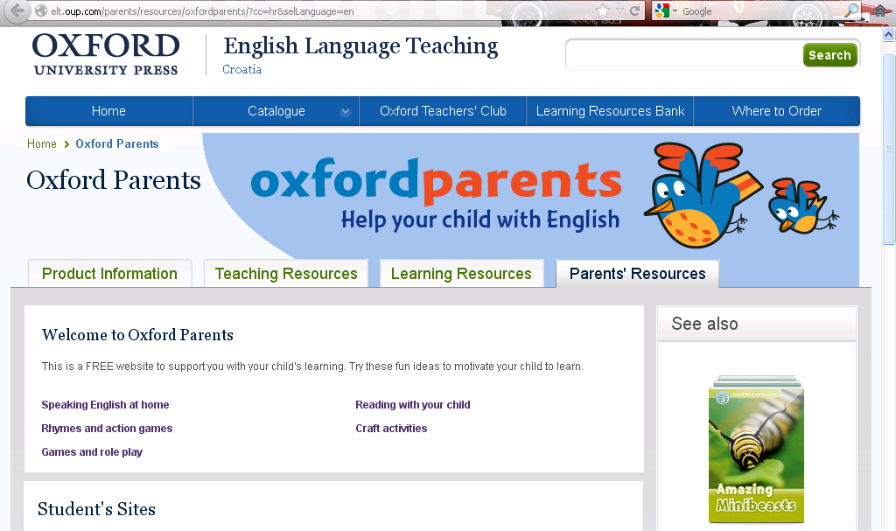
Oxford Parents web stranica za roditelje www.oup.com/elt/oxfordparents
nova je web stranica na kojoj možete pročitati kako pomoći vašem djetetu u svladavanju engleskog jezika. Sve aktivnosti koje možete isprobati sa vašom djecom kod kuće prikazane su i kroz video isječke koji objašnjavaju kako ih odraditi. Za sada je stranica na engleskom jeziku, no uskoro će biti prevedena i na hrvatski.

Slide 13
IGRE SA SLIČICAMA
Pairs PAROVI – slika-slika, ili slika-riječ (2. pol)
Order the words POREDAJ SLIKE/RIJEČI
  Igra se u paru, jedna osoba izmiješa svoje kartice pa pročita riječi/slike redom, a druga osoba ih treba točno tako poredati
Group the words RAZVRSTAVANJE RIJEČI/SLIKA U GRUPE
npr. snow, Monday, zebra, crocodile, rain, Tuesday, monkey
Animals: zebra, crocodile, monkey
Weather: snow, rain
Days: Monday, Tuesday
Odd one out IZBACI ULJEZA
  Teži zadaci npr. Parni i neparni brojevi, riječi koje počinju određenim slovom
Draw monsters CRTANJE ČUDOVIŠTA (dijelovi tijela, opis osobe)
My monster has a big head and long hair. He has three green eyes and a small blue nose. He has a very big mouth with two teeth. He has a small pink body. He has six green arms and one red leg.
Kim's game
10 sek gledaju sličice, zatvore oči, sakrijete jednu, trebaju pogoditi koja je sakrivena
Notes:
Pairs – PAROVI – slika-slika, ili slika-riječ (2. pol)
Use cards with two of every picture or with words and matching pictures.
Play until the cards have all gone. The winner is the one with the most cards at the end. You can print these pictures (PDF, 3MB).
Order the words
Have a set of picture cards each. Shuffle your cards and read them out in order. The other person listens and puts their cards in the same order. Then compare your cards to see if they match.
Group the words
Make word cards with lots of different words that your child knows in English. The words must be from a few different vocabulary sets. Tell your child to put the words into two or three groups. They can group them in any way they like. Ask your child to list the things in each group and explain what this group is called – they may need to use their own language to explain. For example:
snow, Monday, zebra, crocodile, rain, Tuesday, monkey
Animals: zebra, crocodile, monkey
Weather: snow, rain
Days: Monday, Tuesday
Odd one out
Say four words where three are part of the group but one is not, e.g. dog, cat, table, rabbit. Ask your child to say which word is the odd one out (table). Make the odd one out more difficult, e.g. four-legged animals and a two-legged animal; odd numbers and an even number; words that start with 'b' and a word that starts with 'c'.
Draw monsters
Take it in turns to describe a monster. Both of you draw the monster in secret. When you have finished, compare pictures. For example:
My monster has a big head and long hair. He has three green eyes and a small blue nose. He has a very big mouth with two teeth. He has a small pink body. He has six green arms and one red leg.
Kim's game
Use toy animals. Put eight or more (more is harder) different animals on a tray and check your child knows the words. Let your child look for 10 seconds then tell them to close their eyes. Take away one animal. Tell your child to look and say which animal has gone. You can use other vocabulary groups from your child's course book, e.g. food, clothes, toys.

Slide 14
IGRE ZA DJECU KOJA NE VOLE DUGO SJEDITI
Run! TRČI!
Sličice rasporedite po sobi, vrtu tako da budu vidljive.
Dijete, ili bolje djeca, trče do sličice riječi koju vi kažete.
Running dictation
Write a sentence on some paper and put it in a different room. You can choose one from your child's course book. Your child should go to the other room, read the sentence, come back to you, and remember the sentence to write it out.
They can go back to the sentence as many times as they like, but they must try not to make mistakes and must be as quick as they can. Time them, then give them another sentence to write – but quicker! You can write more than one sentence if your child finds this easy. You can have a time limit or limit how many times they can read your sentence.

Slide 15
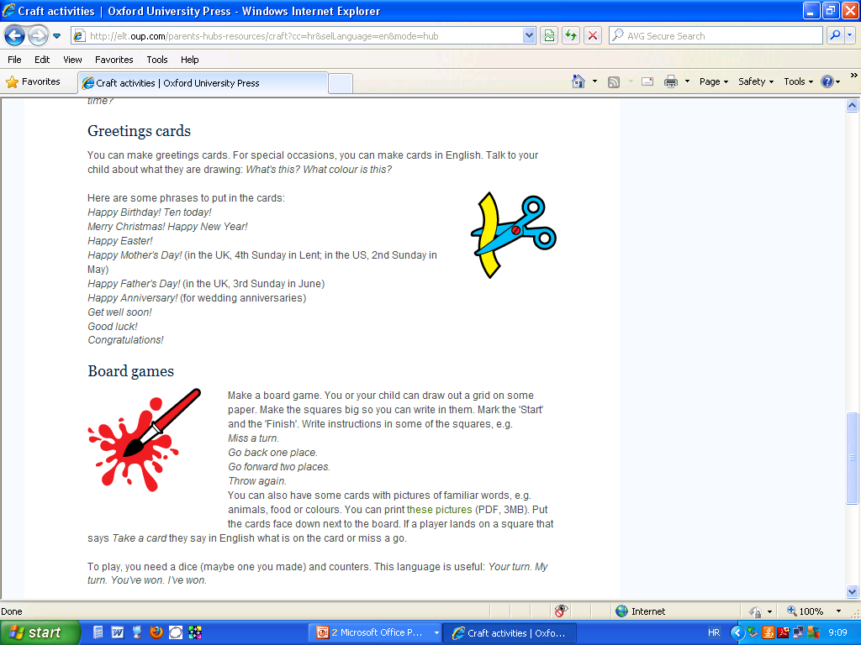

Slide 16
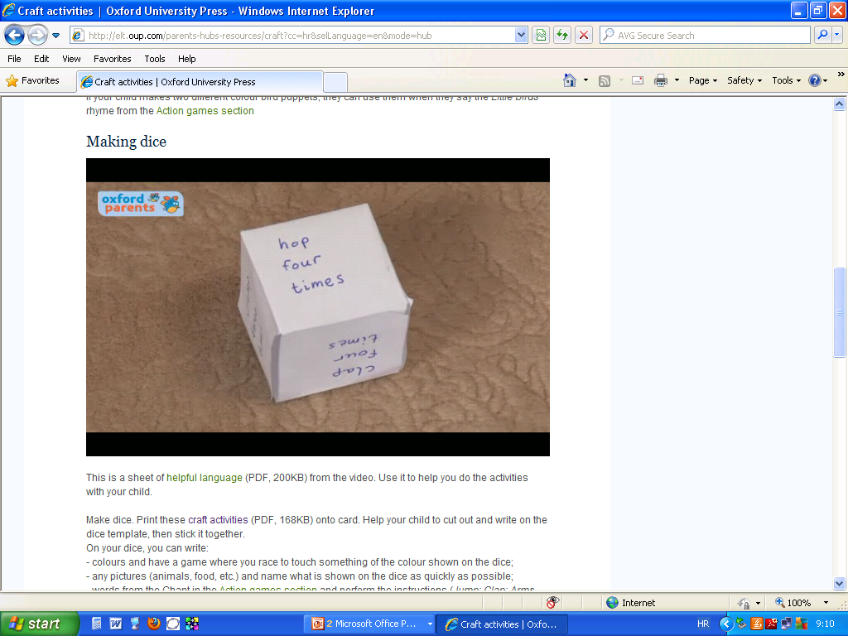

Slide 17
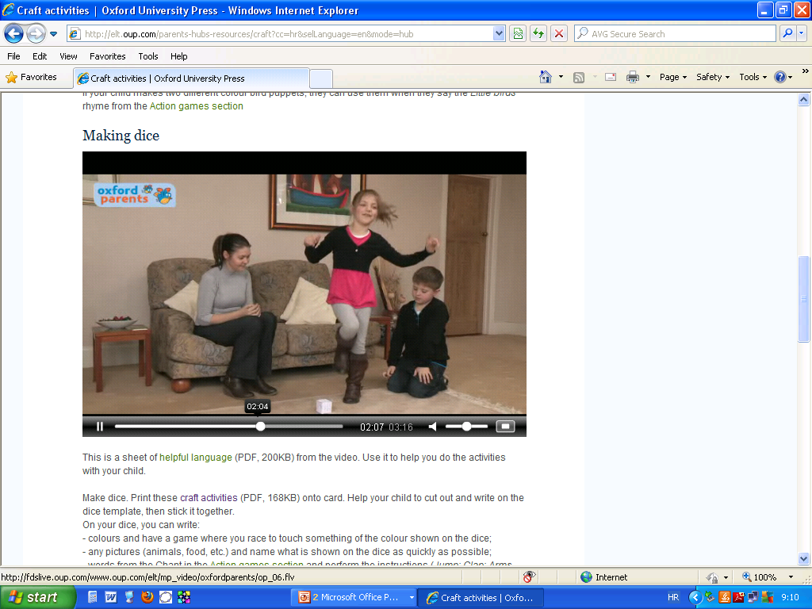

Slide 18
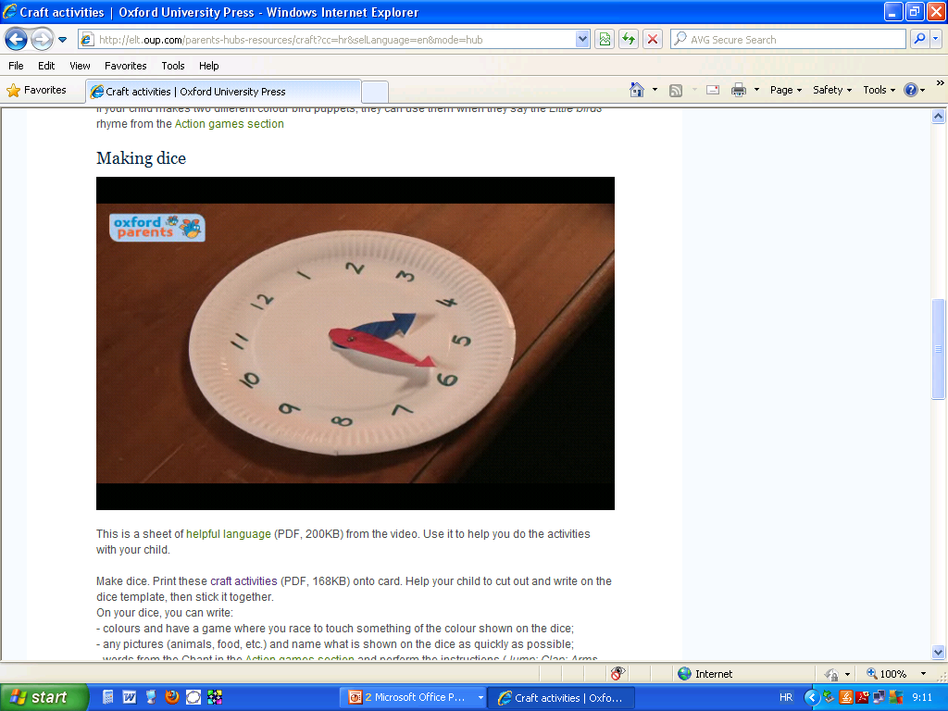

Slide 19
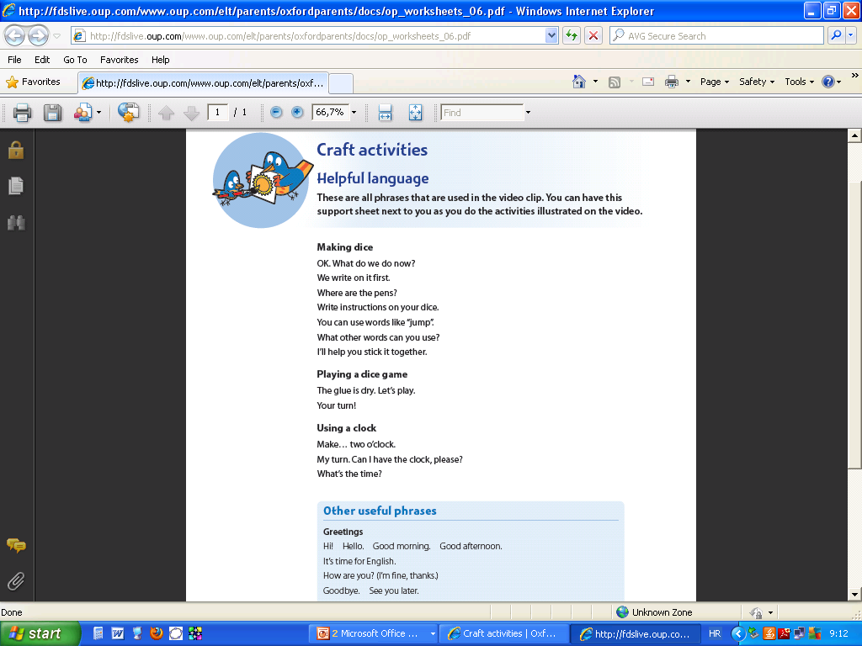

Slide 20
BRITISH COUNCIL
Learnenglish
http://learnenglishkids.britishcouncil.org/en/
http://learnenglishteens.britishcouncil.org/
http://www.ego4u.com/

Slide 21
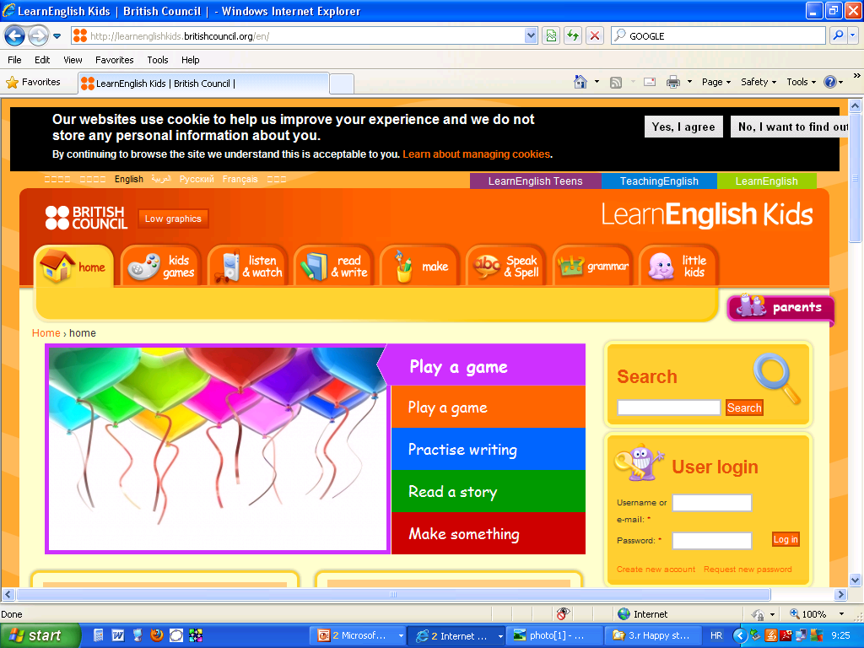

Slide 22
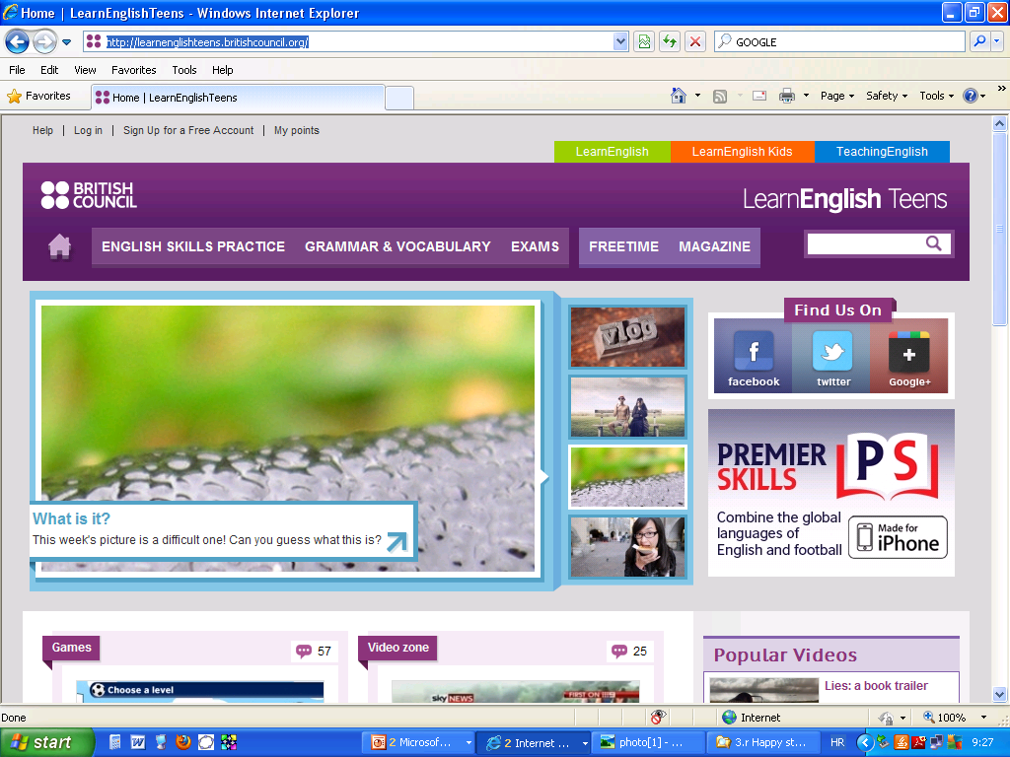

Slide 23
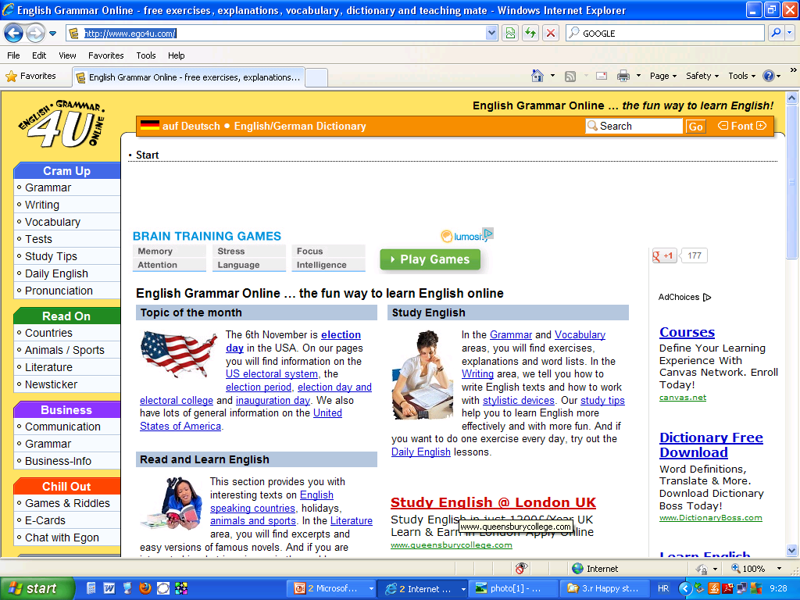

Slide 24
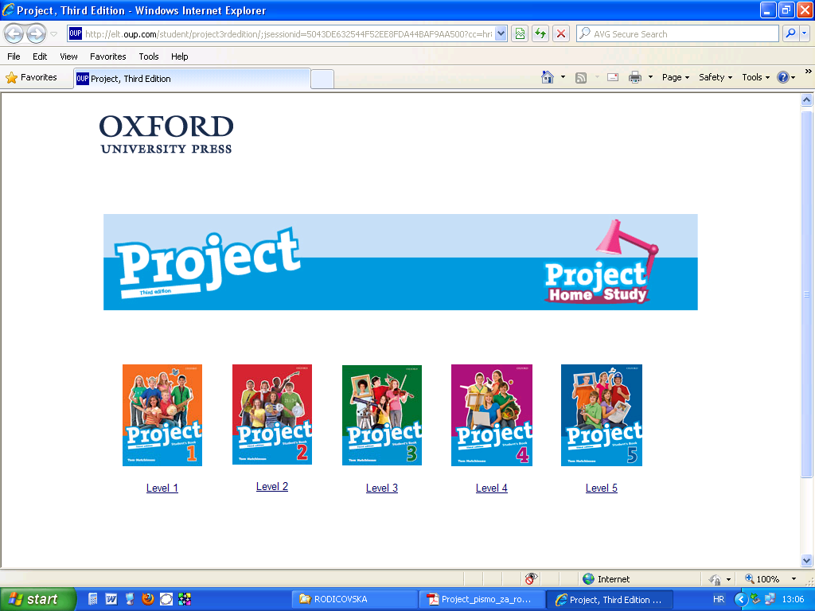

Slide 25


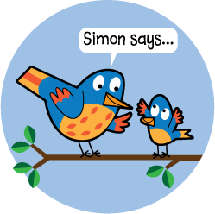

Děkuji za pozornost

