Slide 1
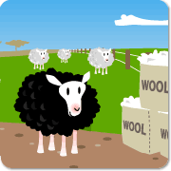
BA-BA-BLACK SHEEP
UNIT 4, LESSON 3

Slide 2
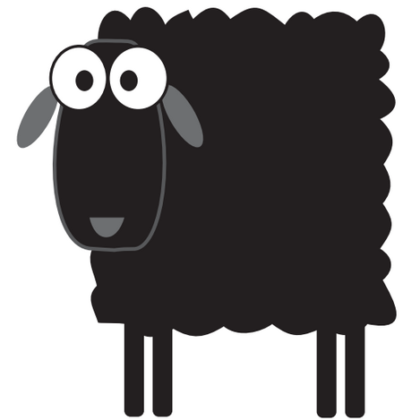
WHAT COLOUR IS THE SHEEP?
IT’S BLACK.

Slide 3
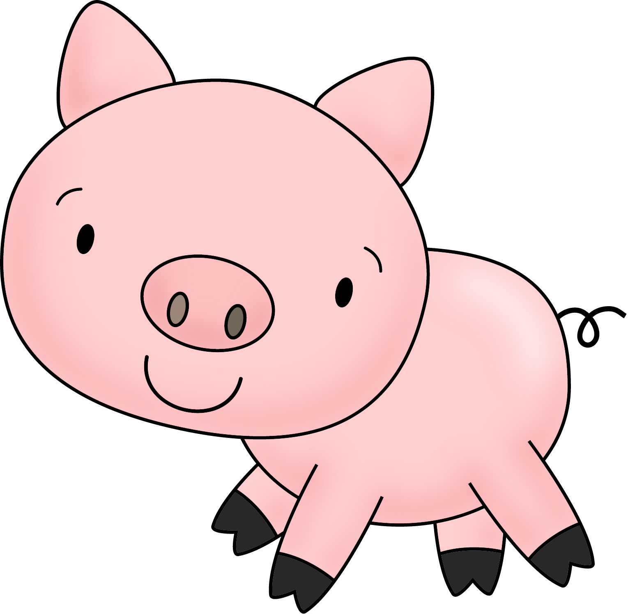
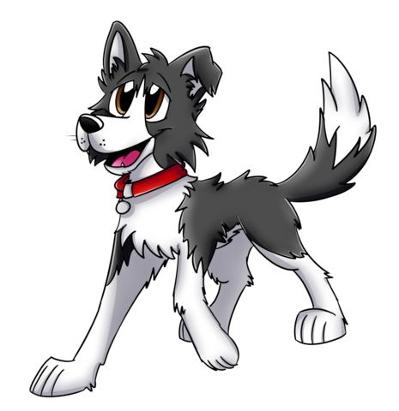
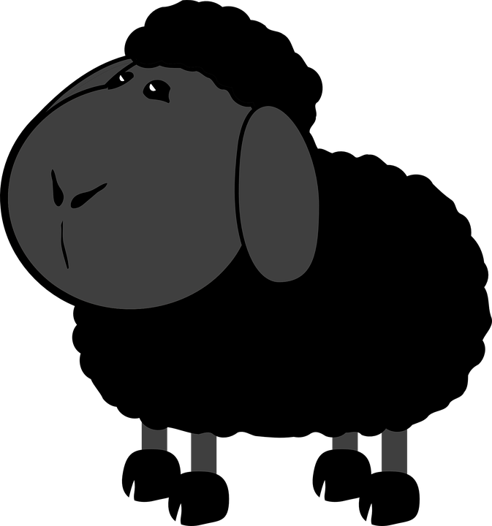
A MASTER
A DAME
CC BY-NC

Slide 5
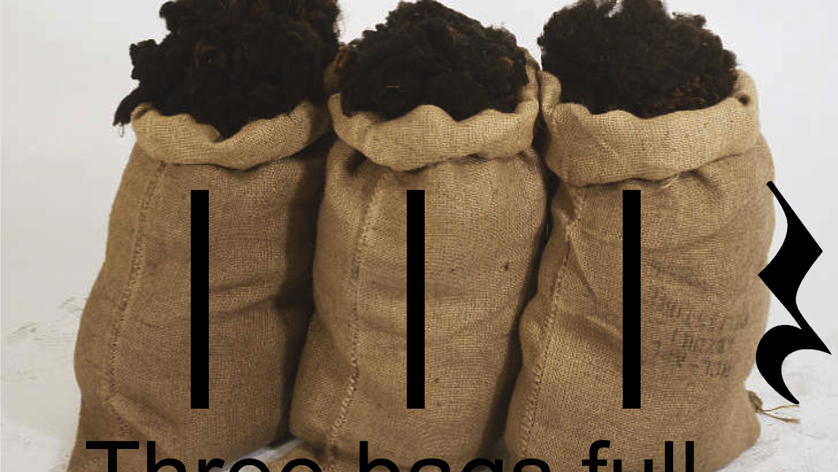
WOOL

Slide 6
A LITTLE BOY

Slide 7
MASTER 1
DAME
LITTLE BOY
3
2

Slide 8
DRAW AND COPY IN YOUR NOTEBOOK. (NACRTAJ I PREPIŠI U PISANKU.)
A MASTER A DAME A BLACK A LITTLE WOOL
SHEEP BOY
Ta fotografija korisnika Nepoznat autor: licenca CC BY-NC-ND

Slide 9
OPEN YOUR BOOK. PAGE 53.
5 LISTEN AND SING

