Slide 1
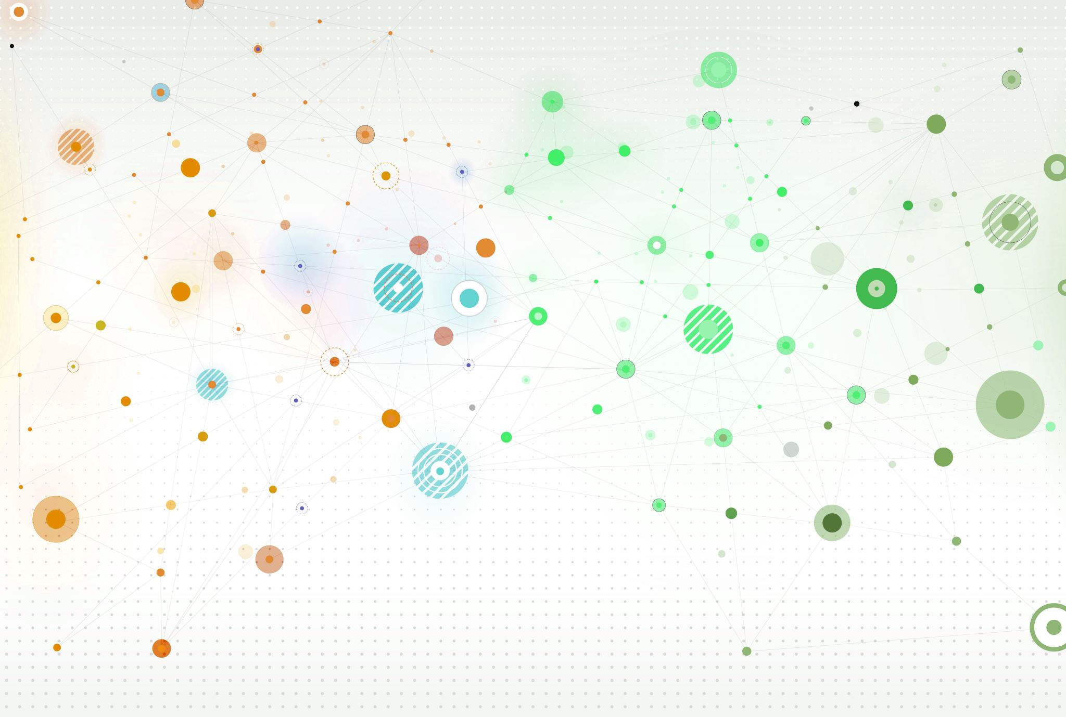
WHAT COLOUR IS IT?
UNIT 4, lesson 2

Slide 2
1 OPEN YOUR PUPIL’S BOOKS. 49
2 LISTEN AND SAY.
3 TRACE.

Slide 3
I
Ta fotografija korisnika Nepoznat autor: licenca CC BY-SA
I LIKE RED.
I LIKE GREEN.

Slide 4
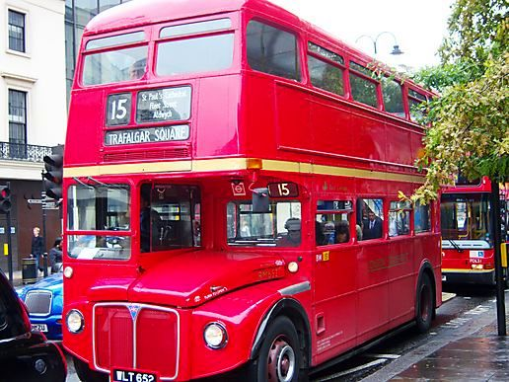
A BUS
WHAT COLOUR IS IT?
Ta fotografija korisnika Nepoznat autor: licenca CC BY-NC-ND
IT’S RED.

Slide 5
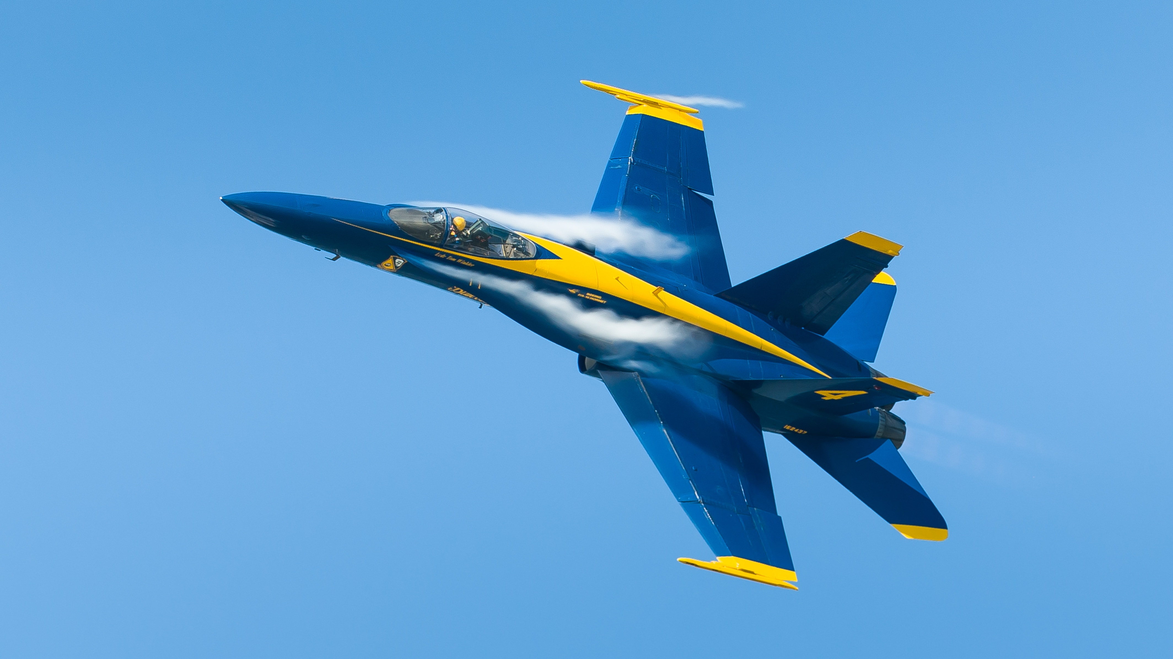
A PLANE
WHAT COLOUR IS IT?
IT’S BLUE..

Slide 6
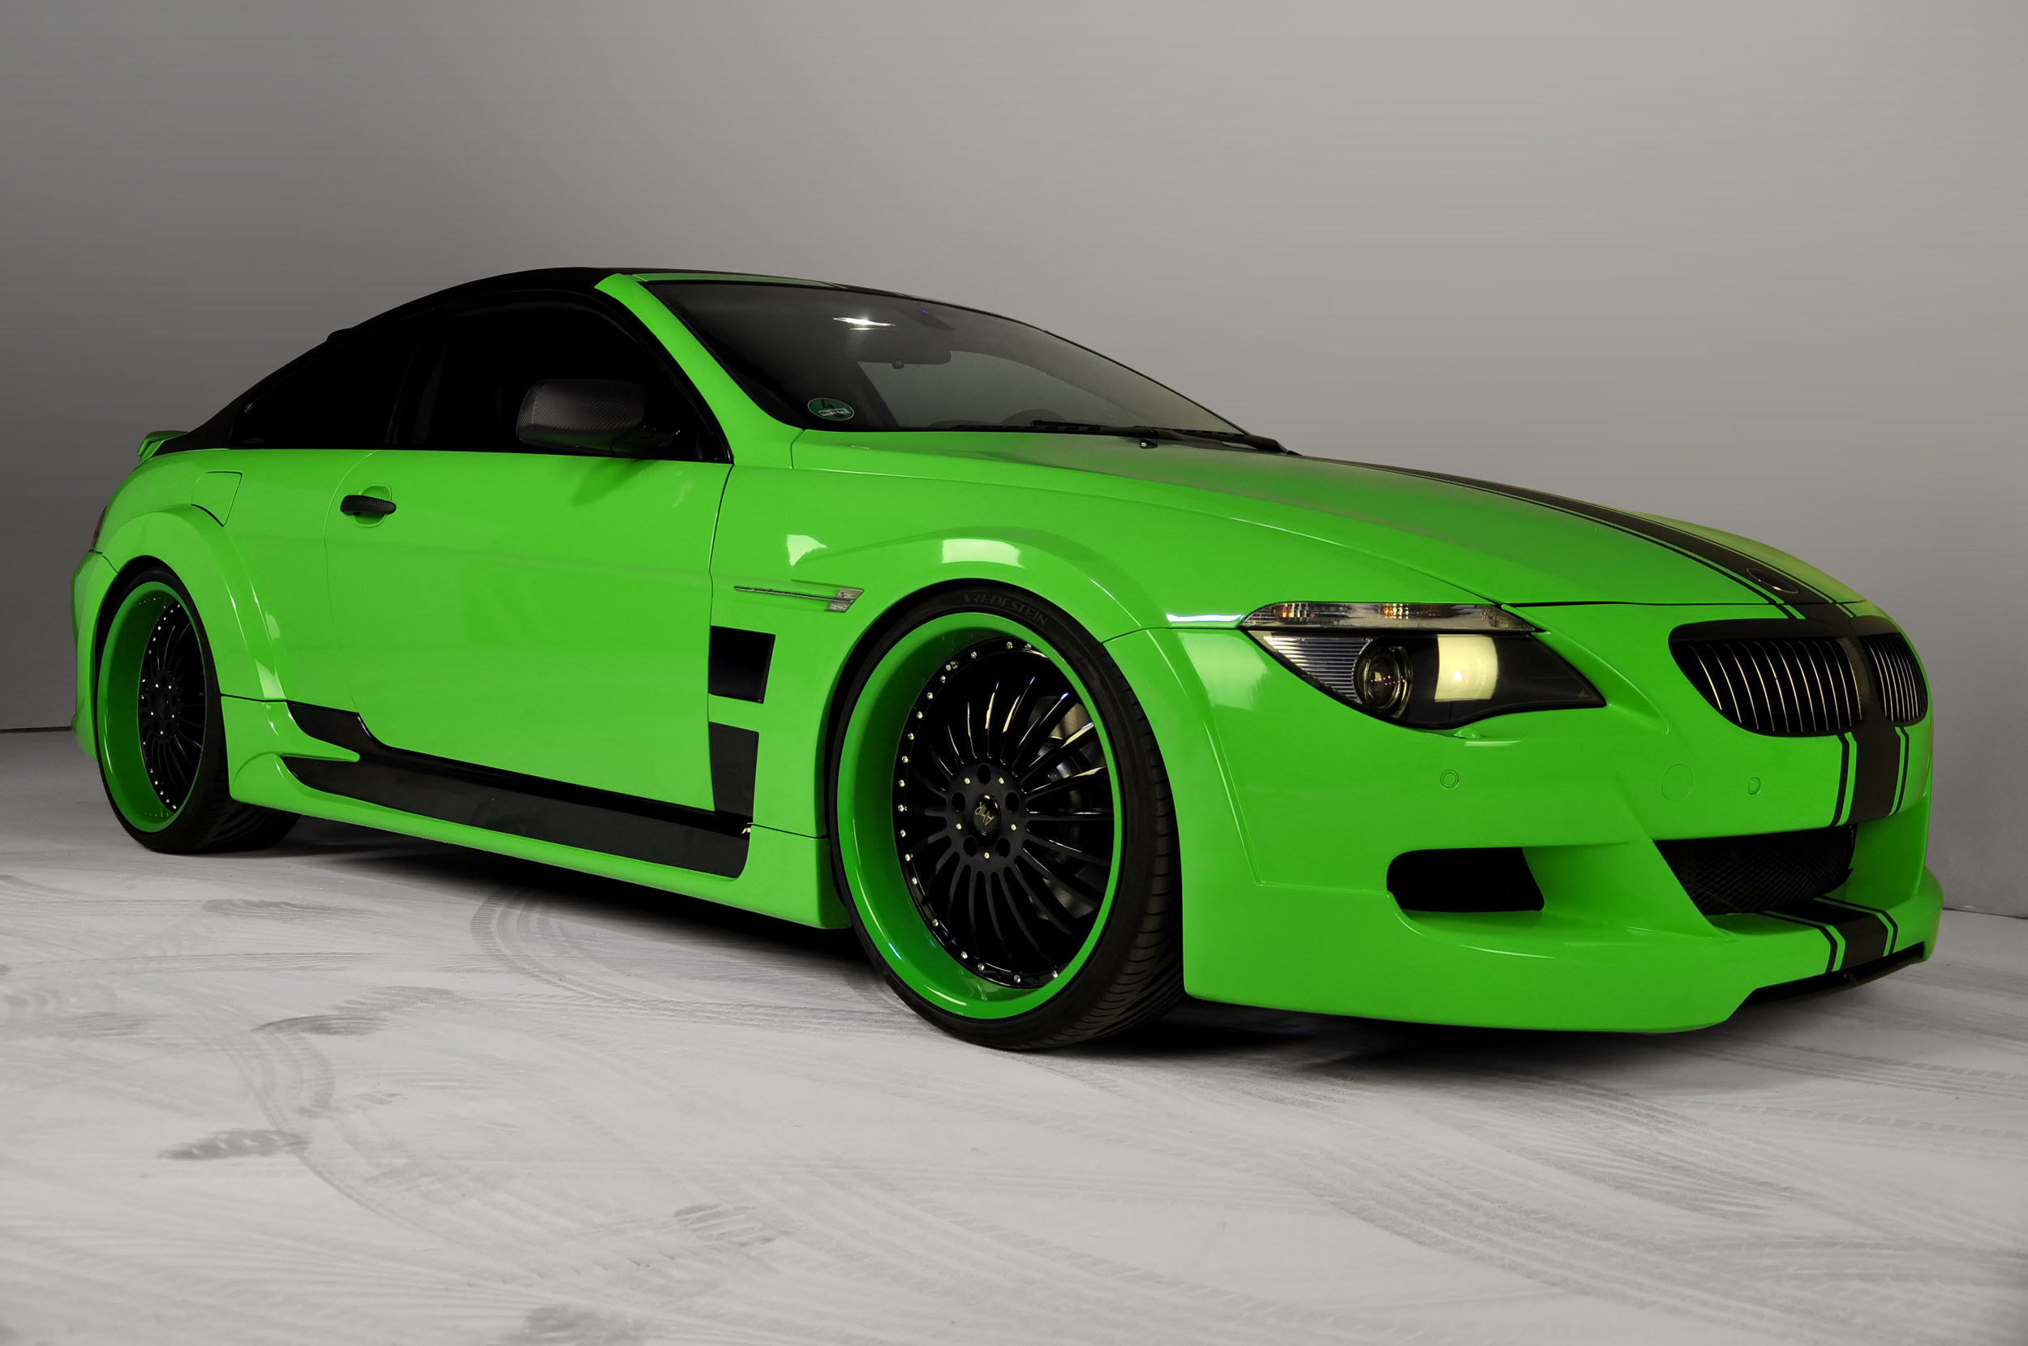
A CAR
WHAT COLOUR IS IT?
IT’S GREEN..
Ta fotografija korisnika Nepoznat autor: licenca CC BY

Slide 7
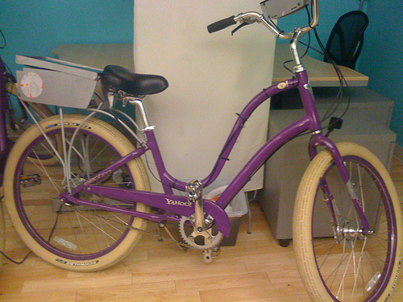
A BIKE
WHAT COLOUR IS IT?
IT’S PURPLE..
Ta fotografija korisnika Nepoznat autor: licenca CC BY-SA-NC

Slide 8
1 OPEN YOUR PUPIL’S BOOKS. 50
LISTEN, LOOK AND SAY.
https://www.e-sfera.hr/dodatni-digitalni-sadrzaji/453d7f46-7c93-470b-9ce2-09cc89ce9c38/

Slide 9
3 LISTEN TO THE TEACHER AND CIRCLE. 51
4 LOOK AND SAY.

Slide 10
WELL DONE! GOODBYE

