Slide 1
BOŽIĆNE ČESTITKE CHRISTMAS CARDS
5.a
22/12/2014
Informatika – Bojanje (IT Classes – Paint)
Iva Naranđa

Slide 3
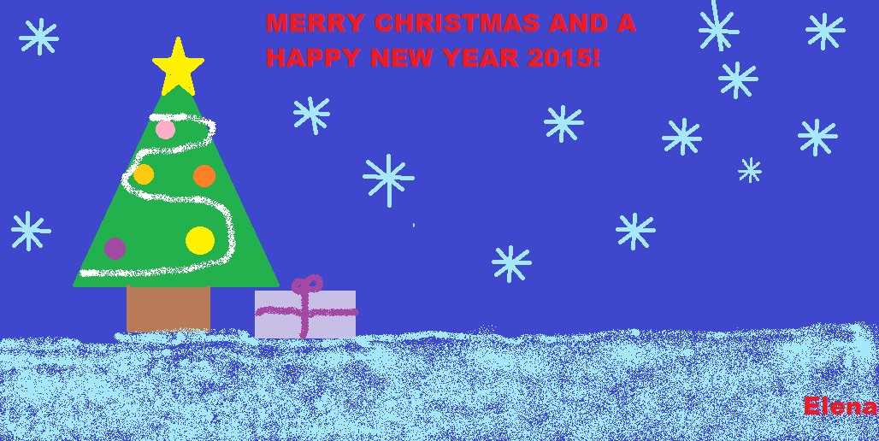

Slide 5
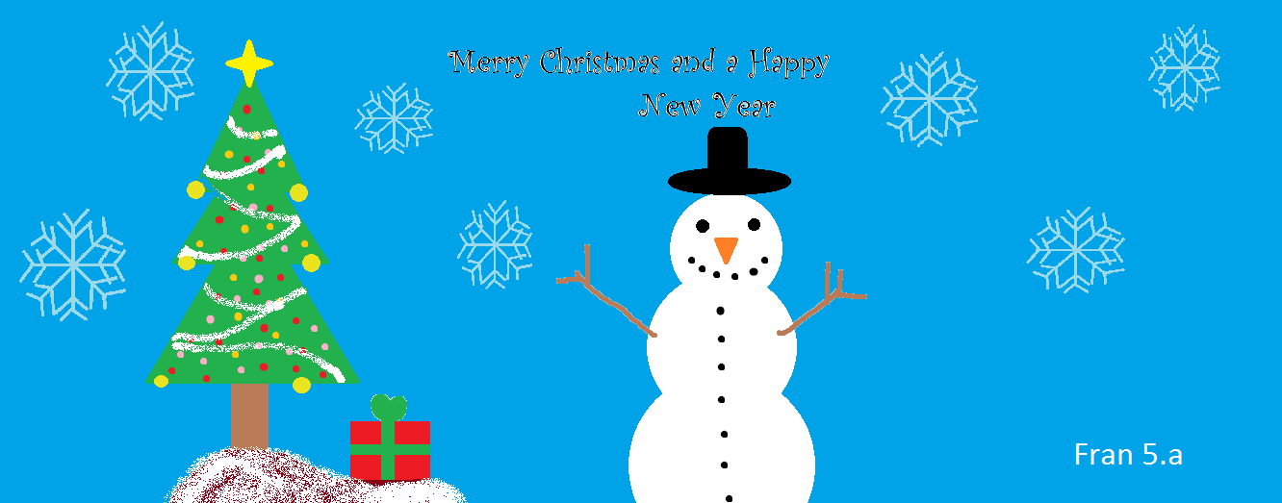

Slide 9
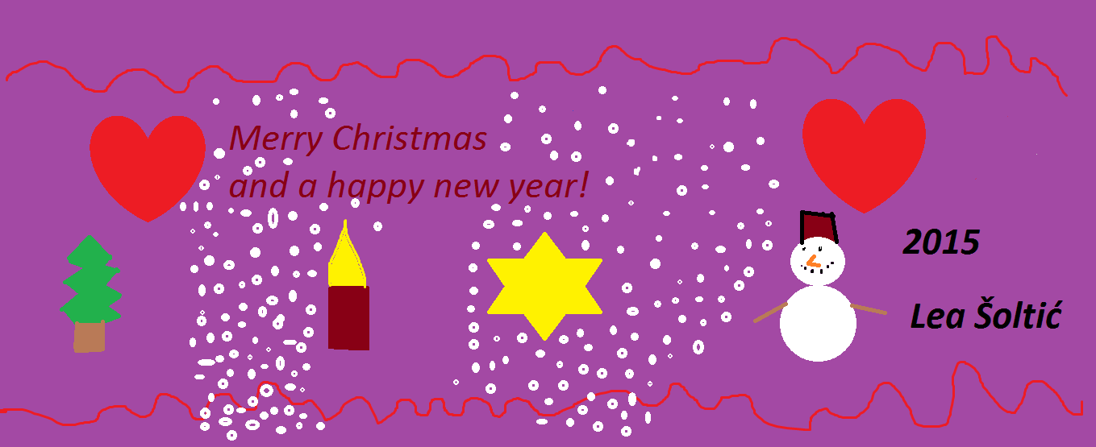

Slide 10
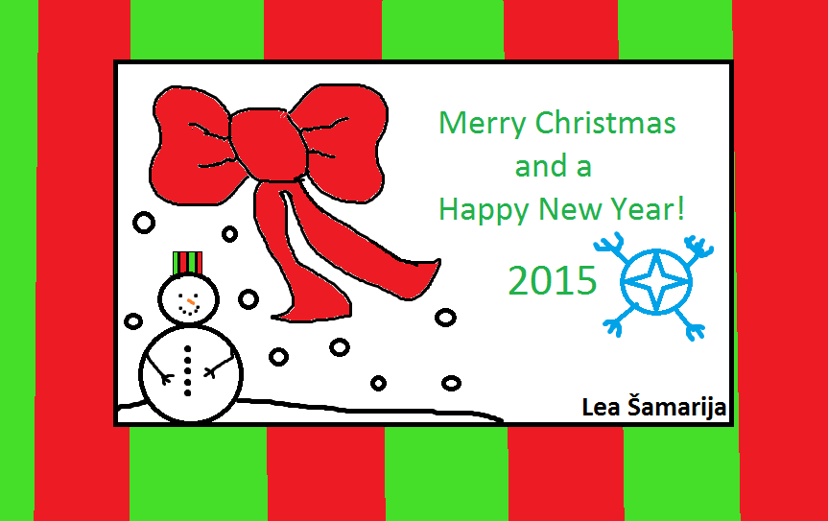

Slide 11
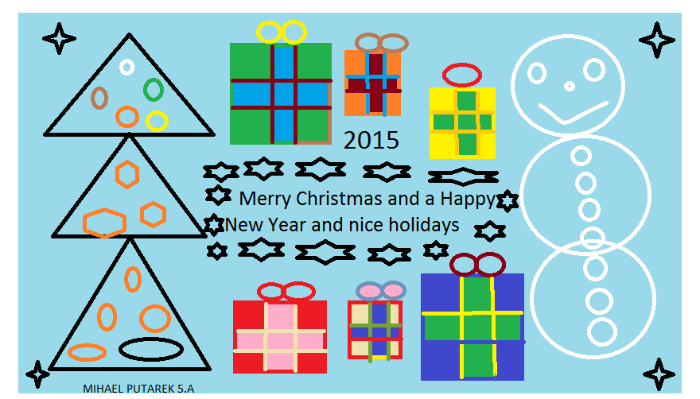

Slide 12
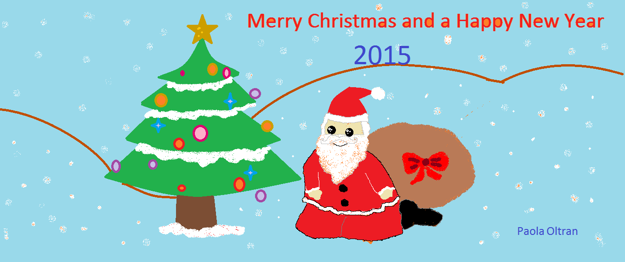

Slide 13
