Slide 1
On the track of our recent past etwinning project
TELEPHONE

Slide 2
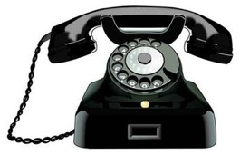
The telephone was the first device in history that enabled people to talk directly with each other across large distances. Telephones rapidly became indispensable to businesses, government, and households, and are today some of the most widely used small appliances.

Slide 3
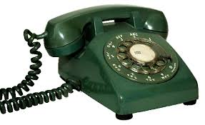
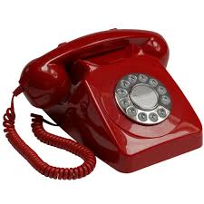
A telephone, or phone, is a telecommunications device that permits two or more users to conduct a conversation when they are too far apart to be heard directly. A telephone converts sound, typically and most efficiently the human voice, into electronic signals suitable for transmission via cables or other transmission media over long distances, and replays such signals simultaneously in audible form to its user.

Slide 4
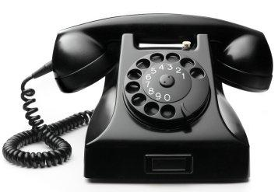
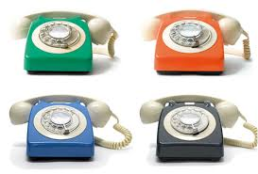
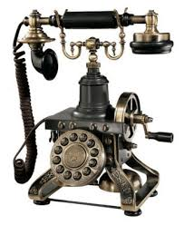
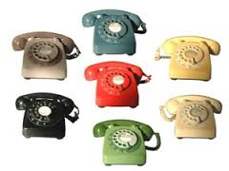
Some examples

Slide 5
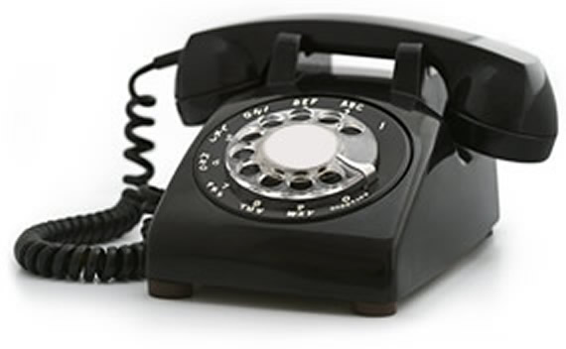
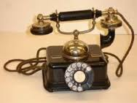
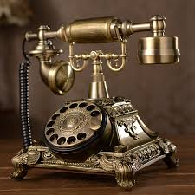

Slide 6
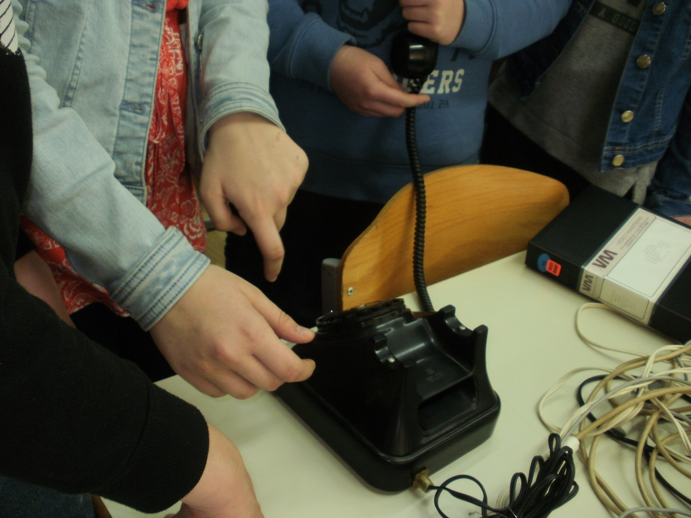
In our school

Slide 7
  Marina Žnidarić
  6th grade
  II. osnovna škola Čakovec, Croatia
  May 2016
  Teacher: Iva Naranđa
  Source: https://en.wikipedia.org/wiki/Telephone

