Slide 1
THE HISTORY OF THE VACUUM CLEANER
By: Ivona Lepen

Slide 2
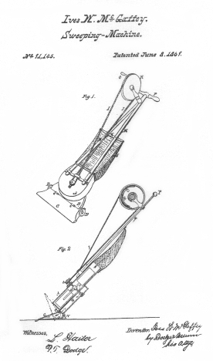
Whirlwind – vacuum cleaner
on June 8, 1869, Chicago inventor, Ives McGaffey patented a "sweeping machine„
McGaffey called his machine the Whirlwind and it was the first hand-pumped vacuum cleaner in the United States

Slide 3
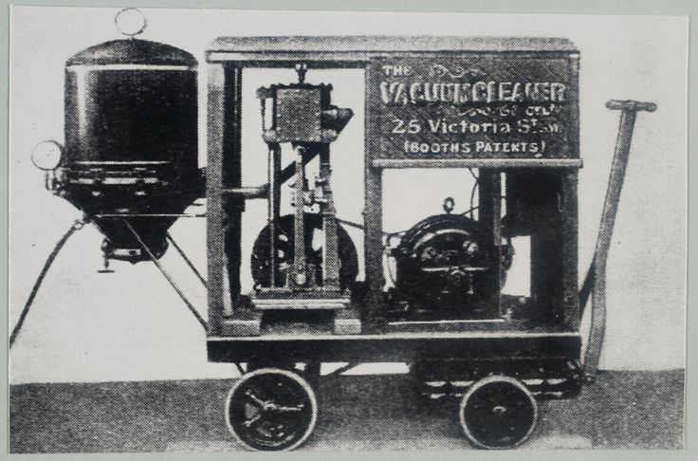
Hubert Cecil Booth
british engineer, Hubert Cecil Booth patented a motorized vacuum cleaner on August 30, 1901.

Slide 4
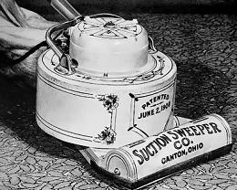
Handheld Units - James Spangler
in 1907, James Spangler, a janitor in a Canton, Ohio department store, deduced that the carpet sweeper he was using was the source of his chronic coughing

Slide 5
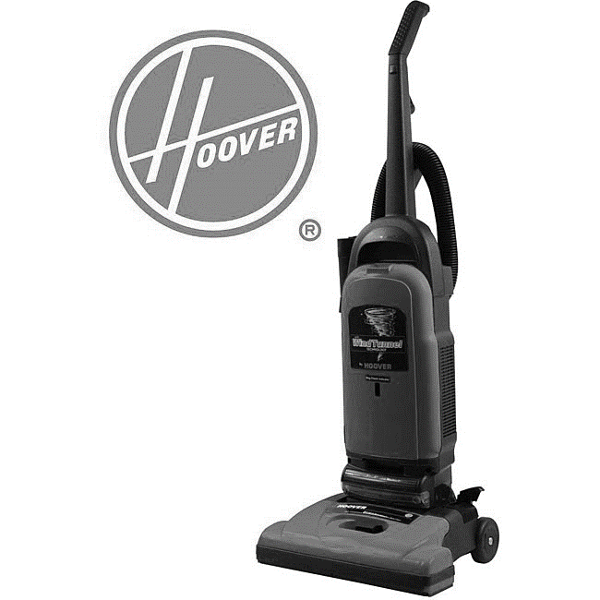
Hoover Vacuum Cleaners
James Spangler soon formed the Electric Suction Sweeper Company. One of his first buyers was his cousin, whose husband, William Hoover became the founder and president of the Hoover Company, a vacuum cleaner manufacturer

Slide 6
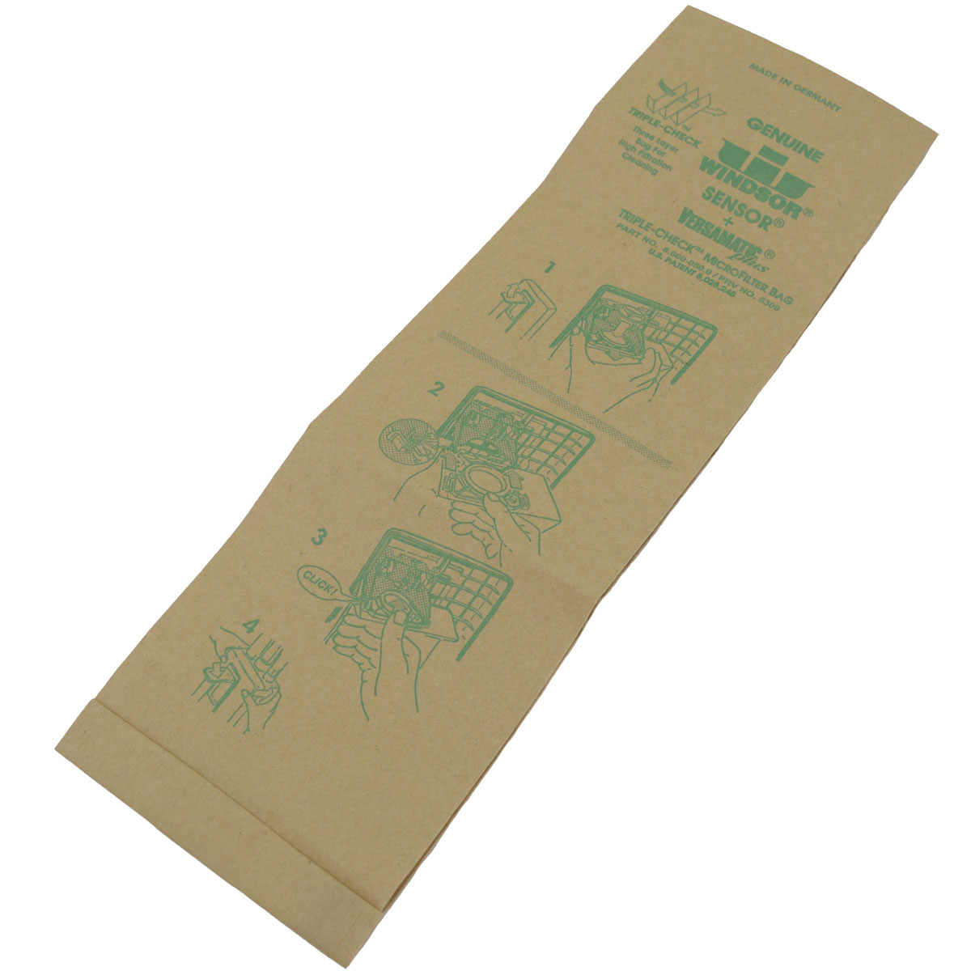
Filter Bags
the Air-way Sanitizer Company which began in Toledo, Ohio in 1920, introduced a new product, the "filter fiber" disposable bag - an important cleaning "first"

Slide 7
Source
http://inventors.about.com/od/uvstartinventions/a/Vacuum-Cleaners.htm
Created for the eTwinning project On the Track of Our Recent Past
Ivona Lepen, 6th grade
II. osnovna škola Čakovec, Croatia
Teacher: Iva Naranđa
May 2016

