Slide 1
European MakerSpace Network
Erasmus+ 2020-2023
2020-1-ES01-KA229-082563
II. Primary school Varazdin
Croatia
Workshops - Programming through play
Ljiljana Inkret-Martinčević

Slide 2
Workshop - working with ozobots
The Ozobot robot is a tiny robot that students can program with different colored lines in the visual block editor OzoBlockly. Ozobot can follow lines, react to colors, change speeds, make decisions and communicate with users. The robot uses light sensors to read digital screens and other surfaces.

Slide 3
Workshop - working with ozobots
Task 1.
Use black marker to complete your path, then place Evo on the START. Evo will randomly select a color. Repeat several times.

Slide 4
Workshop - working with ozobots
Task 2.
Can you tell which Color Codes mean Slow, Fast, and U-Turn?

Slide 5
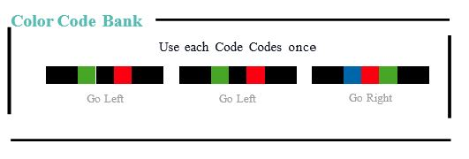
Workshop - working with ozobots
Task 3.
Place Color Codes on the lines to guide Evo to the ﬁnish.

Slide 6
Workshop - working with Arduino boards
What is ARDUINO?
open-source electronics platform based on easy-to-use hardware and software.
Arduino boards are able to read inputs - light on a sensor, a finger on a button, or a Twitter message - and turn it into an output - activating a motor, turning on an LED, publishing something online.
https://sourceforge.net/projects/ardublock/files/ardublock-all-20130712.jar/download

Slide 7
Workshop - working with Arduino boards
INSTALLATION ARDUINO SET
Arduino 1.8.9
https://www.arduino.cc/en/Main/Software
Drivers can be downloaded from the following pages:
http://www.ftdichip.com/Drivers/CDM/CDM%202.08.24%20WHQL%20Certified.zip
INSTALLATION OF ARDUBLOCK TOOL FOR GRAPHIC PROGRAMMINGhttps://sourceforge.net/projects/ardublock/files/ardublock-all-20130712.jar/download

Slide 8
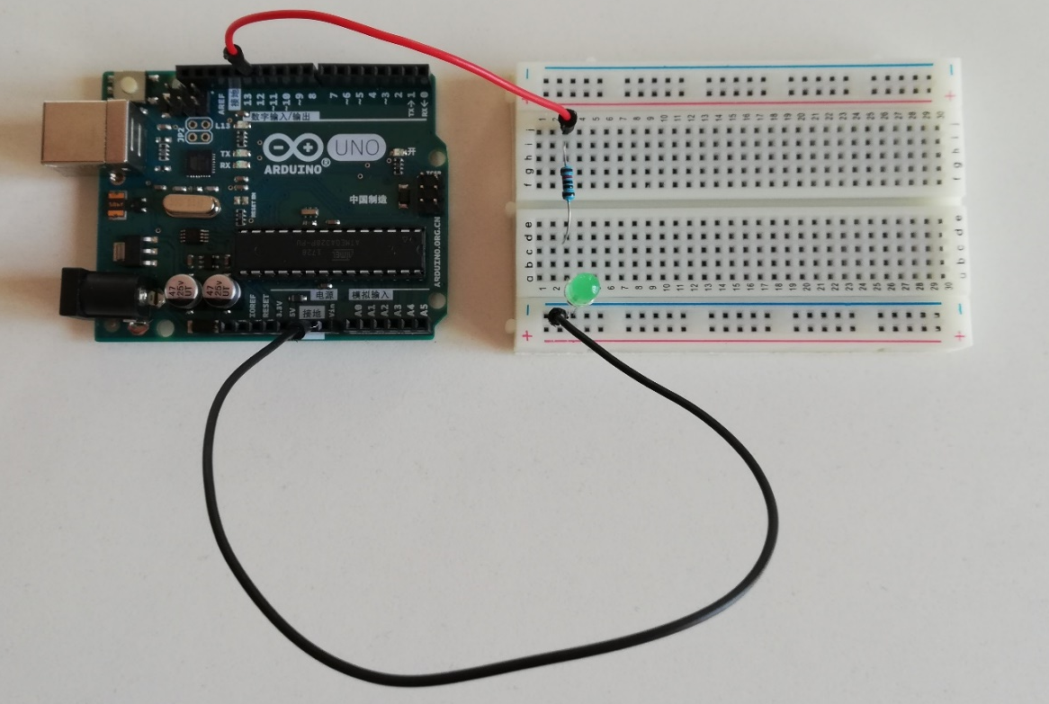
Workshop - working with Arduino boards
TASK 1. CONNECTION OF ONE DIODE
Connecting one light bulb that will light up alternately

Slide 9
Workshop - working with Arduino boards
TASK 1. CONNECTION OF ONE DIODE

Slide 10
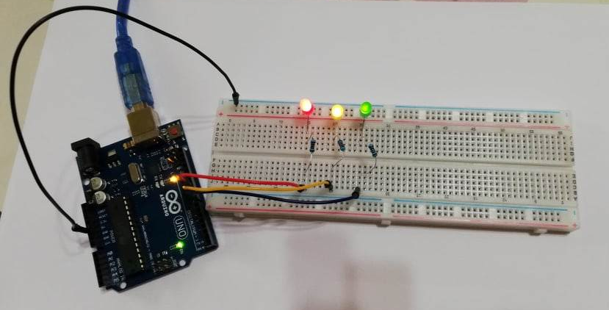
Workshop - working with Arduino boards
TASK 2. CONNECTION OF 3 DIODES

Slide 11
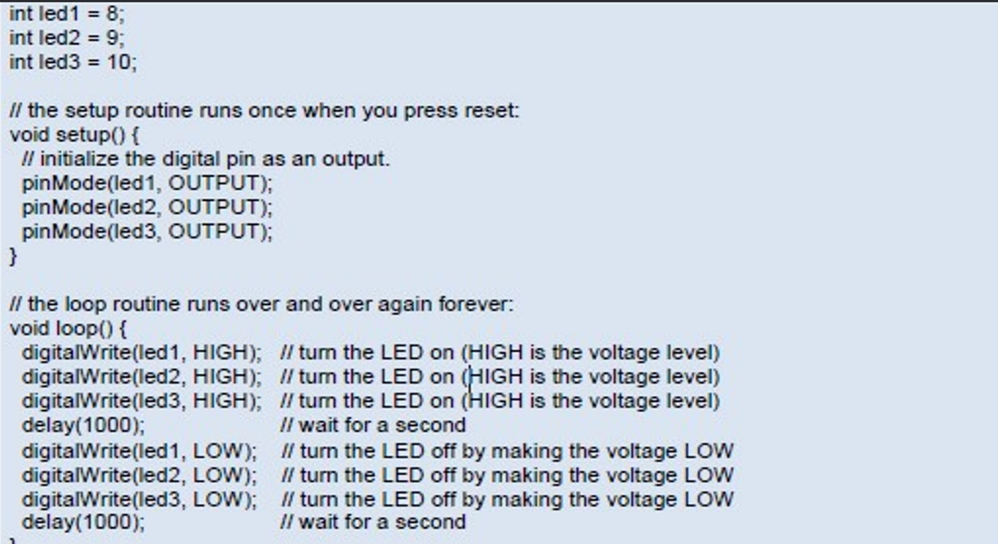
Workshop - working with Arduino boards
TASK 2. CONNECTION OF 3 DIODES

Slide 12
Workshop - working with Arduino boards
TASK 3. RUNNING LIGHTS

Slide 13
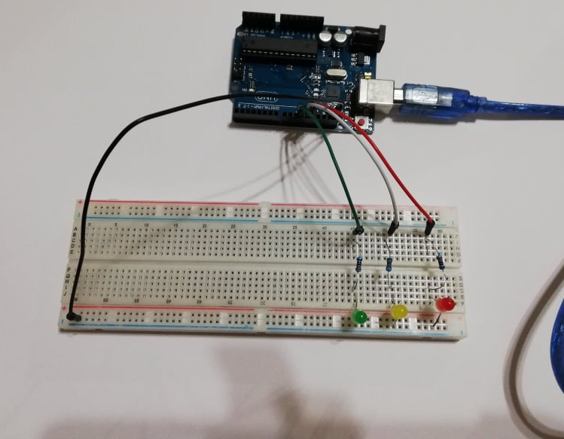
Workshop - working with Arduino boards
TASK 4. SIMPLE TRAFFIC LIGHT

Slide 14
Workshop - working with Arduino boards
TASK 4. SIMPLE TRAFFIC LIGHT

Slide 15
Workshop - working with mBots
What does mBot do?
mBot is a STEAM education robot for beginners, that makes teaching and learning robot programming simple and fun. With just a screwdriver, step-by-step instructions, and a study schedule, children can build a robot from scratch and experience the joys of hands-on creation.
Makeblock has partnered with Arduino - the leading open-source hardware platform in the education and maker community. The mBot - an educational robot set, for which Arduino is the heart of the program, was presented

Slide 16
Workshop - working with mBots
Graphic programming
Drag and drop computer graphics software mBlock V3 or mBlock V5 developed on the basis of Scratch 2.0. or mBlock V5.2.0 for Scratch3.0 allows children to quickly learn programming, control the robot and realize more and more functions that mBot has.

Slide 17
Workshop - working with mBots
Task 1
Place the robot in the START position,
by pressing a button on the robot or any button on the remote control, the robot turns on blue or green lights and starts driving forward following the path (squares). when it reaches the end of the track, the robot should stop.

Slide 18
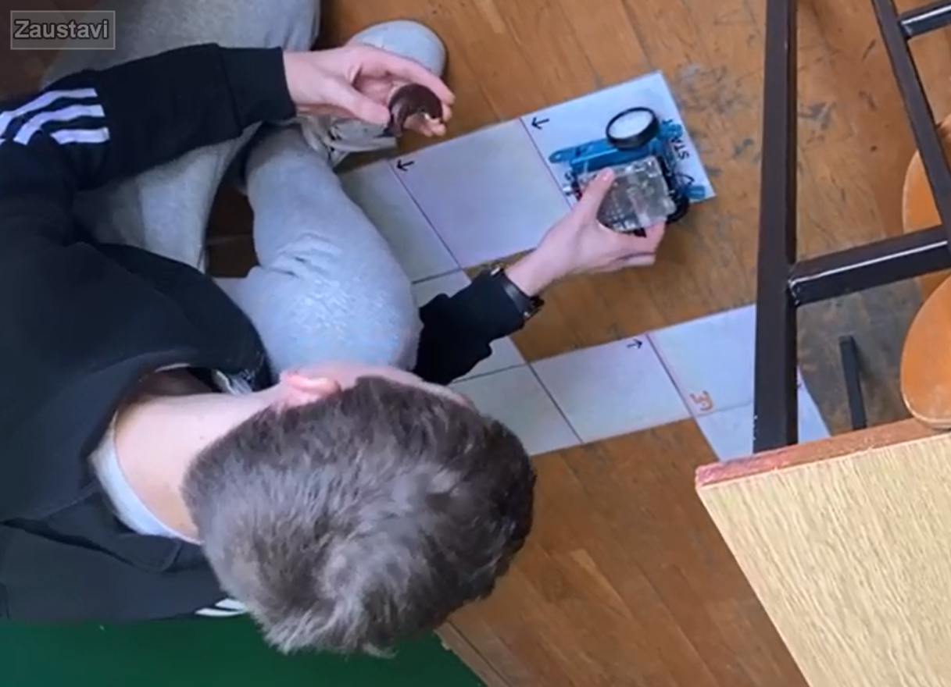
Workshop - working with mBots

Slide 19
Workshop - working with mBots
Task 2.
Set the robot to the START position, by pressing the button on the robot or any button on the remote control, the robot turns on blue or green lights and starts driving forward following the track, i.e. following the black line. When it reaches the end of the track, the robot turns, follows the hand line to START, and then it should stop and turn on the red lights.

Slide 20
Workshop - working with mBots
Task 3.
Set the robot to the START position, by pressing the button on the robot or any button on the remote control, the robot turns on the blue lights and starts driving forward following the path, i.e. it follows the black line. When he comes to the first obstacle, he stops, changes the lights to red (2 seconds) and continues on the path. When he reaches the next obstacle, he stops, changes the color of the light to yellow (2 sec.) and continues driving to the finish line. When he reaches the GOAL, he stops, the light changes to green.

Slide 21
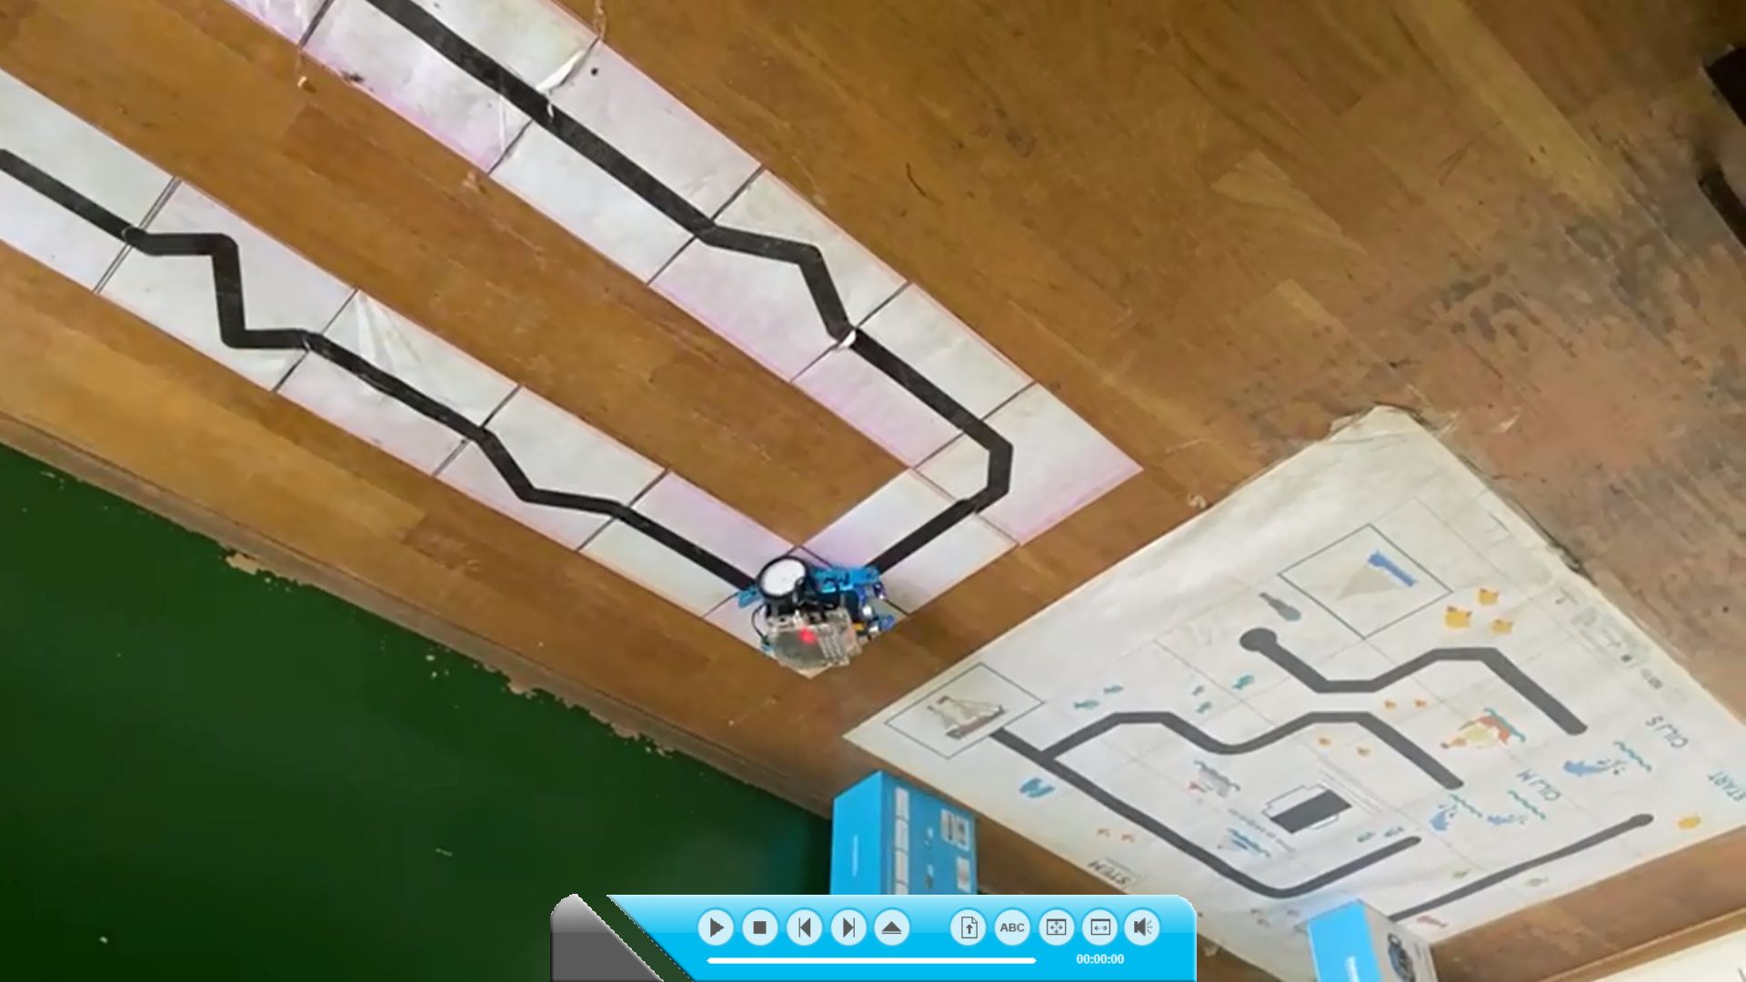
Workshop - working with mBots

Slide 22
Workshops - Programming through play
Through the game, we learned to program and work with different robots.
Thank you!
Croatia, July 2023.

