Slide 1

Ecological conditions in Croatia
Lana Rovišan, Jakov Babić, Ivana Šaponja, Stjepan Abramović, Lukas Gregurić
This Photo by Unknown author is licensed under CC BY-SA-NC.

Slide 2
HOW CAN WE PERSONALLY CONTRIBUTE TO REDUCING THE ECOLOGICAL FOOTPRINT IN CROATIA?

Slide 3
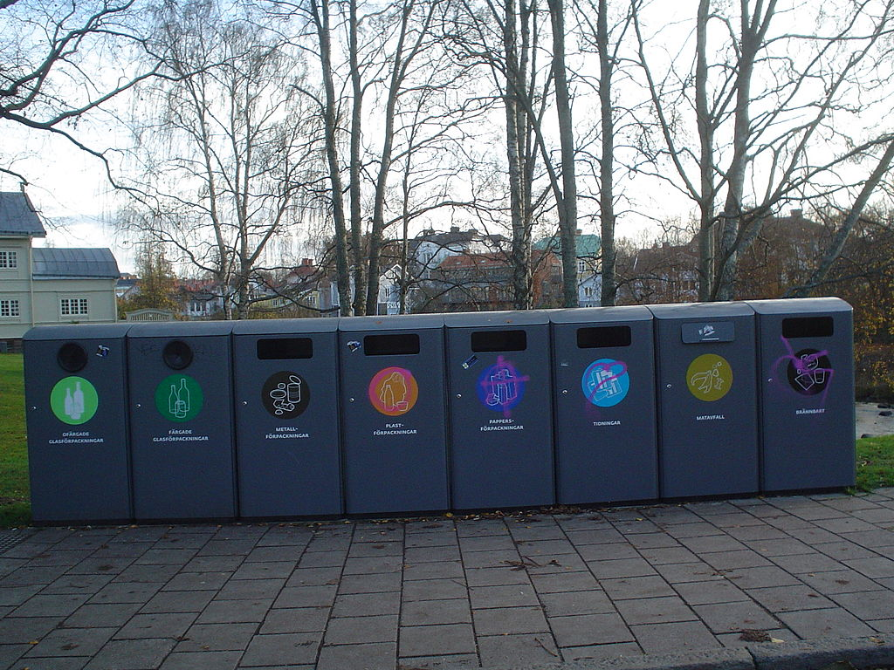
BY SORTING AND DISPOSING WASTE IN THE RECYCLING CONTAINERS
This Photo by Unknown author is licensed under CC BY-SA.

Slide 4
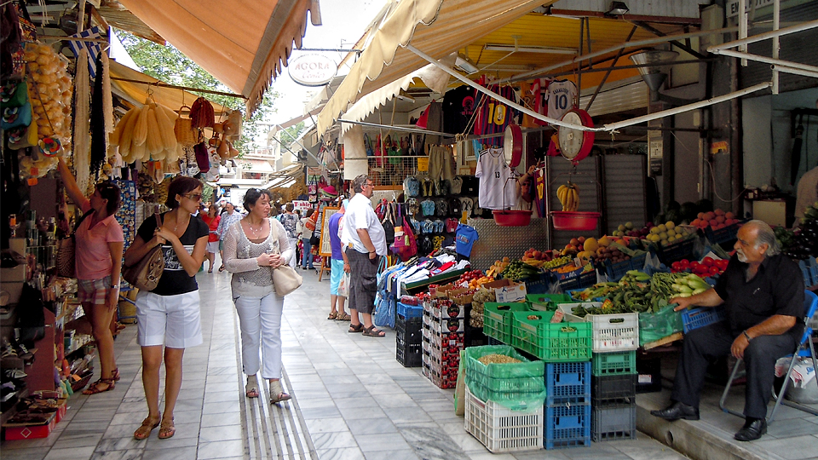
BY PLANNED PURCHASE OF GROCERIES THAT THE FAMILY CAN CONSUME BEFORE THEIR EXPIRY DATE
This Photo by Unknown author is licensed under CC BY-NC-ND.

Slide 5

USING CANVAS AND PAPER BAGS INSTEAD OF PLASTIC
This Photo by Unknown author is licensed under CC BY.

Slide 6
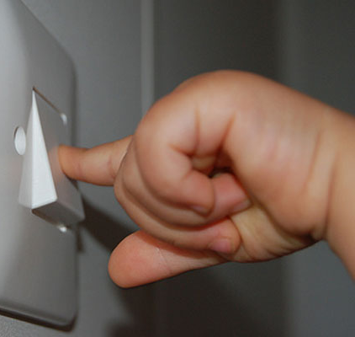
BY SWITCHING OFF THE LIGHTS IN THE PREMISES IN WHICH YOU DO NOT STAY AND SWITCHING OFF THE ELECTRICAL DEVICES THAT ARE NOT BEING USED
This Photo by Unknown author is licensed under CC BY-SA-NC.

Slide 7
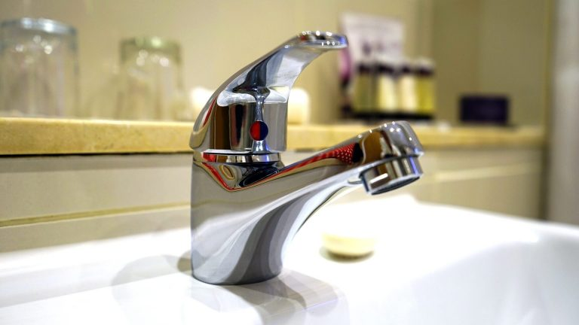
BY SHUTTING OFF THE WATER WHEN BRUSHING YOUR TEETH, TAKING A SHOWER INSTEAD OF BATHING, REPAIRING FAUCETS AND WATER TANK THAT ARE DEFECTIVE BECAUSE THAT'S HOW WATER IS SAVED.
This Photo by Unknown author is licensed under CC BY.

Slide 8
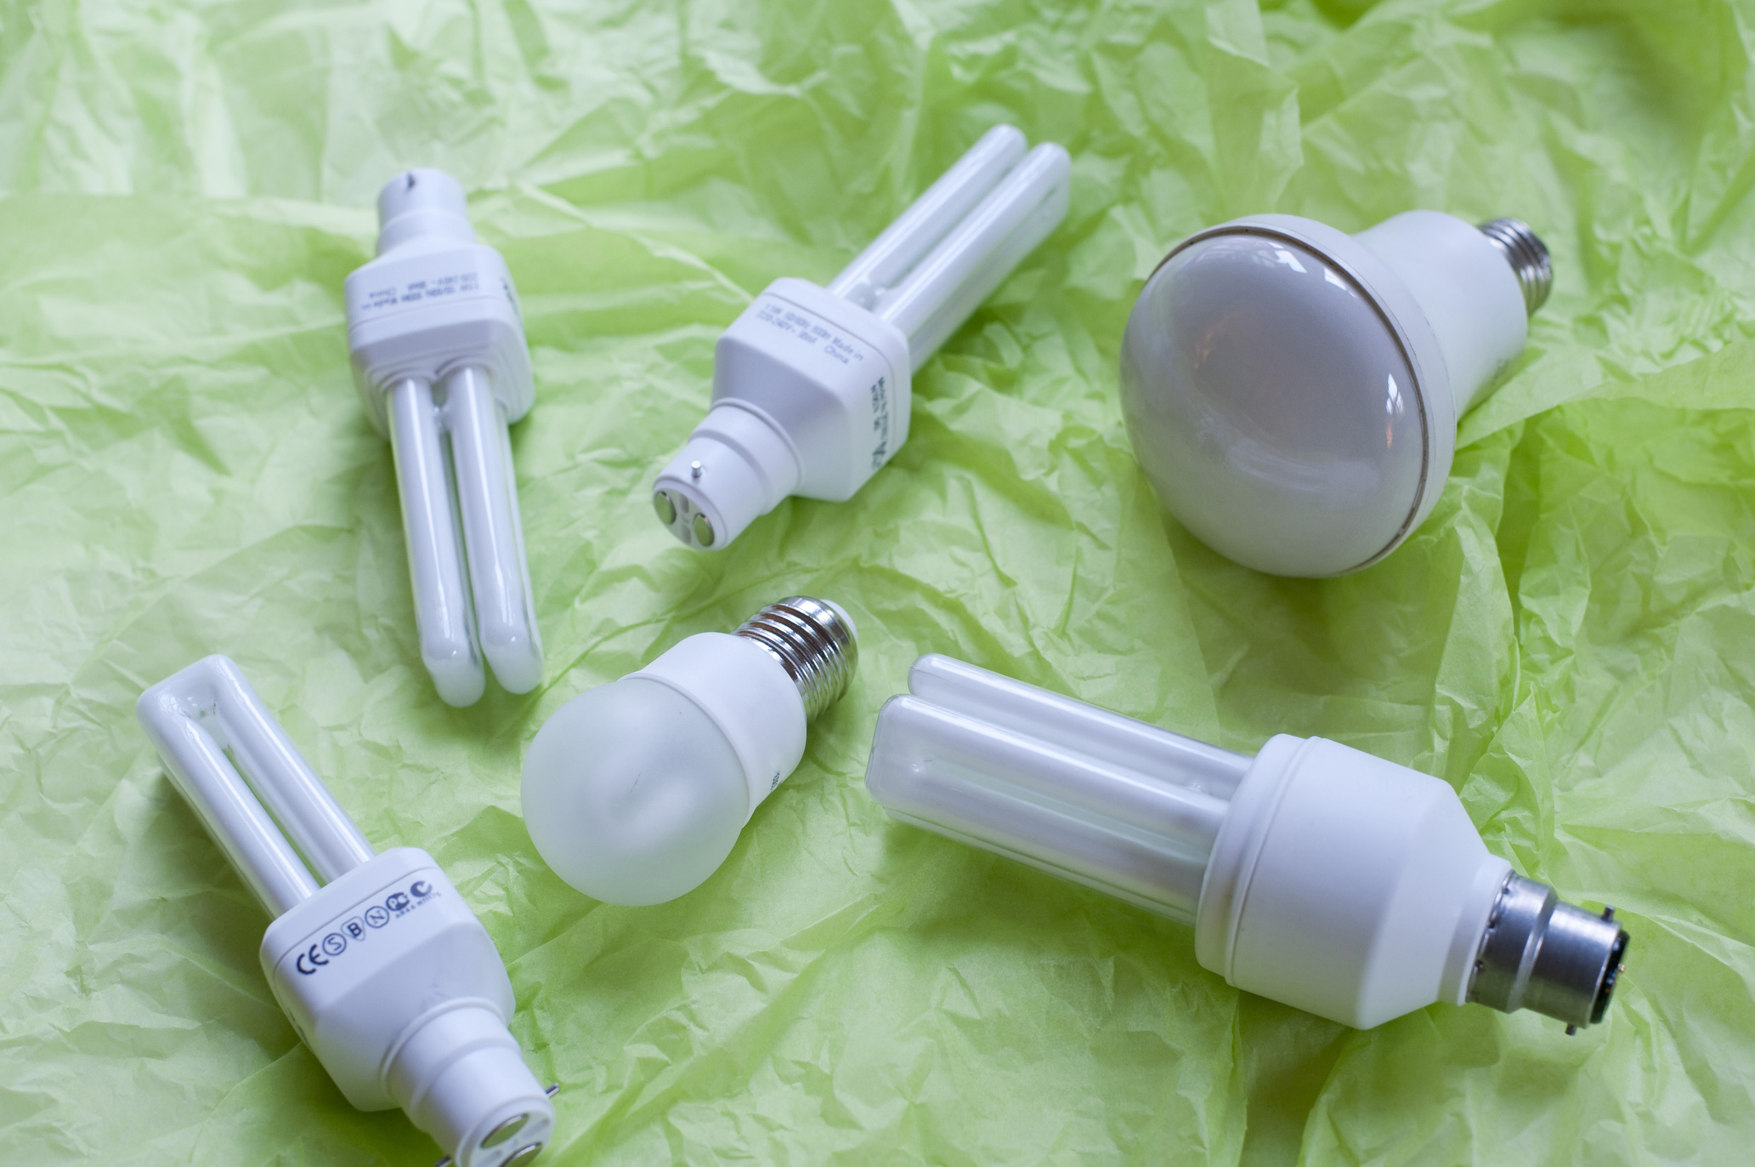
BY USING ENERGY-SAVING BULBS THAT CONSUME LESS ELECTRIC ENERGY
This Photo by Unknown author is licensed under CC BY.

Slide 9

INSTALLATION OF SOLAR PANELS ON HOUSE ROOFS
This Photo by Unknown author is licensed under CC BY.

Slide 10
HOW CAN CITIES ENCOURAGE LIFE IN HARMONY WITH NATURE?
- by arranging wild waste disposal sites
-by setting up "green islands" with containers for sorting waste
-construction of energy-efficient houses and buildings
-by building bicycle paths and banning the use of fuel-powered vehicles
-using renewable energy sources
-planting trees

Slide 11


