Slide 1
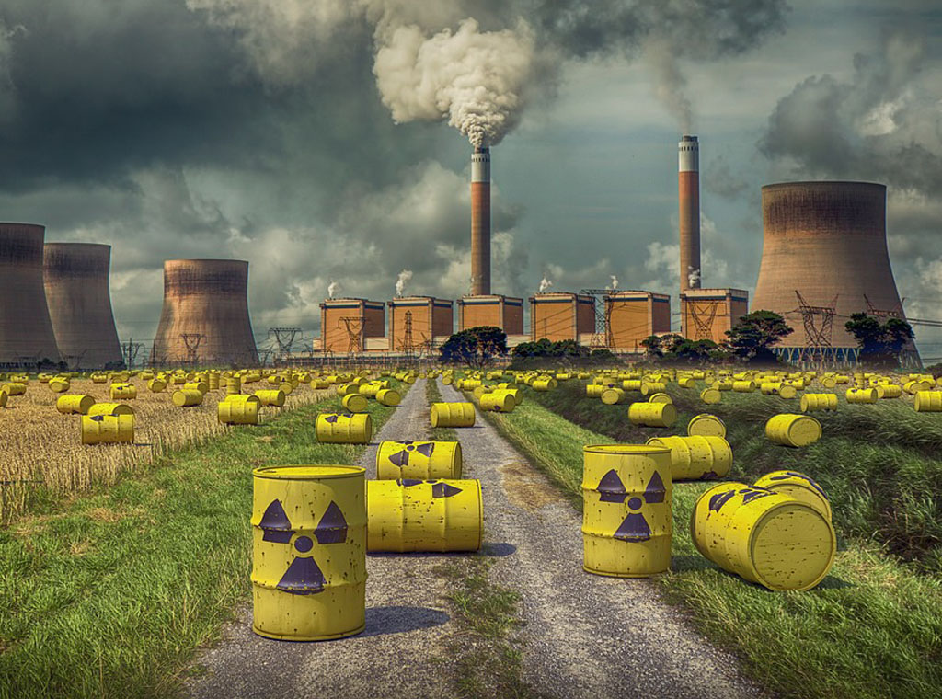
Nuclear waste

Slide 2
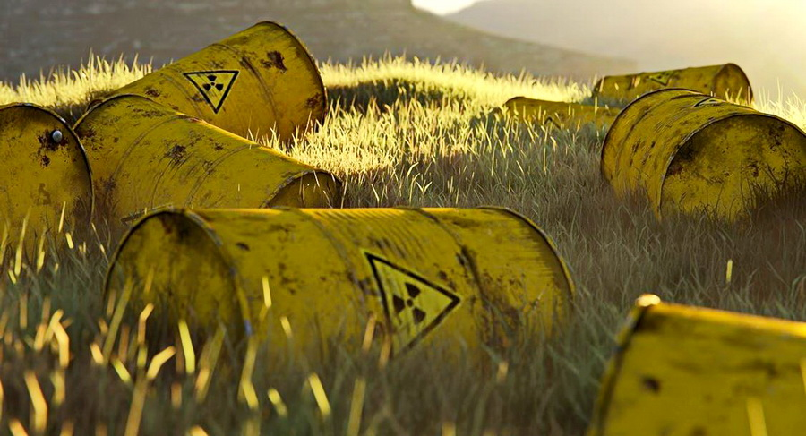
What is nuclear waste?
Radioactive waste is waste that is not intended for further use. It is a special type of industrial waste. Part of the radioactive waste is generated in healthcare. Radioactive waste contains radioactive isotopes of such activities that exceed the limit values ​​prescribed by the relevant legislation, which is why a special management regime applies to it. A common feature of radioactive isotopes is ionizing radiation.

Slide 3
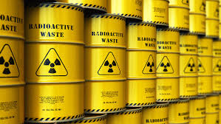
Nuclear waste
Radioactive materials used in various applications become, after some time, partially or completely unusable, but often still retain a large part of the radioactivity they had (or acquired) during use (eg spent radiation sources or spent nuclear fuel).

Slide 4
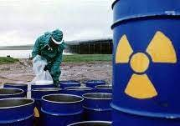
Radioactivity of radioactive waste
A larger nuclear power plant (of 1,000 MW) typically consumes about 100 tons of nuclear fuel (enriched uranium) every 3 years. This fuel is obtained by various physical and chemical processes of purification and processing of uranium isotopes from uranium ore, and before use it still represents a natural material in terms of radioactivity, although several tens of thousands of times more active than, for example, an equal mass of ordinary stone. In fact, radioactive waste should also include the tailings of used uranium ore, which by its quantity significantly exceeds all other radioactive materials used in the nuclear industry. However, it is a very small activity and can be disposed of at the place of origin, i.e. in mines, without prior processing.

Slide 5
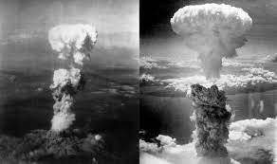
Atomic bombings of Hiroshima and Nagasaki
On 6 and 9 August 1945, the United States detonated two atomic bombs over the Japanese cities of Hiroshima and Nagasaki, respectively. The two aerial bombings together killed between 129,000 and 226,000 people, most of whom were civilians, and remain the only use of nuclear weapons in an armed conflict. Japan surrendered to the Allies on 15 August, six days after the bombing of Nagasaki and the Soviet Union's declaration of war against Japan. The Japanese government signed the instrument of surrender on 2 September, effectively ending the war.

Slide 6
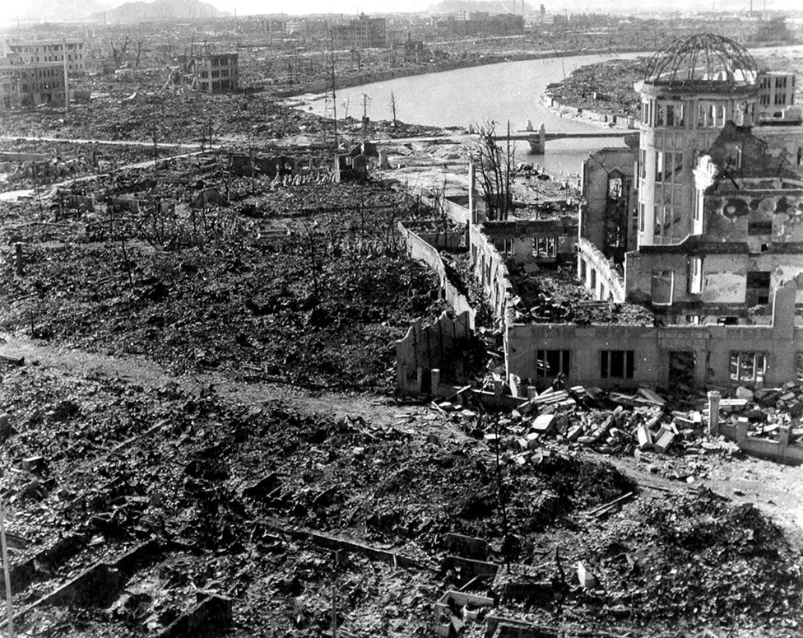
Consequences of the explosion
By the end of 1945, the bombing had killed an estimated 140,000 people in Hiroshima, and a further 74,000 in Nagasaki. In the years that followed, many of the survivors would face leukemia, cancer, or other terrible side effects from the radiation. “Each person had a name. Each person was loved by someone.

Slide 7
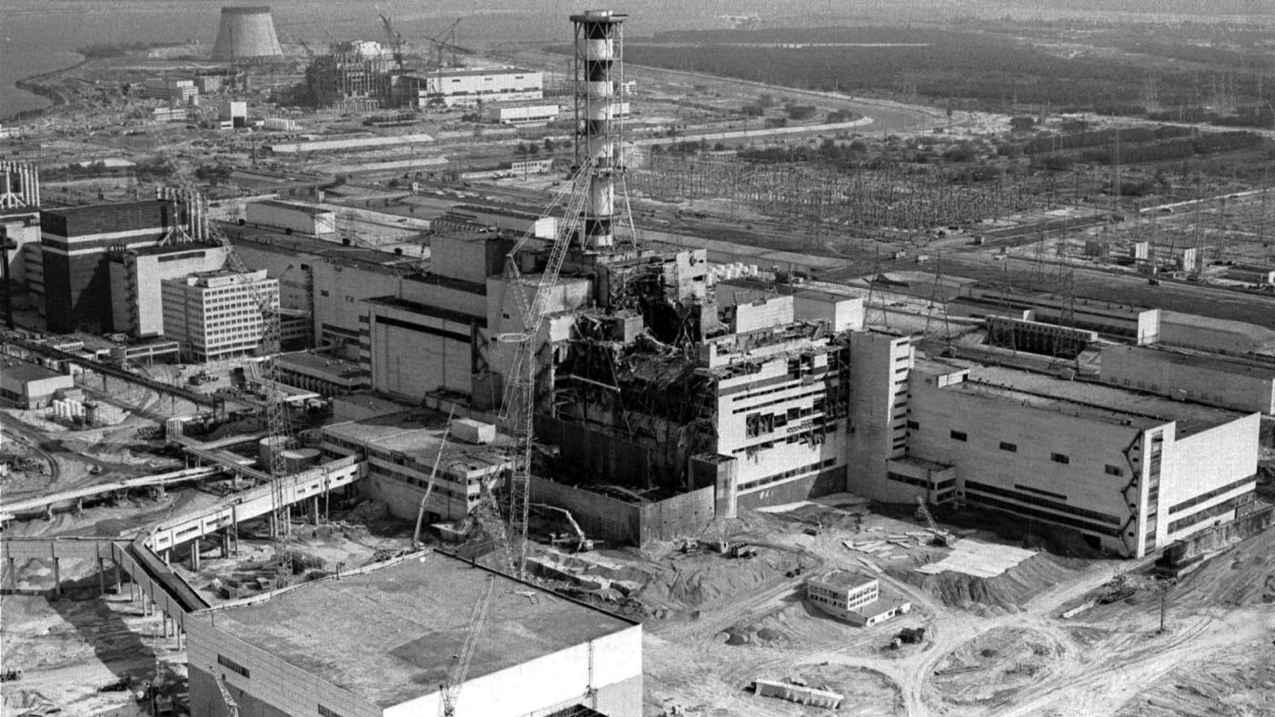
Chernobyl disaster
The Chernobyl disaster was a nuclear accident that occurred on 26 April 1986 at the No. 4 reactor in the Chernobyl Nuclear Power Plant, near the city of Pripyat in the north of the Ukrainian SSR in the Soviet Union. Called the world's worst-ever civil nuclear incident, it is one of only two nuclear energy accidents rated at seven—the maximum severity—on the International Nuclear Event Scale, the other being the 2011 Fukushima nuclear disaster in Japan. The initial emergency response, together with later decontamination of the environment, involved more than 500,000 personnel and cost an estimated 18 billion roubles—roughly US $68 billion in 2019, adjusted for inflation.

Slide 8
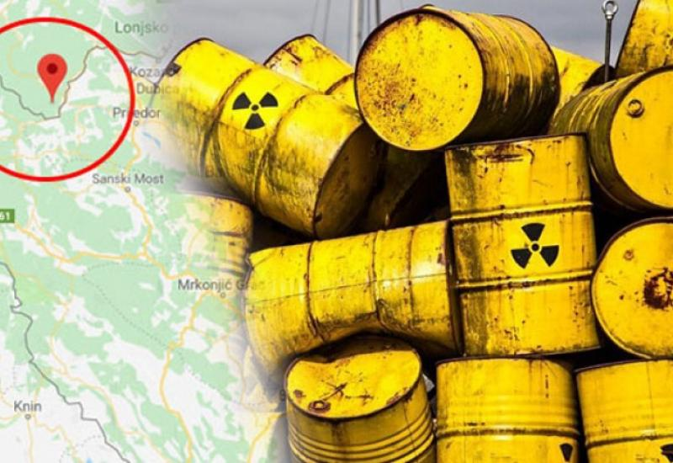
Nuclear waste in Croatia
Radioactive waste (RAW) that Croatia is obliged to dispose of originates from a whole range of activities in which radioactive sources and materials are used on a daily basis, such as industry, medicine, science, research and the like. We call such waste institutional waste. Except for institutional waste, the disposal obligation also applies to radioactive waste (RAW) and spent nuclear fuel (SNF) from the Krško Nuclear Power Plant, which is 50% owned by the Republic of Croatia and 50% by the Republic of Slovenia. Although Croatia has a small amount of radioactive waste compared to other countries in the world, the fact is that we create this waste in our daily life, and it needs to be adequately disposed of.

Slide 9
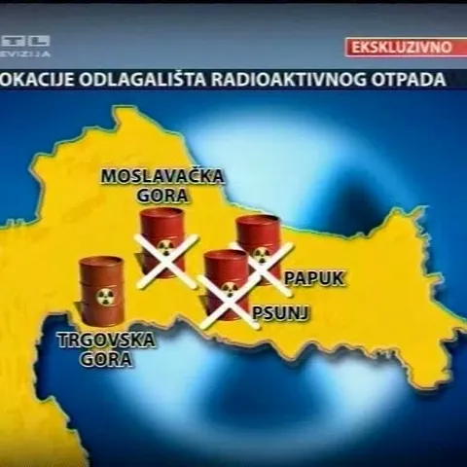
Locations of nuclear waste in Croatia

Slide 10
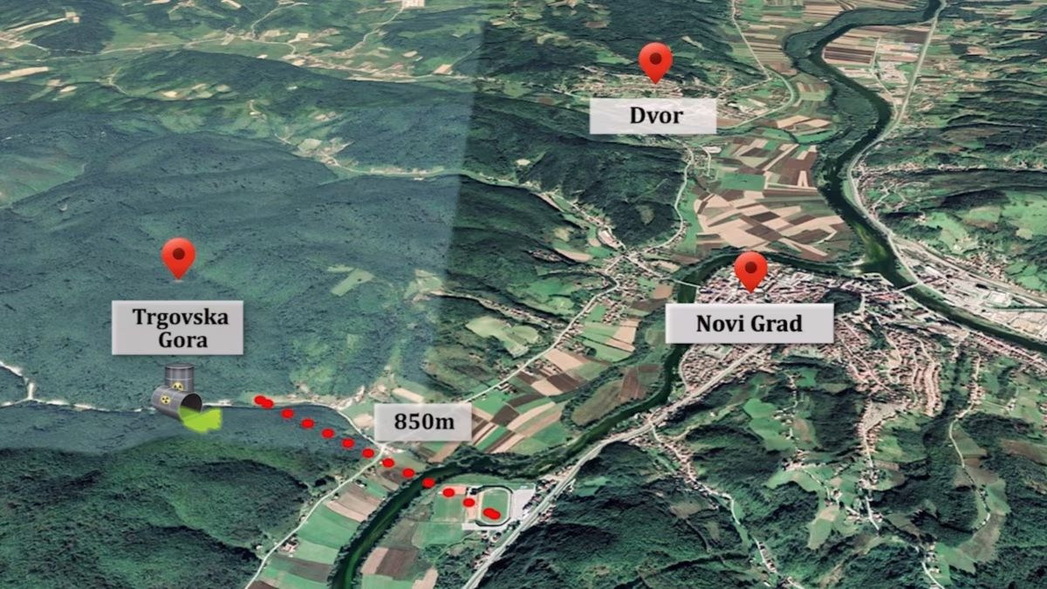
Nuclear waste in Sisak-Moslavina County
Citizens of 13 municipalities in the Una river basin are in fear because of the construction of a radioactive waste disposal site on Trgovska Gora in Croatia. According to the National Program for the Implementation of the Strategy for the Disposal of Radioactive Waste, Used Sources and Spent Nuclear Fuel, which was adopted by the Government of Croatia at the end of 2018, Trgovska Gora and Čerkezovac Barracks are planned as the location of a long-term storage of this waste.

Slide 11
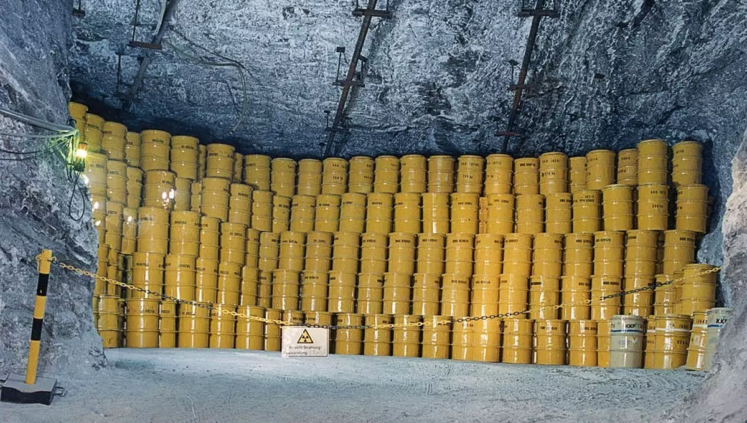
Nuclear energy
Do you think nuclear energy is a "green" energy?
We do not think that nuclear energy is green energy because it is harmful and also radioactive.
Is there a sustainable way for nuclear wastes to be disposed of? If so, where?
Nuclear power is the only large-scale energy-producing technology that takes full responsibility for all its waste and fully costs this into the product.

Slide 12
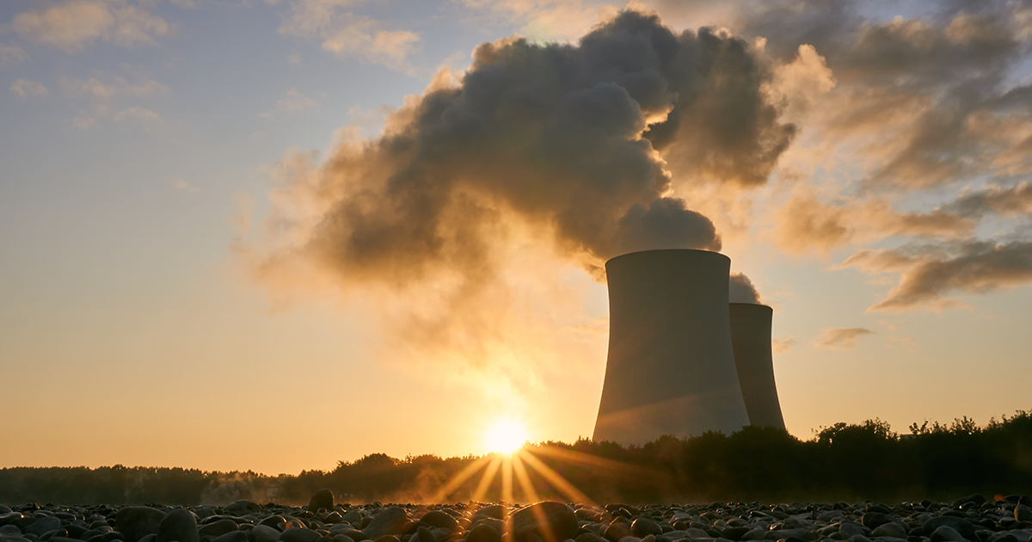
Nuclear energy
Safe methods for the final disposal of high-level radioactive waste are technically proven; the international consensus is that geological disposal is the best option.
In the case of nuclear reactors, about 99% of the radioactivity is associated with the fuel. Apart from any surface contamination of plant, the remaining radioactivity comes from 'activation products' such as steel components which have long been exposed to neutron irradiation. Their atoms are changed into different isotopes such as iron-55, cobalt-60, nickel-63, and carbon-14. The first two are highly radioactive, emitting gamma rays, but with correspondingly short half-lives so that after 50 years from final shutdown their hazard is much diminished. Some caesium-137 may also be found in decommissioning wastes.

Slide 13
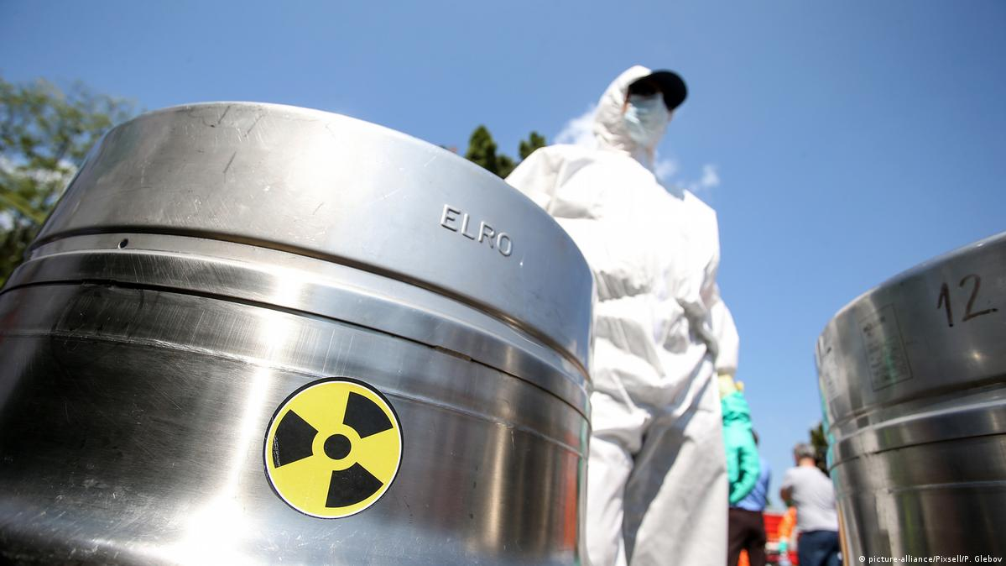
Nuclear waste disposal sites
Landfilling is the final placement of waste in a landfill, with no intention of ever removing it and without necessarily relying on long-term monitoring and maintenance of the landfill. In addition to pretreatment and conditioning, a system of natural and constructed multiple barriers around the waste in the repository provides assurance that any release of radionuclides into the environment will occur at an acceptable rate. There are barriers that ensure the complete isolation of waste for a period of time, such as metal containers, as well as those that slow down the penetration of radionuclides into the environment, such as the material used to fill the landfill or the rock in which it was built.

Slide 14
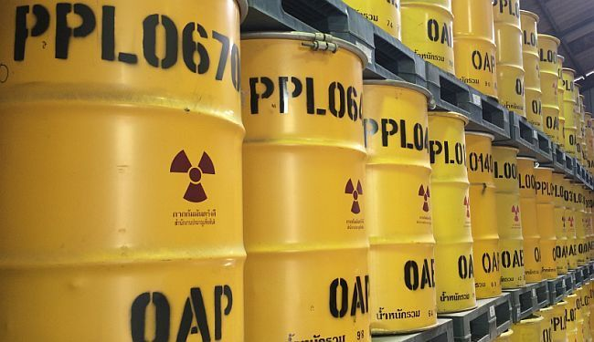
Nuclear waste disposal sites
Landfills can be located on the surface or at different depths underground, and a special group consists of deep landfills in geologically stable and impermeable layers, intended for high-level waste (which are not currently in regular operation).

Slide 15
THANK YOU ALL FOR YOUR ATTENTION, WE HOPE YOU ENJOYED THE PRESENTATION.

