Slide 2
SALT in croatia

Slide 3
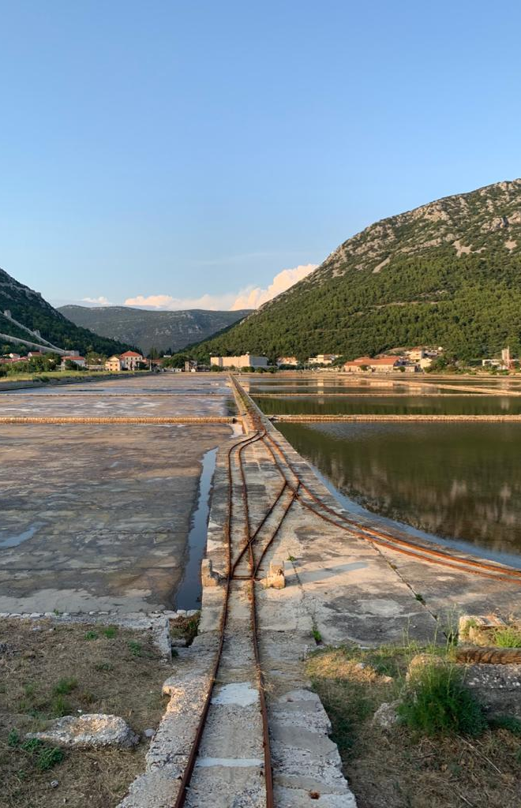
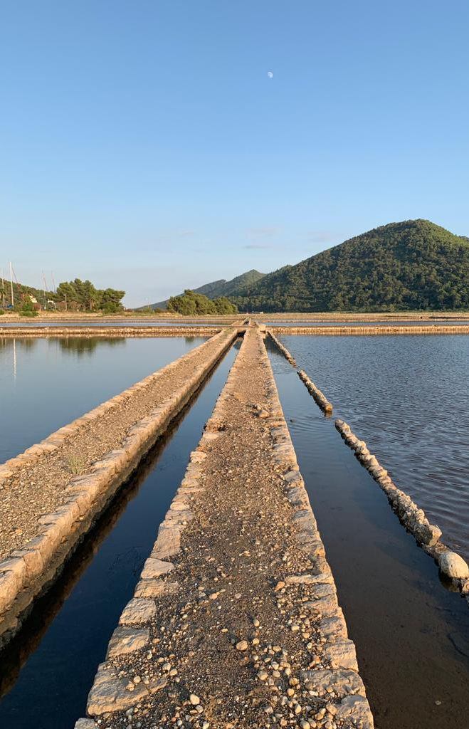
Saltworks ston
Saltwork ston is one of the oldest saltworks in europe and one of the most famous in croatia.
It dates from the 14th century and is still operational today.
Working on:
- production of organic salt
- creating new products(e.g salt flower, flavored salt)
- turning saltwork into attraction, salt museum
About 2,000 tonnes of salt are produced annually in the saltworks.

Slide 4
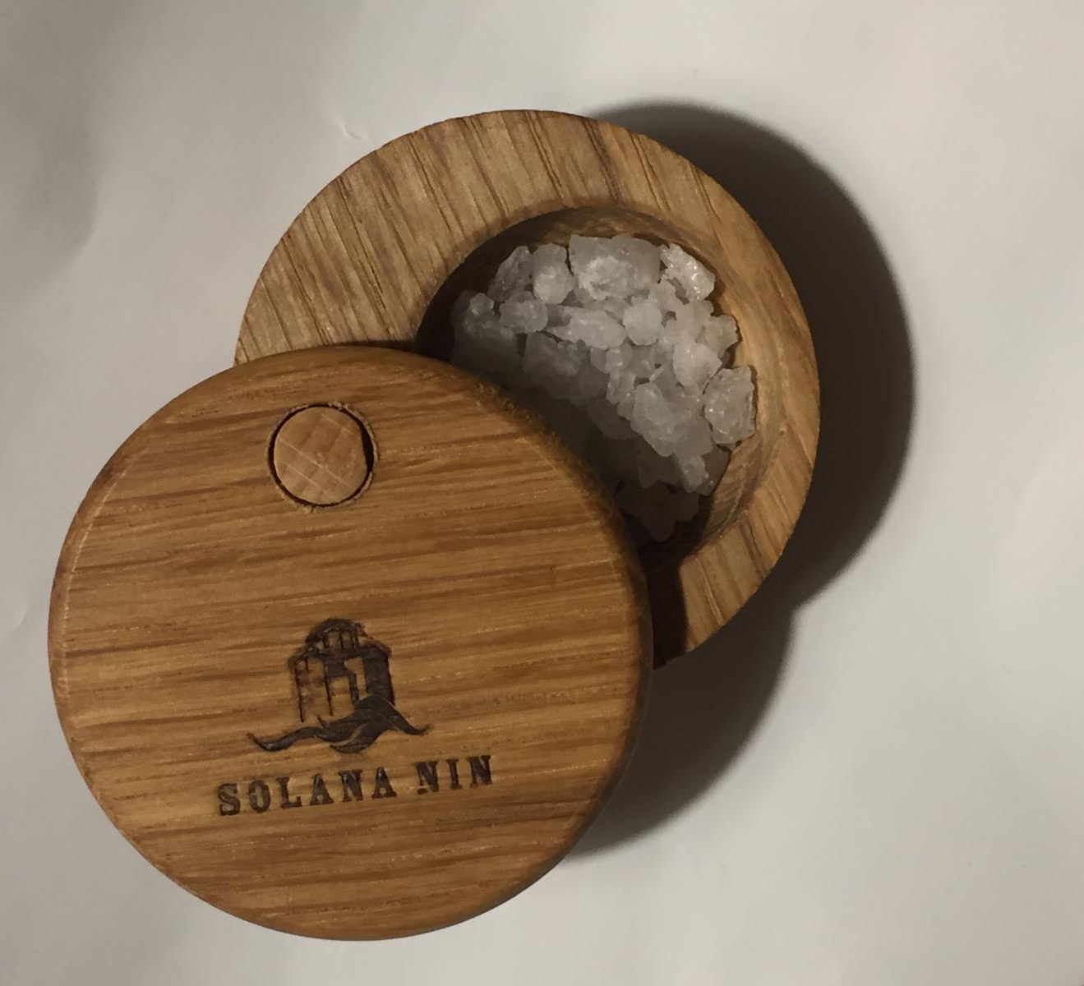
Saltworks nin
The average productin of sea salt in the last 10 years at the nin saltworks.
Is 32oo tonnes. Season „harvest” lasts on average 63 days during the spring, summer and early fall.
In 1500, venetians bought our nin saltworks. Since it was a rival to their salt pans , they shut it down for 500 years.

Slide 5
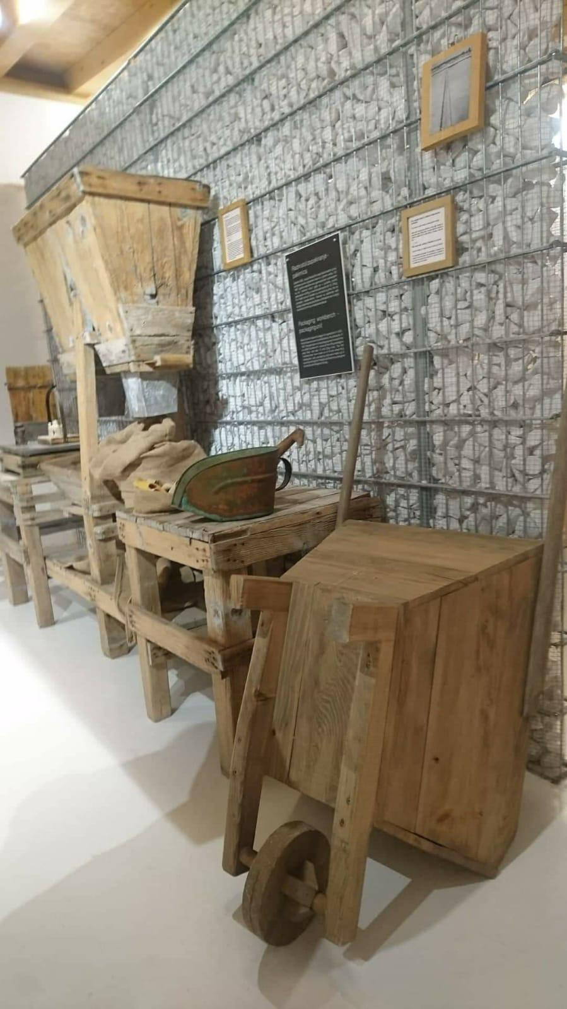
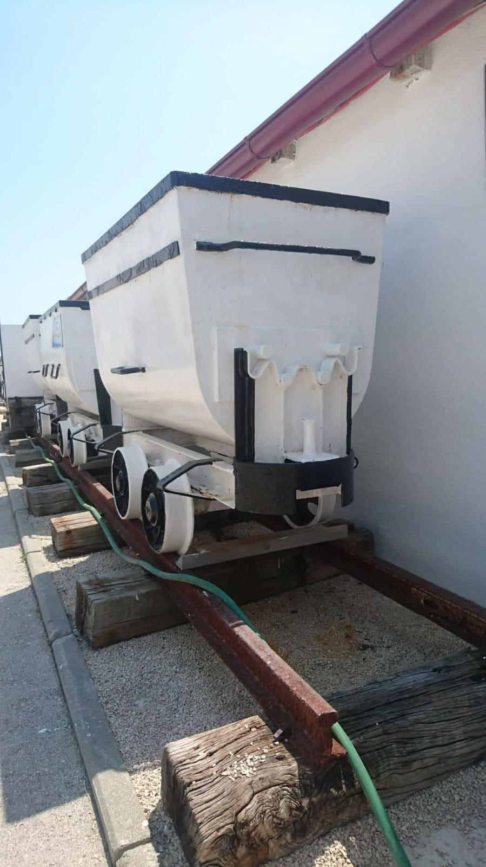
Nin saltworks was still alive and biodynamic ecosystem. Even today, it still lives and produces at the same way.
Nin is located between five croatian national parks.

Slide 6
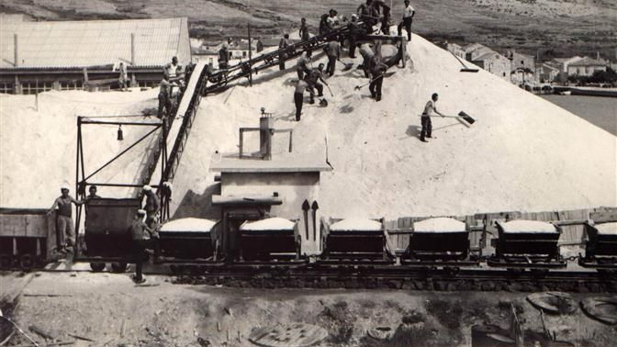
Saltworks pag
Saltwork pag is the largest producer of sea salt in croatia and bases its production on the millennial tradition of sea salt production on the islAND OF PAG. IMPERMEABLE SALT MADE MAINLY OF LOAM AND CLAY, AND SPECIFIC CLIMATic conditions are an excellent base for the top salt of pag.

Slide 7
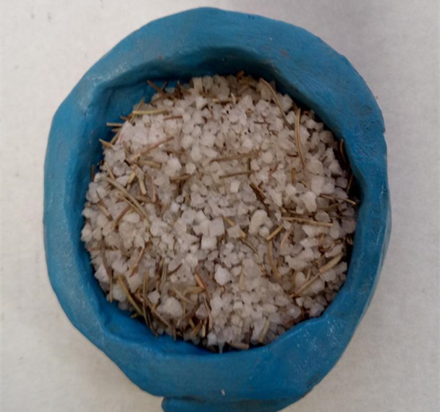
OUR SCHOOL STUDENT COOPERATIVE
There is a Student Cooperative at our school. It brings together interested students of all grades. The cooperative is most visible in the integration of children with special needs with regular students, who work together and make decorative items, soaps, aromatic salts, bath balls, medicinal teas from plants that grow in our school garden. In this way, students learn about the needs of nature protection, organic plant cultivation, composting and sorting waste and through various workshops produce and sell their products at school fairs themselves
THERE IS A STUDENT COOPERATIVE AT OUR SCHOOL. IT BRINGS TOGETHER INTERESTED STUDENTS OF ALL GRADES. IN THE COOPERATIVE WE HAVE INTEGRATION OF CHILDREN WITH SPECIAL NEEDS WITH REGULAR STUDENTS, WHO WORK TOGETHER AND MAKE DECORATIVE ITEMS, SOAPS, AROMATIC SALTS, BATH BALLS, HEALTY TEAS FROM PLANTS THAT GROW IN OUR SCHOOL GARDEN.

Slide 8
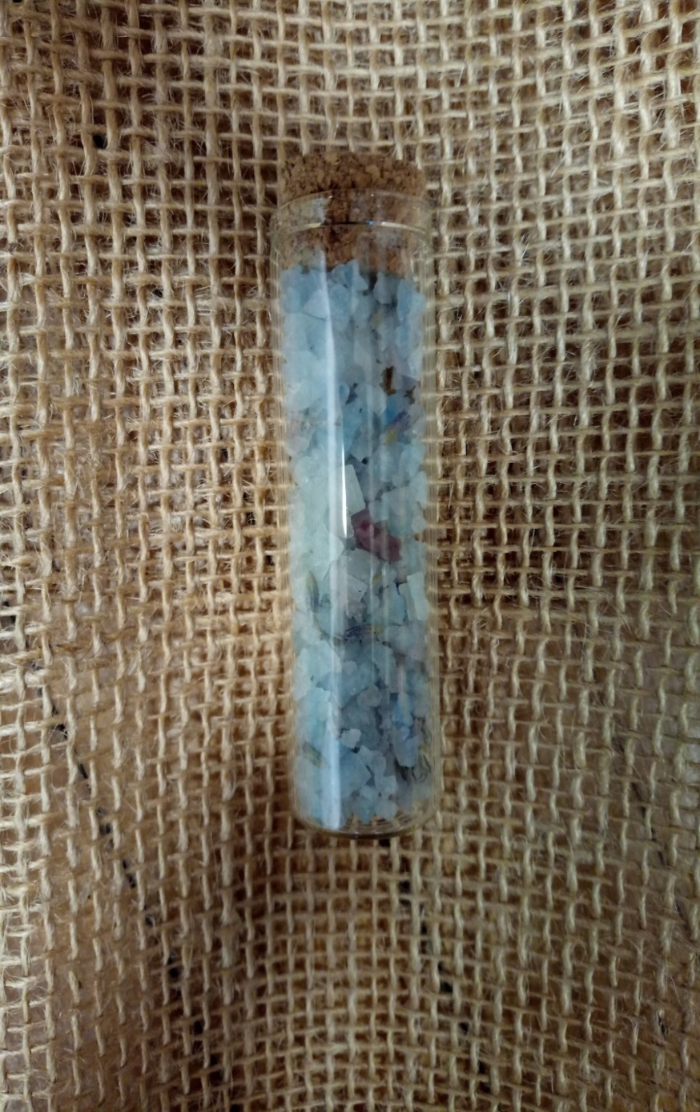
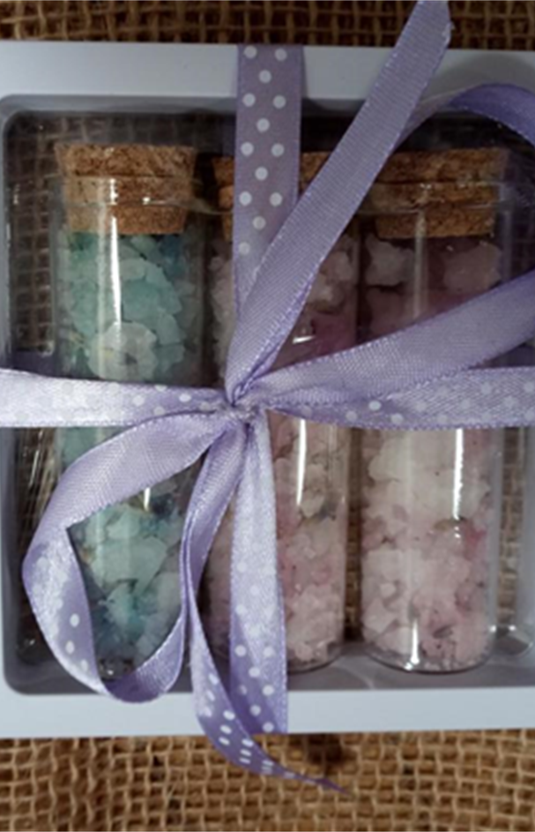
IN THIS WAY, STUDENTS LEARN ABOUT THE NEEDS OF NATURE PROTECTION, ORGANIC PLANT CULTIVATION, COMPOSTING AND SORTING WASTE AND THROUGH VARIOUS WORKSHOPS PRODUCE AND SELL THEIR PRODUCTS AT SCHOOL FAIRS THEMSELVES

Slide 10
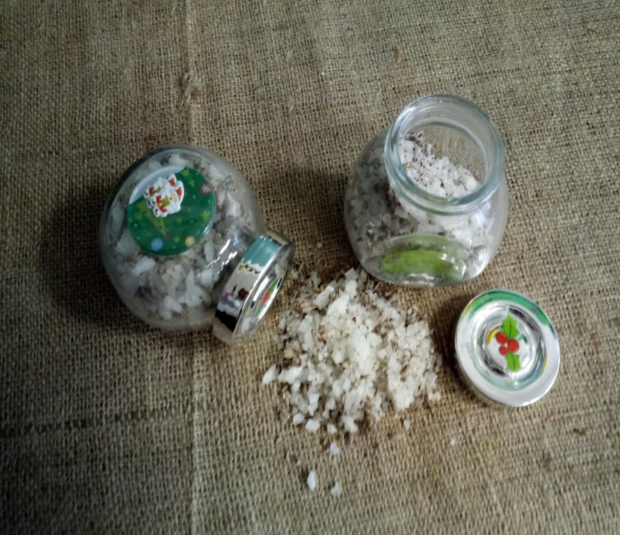
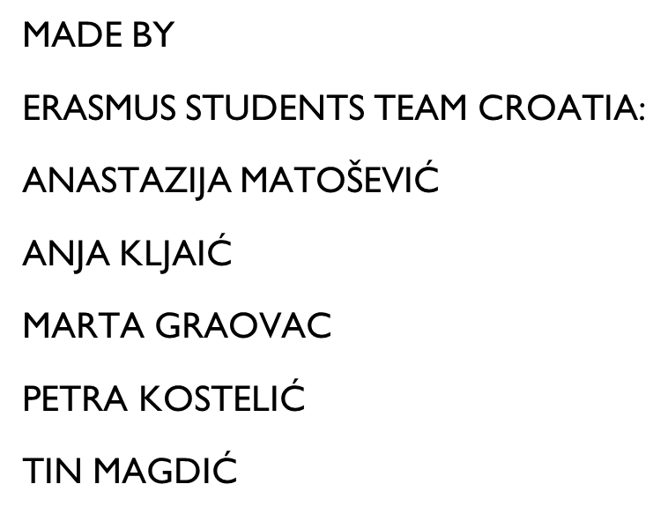
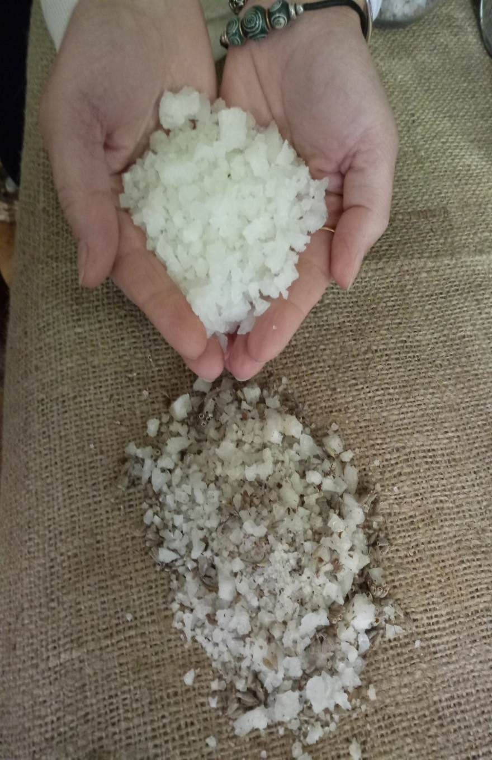
The end

