Slide 1
UNESCOPassport

Slide 2
About The ”Unesco Passport” project
The “Unesco Passport“ is a project in which we are going to explore our cultural heritage which is under Unesco’s protection on our island. We believe that heritage shapes our identity and our everyday life so we think that it is important to include it in our educational process. Our partners in this project are schools from Italy, Spain and Cyprus. There will be four teacher and student visits during the two years of the project.

Slide 3
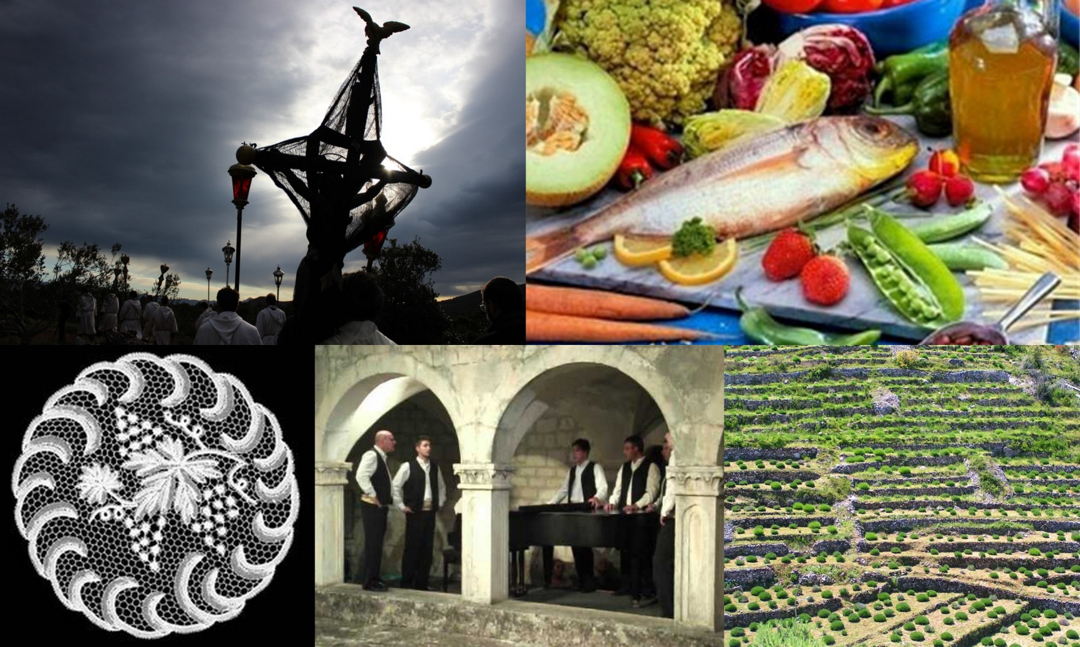
The island of Hvar has six pieces of heritage on the UNESCO World Heritage List. These are the Stari Grad Plain, the Procession Following the Cross, agave lace from the Benedictine nuns, The Mediterranean Diet, klapa singing, and recently, the art of building drywalls.

Slide 4
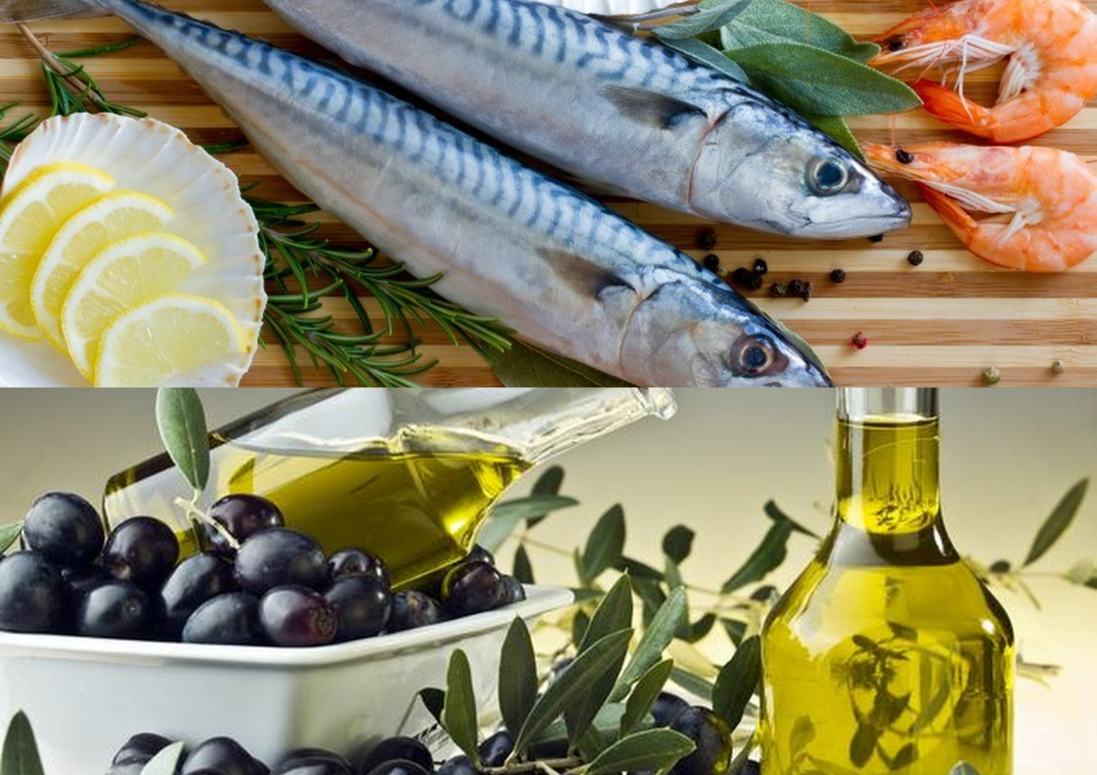
THE MEDITERRANEAN DIET

Slide 5
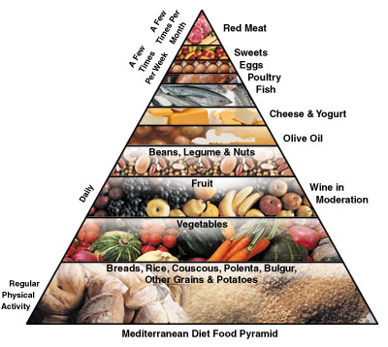
INTAnGIBLE HERITAGE
The Mediterranean diet is protected by UNESCO in Croatia. In Croatia, it has been protected since 2003. Spain, Italy, Cyprus, Portugal, Morocco and Greece are also countries where the Mediterranean diet is under UNESCO’s protection. That is the reason why we chose Spain, Italy and Cyprus as our partners.

Slide 6
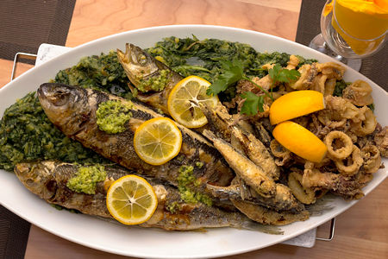
WHAT IS THE MEDITERRANEAN DIET?
It is a diet which involves a set of skills, rituals, symbols and traditions.
It includes fishing, growing crops, harvesting, animal raising, cooking and, above all, consumation with your relatives and friends.

Slide 7
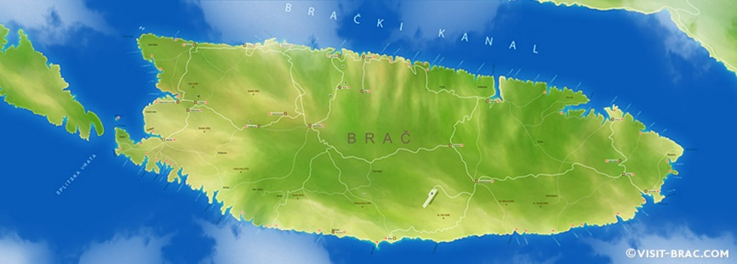
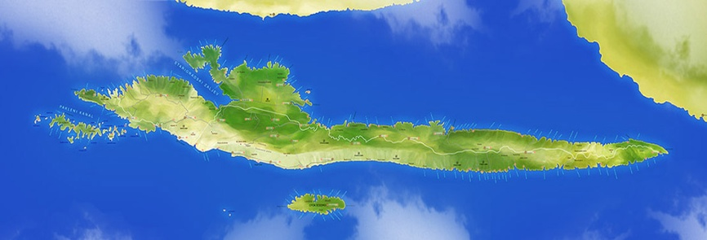
Where all in croatia is it protected?
With some of the world´s finest olive oil, a quality wine tradition dating back to the Ancient Greeks, and an emphasis on the freshest local produce, it is not hard to see why the Hvar diet is so healthy and popular.
In Croatia, the islands of Hvar and Brač are chosen to represent the Mediterranean diet.

Slide 8
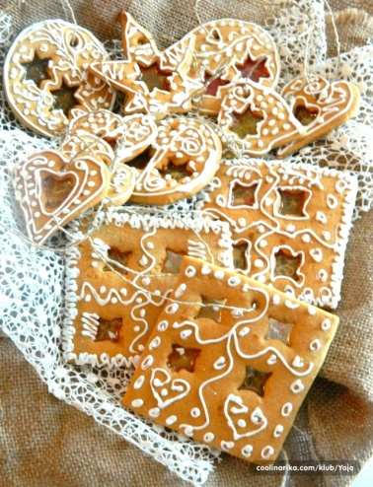
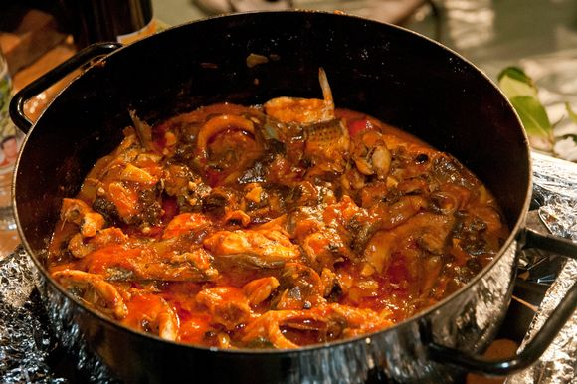
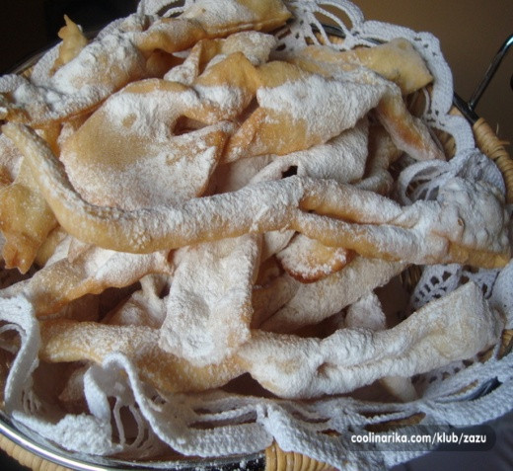
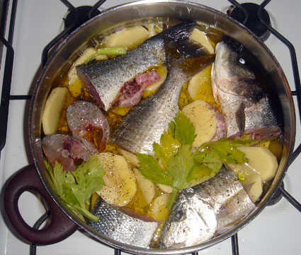
Since almost every family produces their wine and olive oil, those are one of most important parts of the diet.
Traditional main course meals in Hvar are: gregada, brujet, grilled fish and pašticada.
Traditional desserts are: hrostule, pašurate, paradižet and paprenjaci.

Slide 9
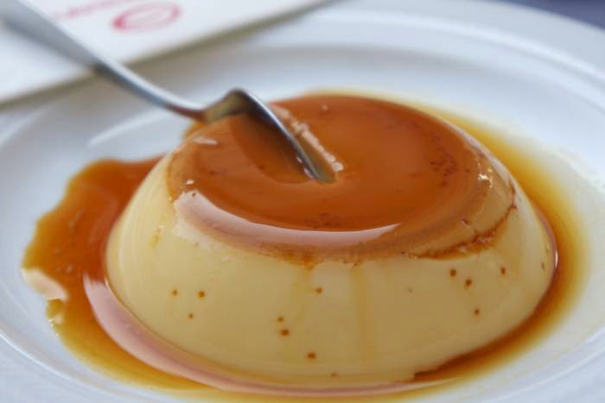
menu
Apetizer: Dalmatian smoked ham and goat cheese with olives
MAIN COURSE: grilled fish
SIDE DISH: boiled potatoes
DESSERT: rožada ( caramelised sugar, milk and eggs)

Slide 10
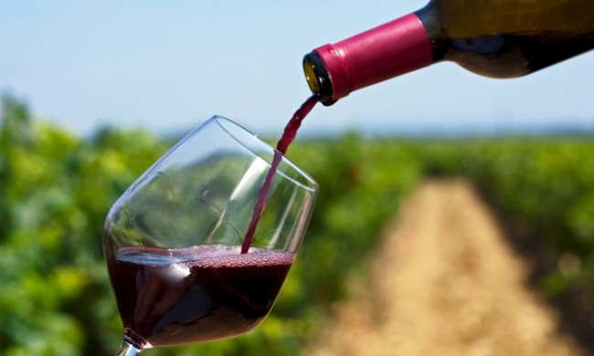
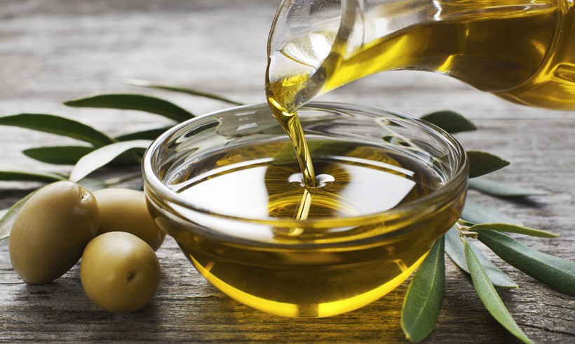
Wine and oil
We are proud of the fact that our island is home of grape vines ever since the ancient Greeks planted the original vines here back in 384BC.
Olive oil is an important part of the Mediterranean diet because it is very healthy.

Slide 11
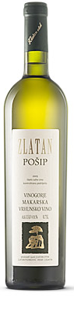
wine
Zlatan otok - Regarded as the premier producer on Hvar, his white Pošip was named best white wine in the region by Decanter Magazine and his Grand Cru is one of the best reds in Croatia.
Andro Tomić
Ivo Duboković
Ivo Carić
Plančić
PZ Svirće

Slide 12
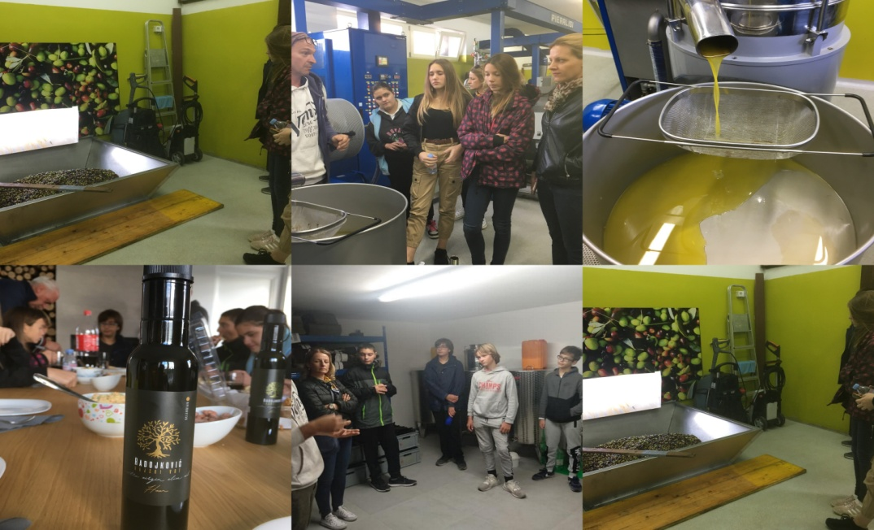
oil
There are two ways of making olive oil: cold pressed and warm pressed. There are three types of oil: extra virgin, virgin and refined olive oil.
We went to the Radojković oil refinery with this project where we learned everything about the process of making olive oil. We tasted local specialties with different types of oil. The culmination of the experience and the pleasant surprise was the tasting of ice cream with an orange flavoured olive oil!

Slide 13
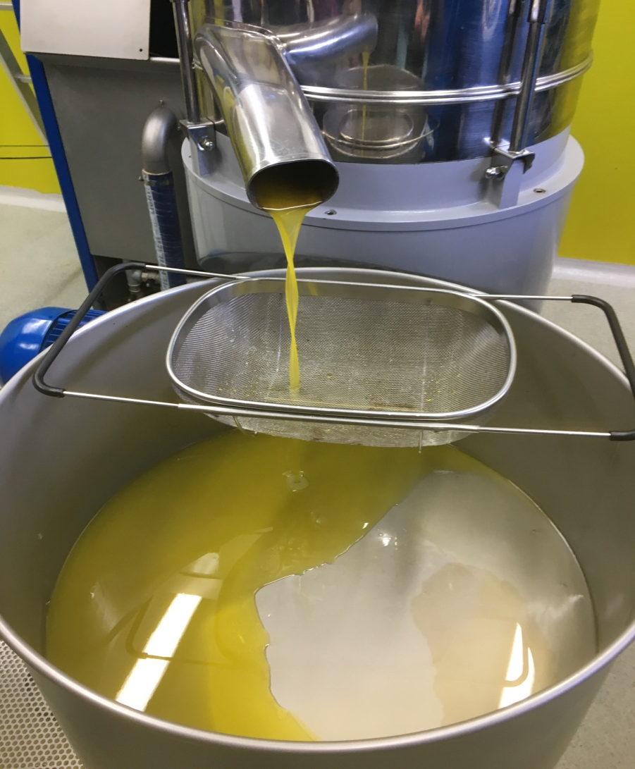
Our school cooperative ”Faria” prepares different products with olive oil, such as lip balms or face and body creams.
To make one liter of oil we need about 7 kilos of olives.
Olive oil can be made with different flavours, like lemon and orange.

Slide 14
In our project we will explore Mediterranean recipes. This will also be done by our partners. At the end of the project we will have a digital cookbook with recipes of the Mediterranean cuisine from all the four countries participating in the project.
We started working on our digital cookbook and it looks like this:

Slide 15
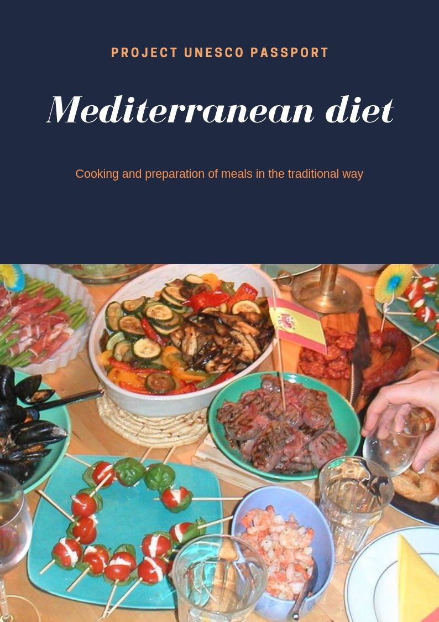

Slide 16
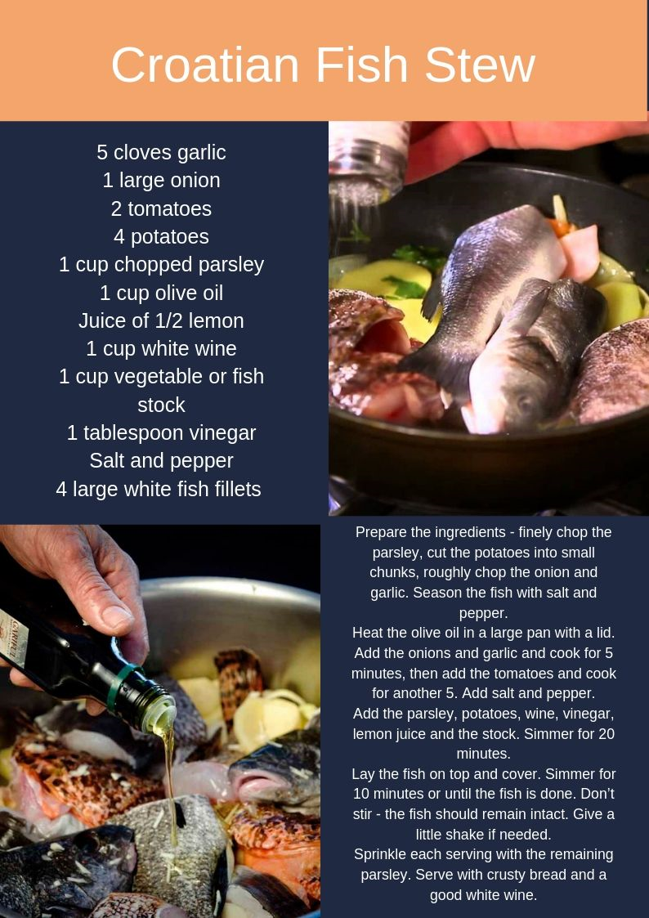

Slide 17
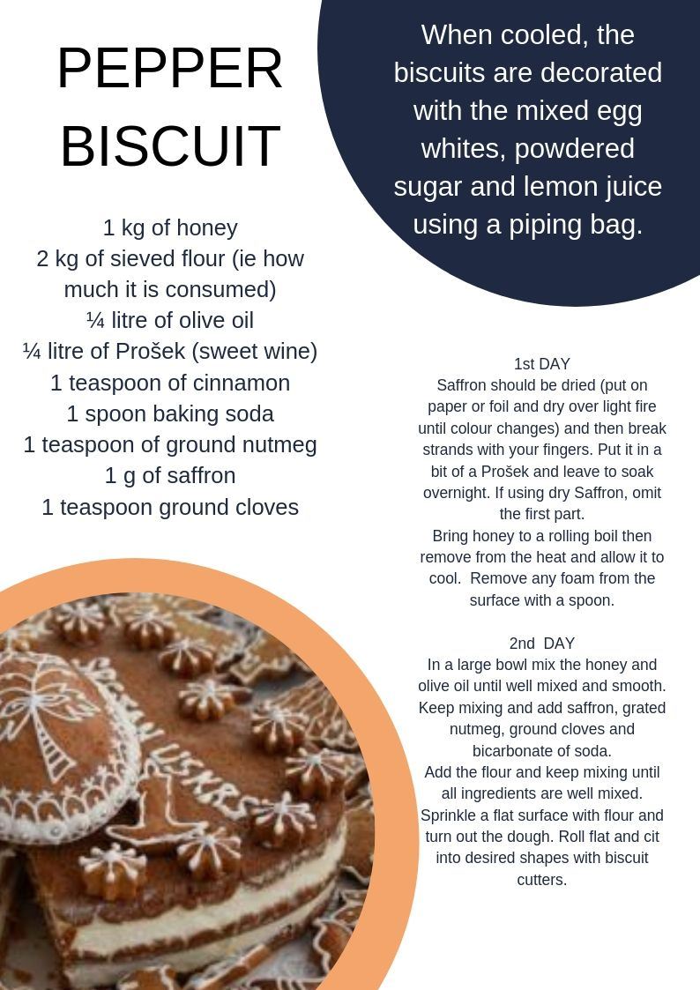

Slide 18
Thank you for your attention!

