Slide 1
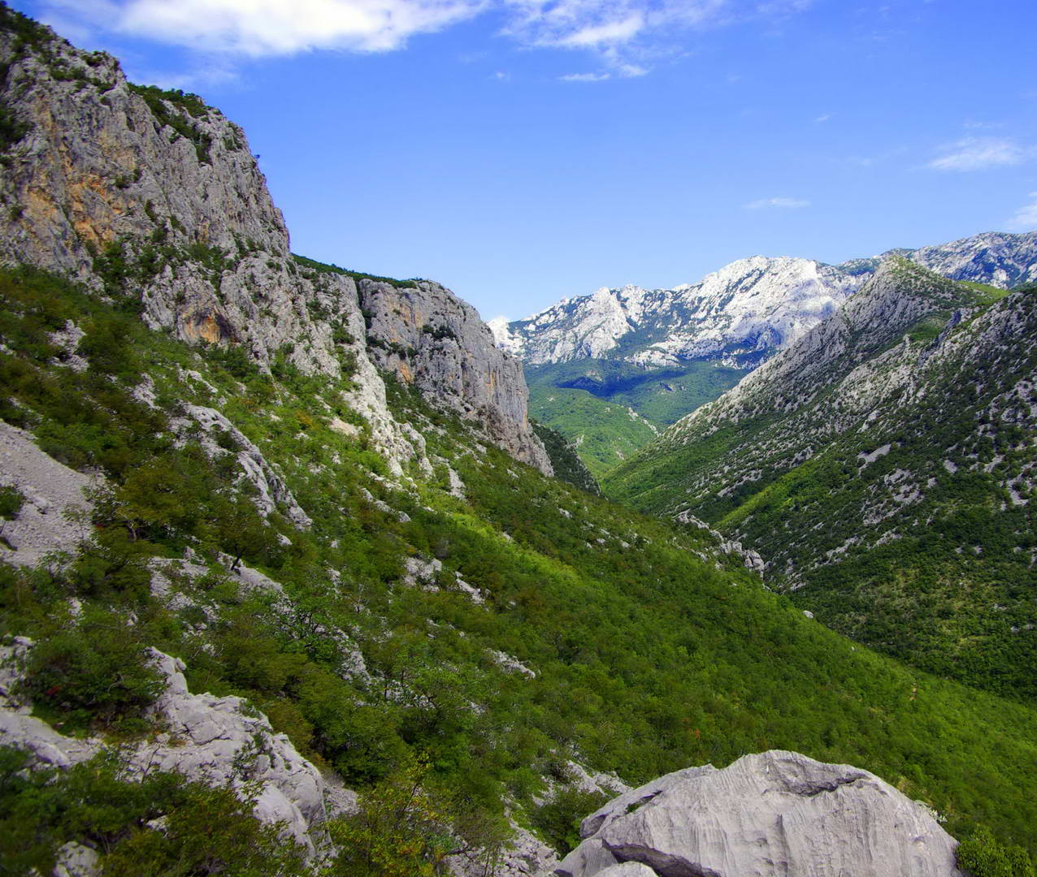
National park Paklenica
Made by Danilo Musulin

Slide 2
NP Paklenica
NP Paklenica is in Starigrad
Zadar county
Dalmatia, Croatia

Slide 3
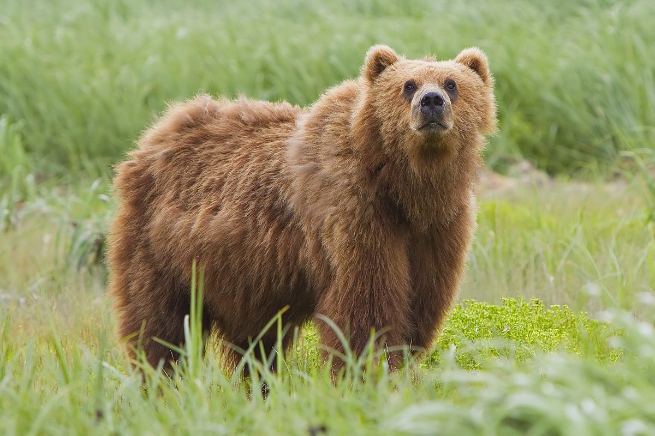
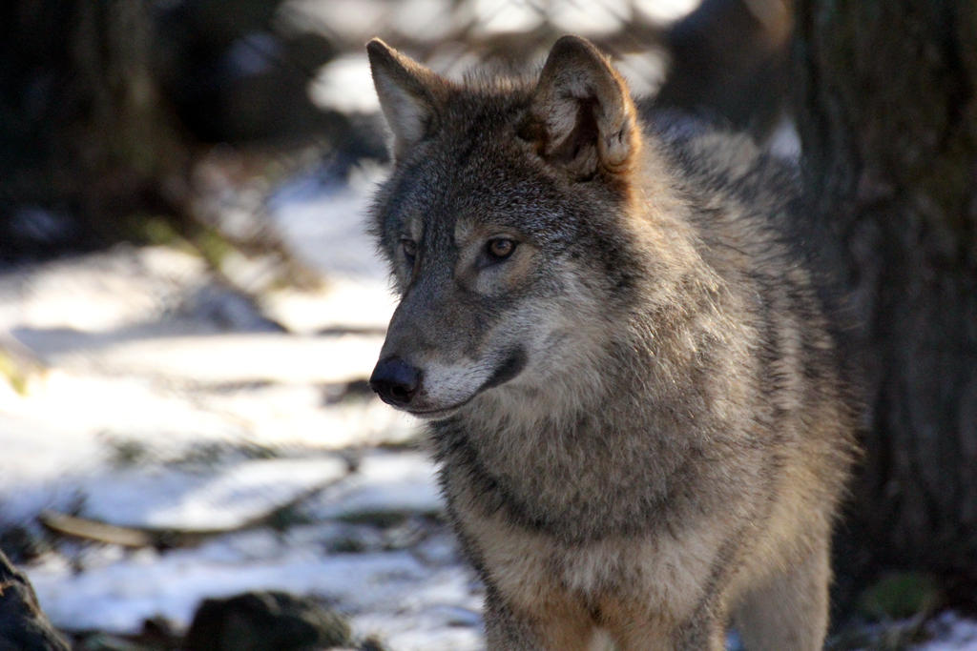
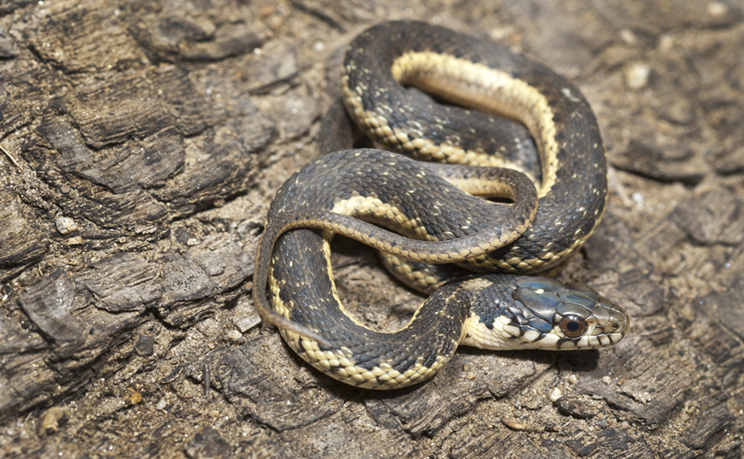
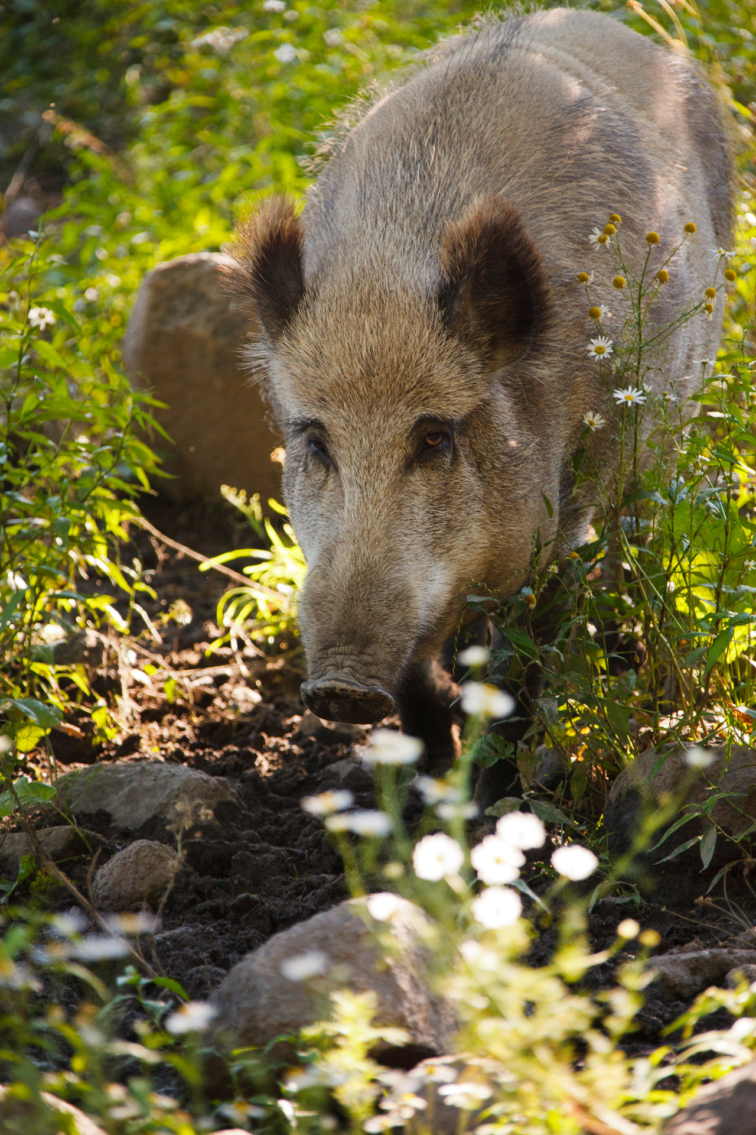
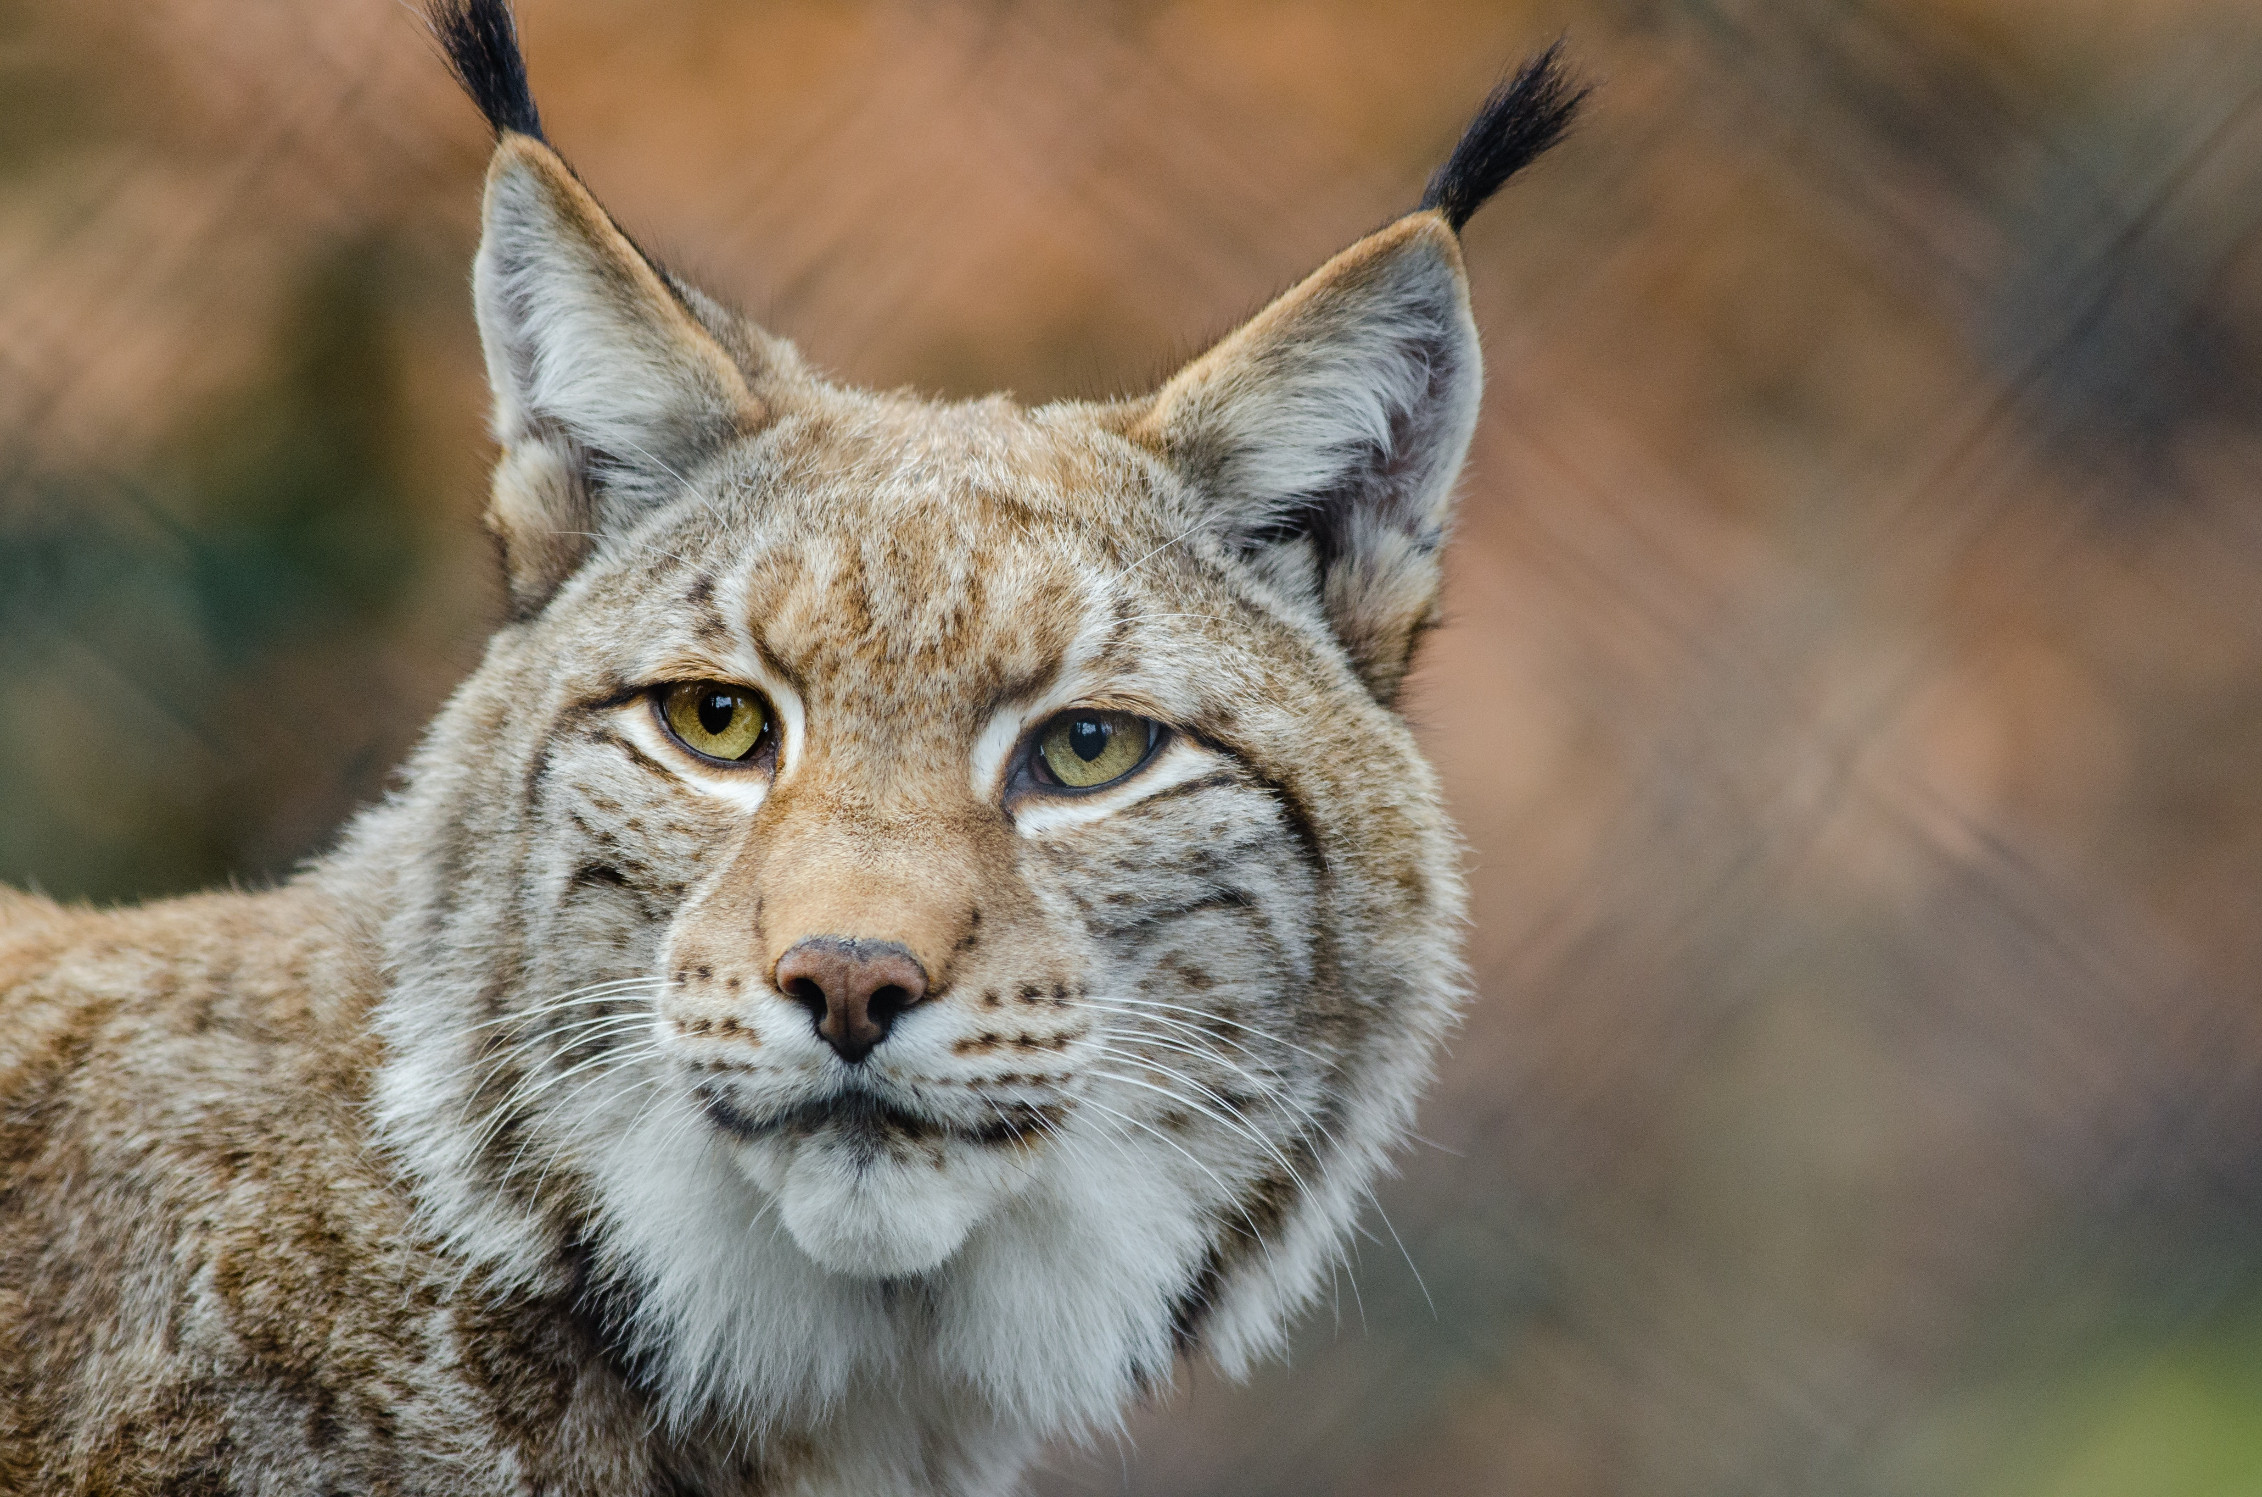
Animals that live there are:
Bear
Wolf
Snake
Lynx
Wild boar

Slide 4
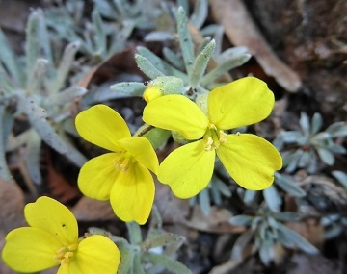
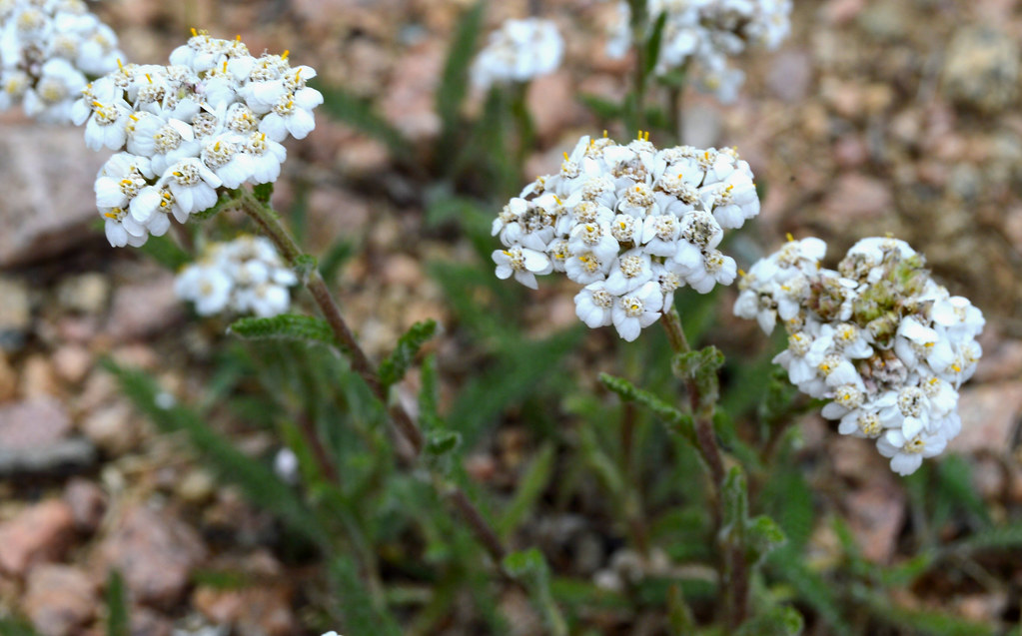
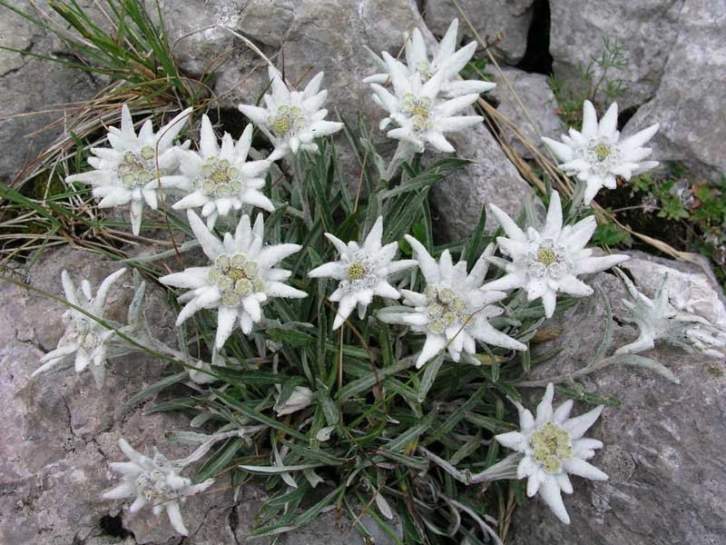
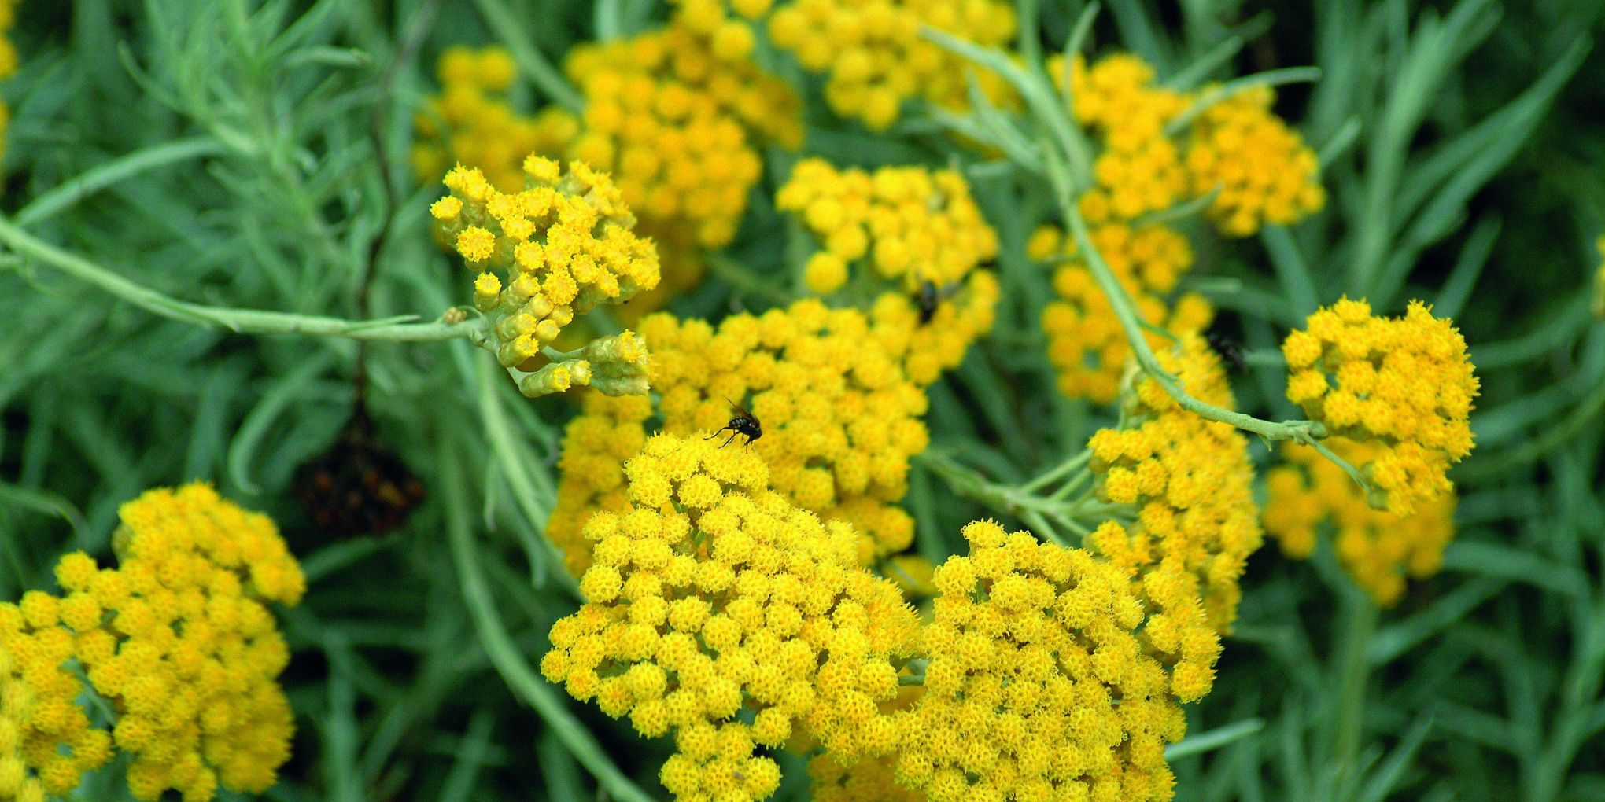
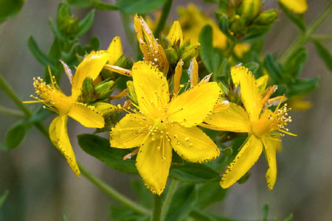
Plants and flowers that are found there are:
Velebit degenia
Immortelle
Edelweiss
Mountain yarrow
St. John’s Wort

Slide 5
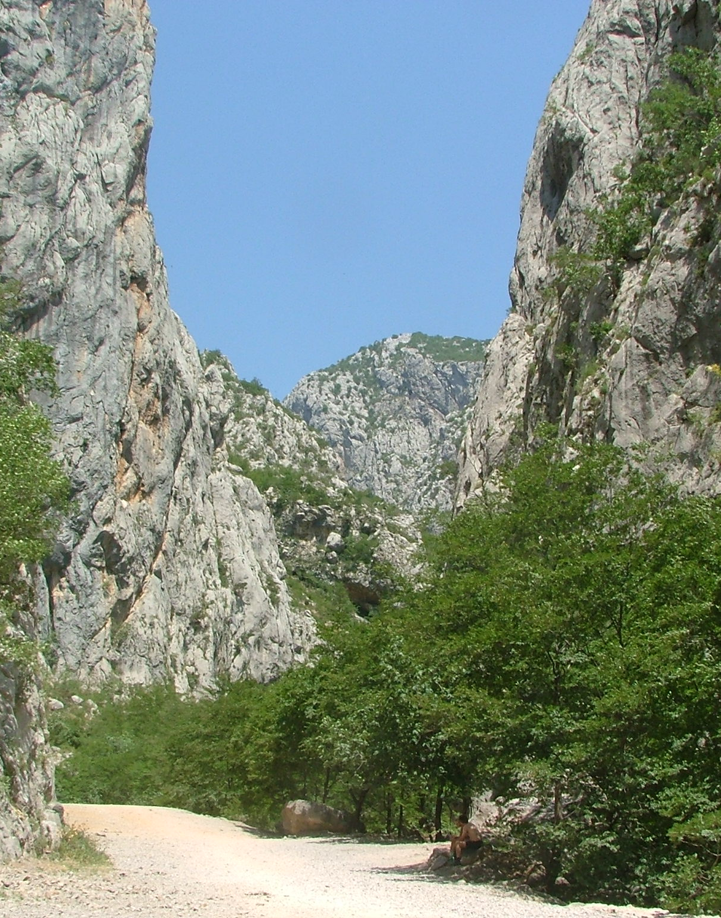
Attractions of the National Park are:
Velika Paklenica
Mala Paklenica
Sveto brdo
Vaganski vrh

