Slide 1
BEING AN ALIEN IN LONDON
Sara Grublješić
Božana Gvero
Vladimir Kljajić
Aleksandra Ninković
Vanja Vučinić

Slide 2
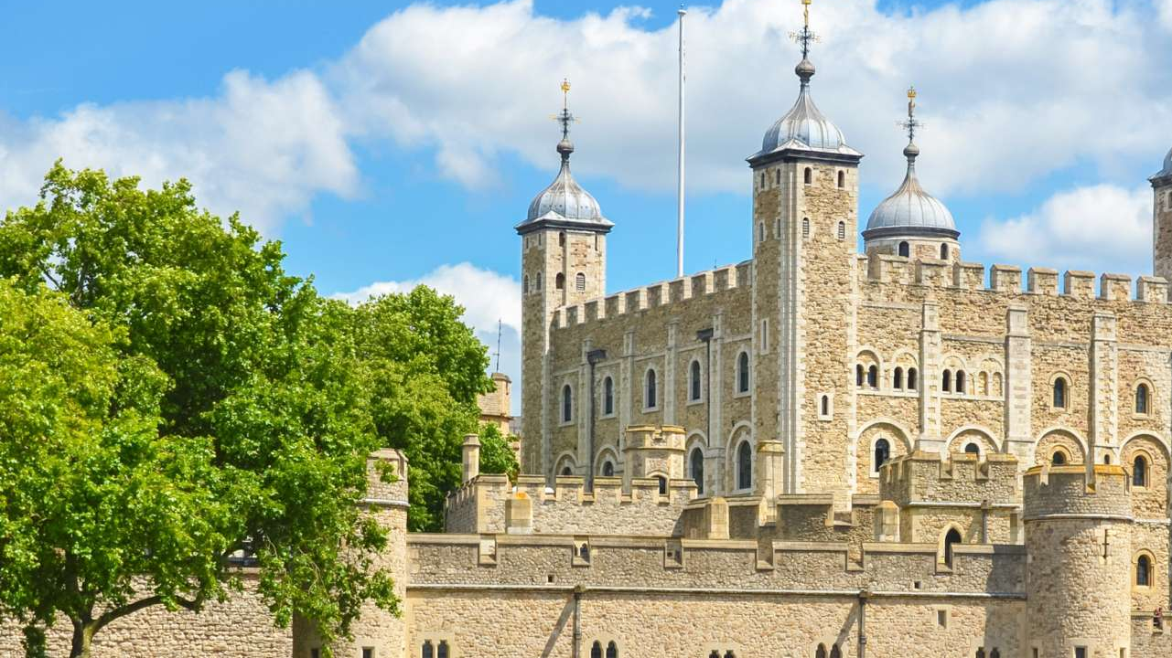
Tower of London
It is said that if the legendary ravens of the Tower of London leave, then the monarchy will fall and the Tower itself will crumble.
The Tower is said to be very haunted.
It used to be London’s first Zoo.
Despite holding famous prisoners, the Tower was never supposed to be a prison.
The Beefeaters and their families live in the Tower of London.
In both World Wars the Tower transformed into an impenetrable military base.

Slide 3
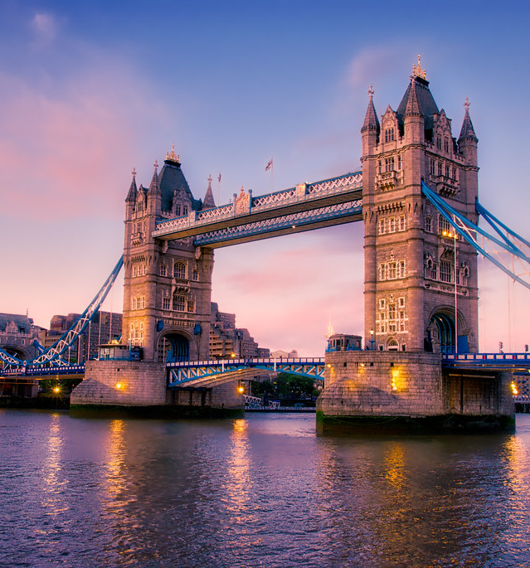
Tower Bridge
It was built to provide better access to the east end of London.
More than 400 workers helped to build the bridge and over 70000 tons of concrete were as sunk to the bed of the River Thames to support the bridge.
Over 40000 people use Tower Bridge every day.
Many people think that Tower Bridge is called London Bridge, when in fact they are two different crossings.
The Tower Bridge LEGO set, released in 2010 as set 10214, contains more than 4000 pieces.
Tower Bridge once opened…with a bus on it
It only takes five minutes to raise the bridge.

Slide 4
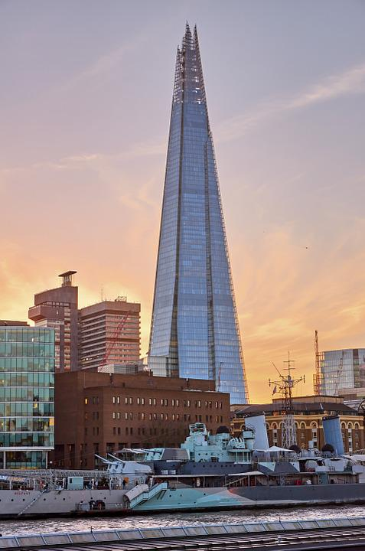
The Shard
The Shard is a hotel and a residential and business skyscraper.
It is the tallest building in the United Kingdom and one of the tallest buildings in Europe (309 meters).
The Shard is covered in 11,000 panels of glass.
The staff once found a fox on the 72nd floor and it got nicknamed Romeo and he has ever since become something of a mascot for the Shard and miniature plush versions of him are available for sale at the tower.
The Shard can be seen from 40 miles in any direction.
The builders of the Shard were quite environmentally conscious and 95% of the building materials are recycled. It is considered to be a very green building.
There are 44 lifts, including double-decker lifts.

Slide 5
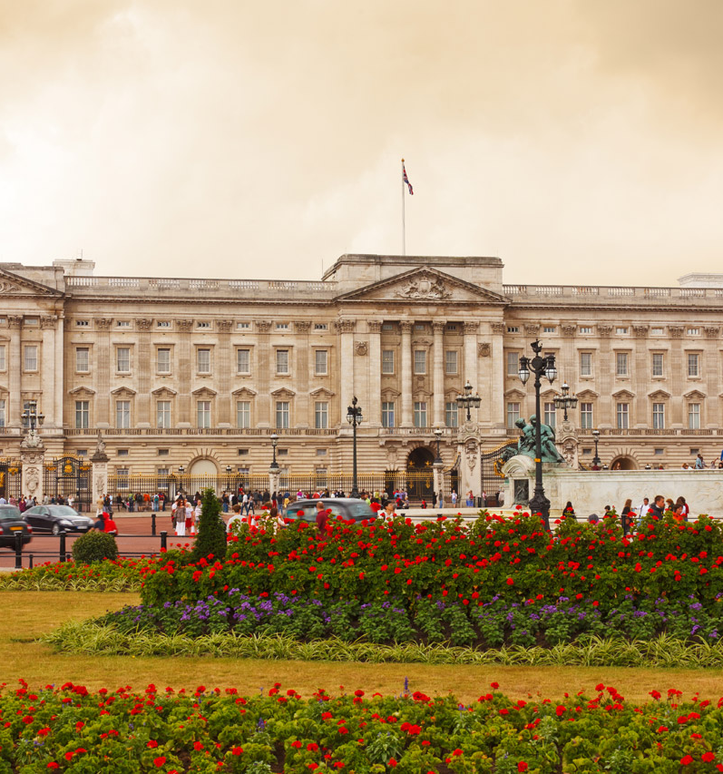
Buckingham Palace
Did you know that a teenager once broke into the Buckingham Palace and stole Queen Victoria’s underwear?!
If the Union Jack is flying, it means the queen is away.
Queen Elizabeth II hosts at least three garden parties every summer in the Buckingham Palace’s 39-acre private garden, where guests consume about 20,000 sandwiches per party.
There’s an ATM inside the Buckingham Palace.
Miraculously the Buckingham Palace survived 9 German bomb attacks during World War II.
The palace is comprised of 775 room. Of these there are 52 royal and guest bedrooms, 188 staff bedrooms, 92 offices, 19 state rooms and 78 bathrooms.

Slide 6
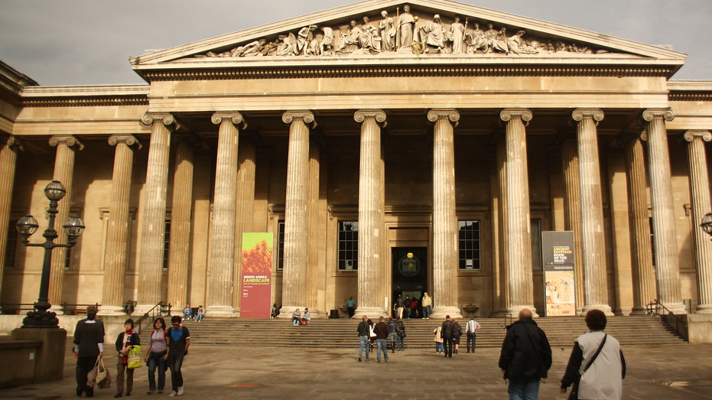
The British Museum
The oldest object in the collection is a stone chopping tool thought to be almost 2 million years old.
Only around 1% of the museum’s collection (80,000 objects) is on display to the public.
The British Museum is the largest in the world covering over 92,000 square meters.
In 1972 almost 1.7 million visitors saw the temporary exhibition “Treasures of Tutankhamun” making it the most successful in the British history.
During the second World War key items such as the Rosetta Stone were moved to secret locations including an underground train station for their protection.

Slide 7
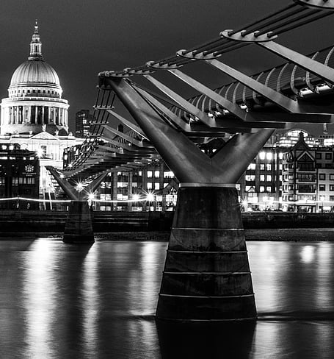
Millennium bridge
It opened in 2000, after taking two years to build. It has a span of 144 meters and is 4 meters wide. 5,000 people can be on the bridge safely at the same time.
St Paul’s Cathedral and the Tate Modern museum are linked by this fantastic bridge.
The bridge is completely pedestrianized.
The magnificent structure is covered in 400 tiny pieces of artwork, all made from chewing gums!
The Millenium Bridge was the first new river crossing in London for over 100 years.

Slide 8
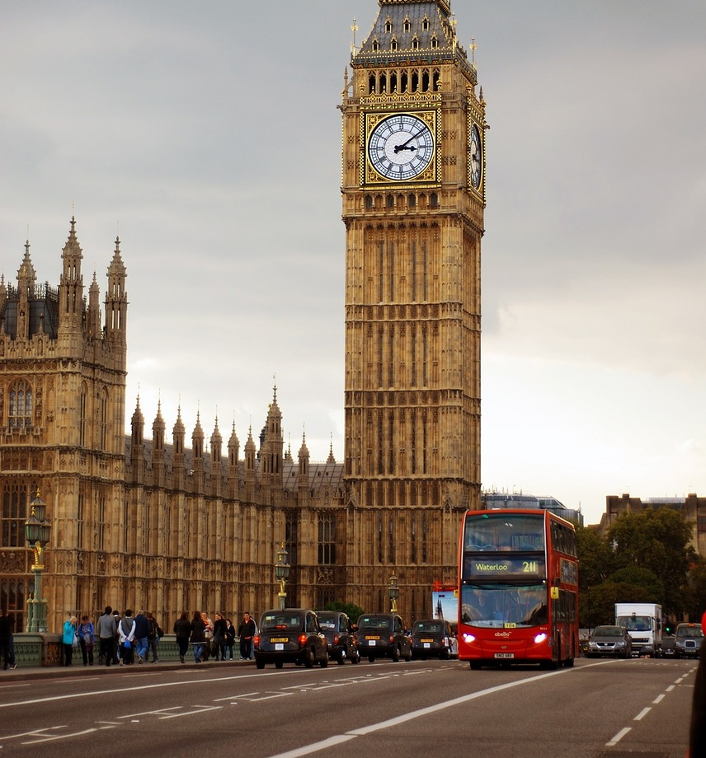
Big Ben
Big Ben is actually called Elizabeth Tower. It was only in 2012 that the tower was given its current name, as an honor to Queen Elizabeth on her jubilee.
The bell of Big Ben weighs over 13 tones.
Big Ben’s clock face began ticking in 1859.
There’s a Latin saying beneath Big Ben’s clock face. It reads ‘O Lord, keep safe our Queen Victoria the First’.
The Elizabeth tower has a total of 399 steps.
Big Ben’s clock faces are made of glass. In fact, there are 312 pieces of glass in each of Big Ben’s clock dials.
You can tour Big Ben which has been closed during its refurbishment.

Slide 9
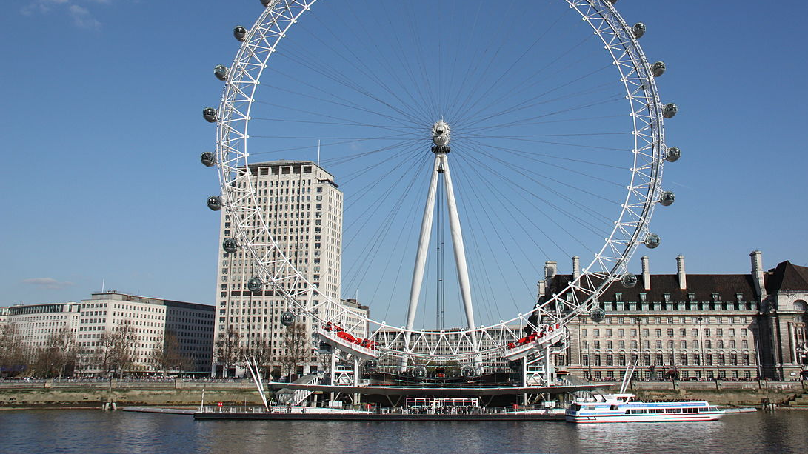
London Eye
The London Eye, at 443 feet tall, is the world's fourth-largest Ferris wheel.
It can carry 800 people at once.
It attracts millions of tourists. The London Eye is now the most popular paid tourist attraction in the United Kingdom.
The entire Wheel weighs more than 1000 tons.
The London Eye is the most voted romantic destination.

Slide 10
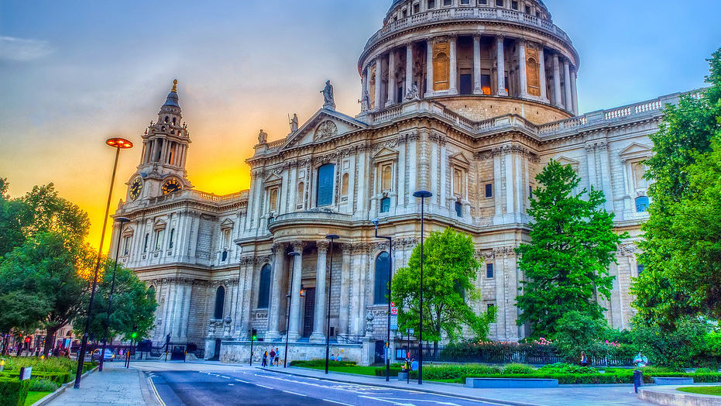
St Paul’s Cathedral
St Paul’s Cathedral was the tallest building in London from its construction until 1962.
In Whispering Gallery, a whisper against the wall can be clearly heard at the other side, 112 feet away.
The cathedral’s crypt is the largest in the Western Europe. There are over 200 monuments and memorials in the crypt.
Funeral services have been held at St Paul’s, for instance Winston Churchill and Lord Nelson. The wedding of Prince Charles and Princess Diana was also held there.
St Paul’s Cathedral is one of the largest churches in the world.

Slide 11
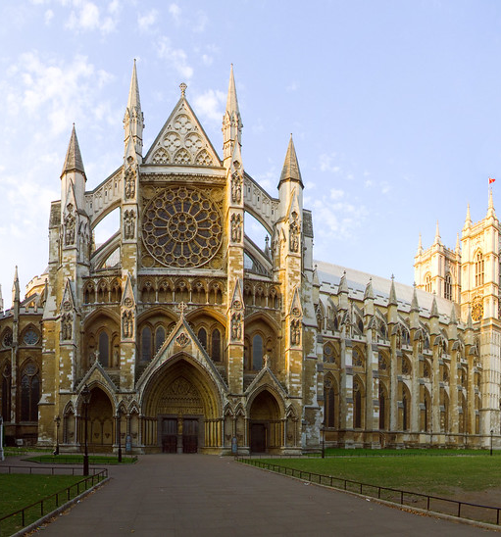
Westminster Abbey
The official name for Westminster Abbey is the Collegiate Church of St Peter at Westminster.
Over 3,300 people have been buried or commemorated at Westminster Abbey. This includes seventeen British monarchs. Other notable people buried at Westminster Abbey include Isaac Newton, Edward the Confessor and Charles Dickens.
There’s a Statue of a bearded lady there.
There’s is also the Poets’ corner.
The Da Vinci Code made it more famous.

Slide 12
THE END

