Slide 1
MAKING THE MOST OF NEW TECHNOLOGIES, APPS AND SOCIAL MEDIA IN THE CLASSROOM
TENERIFE, 7. – 13. TRAVNJA

Slide 2
CILJEVI TEČAJA
DOBITI UVID U NEKE OD NAJPOPULARNIJIH APLIKACIJA ZA KORIŠTENJE U NASTAVI
UPOZNATI SE S DRUŠTVENIM MREŽAMA I NAUČITI KAKO IH KORISTITI U NASTAVI
NAUČITI NAPRAVITI WEB STRANICU ILI BLOG
DOBITI NOVU PERSPEKTIVU VEZANU ZA IKT
UČINITI NASTAVU ZANIMLJIVIJOM UZ POMOĆ NOVIH ALATA
PODIJELITI ISKUSTVA S KOLEGAMA IZ DRUGIH DRŽAVA

Slide 3
APLIKACIJE I ALATI S KOJIMA SMO SE UPOZNALI NA TEČAJU SU:
TED ED
GENIALLY
WORDWALL
ACTIONBOUND
MENTIMETER
BAAMBOOZLE
FIGJAM
PADLET
CANVA
LINGOCLIP
MONKEY QR
https://padlet.com/iclofent/new-tech-04-24-tqbe8encddwrb9ry

Slide 4
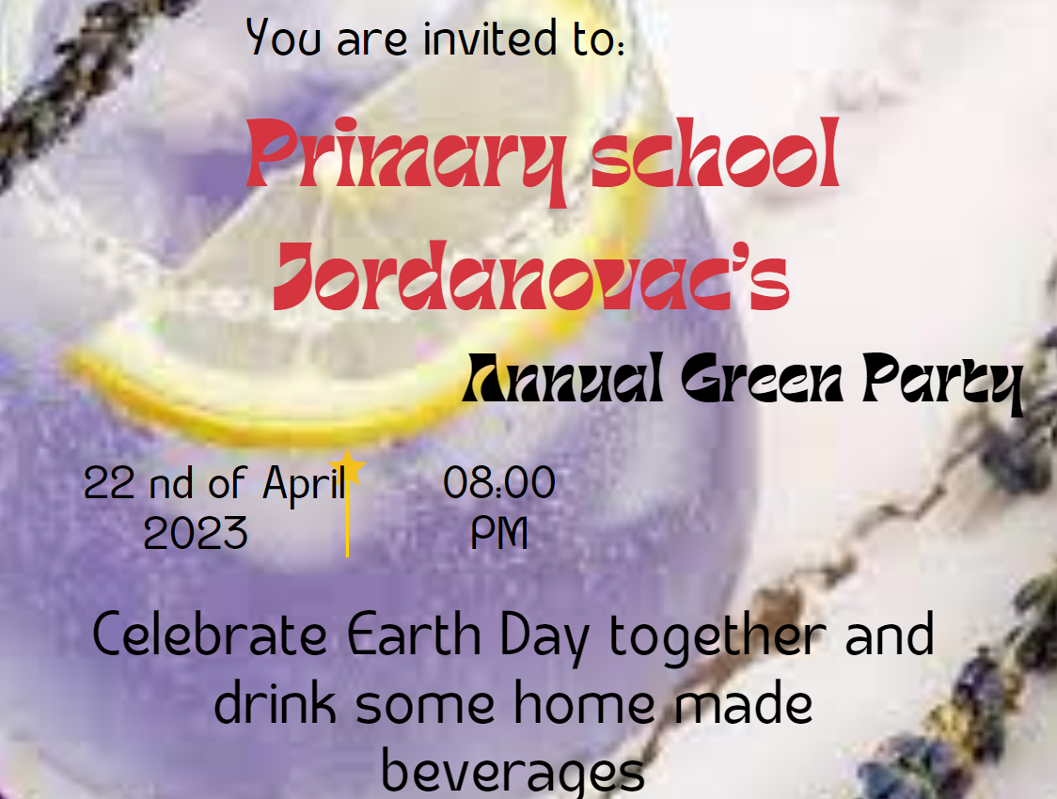
CANVA

Slide 5
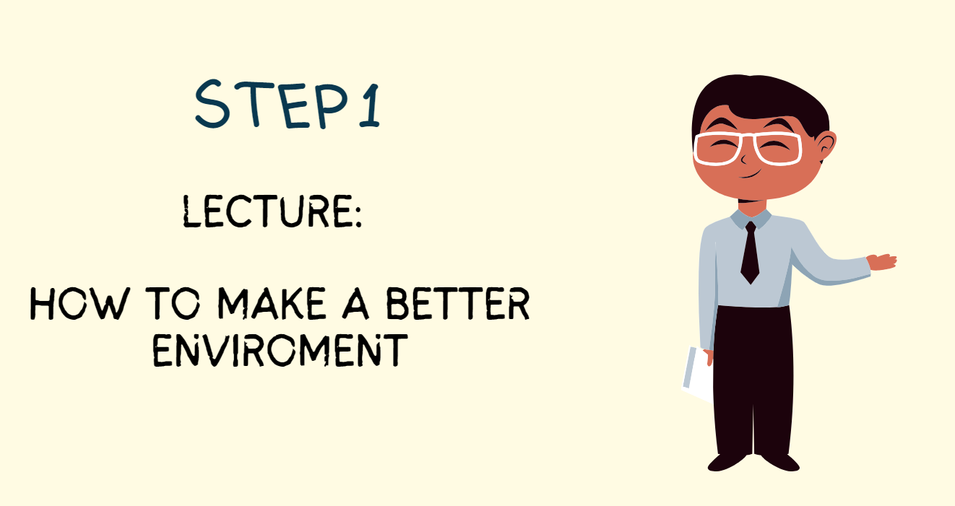
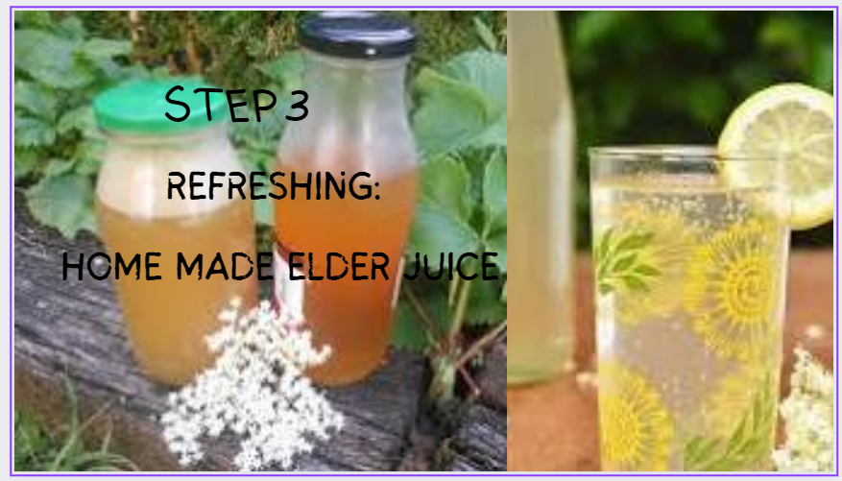
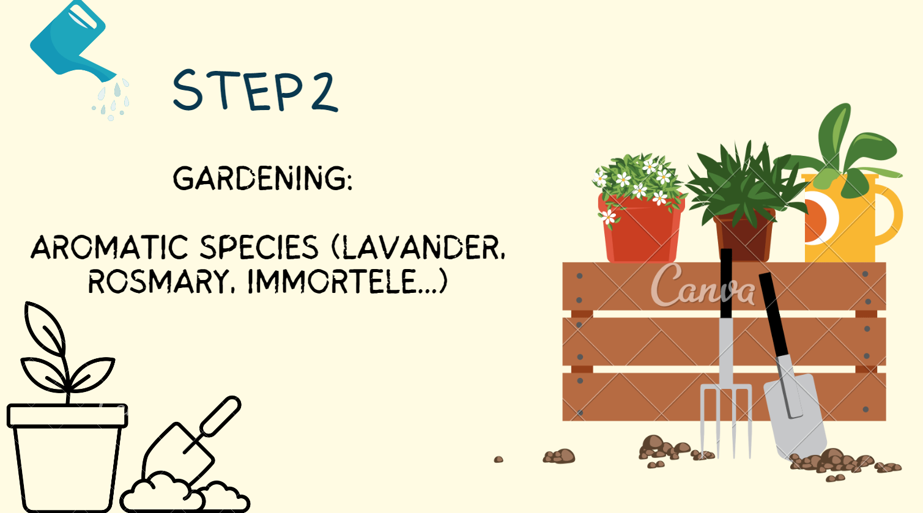
https://www.canva.com/design/DAGCL0EK12Y/Hkfx86fSrlvFZzeadwVAzQ/view?utm_content=DAGCL0EK12Y&utm_campaign=designshare&utm_medium=link&utm_source=editor#5

Slide 6
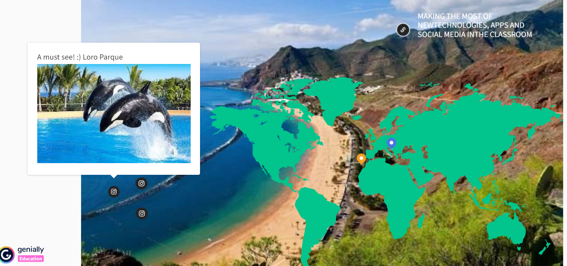
GENIALLY
https://app.genial.ly/editor/6618fd2f62422e00141fd620

Slide 7
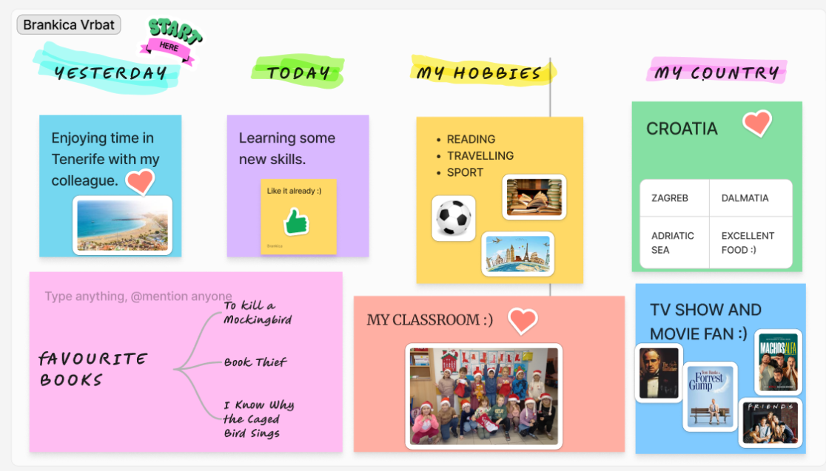
FIGJAM

Slide 8
PADLET
https://padlet.com/BrankicaV/primary-school-jordanovac-zagreb-h7leia0mhqs5rwnw

Slide 9
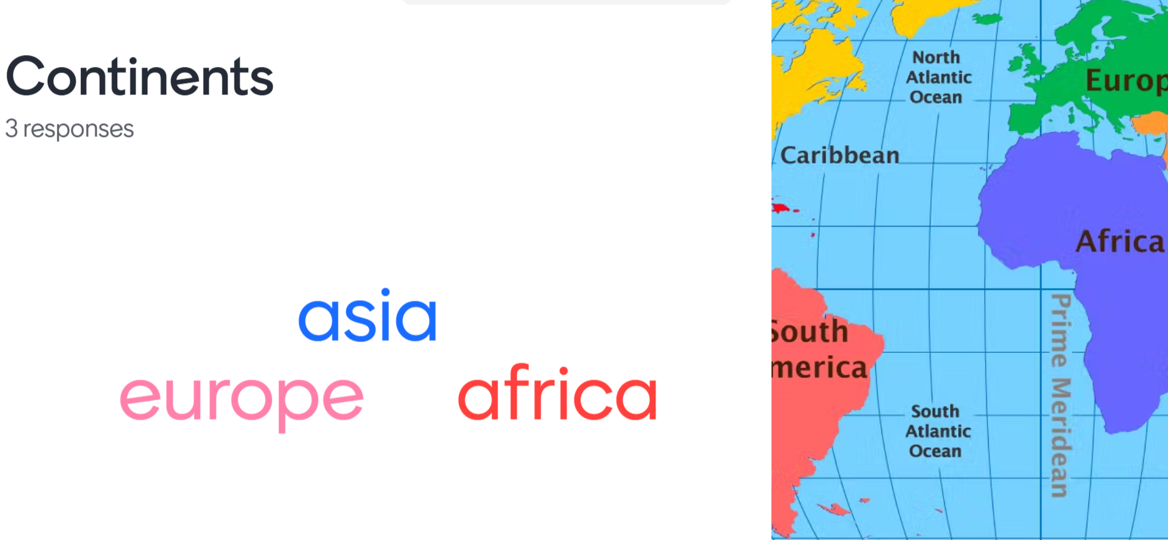
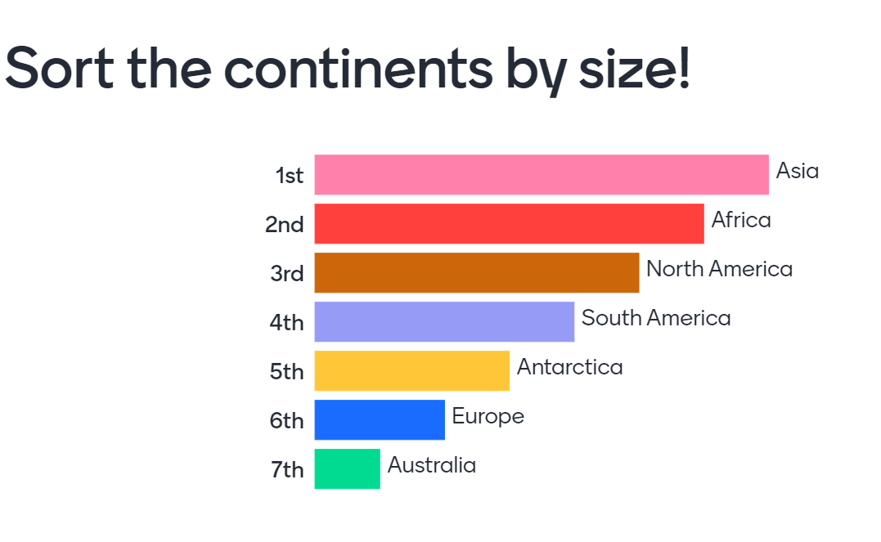
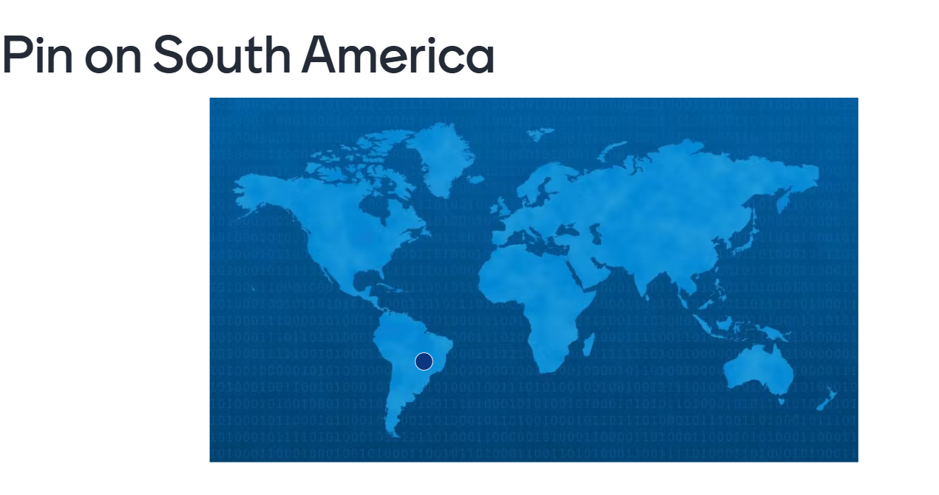
MENTIMETER
https://www.mentimeter.com/app/presentation/alrjjoon4a9mgn5wc1nf6nmafpdgp6hm/heji23gemya1

Slide 10
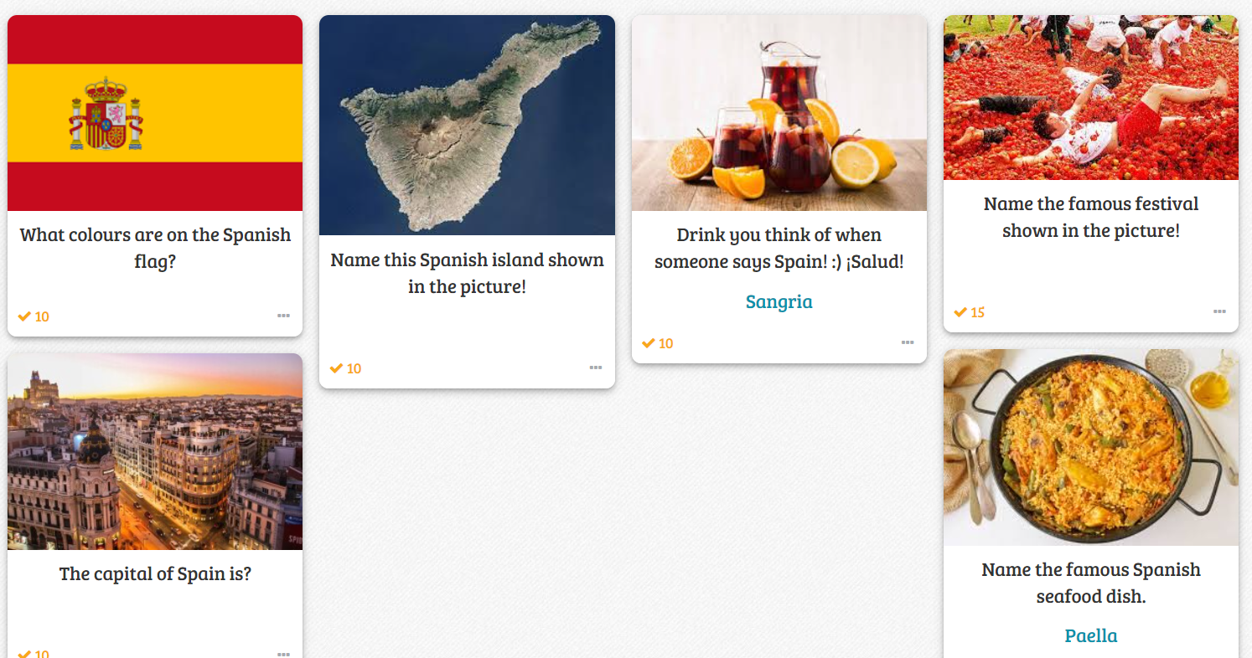
BAAMBOOZLE
https://www.baamboozle.com/mygames

Slide 11
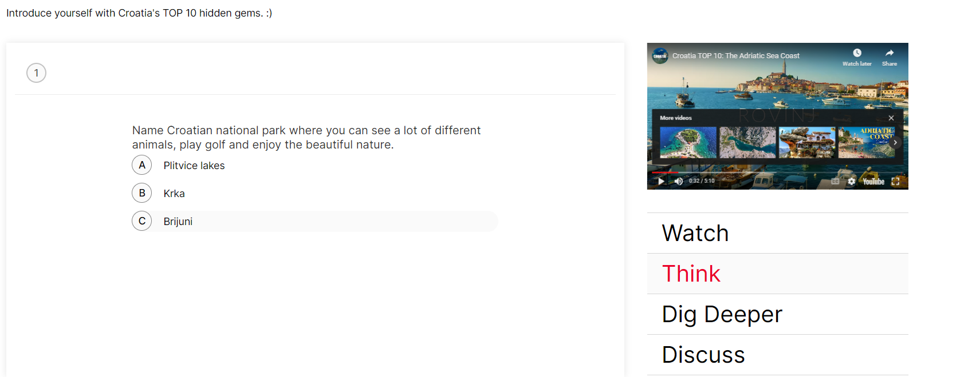
TED-ED
https://ed.ted.com/on/hOuesWre

Slide 12
https://en.actionbound.com/qrcodes/things-to-do-in-tenerife
ACTIONBOUND

Slide 13
WORLDWALL
https://wordwall.net/resource/17205471/hrvatski-jezik/lektira-tri-medvjeda-i-gitara

Slide 14
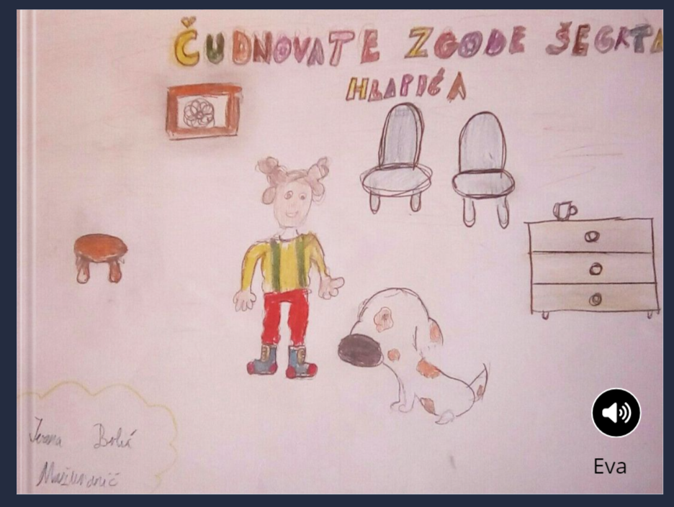
https://read.bookcreator.com/u67vO6uuWBf0qRJXyX4rsNxeayv2/6Ype1DtNQZ2beBdleFDgXQ/6e47GHEySCSwwVTIJsUWIA
BOOK CREATOR

Slide 15
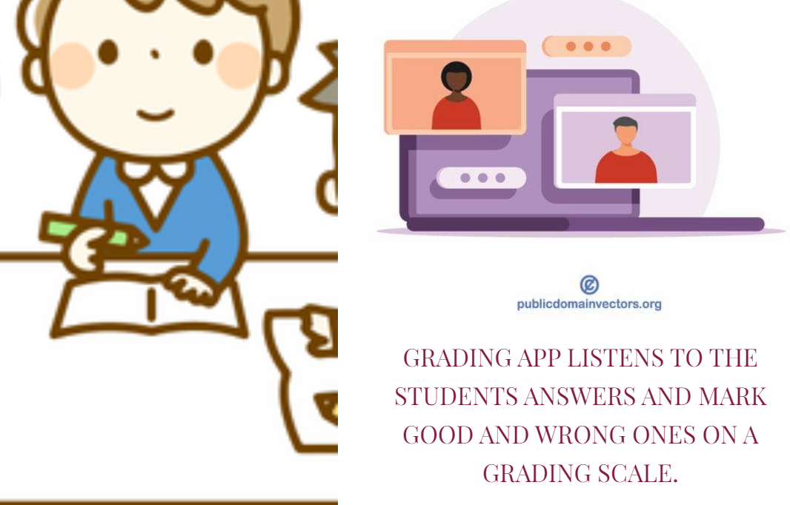
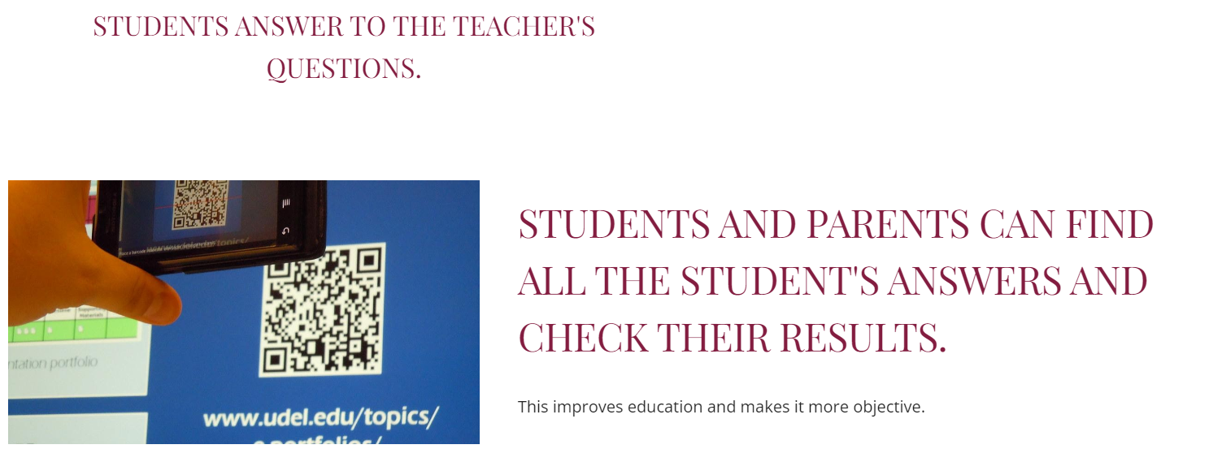
MY DREAM APP
https://sites.google.com/view/brankicaimirta/home

