Slide 1
PEBBLE "Bepo"
The Method of Making

Slide 2
SOMETHING ABOUT THESE
Harmony singing is a traditional Croatian vocal music from Dalmatia.
It is sung in many voices, unaccompanied by musical instruments.
Harmony singing is extremely popular in Omiš with it’s annual festival. We just celebrated 50 years of this event. We created an original souvenir in honor of this tradition.

Slide 3
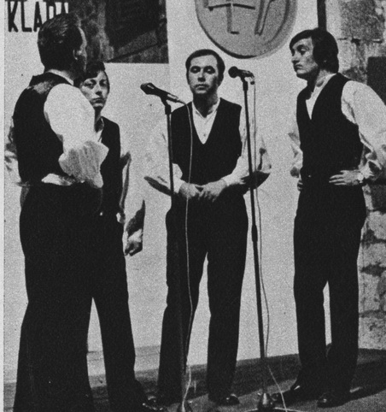
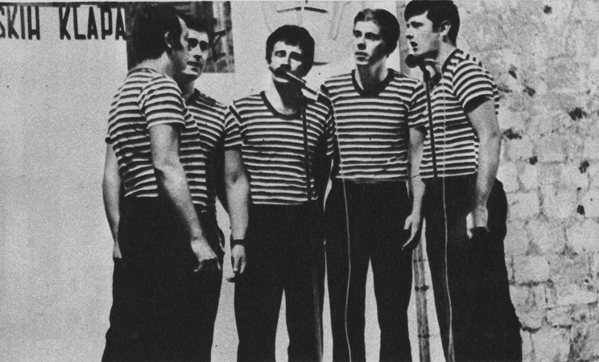
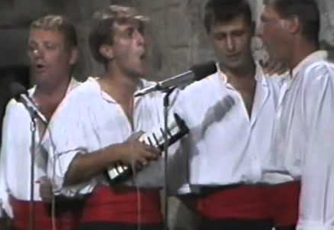
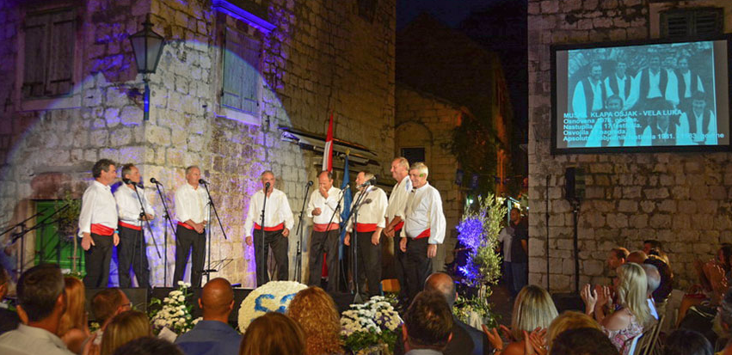

Slide 4
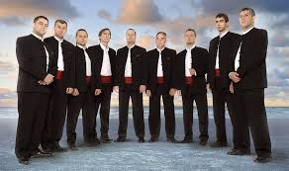
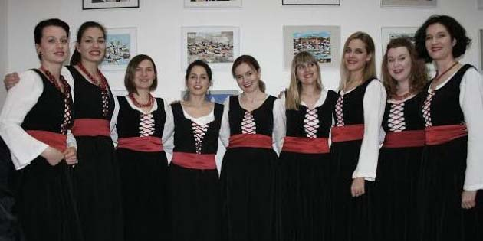
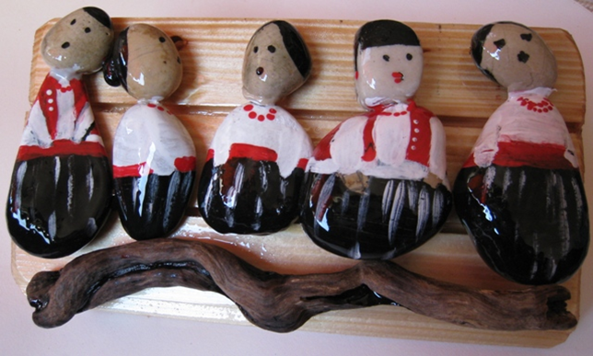
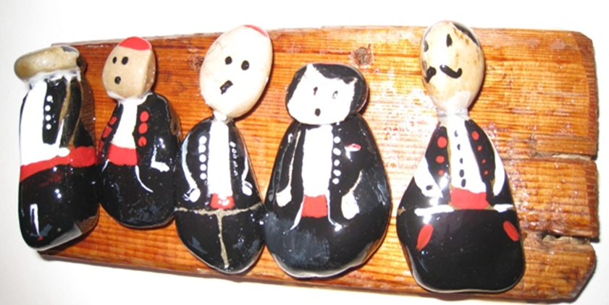
We are sure that you will be able to replicate a harmony singer.

Slide 5
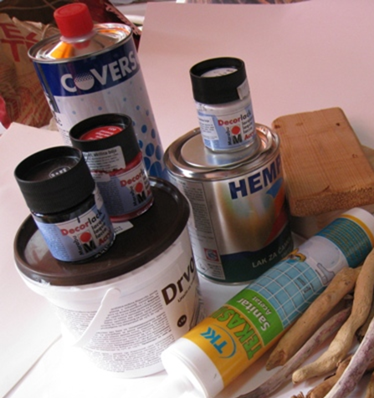
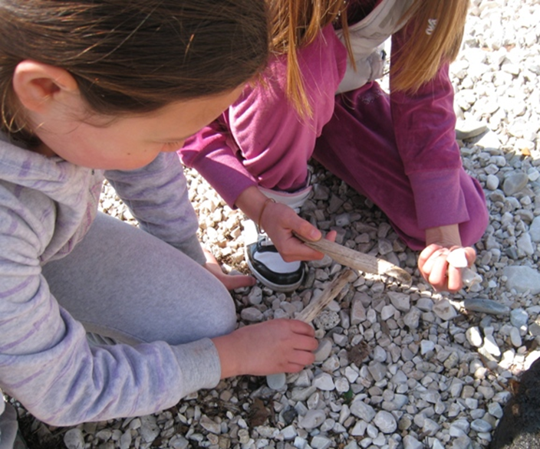
We have prepared the paint and glue that is needed for the making. We gathered pebbles in various shapes and sizes to form the head and body.

Slide 6
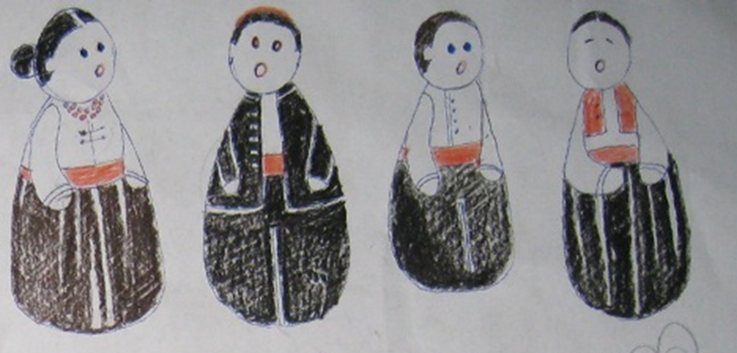
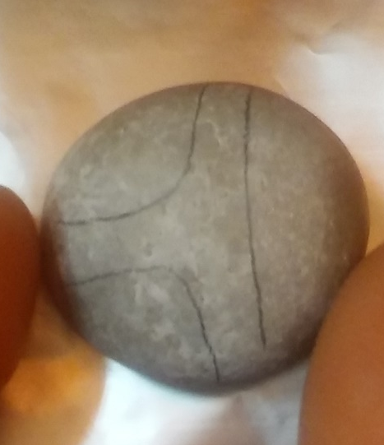
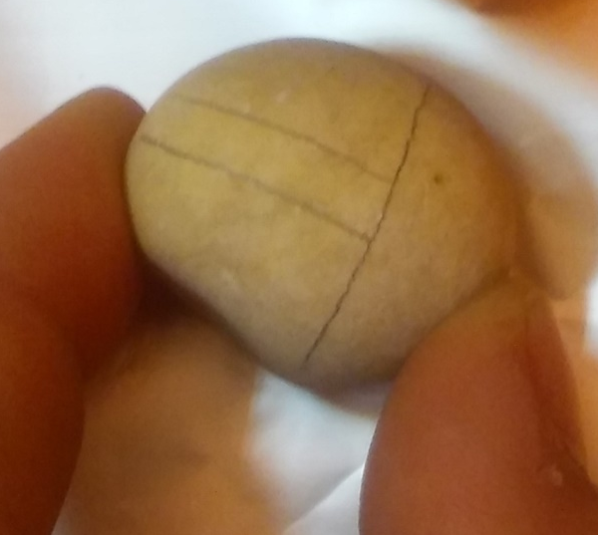
According to the sketch, we must outline the simple contours of the body.

Slide 7
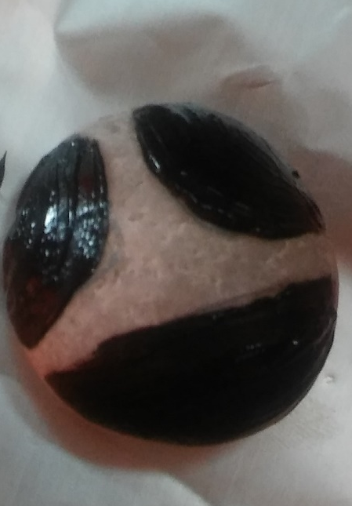
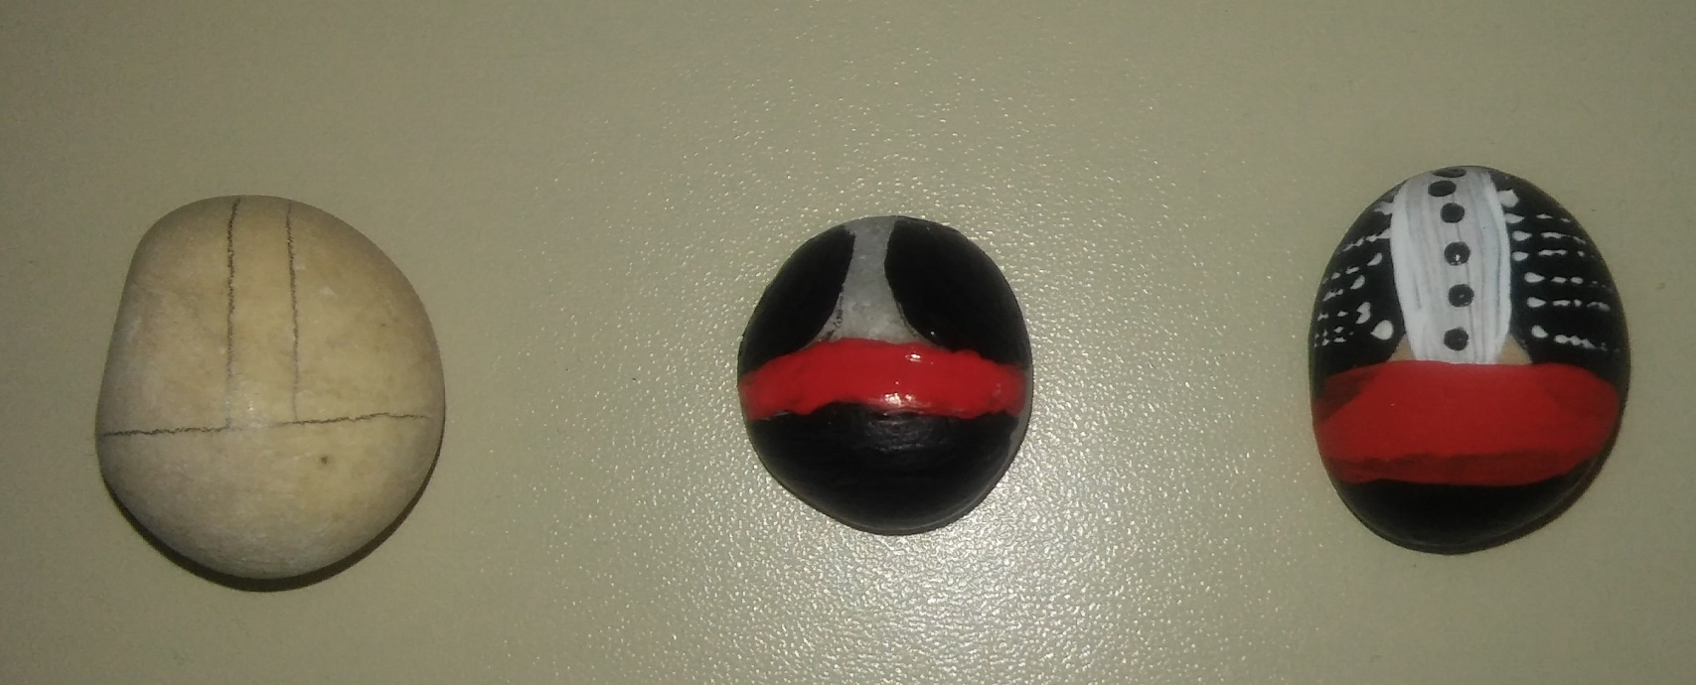
The black color is used to paint the pants and jacket. Red is used for the belt. White paint for the front of the shirt. Contour paint to add buttons and details.
.

Slide 8
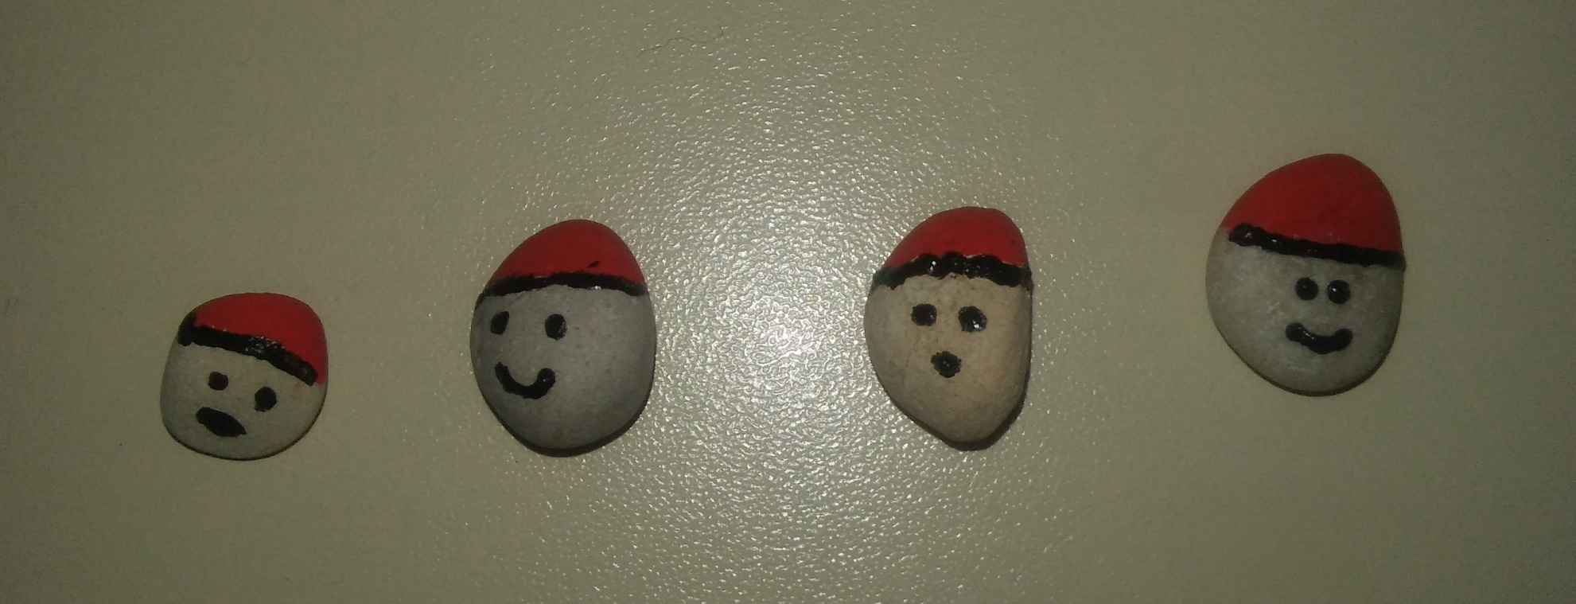
On the small pebbles, we add the hat, hair, eyes and mouth.

Slide 9
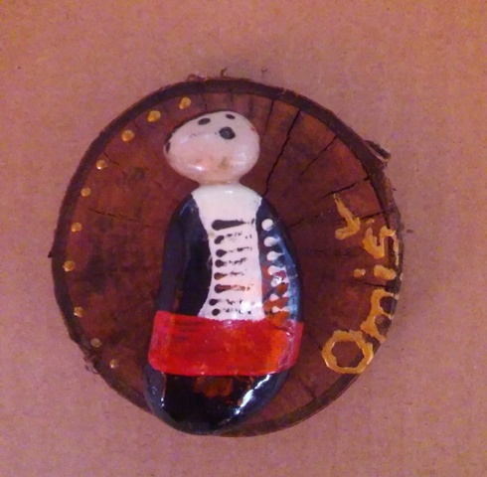
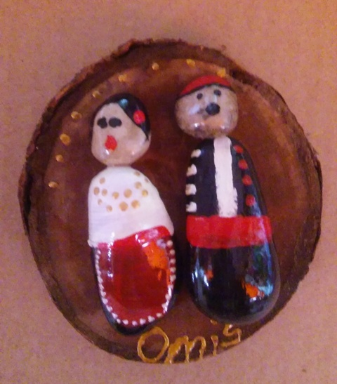
Finished parts are then glued to a wooden base and a magnet is placed on the back. We have just completed a souvenir that will remind you of Omiš.

Slide 10
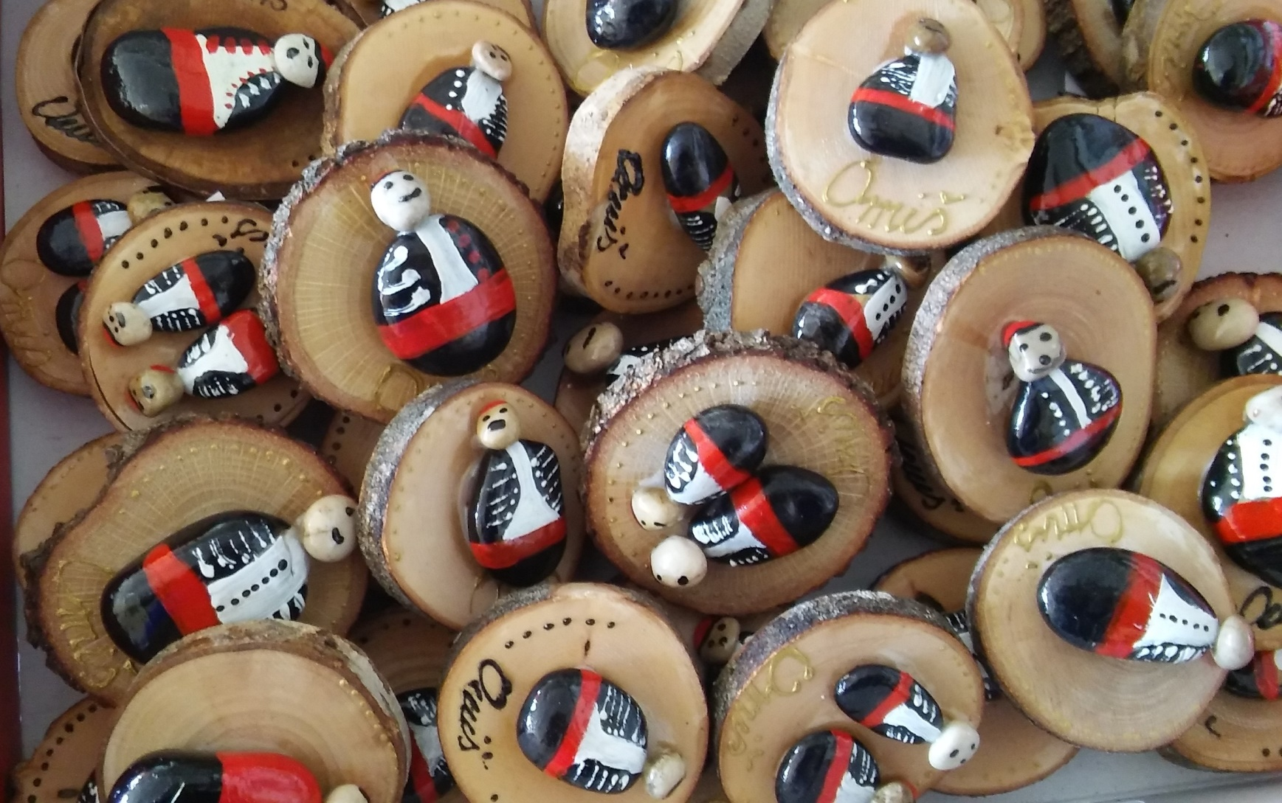
Go ahead and try! Good luck!

