Slide 1
National Park Plitvice Lakes

Slide 2
blazon
declared a national park on April 8. 1949
it is the largest, oldest and most popular Croatian national park
UNESCO declared world heritage in 1979
in 2011 there were more than one million visitors for the first time

Slide 3
Accommodation
there is the source of the river Korana
consist of 16 lakes located between Mala Kapela and Pljesivice in Lika

Slide 4
6

Slide 5
Name
Dominik Vukasović pastor from Otočac was first mentioned in the title of "Plitvice" in a written document from 1777
Some scientists believe that the name of the park comes from the river Plitvica that meets the Plitvice Lakes.

Slide 6
Animals
brown bear
lynx
otter
wolf
hawk
many species of woodpeckers and forest owls

Slide 7
Plants
The most common tree species: Beech, fir, white pine
The park has registered 1,267 different plant species of which 50 species are orchids.

Slide 8
History
According to legend the Plitvice lakes were created after a long drought. The people prayed and prayed. Then in the valley of the Black Queen with her magnificent retinue. She took pity on the people and with a strong wind and thunder on the country's rain came. It was raining so long as the water level has not grown enough to create the lakes.

Slide 9
On Bloody Easter 1991 at Plitvice was killed first Croatian defender Josip Jovic
monument

Slide 10
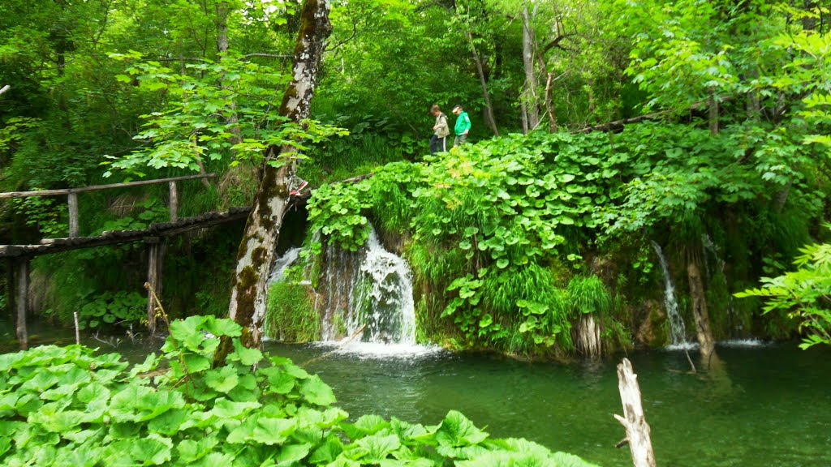
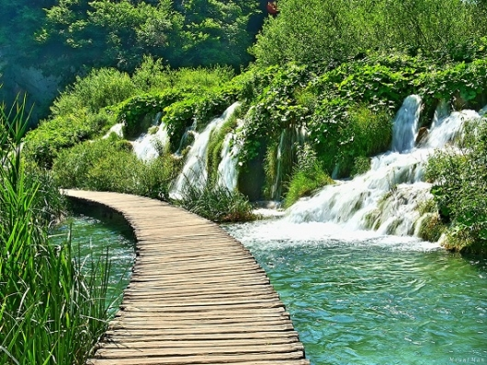
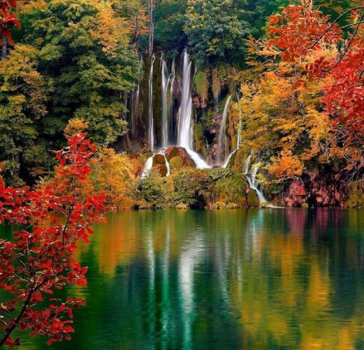

Slide 11
The end

