Slide 1
Osnovna škola “katarina zrinska mečenčani”
Primary school “Katarina Zrinska Mečenčani”

Slide 2
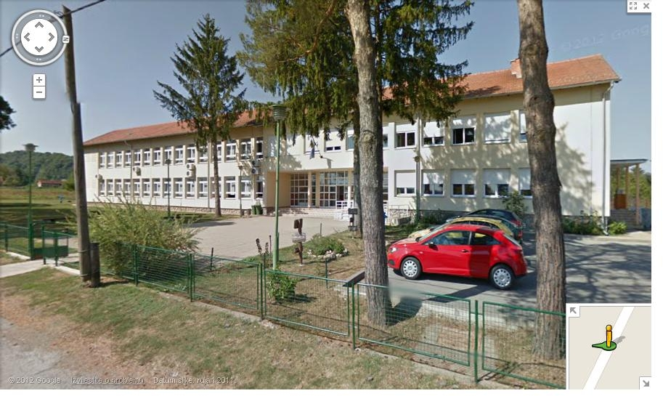
About our school
Situated under Zrinska Gora slopes, 80 km south of Zagreb, capital of Croatia, surrounded by nature and not affected by industrial pollution.
https://maps.google.com/maps?z=17&layer=c&cbll=45.284225%2C16.432975&panoid=my2OZNzkG-RhnpubNdxLYQ&cbp=12%2C-115.21472392638037%2C%2C-2%2C0.8282208588957032&hl=hr

Slide 3
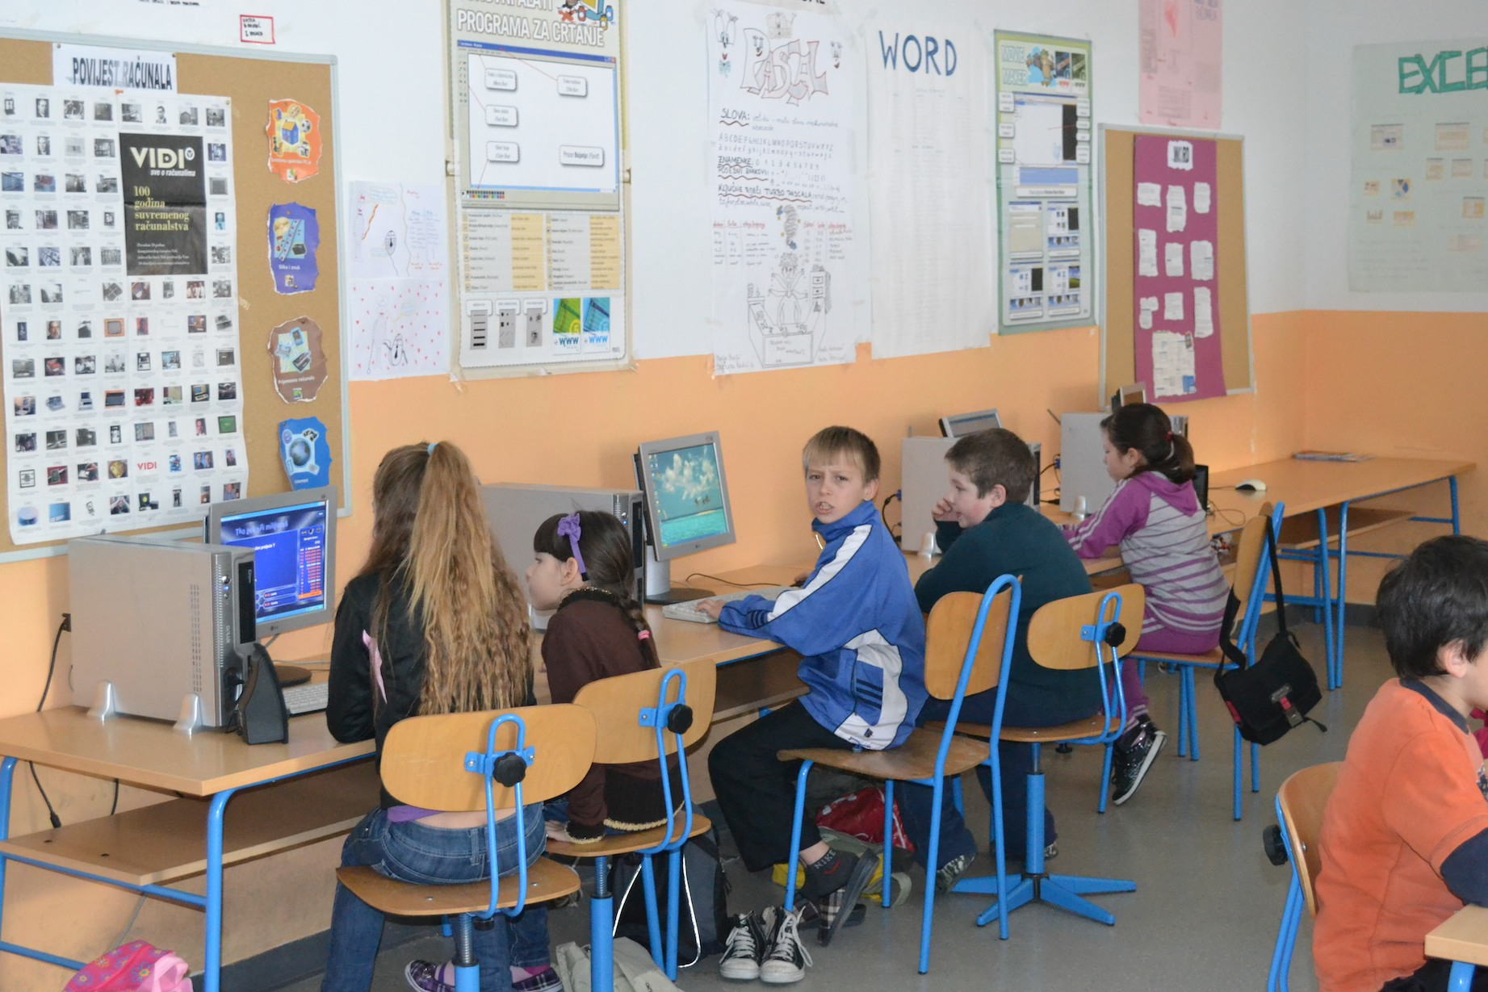
Our school is our second home so we organized and equipped it well
Informatics classroom

Slide 4
Library

Slide 5
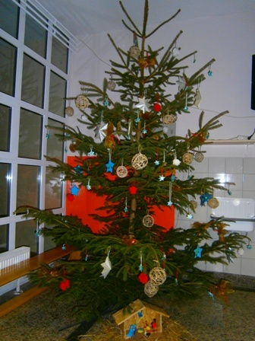
Autumn and winter ambiance in our school.

Slide 6
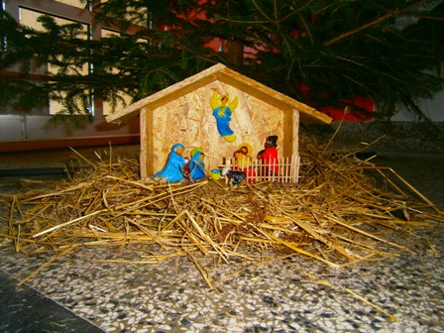
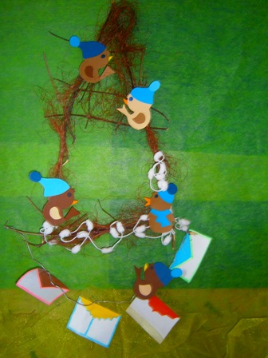
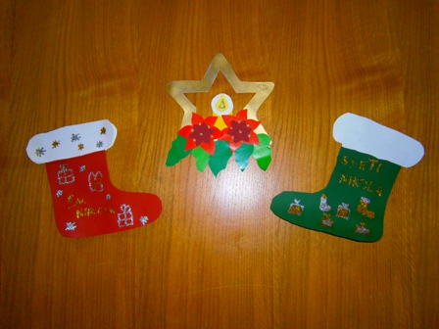
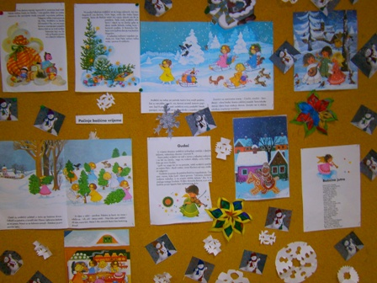
Billboards

Slide 7
We like to dance aNd PLAY...
Drama club on competition.

Slide 8
... AND winning the first place! ☺

Slide 9
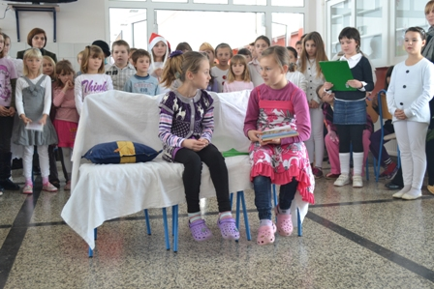
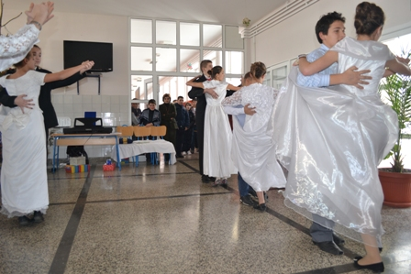
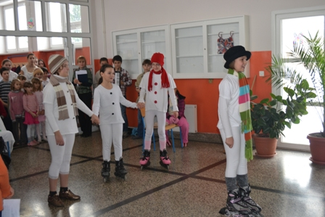
We do christmas shows...

Slide 10
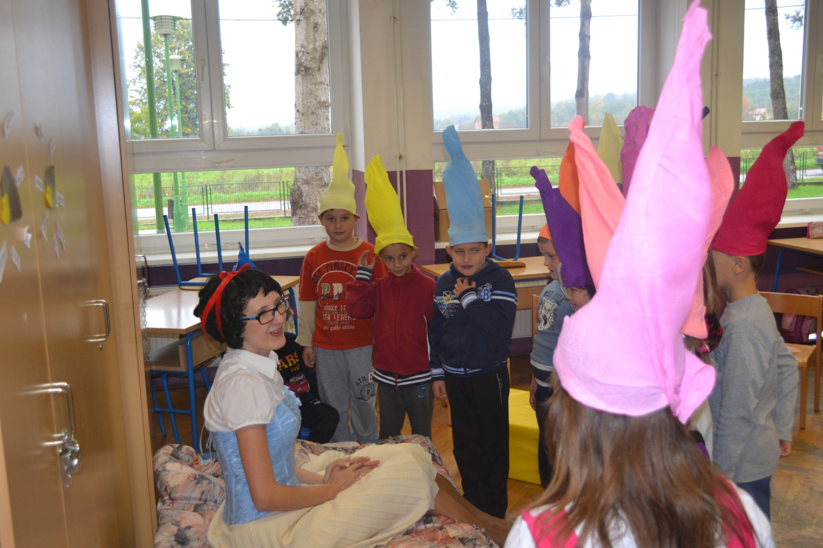
...and fairy tale plays
Snow White and the Seven dwarfs

Slide 11
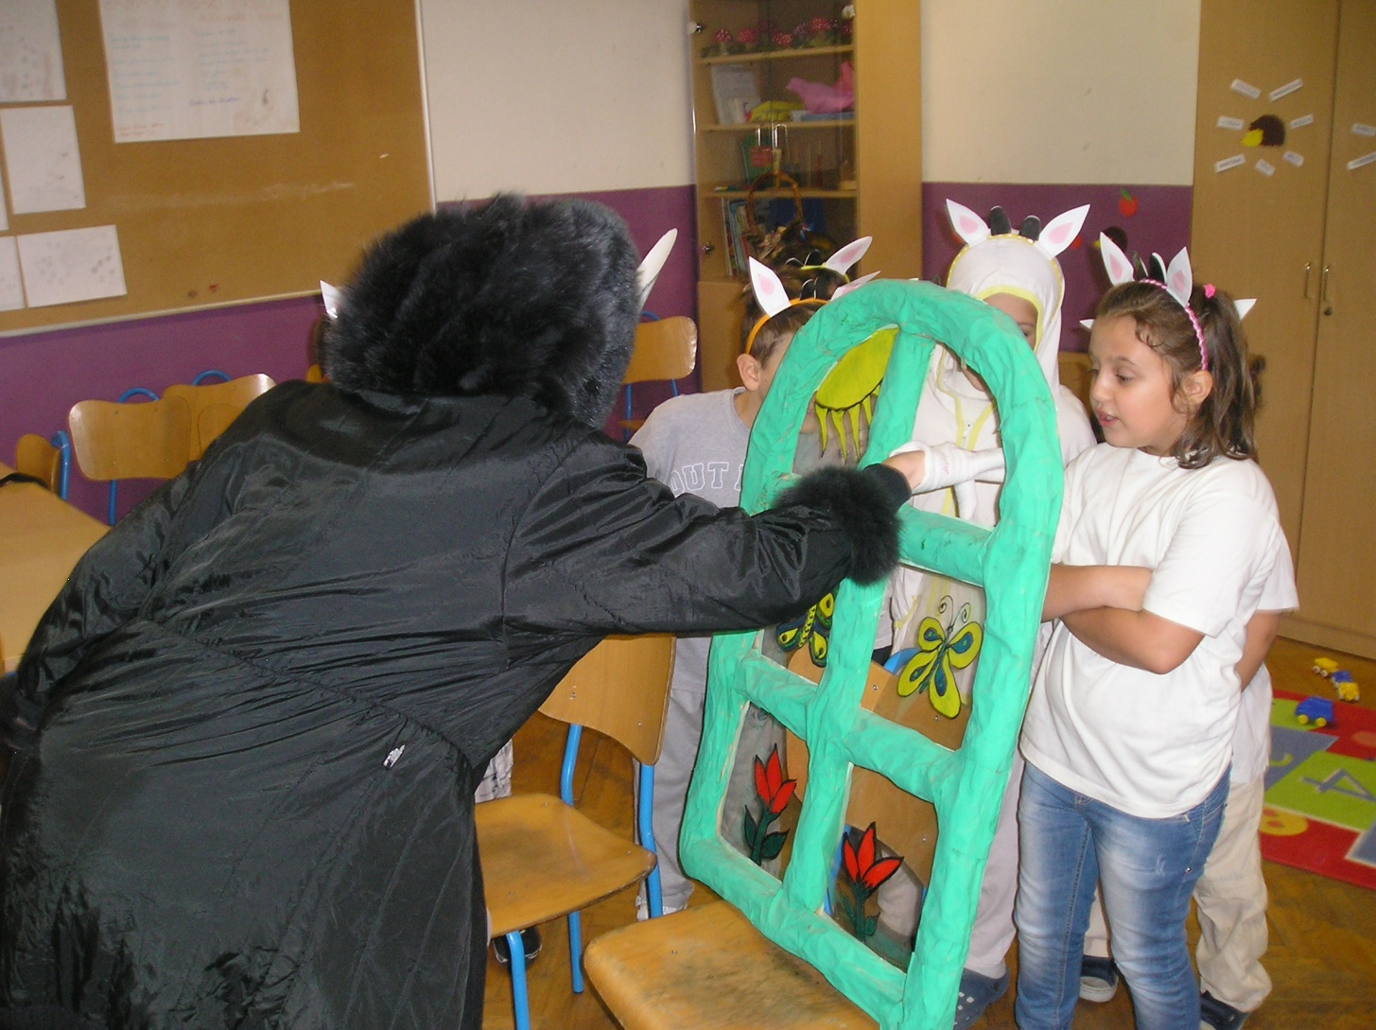
WOLF AND THE SEVEN LITTLE GOATS

Slide 12
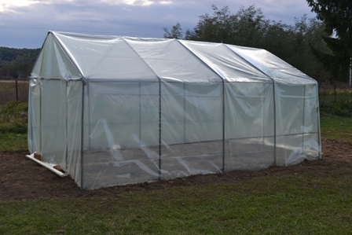
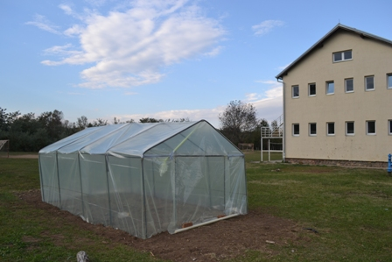
We are also serious – we build greenhouses...

Slide 13
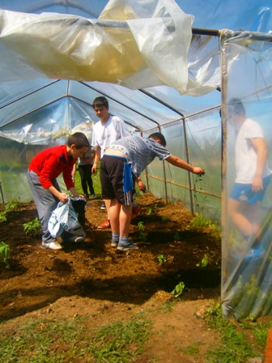
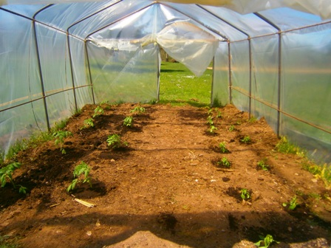
...and plant vegetables

Slide 14
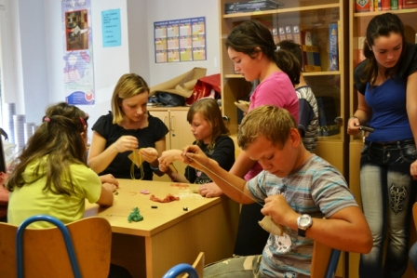
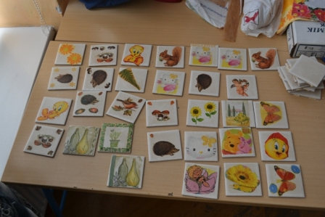
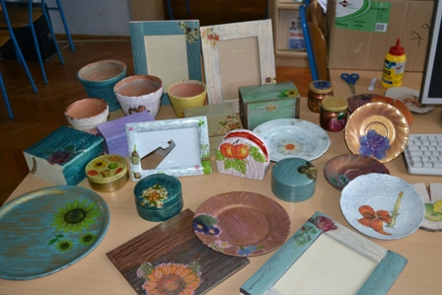
We organize creative workshops

Slide 15
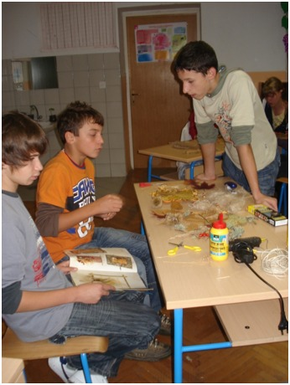
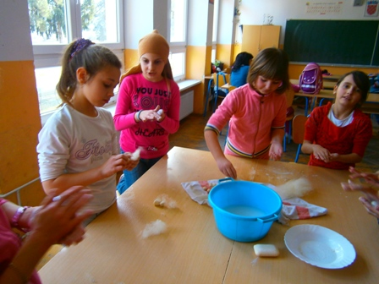

Slide 16
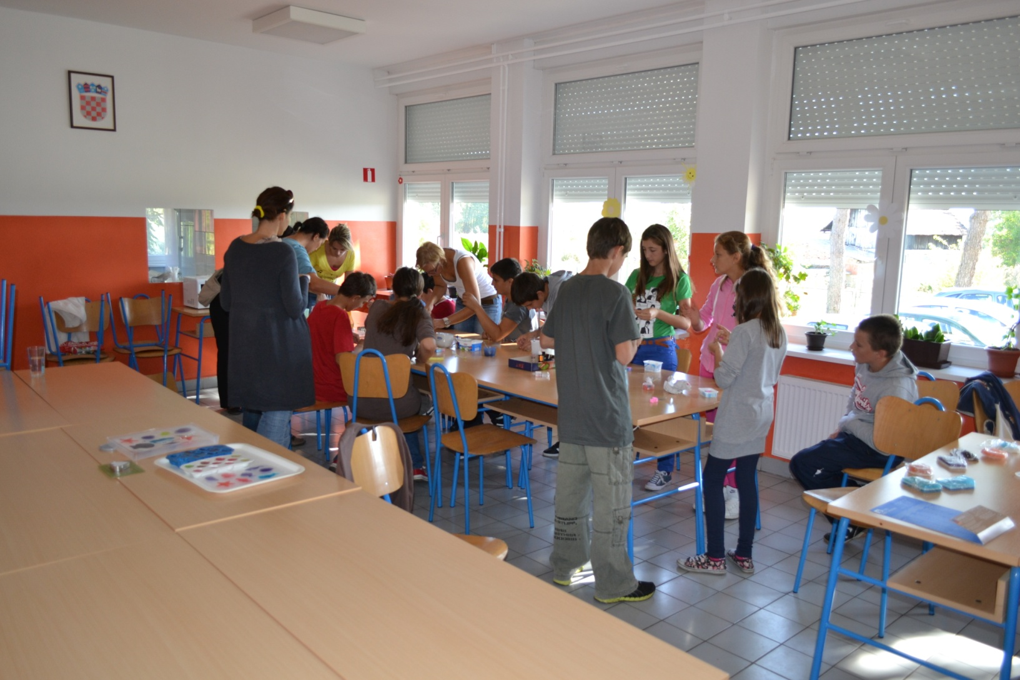

Slide 17
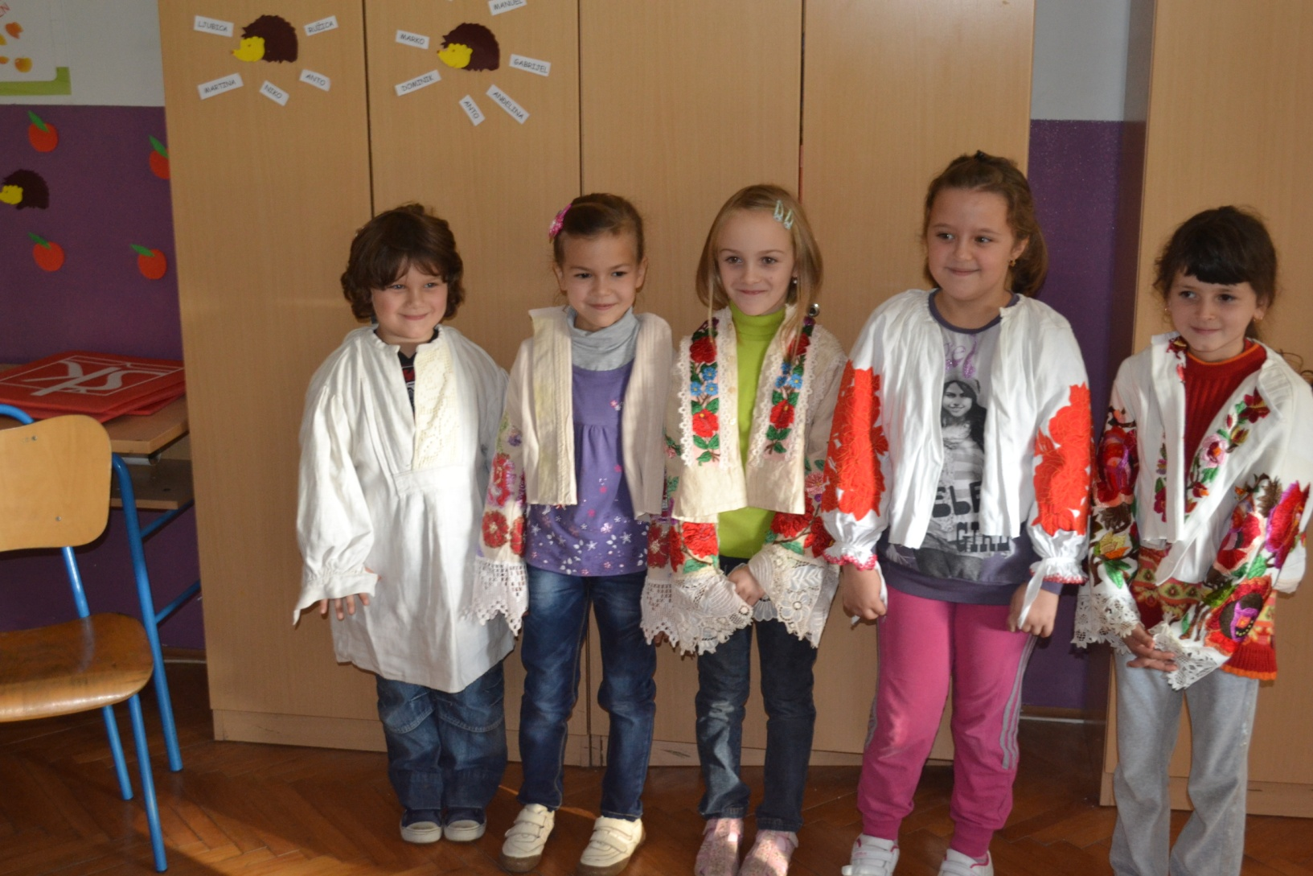
We honor our traditions...

Slide 18
...take part in country’s famous “KESTENIJADA” – chestnut festival...

Slide 19
...And WE try To lead a healthy life

Slide 20
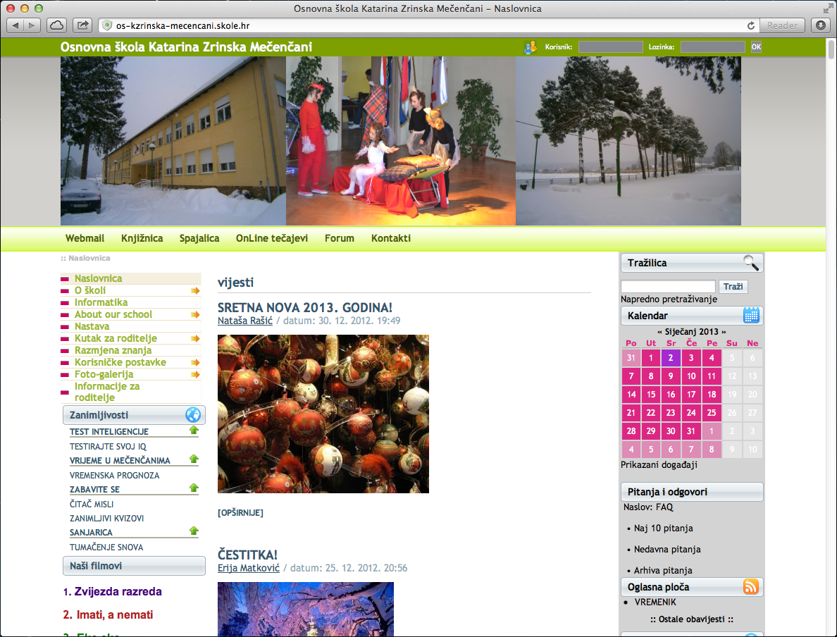
To learn more, visit us on web
http://os-kzrinska-mecencani.skole.hr/

Slide 21
Naši filmovi
Zvijezda razreda http://www.youtube.com/watch?v=48VKMkPP3BQ
Imati, a nemati http://www.youtube.com/watch?v=TKp0A73FnZo&feature=youtu.be
Tolerancija http://www.youtube.com/watch?v=yDSh0Ch9B4c&feature=youtu.be

Slide 22
Thank you!

