Slide 1
Global concerns in the 21st century

Slide 2
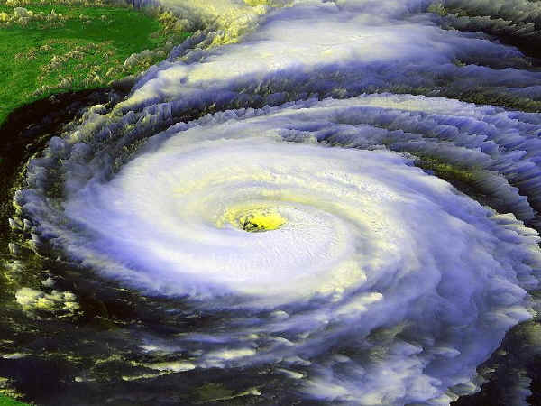
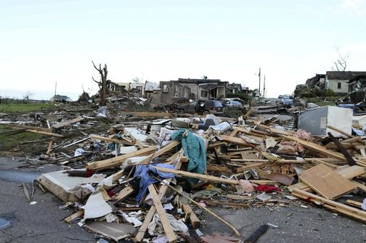
Natural disasters : Volcanic eruptions, fires, earthquakes, hurricanes and tornadoes happens every year somewhere in the world.

Slide 3
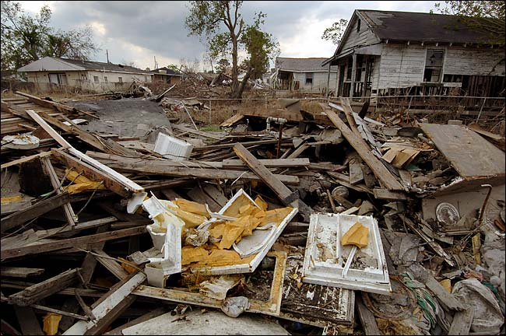
Some of disasters :New Orleans was devasted. Hurricanes totally destroyed city. More than 1833 people were killed, and thousand and thousand people were homeless.

Slide 4
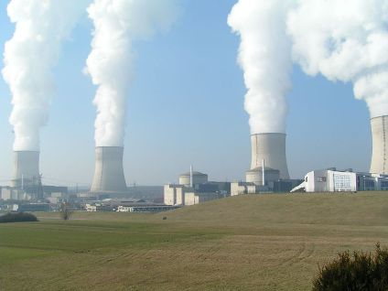
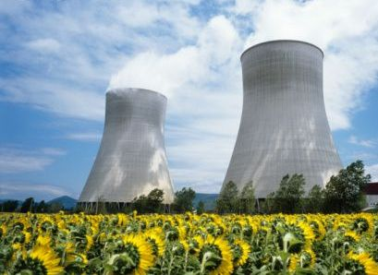
NUCLEAR POWER: It is one of the cheapest sources of energy but it can cause dangerous radiations which can kill people or damage their health. Those radiations can cause cancer.

Slide 5
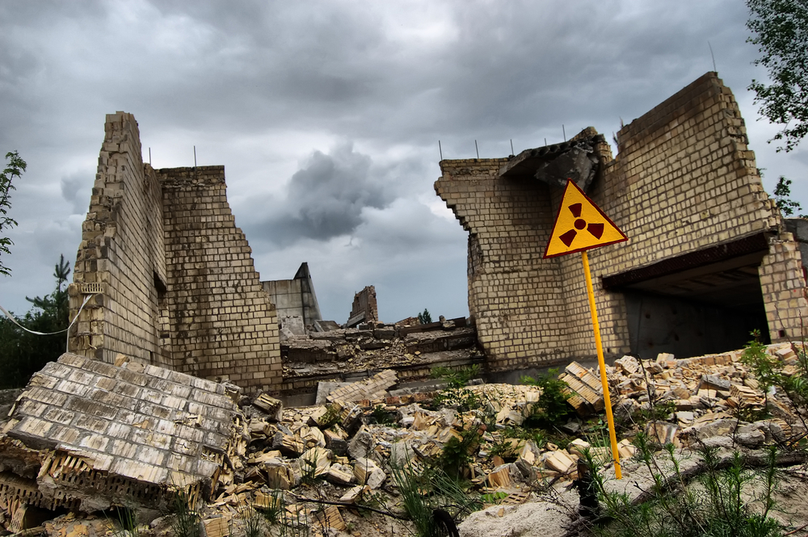
One of the nuclear disaster happened in Chernobyl in 1986 where an explosian destroyed place and caused deaths and illness many years afterwards.

Slide 6


When we developed new tehnology,terrorist organizations are becoming a real threat to our safety.

Slide 7
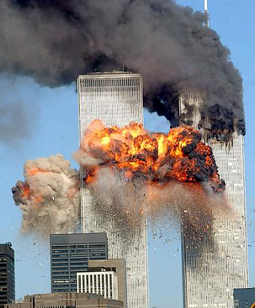
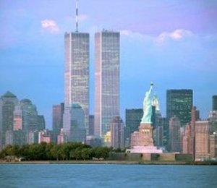
The most popular terrorist attack was on September 11.2001 terrorist attacked and destroyed the twin towers of the World Trade Center in New York. More than thousand people were killed.

Slide 8


Aids is very serious disease. It is caused by the Hiv virus. The most effected continent is Africa. There people can’t afford building hospitals and they don’t have doctors or nurces. Globally a child dies of Aids every minute and about 30 million people have already died of Aids.

Slide 9
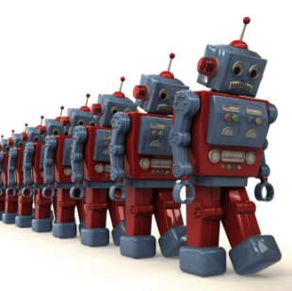

Good sides
Becouse we developed new technology people created robots and with hard work they can help people, they will do most of the work and we will have more free time.

Slide 10
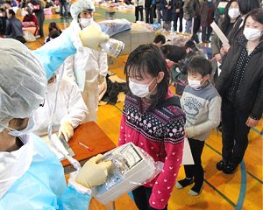
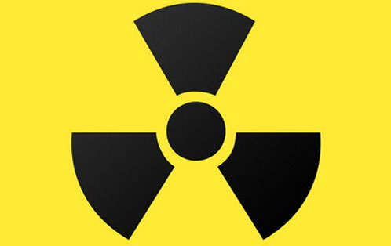
If our scientists work hard they can use nuclear power without consequences and without conserns of radiation.

Slide 11
Questions

Slide 12
Why is nuclear power dangerous?
A) Radiation
B)Technology interference
C) It causes hurricanes

Slide 13
When was terrorist attack on World Trade center?
A)11.07.2006.
B)11.09.2001.
C)28.12.1654.

Slide 14
What is AIDS?
A)Virus
B)Disease
C)Eruption

