Slide 1
Egypt
by:Lucija Požar
7.a

Slide 2
1. On what continent is Egypt?
Africa
Asia
South America
Europe

Slide 3
Correct answer

Slide 4
Uncorrect answer

Slide 5
2. Egypt is a gift of
the Nile.
the Amazon.
the Sava.
the Rajna.

Slide 6
Correct answer

Slide 7
Uncorrect answer

Slide 8
3. Tutankhamun is
a king.
a pharaoh.
an emperor.
a count.

Slide 9
Correct answer

Slide 10
Uncorrect answer

Slide 11
4. What is a pyramid?
a tomb
a museum
a teatre
a cinema

Slide 12
Correct answer

Slide 13
Uncorrect answer

Slide 14
5. Sphinx has human´s head and
parrot´s body.
dog´s body.
lion´s body.
cat´s body.

Slide 15
Correct answer

Slide 16
Uncorrect answer

Slide 17
6. Amon Ra, Anubis, Horus and Oziris are
people.
kings.
dogs.
gods.

Slide 18
Correct answer

Slide 19
Uncorrect answer

Slide 20
7. What animal in Egypt is famous like „means of transport?”
a lion
a zebra
a camel
a cat

Slide 21
Correct answer

Slide 22
Uncorrect answer

Slide 23
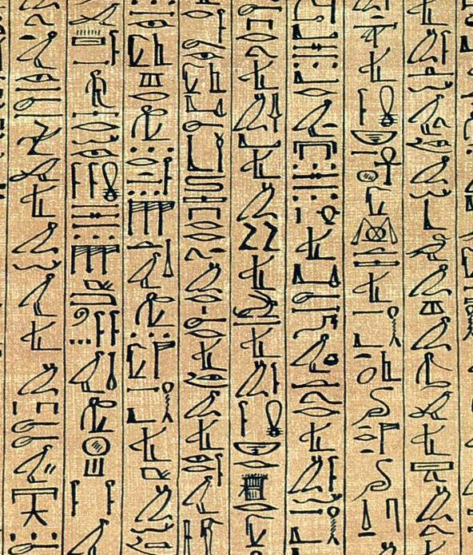
8. What is this?
latin
cyrillic
glagolitic
hieroglyphs

Slide 24
Correct answer

Slide 25
Uncorrect answer

Slide 26
9. How long is the Nile?
3486km
4302m
6655km
275cm

Slide 27
Correct answer

Slide 28
Uncorrect answer

Slide 29
Thank you for playing with us.

Slide 30
Do you like this quiz?
yes
no

Slide 31
I hope that was not so bad.

Slide 32
I´m glad you liked it.

