Slide 1
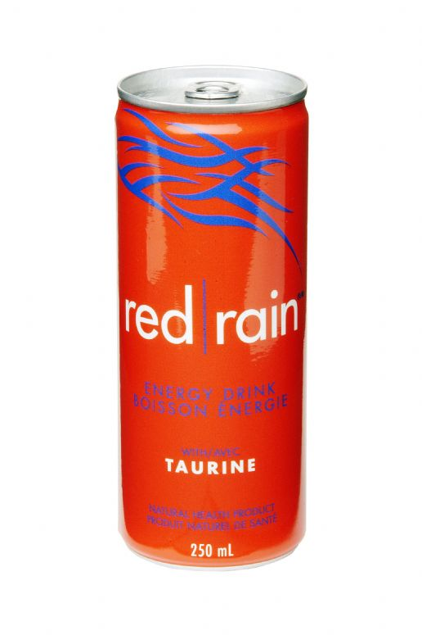
Red rain
Energy drink
We have decided to develop a new product.
We will call it “Red Rain”. We belive this product will be popular with teenagers / athletes / musicians

Slide 2
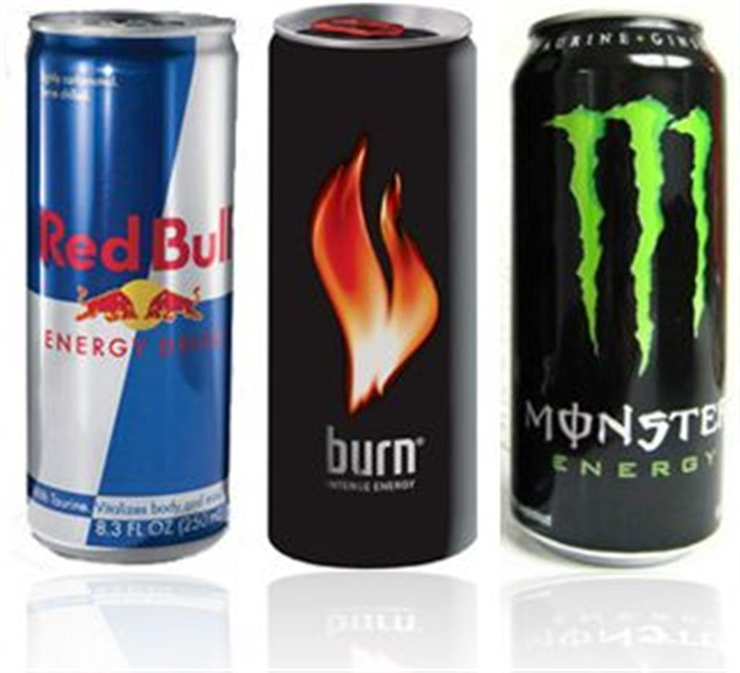
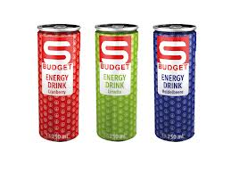
Similar products...
There are several similar products on the market like... S Budget, Red Bull, Burn, Monster...
S Budget sells well because its not too expensive while Red Bull, Burn, Monster doesn’t sell well because these products are too expensive.

Slide 3
Taste of the new product...
Our new product will be better with the new red orange taste.
Container: 250 ml.
Cost: 2 dollars.

Slide 4
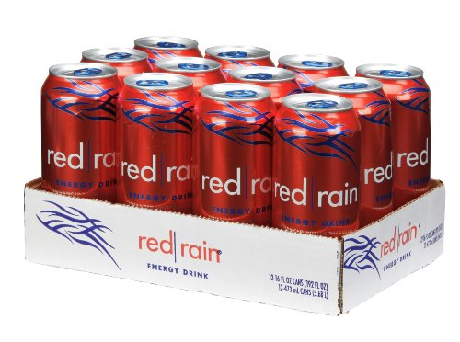
Package,container,size...
It will be packed in a box containing 12 cans un red colour.

Slide 5
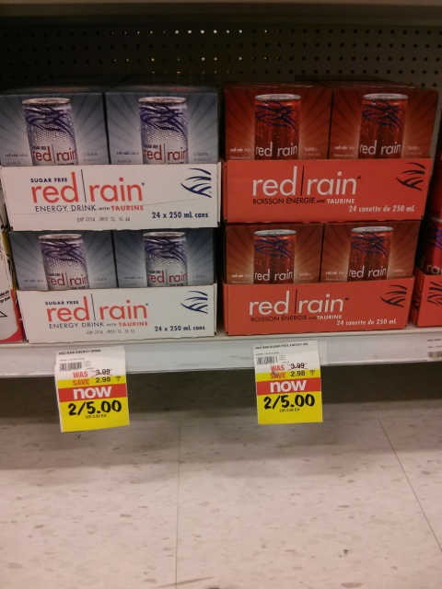
Selling products...
We will sell our products in supermarket.

Slide 6

Who will promote our product?
We have chosen a famous person to promote it.
That will be
Because his concerts are popular with young people, and they like energy drinks.

Slide 7

Advertising product on tv...
We will advertise our product on RTL television because RTL is one of the most popular television channels.

Slide 8
Made by: Mario Strukar 8.a

