Slide 1
Bookmark Exchange project
Elemetary school Marija and Lina Umag
Edited by: Maja Lalić

Slide 2
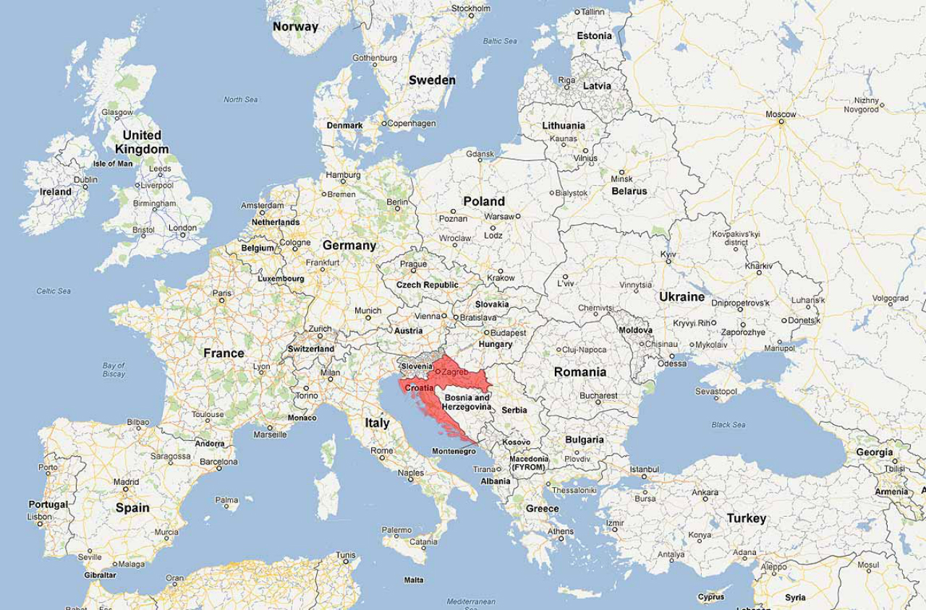

Croatia on the map of europe
Croatia - officially the Republic of Croatia is a country in Central and
Southern Europe, on the Adriatic Sea.

Slide 3
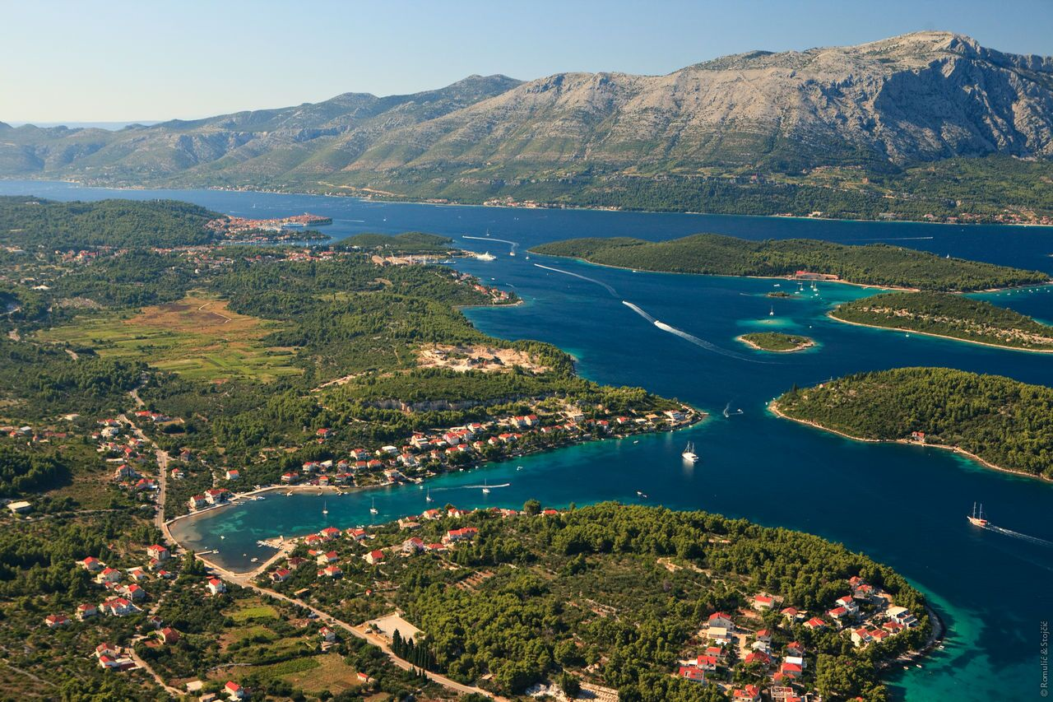
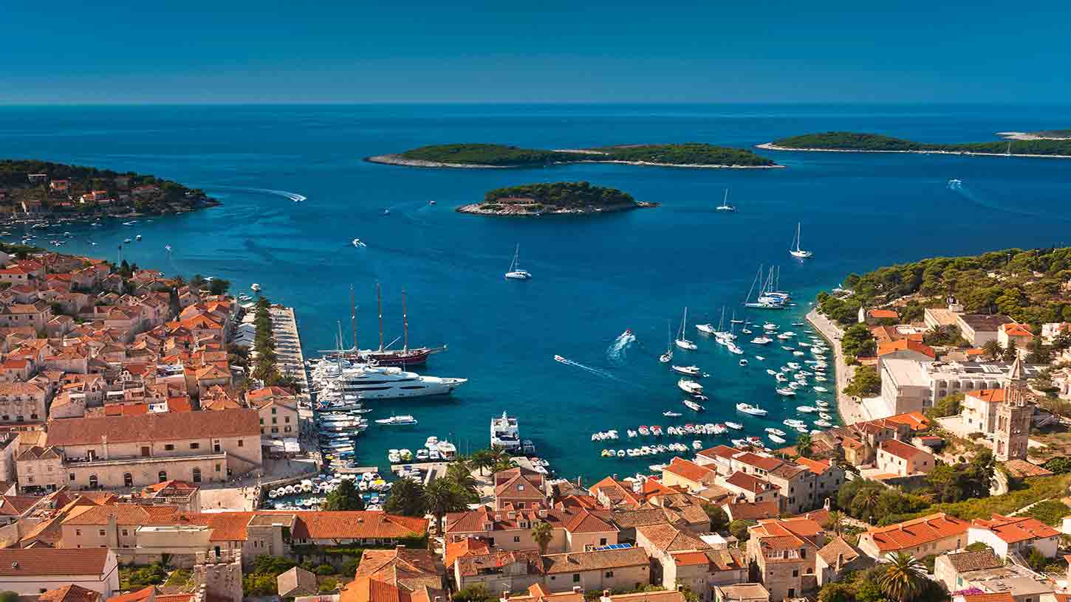
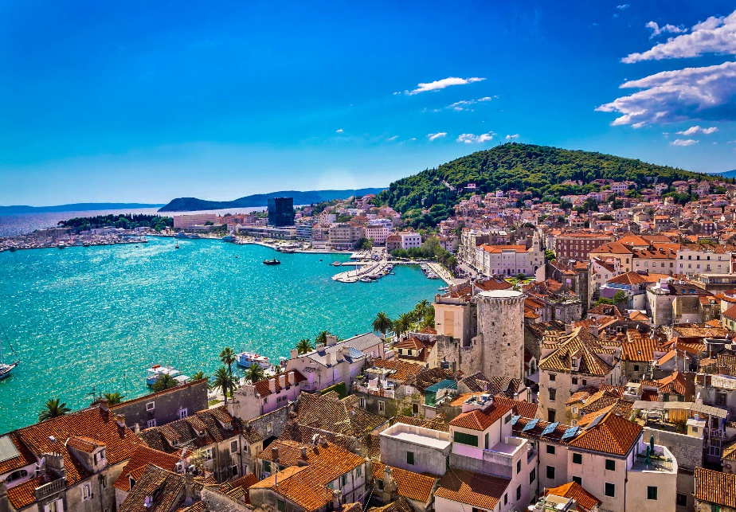
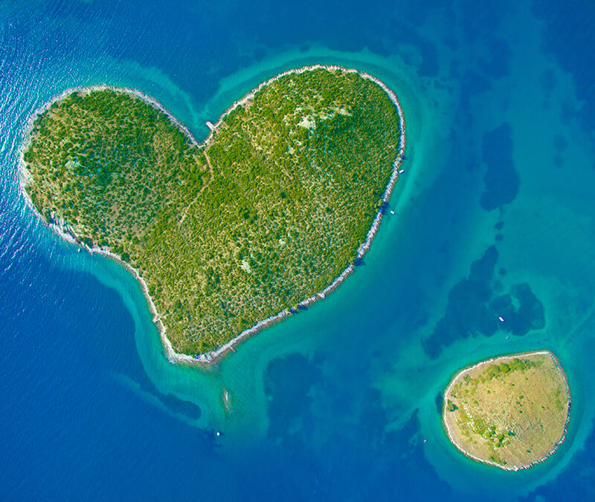
some cool facts about Croatia
Croatia has 1246 islands which are divated into 79 islands, 526 islets and 641 reefs and rocks.

Slide 4
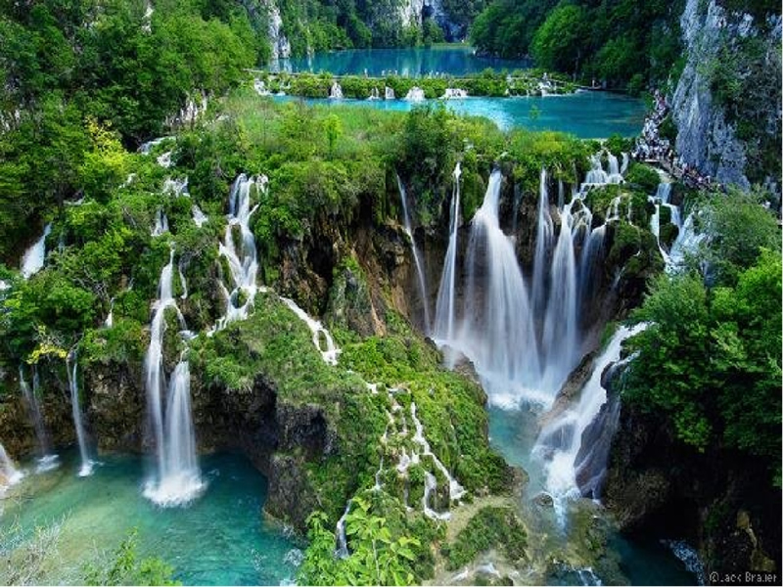
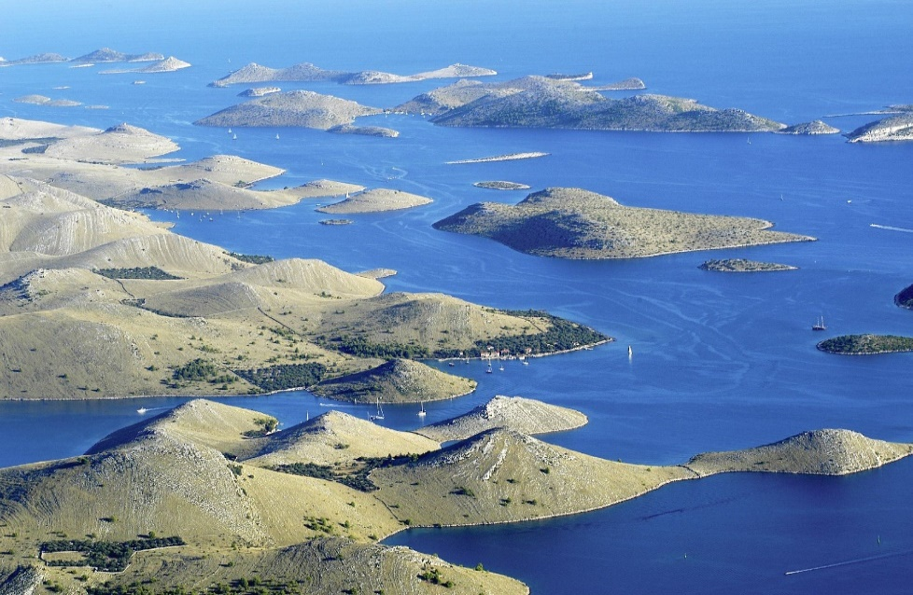
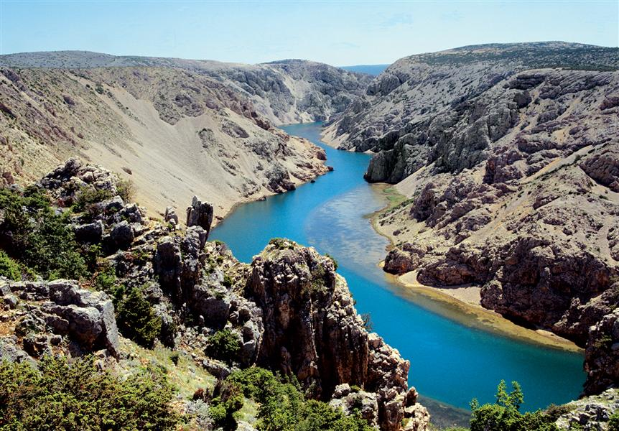
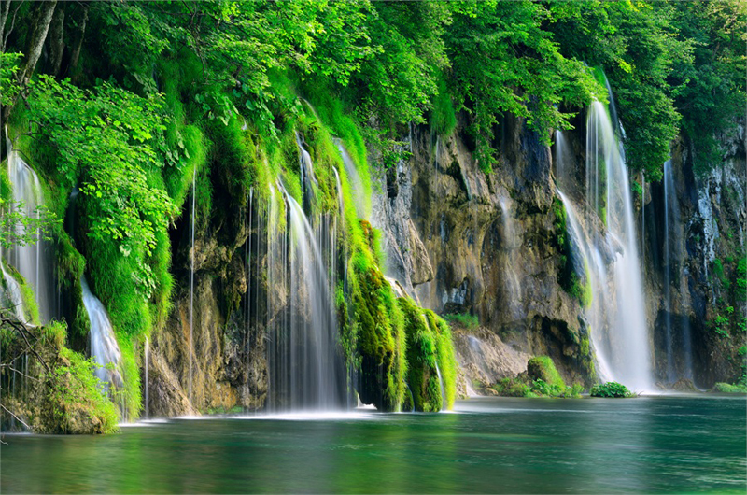
some cool facts about Croatia
Almost 10 % of Croatia is made up of 11 nature parks, eight national parks and two nature reserves.

Slide 5

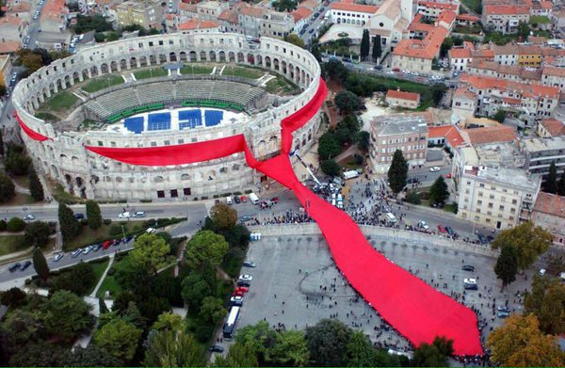
some cool facts about Croatia
Croatia invented the necktie.

Slide 6
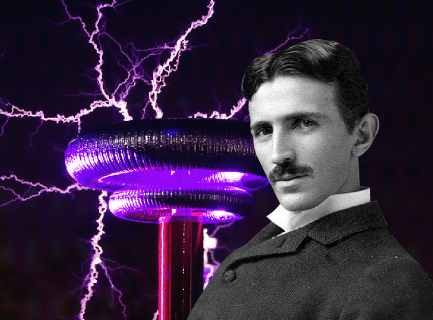
some cool facts about Croatia
Nikola Tesla was born in Croatia.

Slide 7
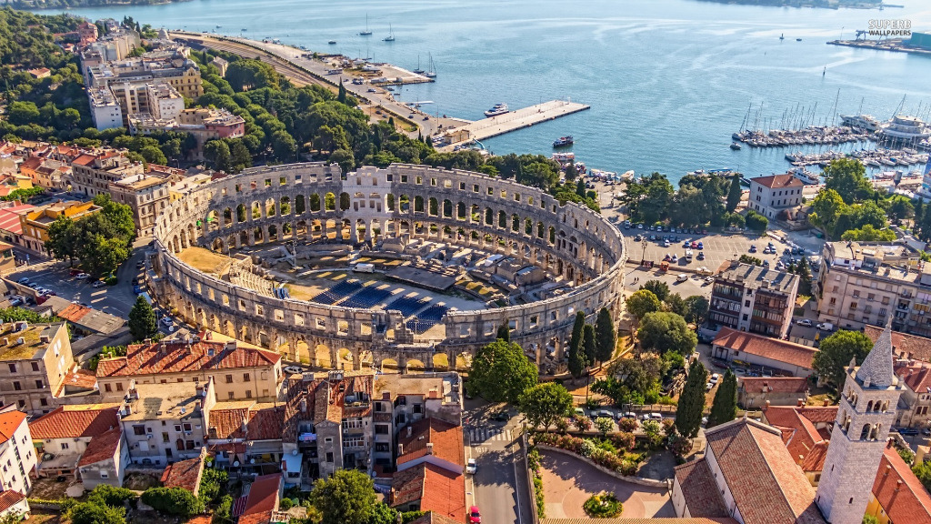
some cool facts about Croatia
Amphiteatre in Croatia (Pula) is one of only 3 preserved in the world.

Slide 8
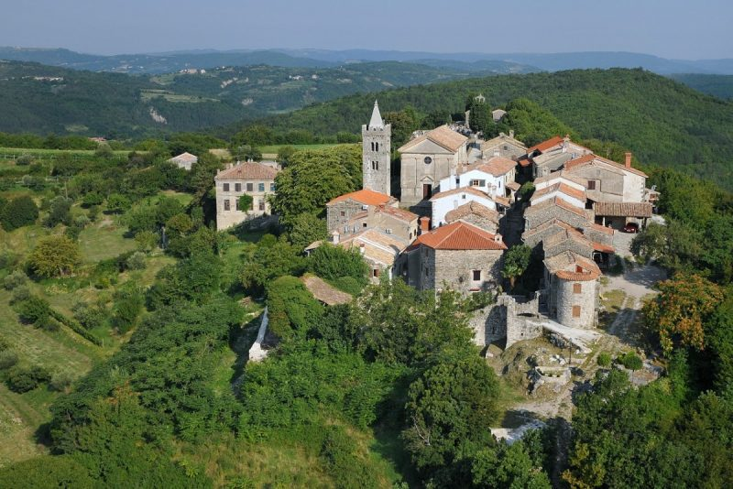
some cool facts about Croatia
Croatia is home of the world’s smallest town called Hum.

Slide 9
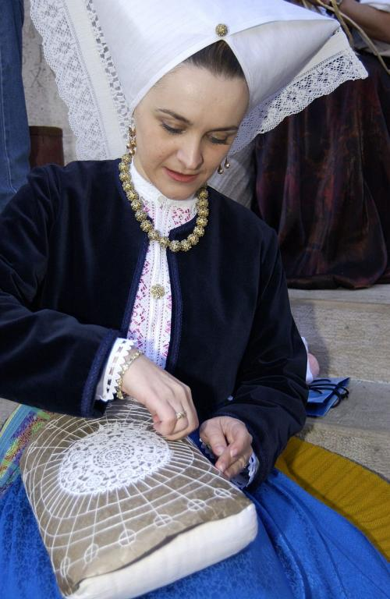
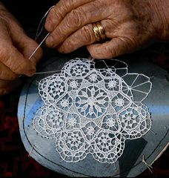

some cool facts about Croatia
Croatia has highest number of UNESCO Intangible Goods of any European country.

Slide 10
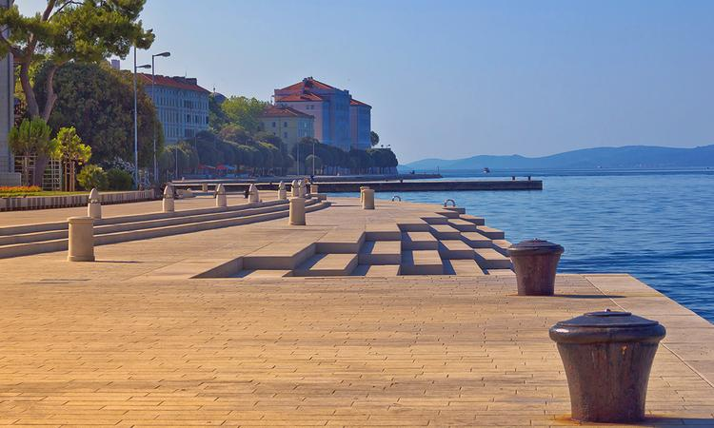
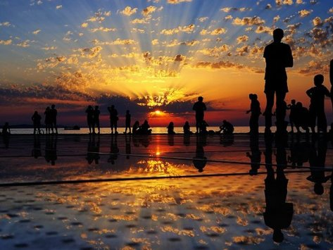
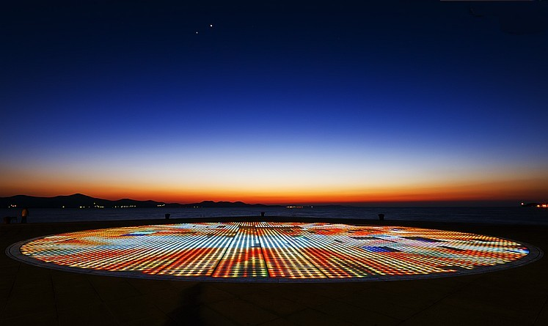
some cool facts about Croatia
World’s first pipe organ (Sea organ) that is played by the sea’s rhythmic waves is in Zadar.
The Greeting to the Sun, right next to the Sea Organ crates playful game of lights activated by the sunlight saluting “The most beautiful sunset in the world”.
“Zadar has the most beautiful sunset in the world, more beautiful than the one in Key West in Florida, applauded at every evening.” Those were the words Alfred Hitchcock said during his visit to Zadar in 1964.

Slide 11
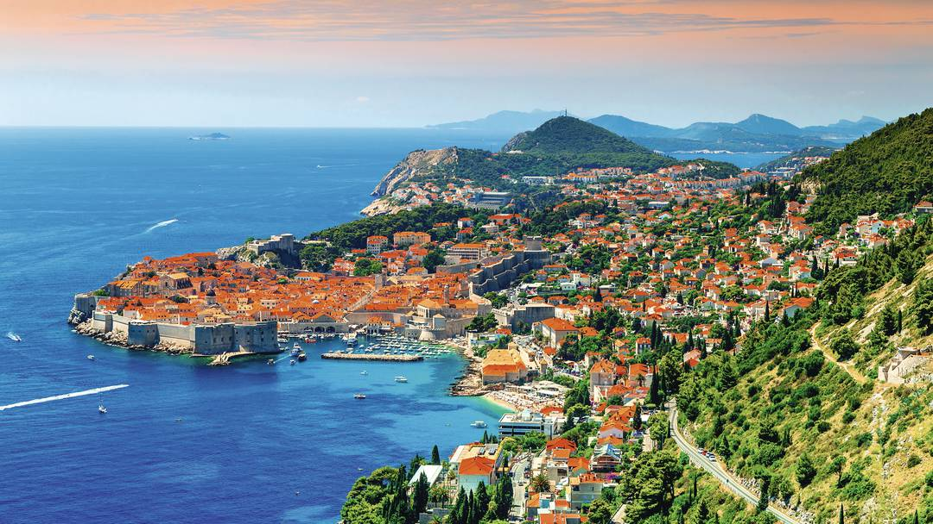
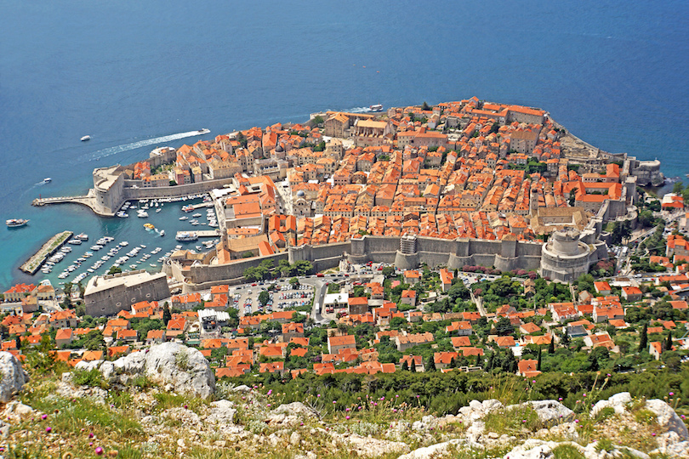
some cool facts about Croatia
English poet Lord Byron was the first to describe Dubrovnik as ‘the pearl of the Adriatic’. Playwright George Bernard Shaw also once said: „Those who seek paradise on earth should come to Dubrovnik”.
Popular tv series Game of Thrones was filmed in Croatia in Dubrovnik.

Slide 12
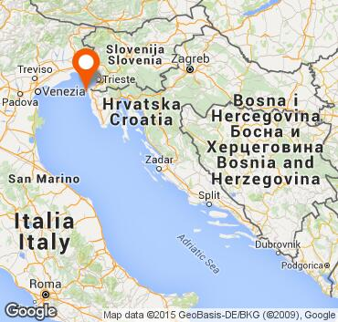

Umag
Umag is a city in Istria that year after year attracts numerous tourists with its beautiful 45 km long coast, interesting hinterland, crystal clear sea and unique old buildings built by the Romans who once used the place as their summer residence and churches in renaissance and baroque style. It is also known as the westernmost city of Croatia and a host of famous ATP tournament.

Slide 13
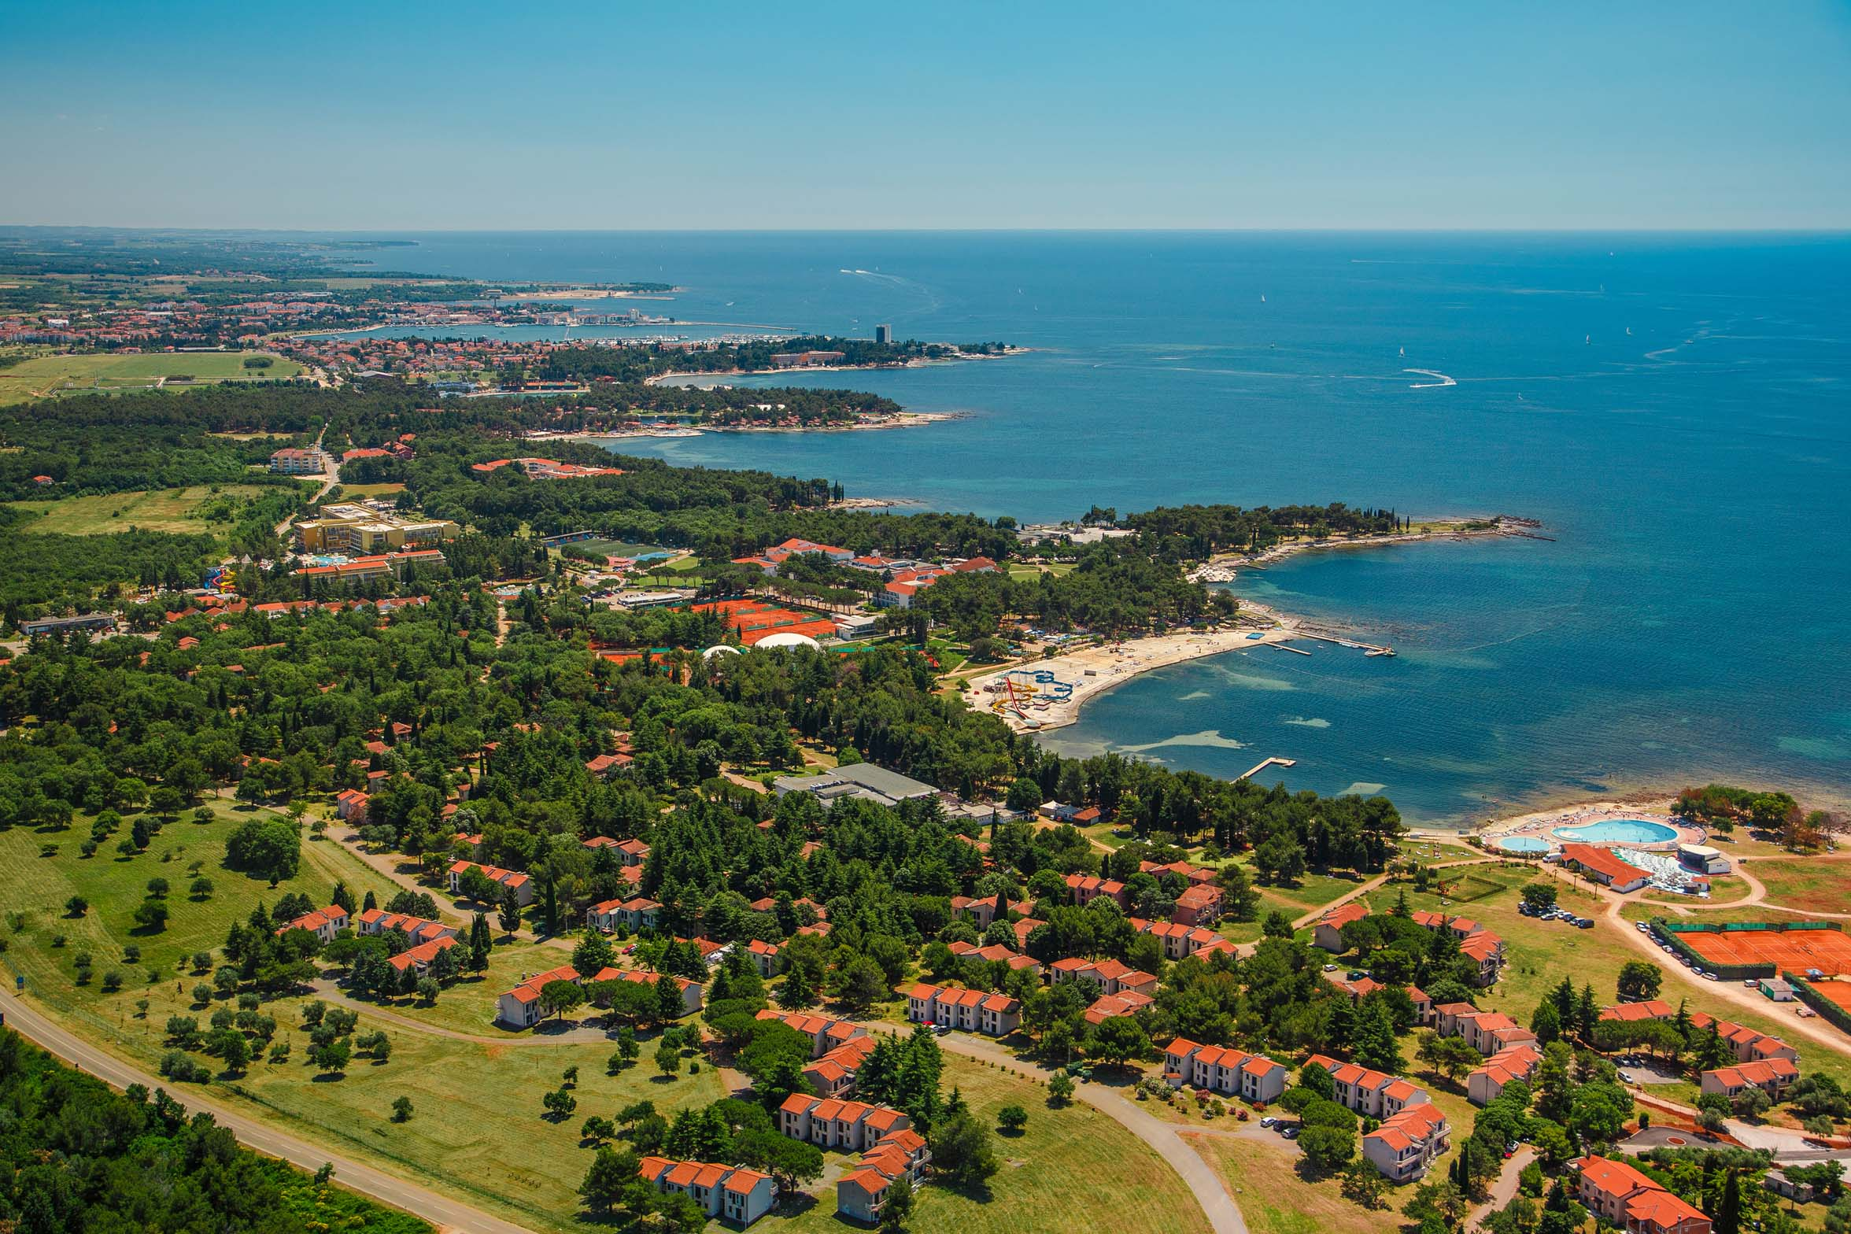
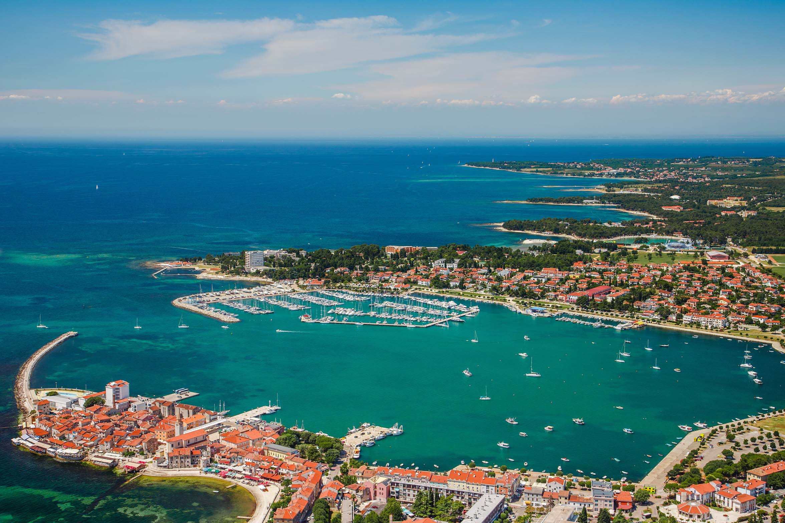
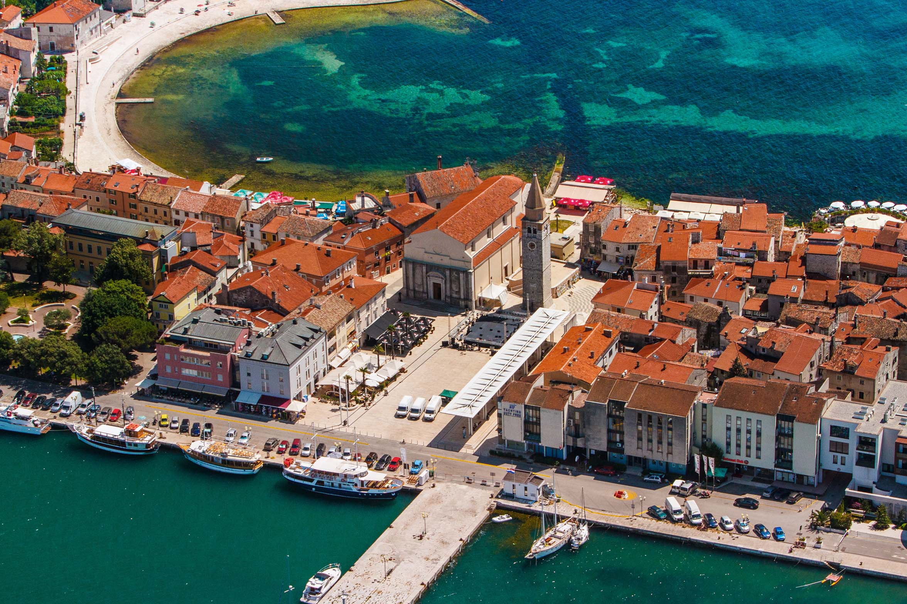
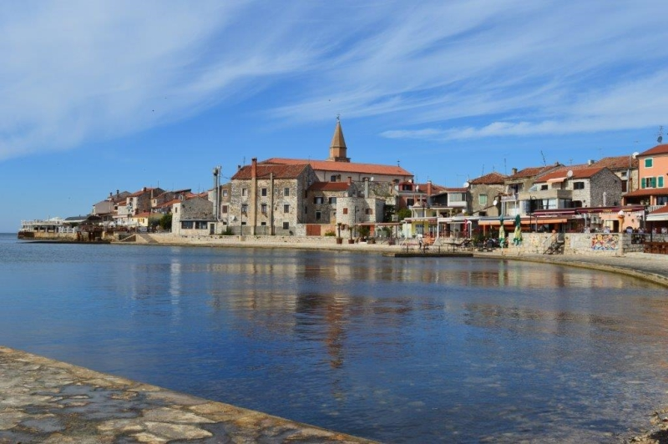
Umag
Umag
Umag

Slide 14
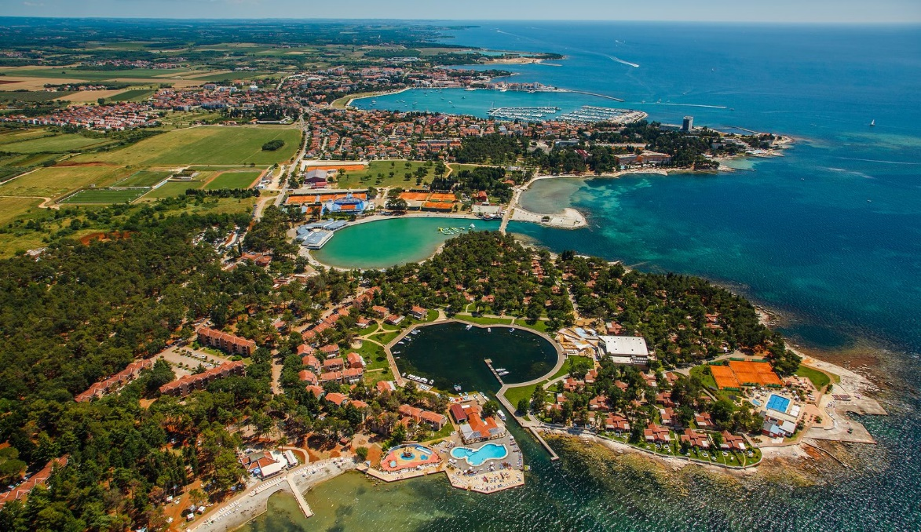
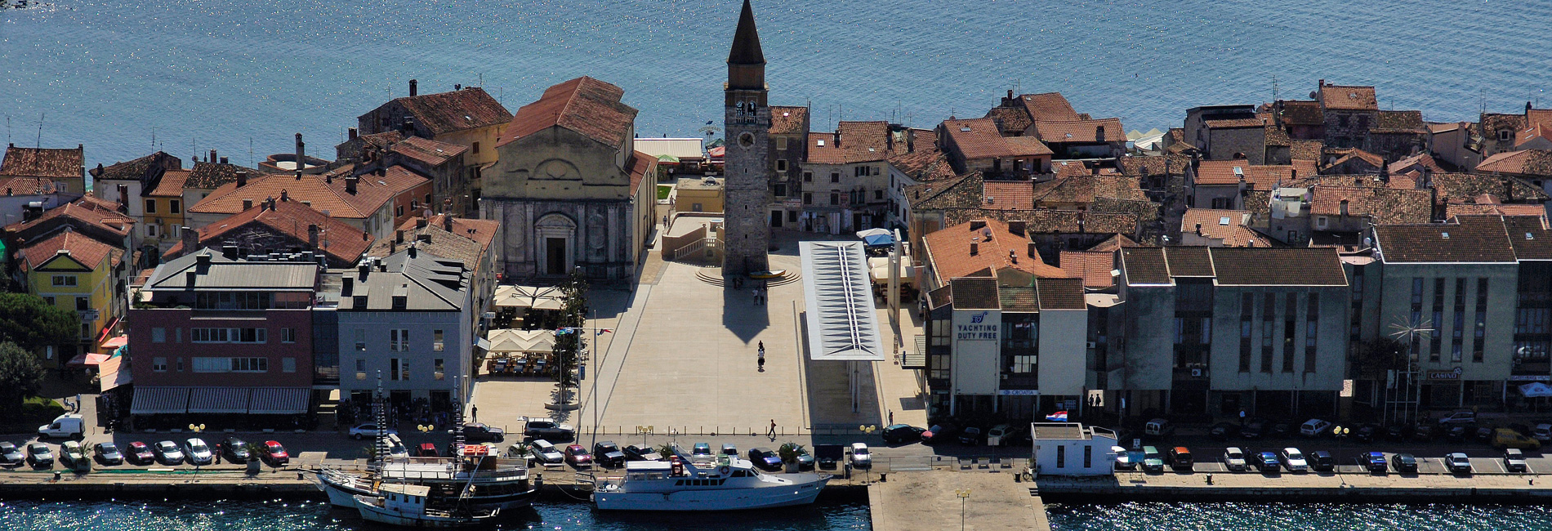
Umag

Slide 15
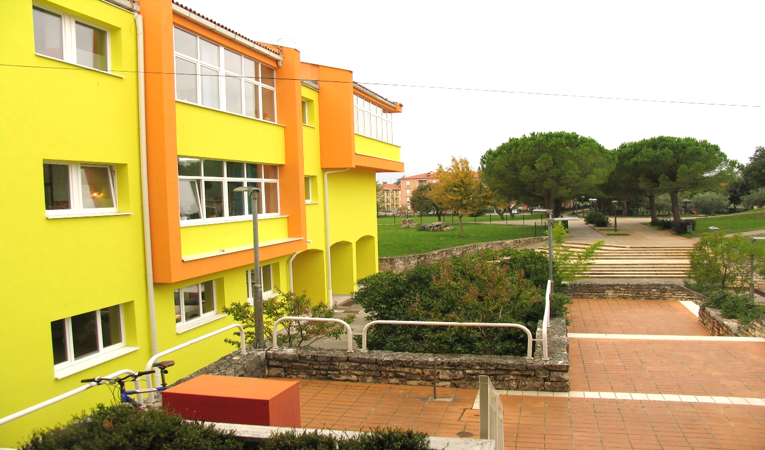
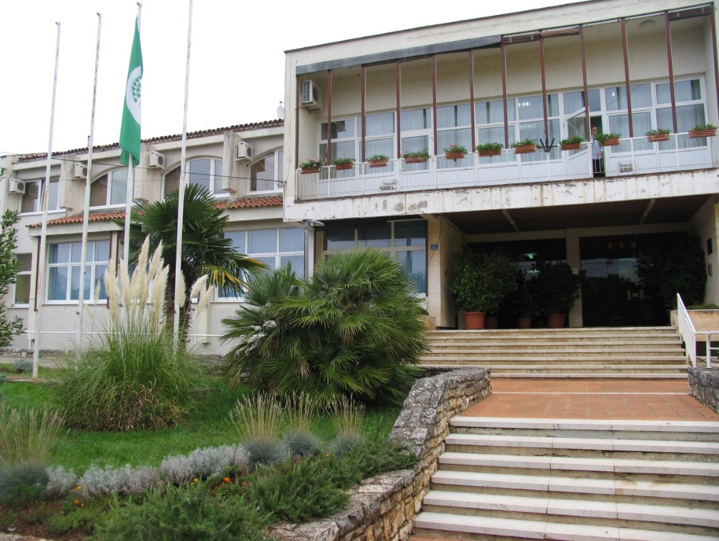
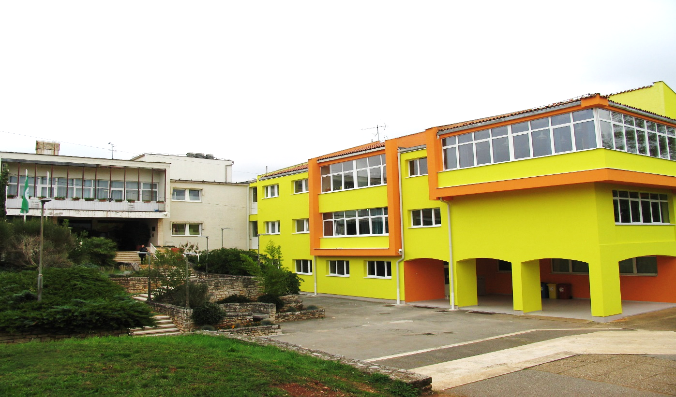
ELEMENTARY SCHOOL MARIJA AND LINA UMAG
E-MAIL: http://os-marijeiline-umag.skole.hr/

Slide 16

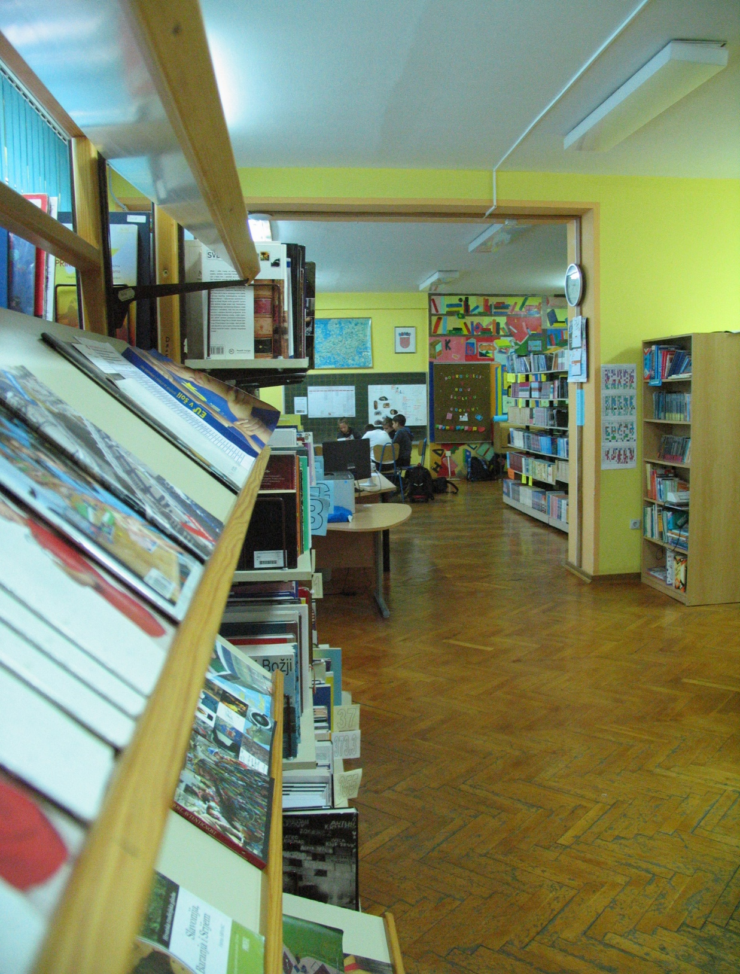
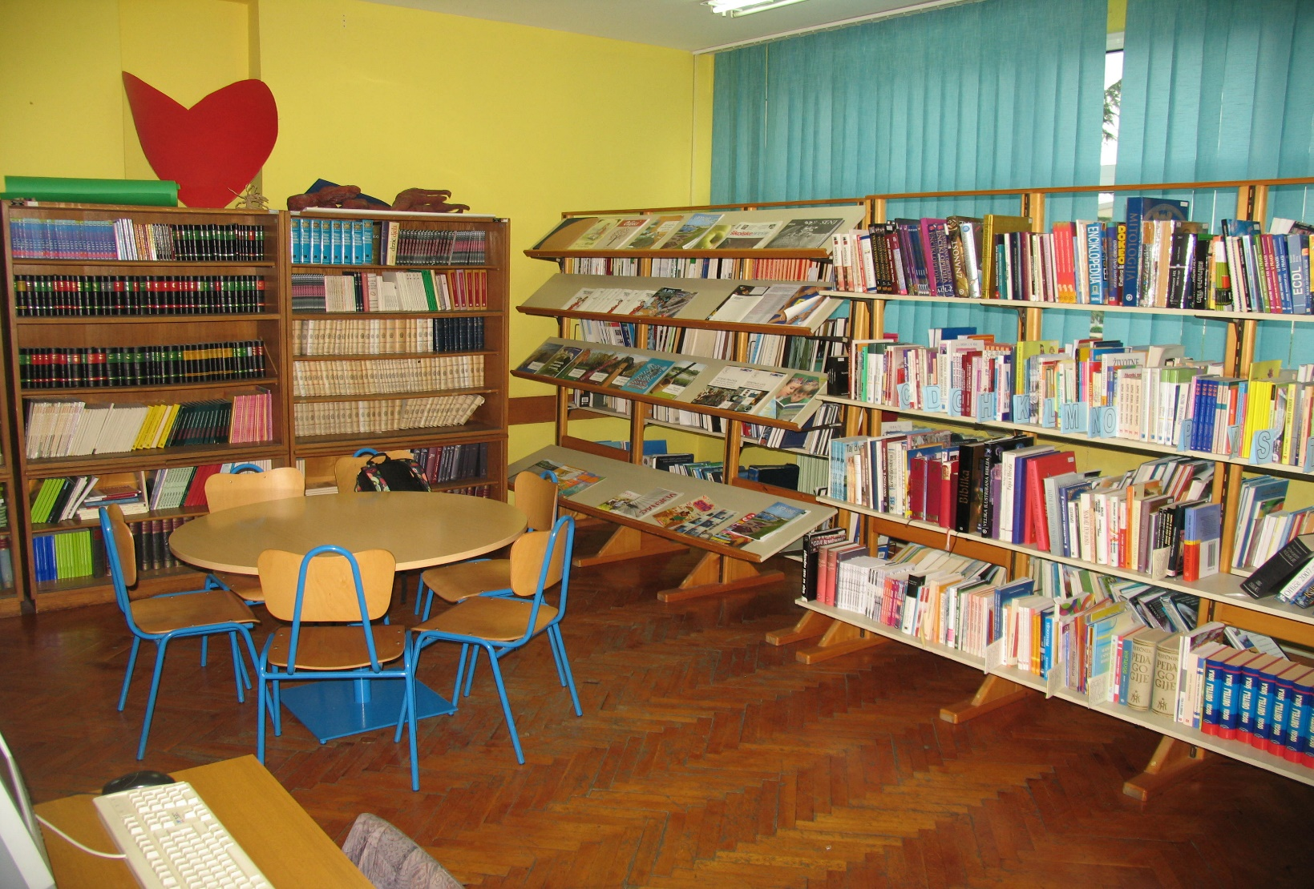
School library

Slide 17

Our school library was founded in 1955. when the Elemetary School of Marija and Lina started to work.
The library is located on the ground floor of the school, next to the main entrance in a space of 100 square meters.
There are more than 12,000 books on almost all subjects in our library.
We have a various of activities such as: creative workshops (cooperation with other teacher and other groups in school), the promotion of reading trough various activities on a local and national level, meetings with writers…

Slide 18
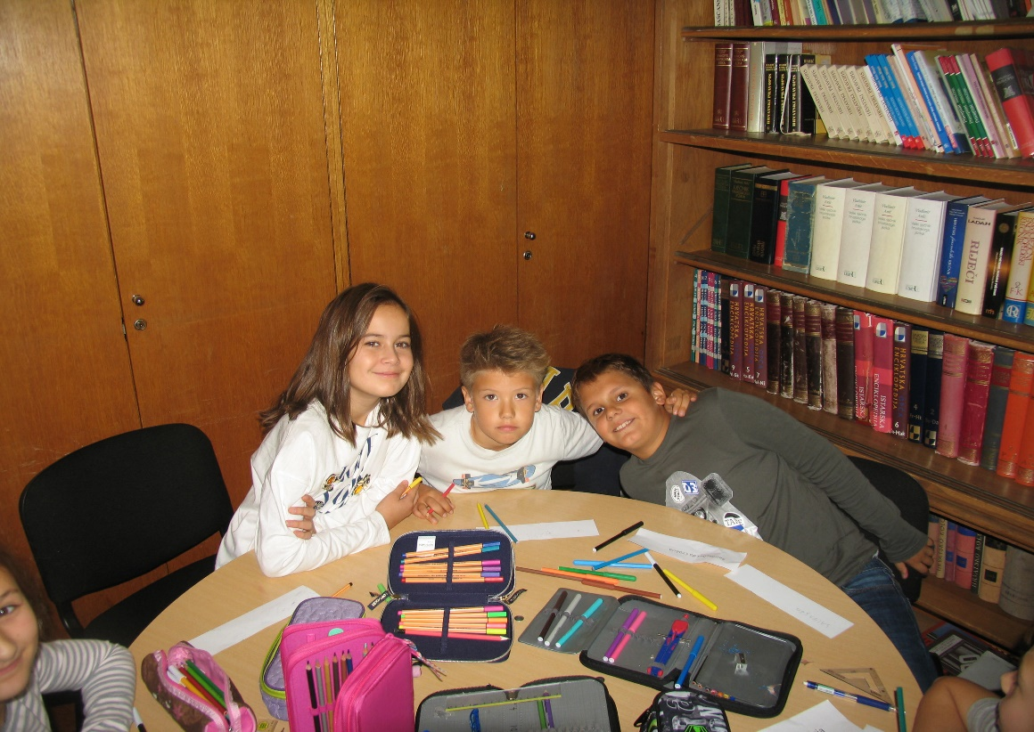
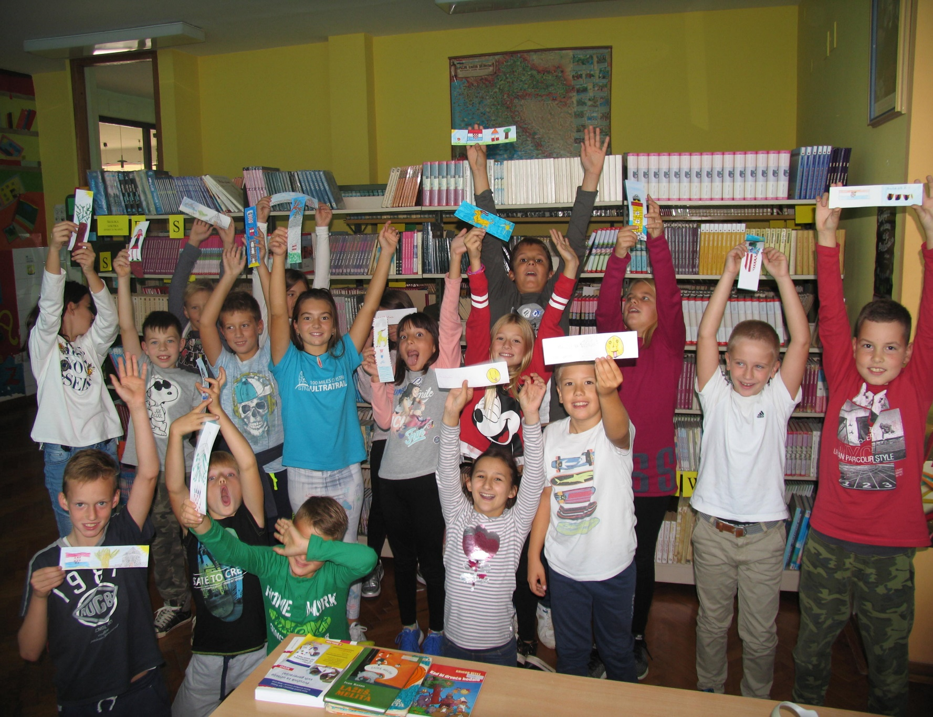
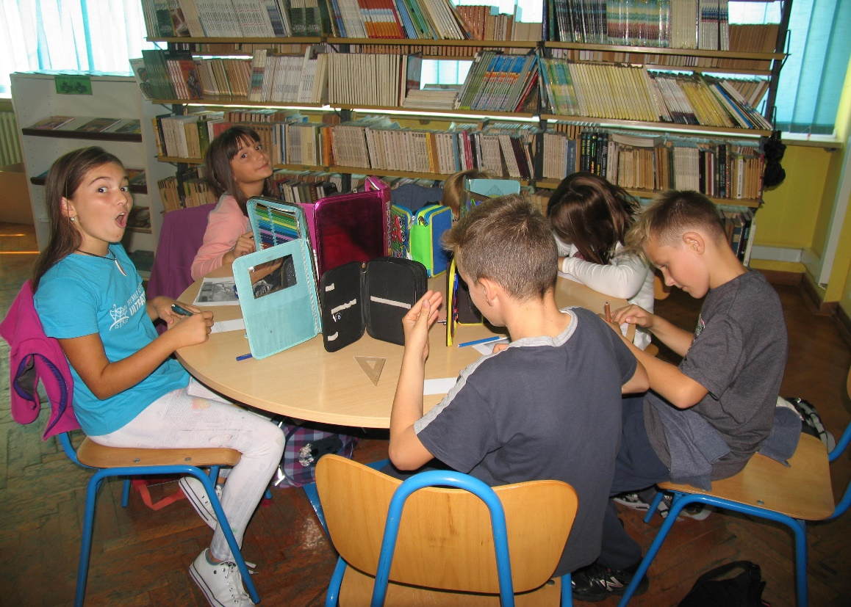
BOOKMARK PROJECT 2017.
4. a

Slide 19
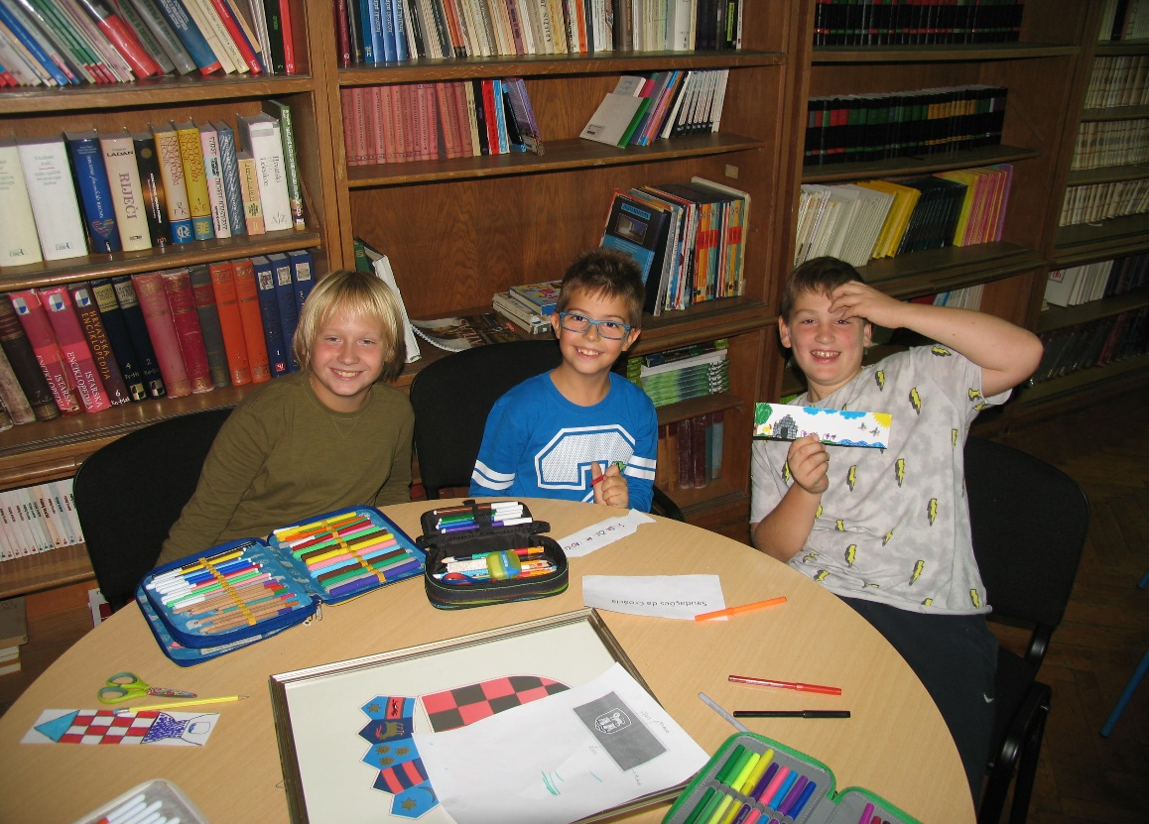
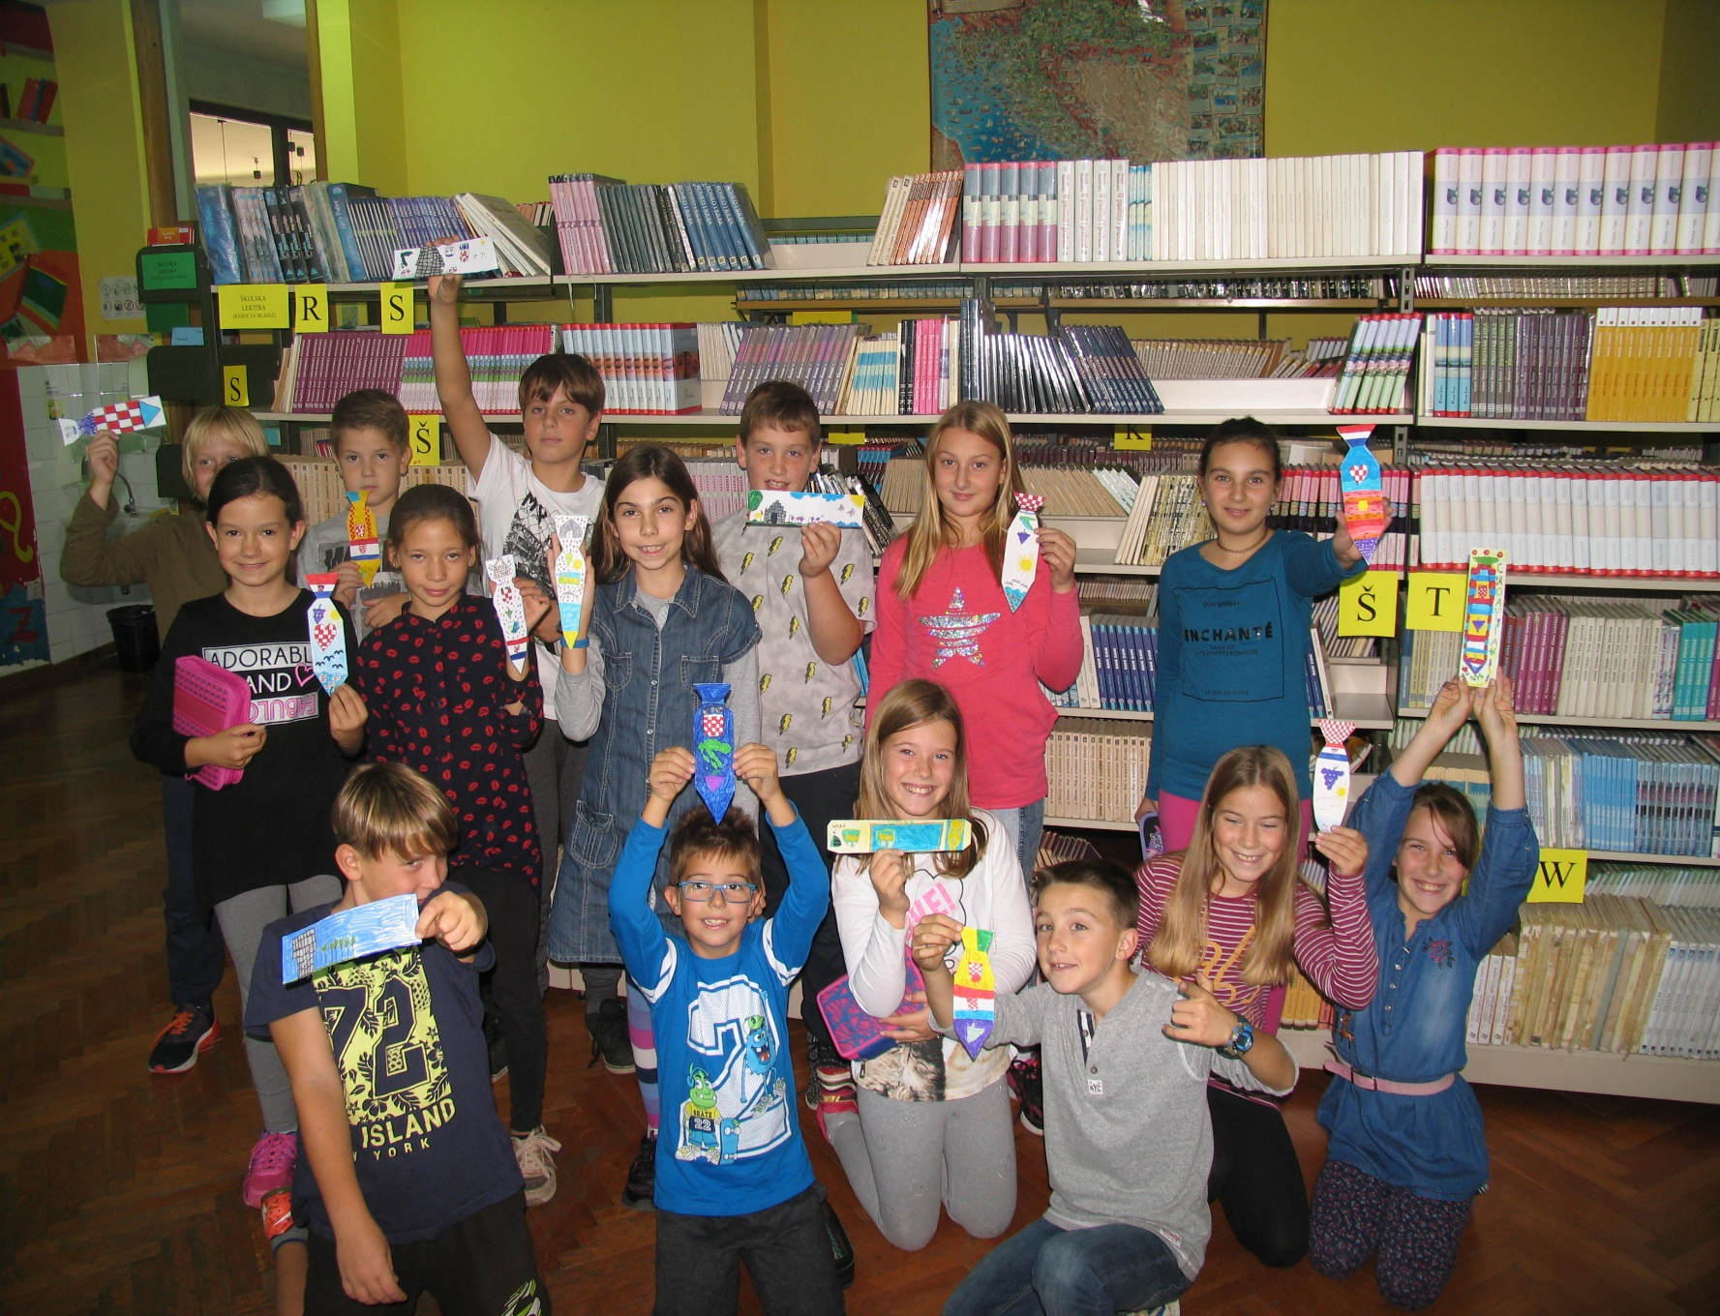
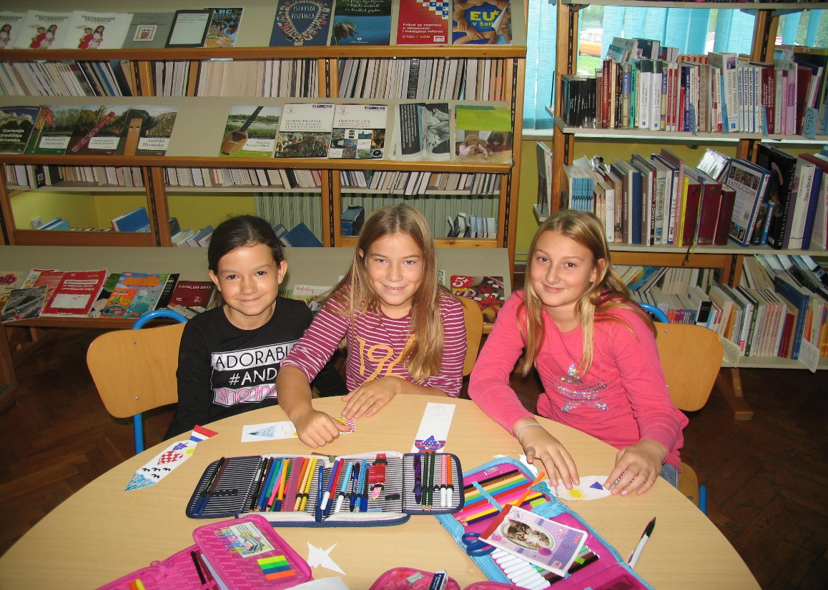
BOOKMARK PROJECT 2017.
4. b

Slide 20
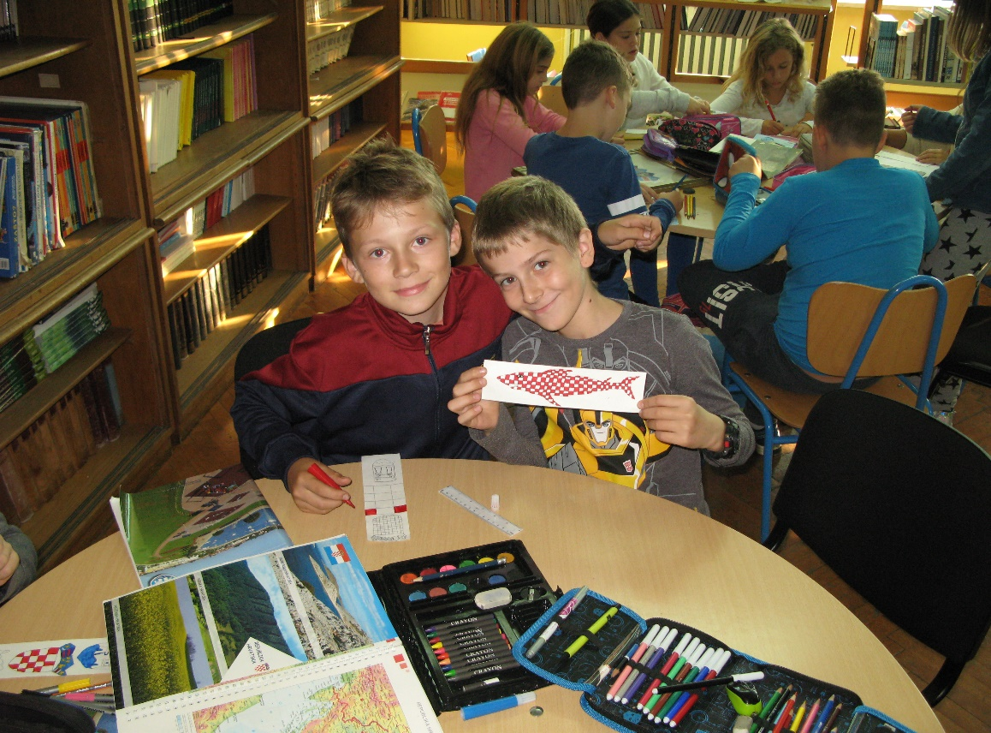
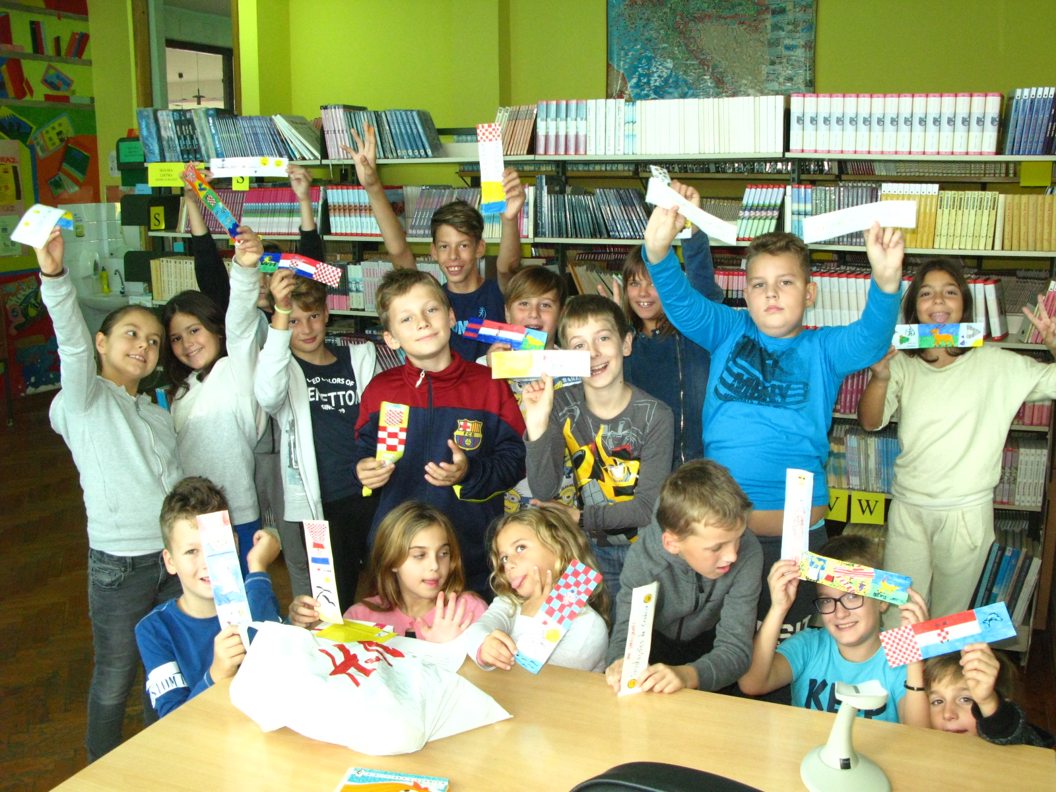
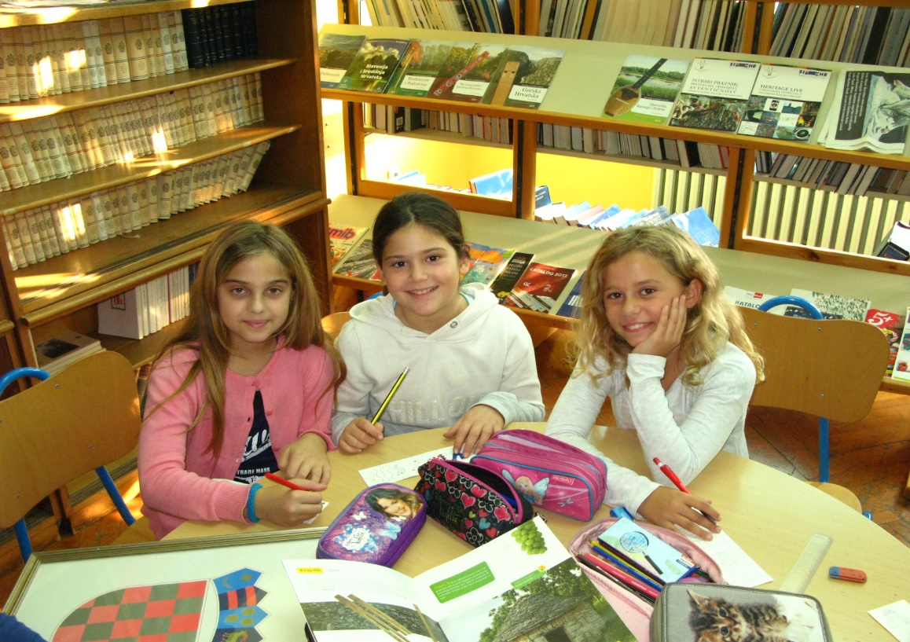
BOOKMARK PROJECT 2017.
4. c

Slide 21
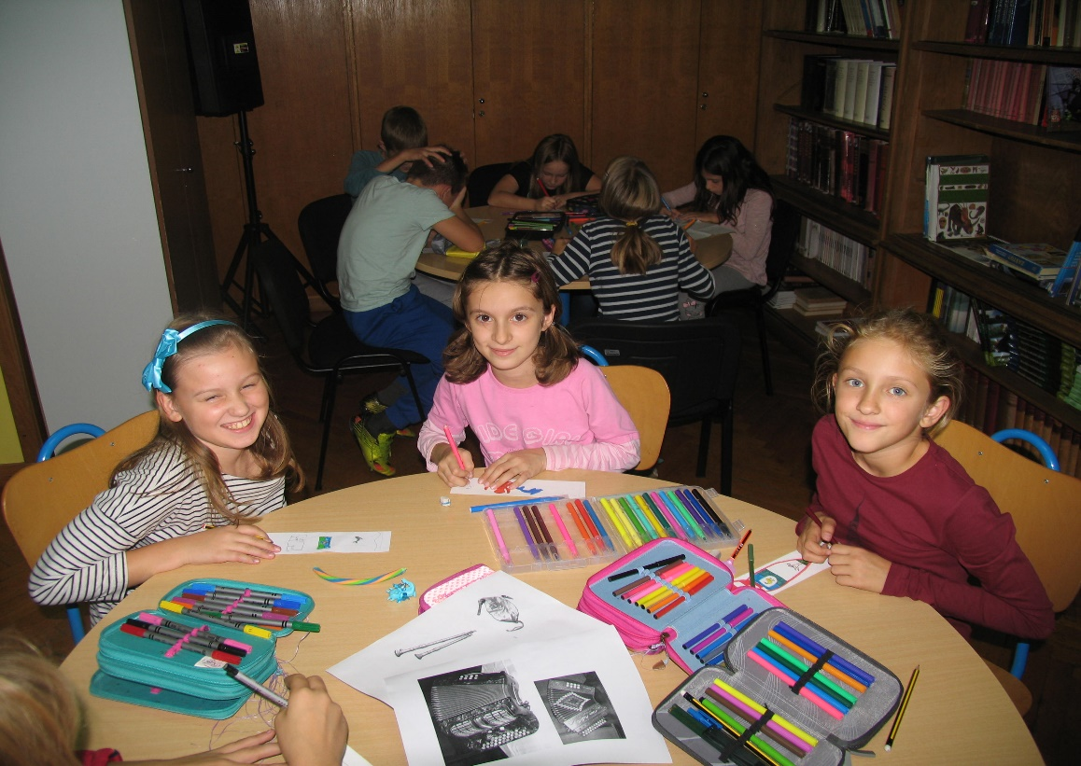
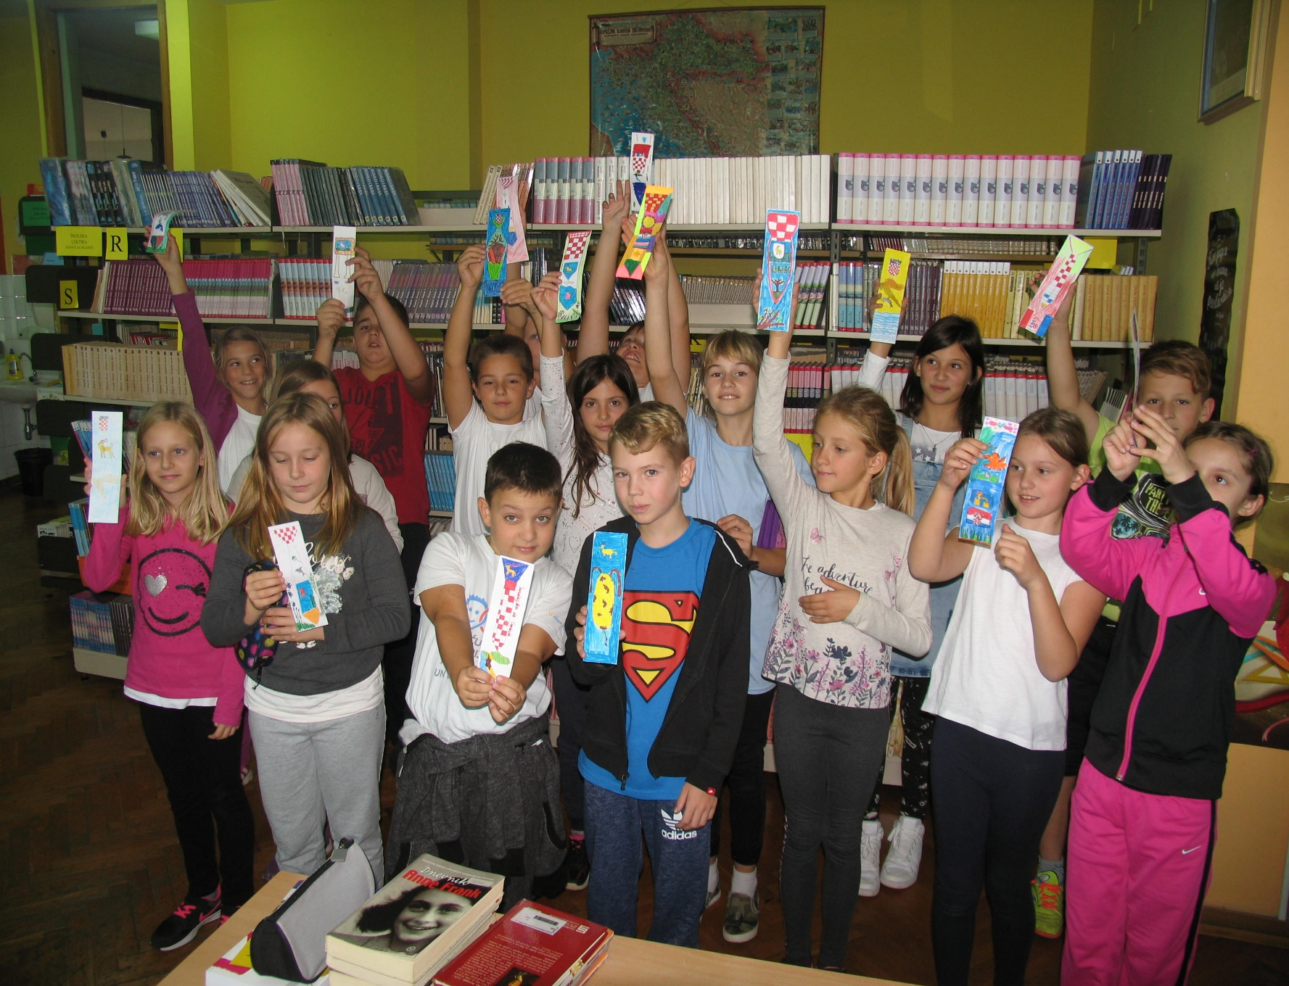
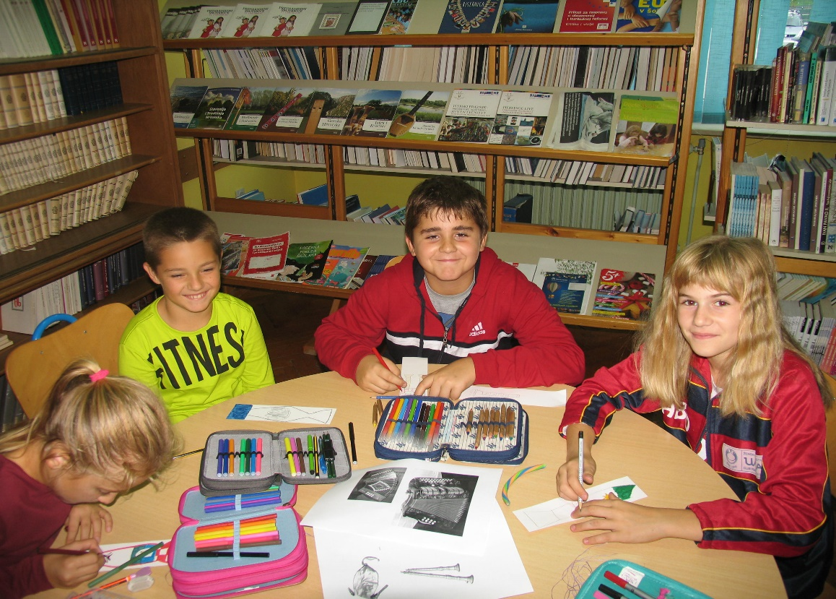
BOOKMARK PROJECT 2017.
4. d

Slide 22
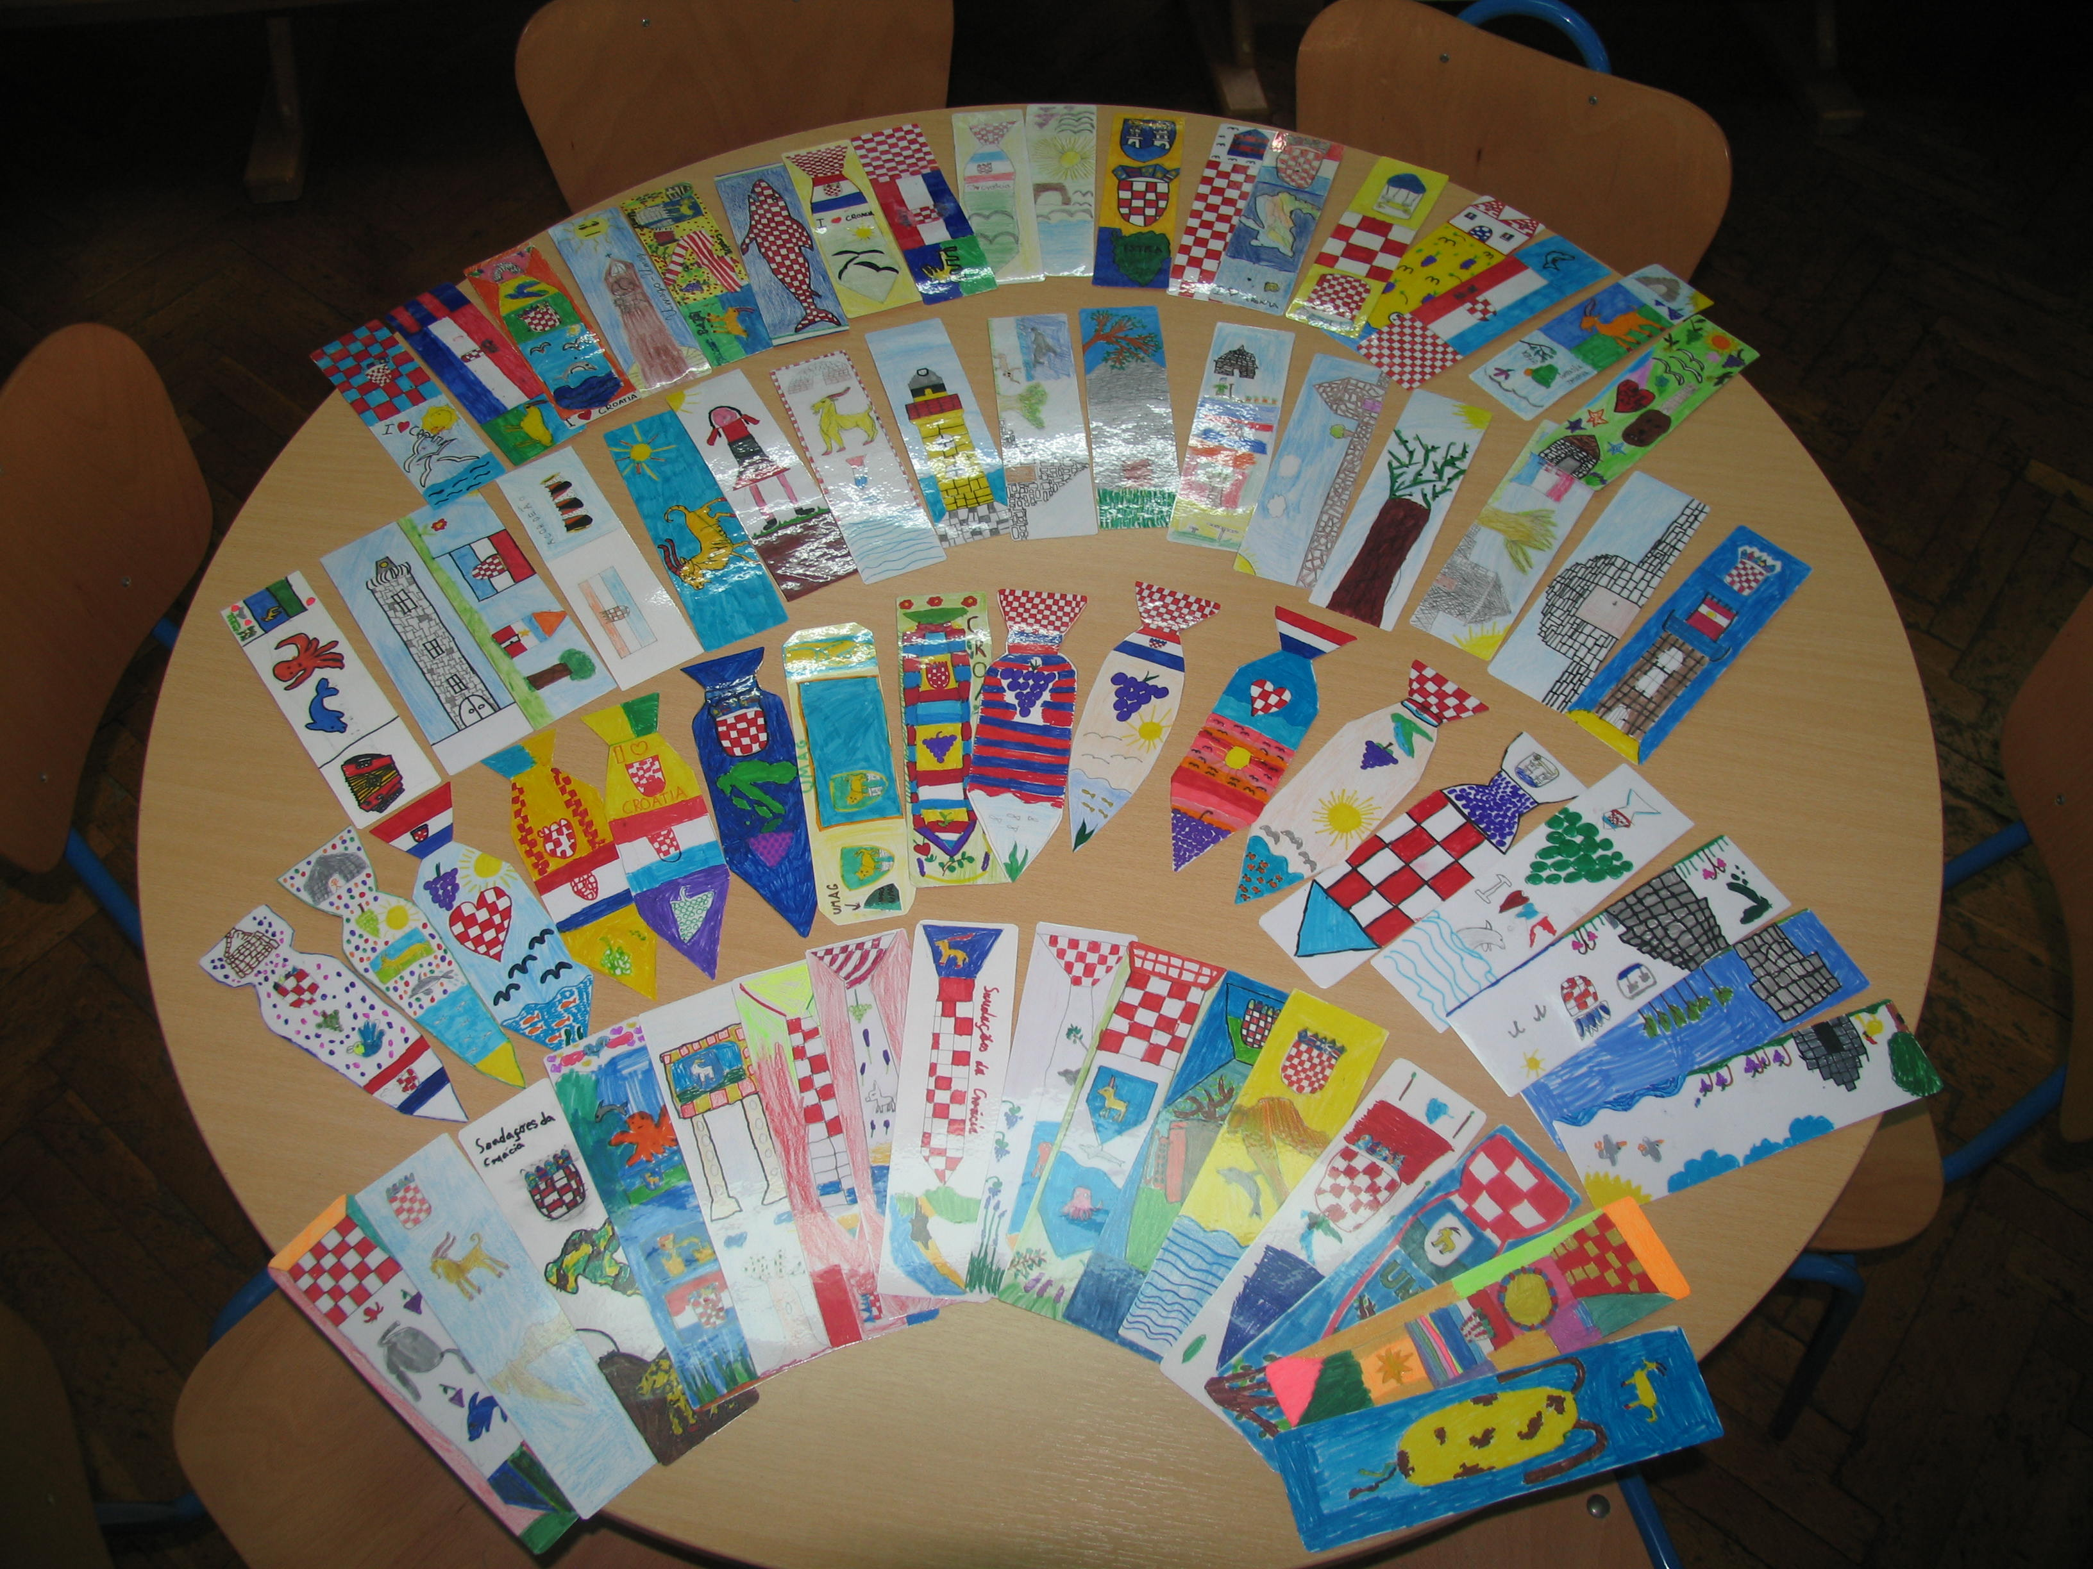

Our bookmark represent our country and the Istrian region.
The most common motives are: croatian flag, croatian coat of arms, red and white cubes, coat of arms of the Umag, geographic form of Croatia and Istra, necktie, sea, Istrian instruments, goat that represents the Istrian county, lavender, olives, grapes.

Slide 23


