Slide 1
RELIGIONS IN CROATIA

Slide 3
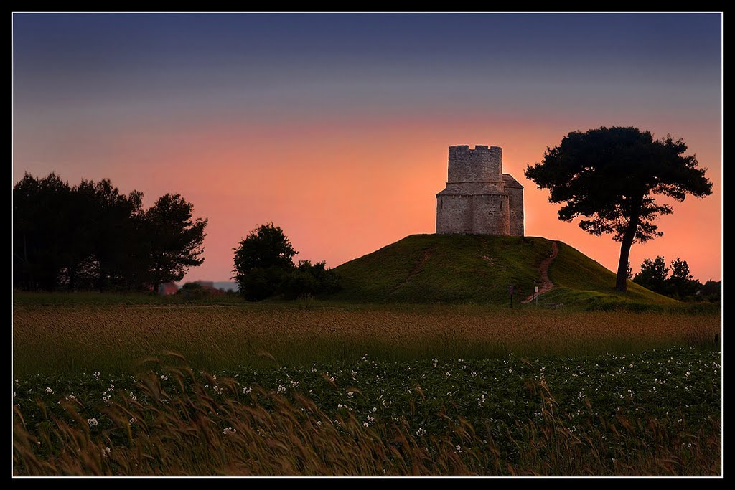
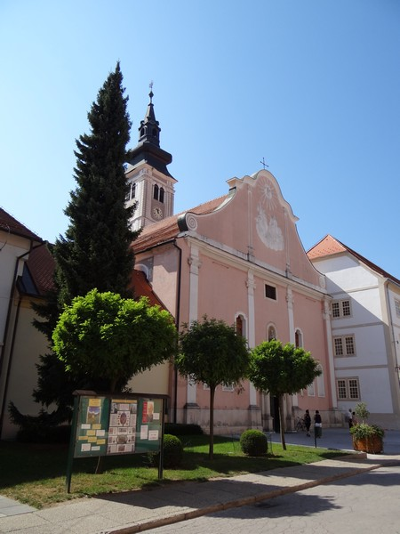
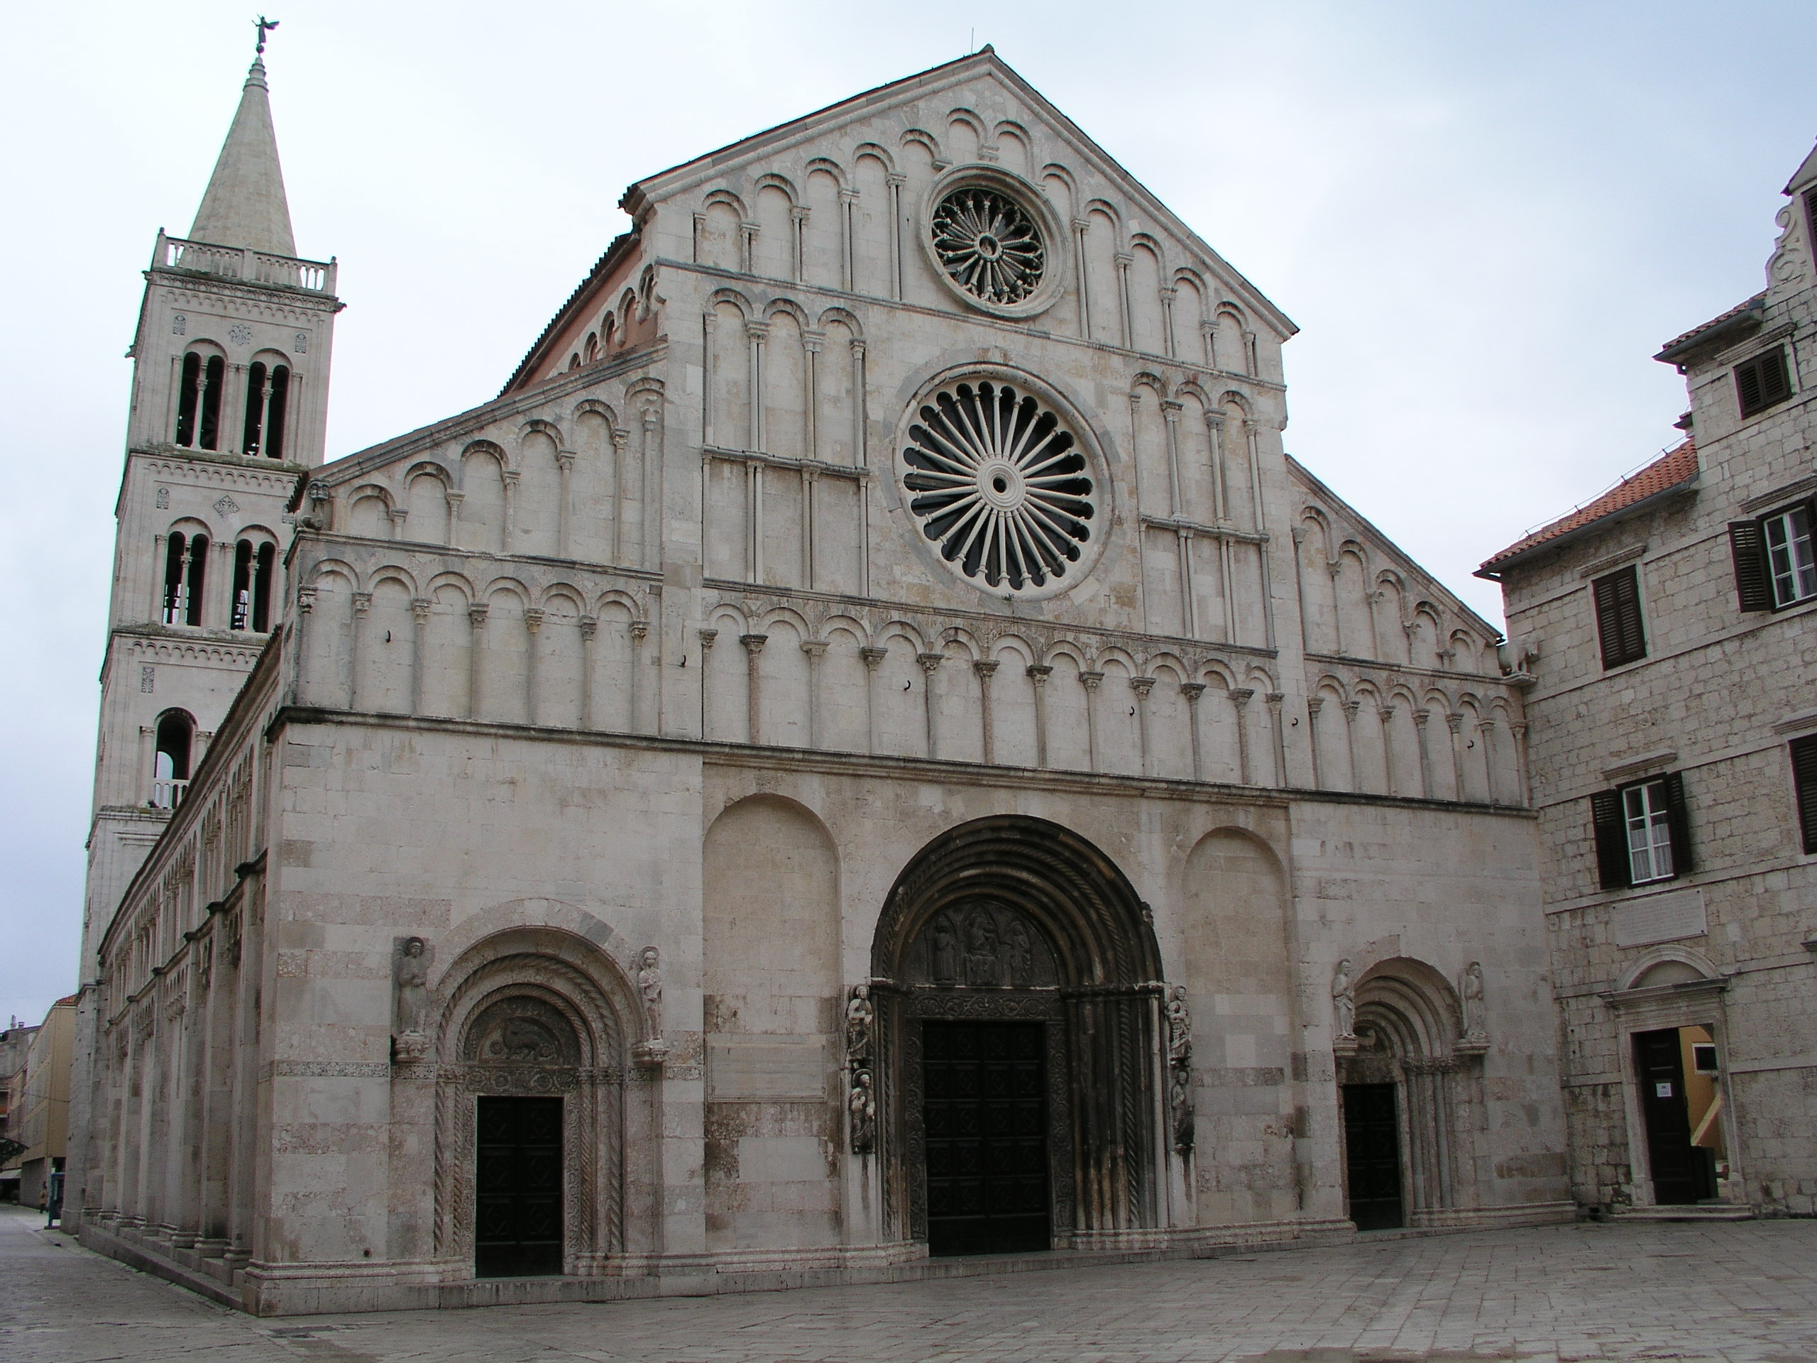
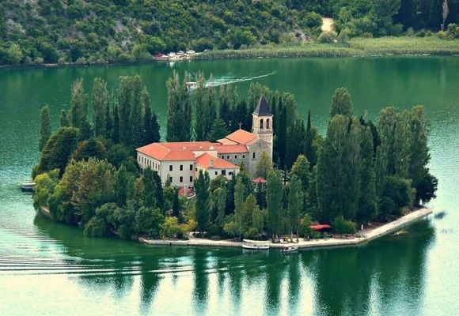
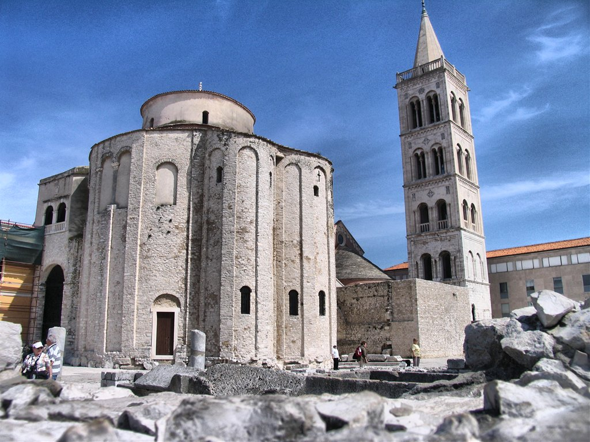
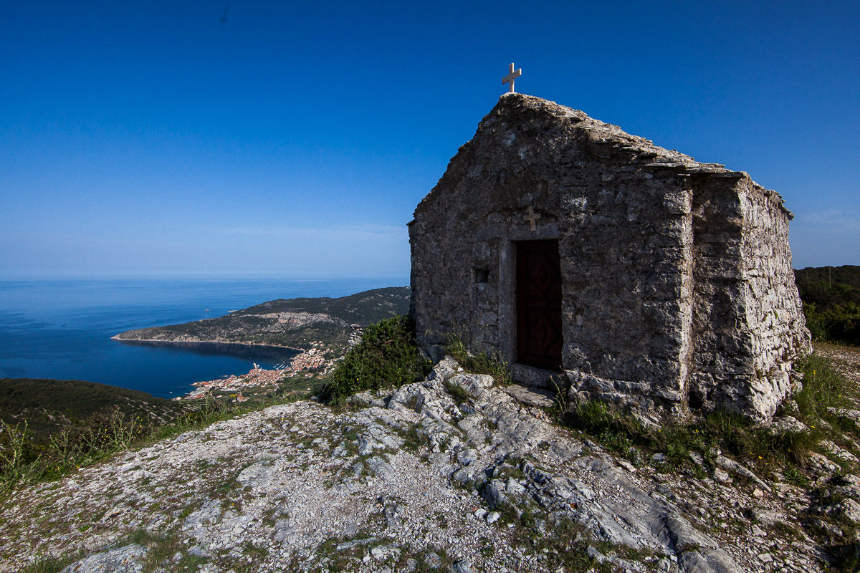
Catholic church
Catholics make 86,28 % of population in Croatia (around 3,5 million people)
Croatians are Christians for more than 13 centuries
The baptising started in the 7th century and lasted until the 9th

Slide 4
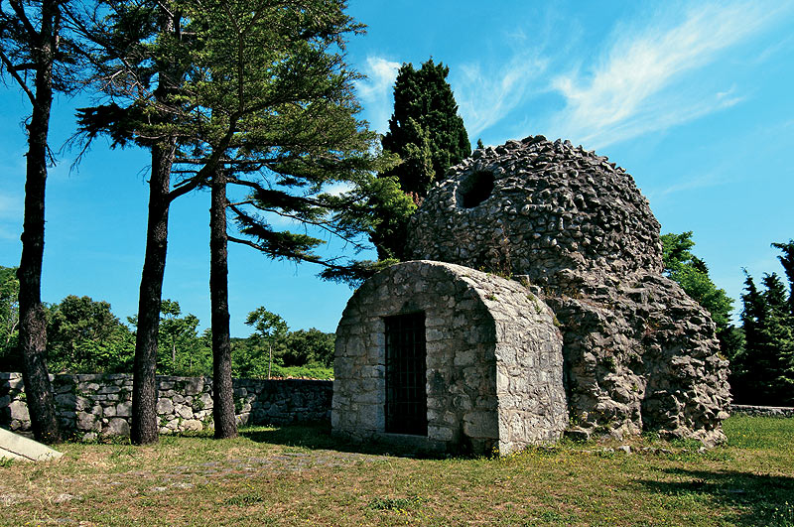
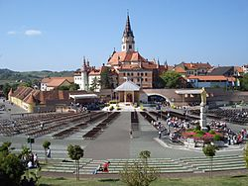
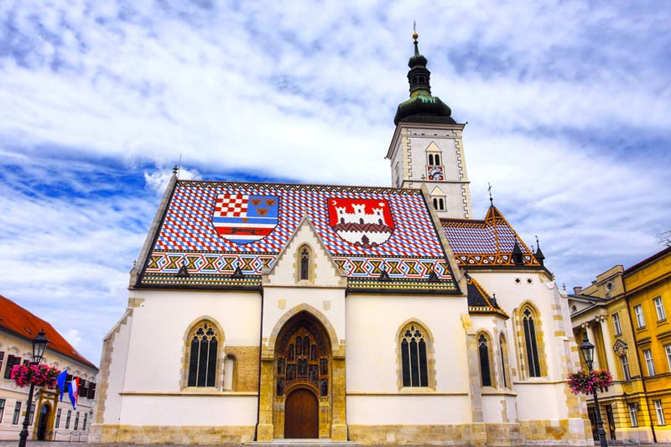
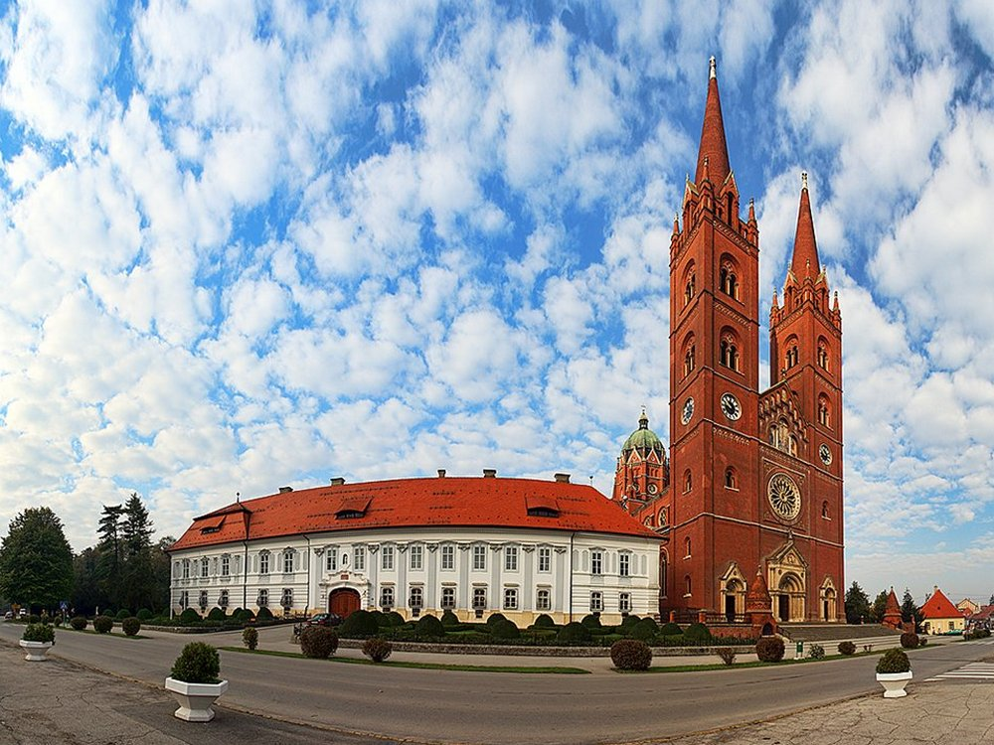
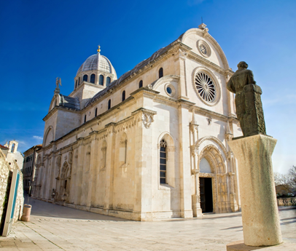
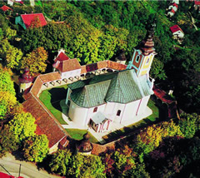
Since most people are Catholics, there are a lot of churches all over Croatia
Croatian National shrine is Marija Bistrica

Slide 5
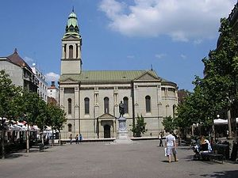
Orthodox chruch
Croatian Orthodox Chruch-COC (Hrvatska Pravoslavna Crkva) is the national orthodox church in The Republic of Croatia
COC has the same orthodox beliefs as other Orthodox Chruches. Greek, Romaninan, Ukrainien…
COC predominatly uses liturgy of western rite
Liturgy is in Croatian

Slide 6
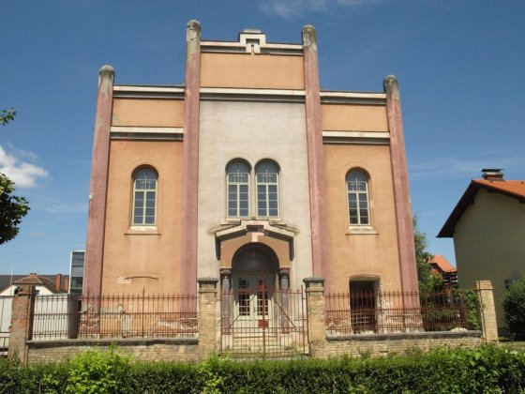
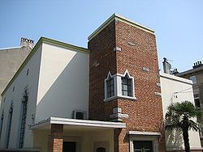
Jewish community
There are 2,500 Jews in Croatia
2 main communities are in Zagreb
Before WWII, there were 24,000 Jews ; 80 % of them died during Holokaust
There are couple of Synagogues across Croatia
The number of Jews is increasing as the years go by

Slide 7
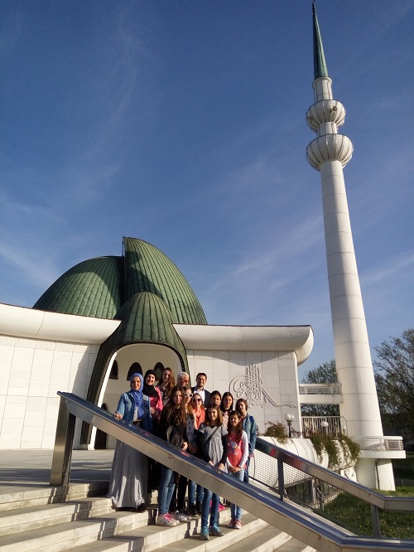
Muslim community
There are around 63,000 of Muslims in Croatia
The structure of Islam community in Croatia includes: Assembly of the Islamic Community in Croatia, Islamic Community in Croatia, Mufti of Zagreb and Islamic high school dr. Ahmed Smajlovic
Islam was introduced to Croats by the Muslim Ottoman Empire
One of the most beautiful mosques in Europe is situaded in Zagreb

Slide 8
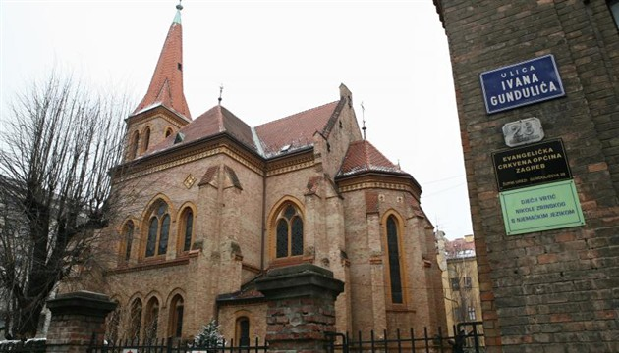
Protestants
There are three ways of Protestantism:
- Lutheran Church (the most expanded in Croatia-
Zagreb, Osijek, Vinkovci, Rijeka…)
- Reformed Church (Zagreb, Karlovac…)
- Anglican Church ( Zagreb)

Slide 9
There are also people who aren’t religious-atheists
There are about 163,000 Atheists in Croatia which is not a lot
Croatia is a country with one of the lowest number of atheists

Slide 10

„Instead of being presented with stereotypes by age, sex, color, class or religion, children must have the opportunity to learn that within each range, some people are loathsome and some are delightful.”- M. Mead

