Slide 1
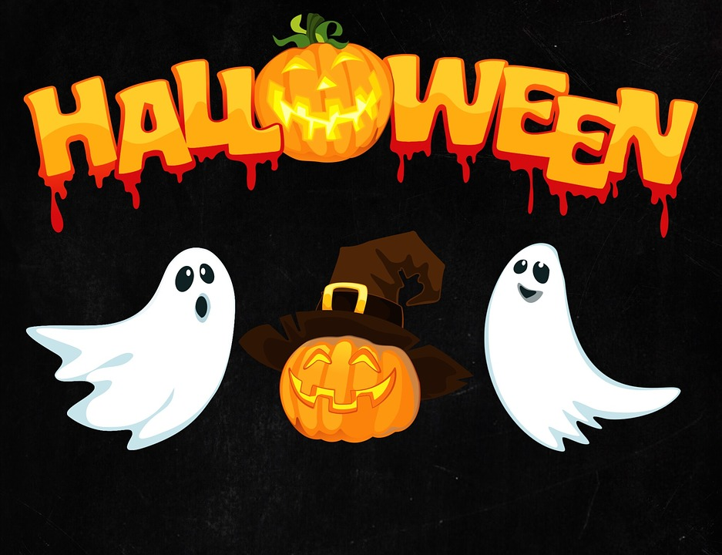
Halloween
Halloween on October 31st, is a pagan custom which celebrated the end of the summer.

Slide 2
On November 1st, days are getting shorter and nights are getting longer. Fires are lit to drive away evil spirits.People wrapp in cloaks, and make noise to drive evil spirits away.

Slide 3
Symbols
Symbols of this custom and that night are carved pumpkins, candles, witches, black cats, scary masks, bats, owls and other nocturnal animals.

Slide 4
Witches
Witches are an integral and unavoidable part of this custom.

Slide 5
black cat
in the Middle Ages it was believed that witches could also turn into a black cat.

Slide 6
nocturnal animals
It was believed that bats, owls and other night’S animals could communicate with the souls of the dead.

Slide 7
MASKS
On Halloween people wear scary masks of clowns, skeletons, zombies ...

Slide 8
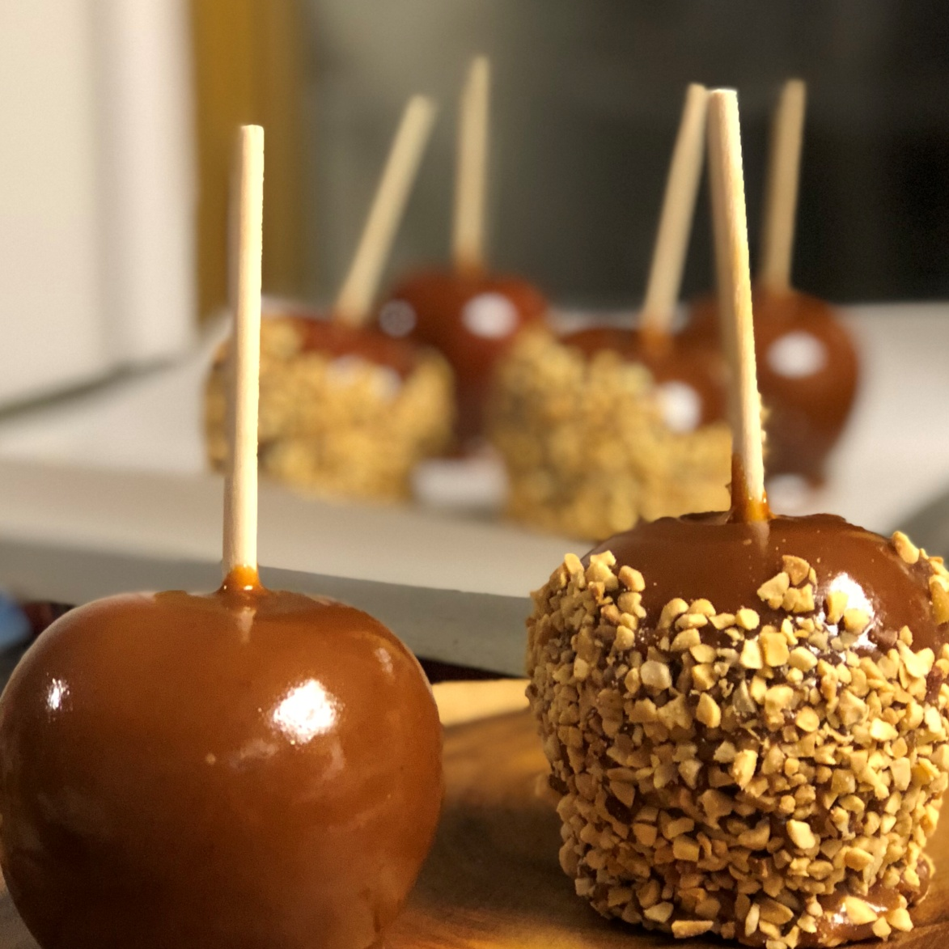
food
Candy and caramel apples
Apple bread
Caramel corn
Candy corn
Pumpkin bread

