Slide 1
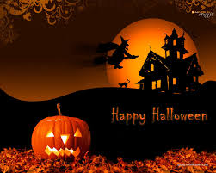
HALLOWEEN
Halloween or Hallowe’ en (a contraction of Hallows’ Even or Hallows’ Evening), also known as Alhalloween, All Hallows’ Eve, or All Saints’ Eve.

Slide 2
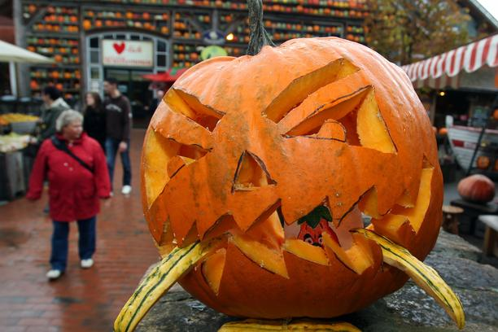
Celebration
Celebration observed in many countries on October 31 st, the eve of the Western Christian feast of All Hallows’ Day. In day of celebration people make scary face on the pumkins.

Slide 3
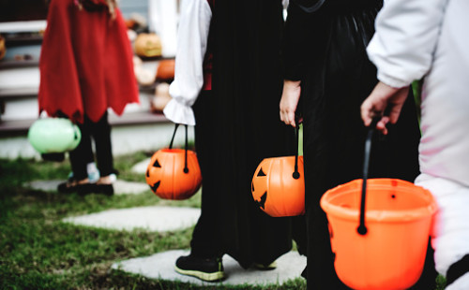
What people do on Halloween day?
On Halloween people have costume parties, make jack-o’-lanterns, light bonifires, play apple bobbing or visit haunted attractions.

Slide 4
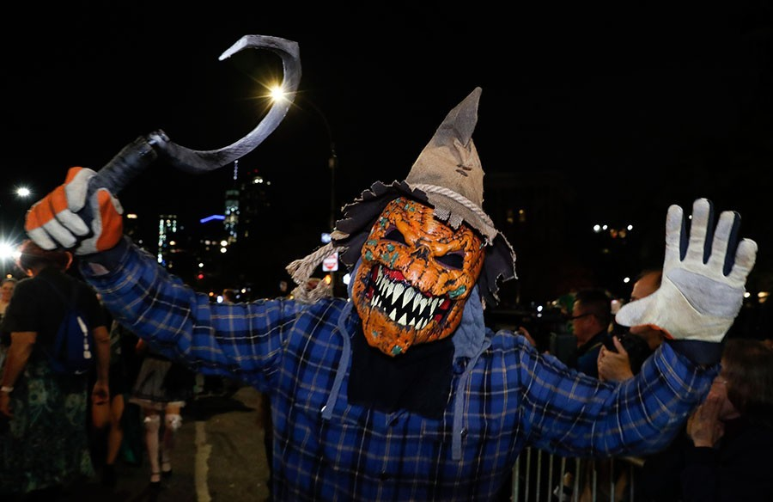
Halloween customs
are thought to have been
influenced by folk customs
and beliefs from the Celtic-speaking countries, some of which are believed to have pagan roots.

Slide 5
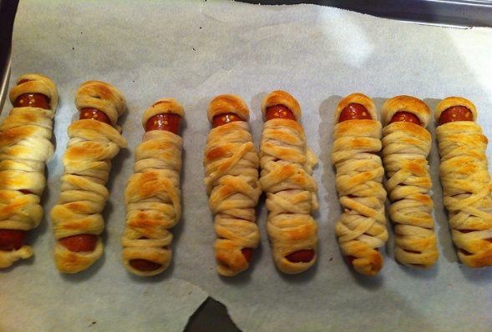
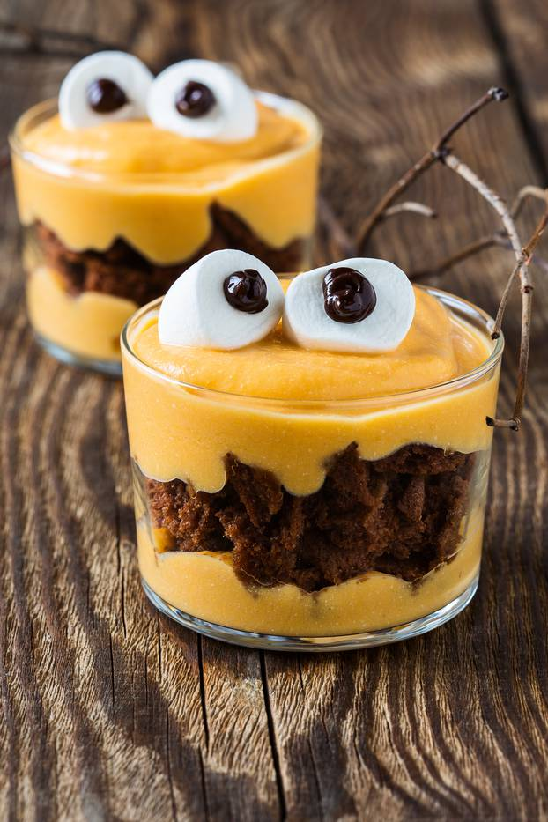
Food on Halloween day
Hot dogs mummy
Monster from the case

