Slide 1
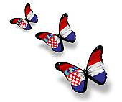
CROATIA
POPULATION
By: Morena Kurtović, Iva Plazibat, Nina Rađa, Karmen Gazibara i Matea Lauš

Slide 2
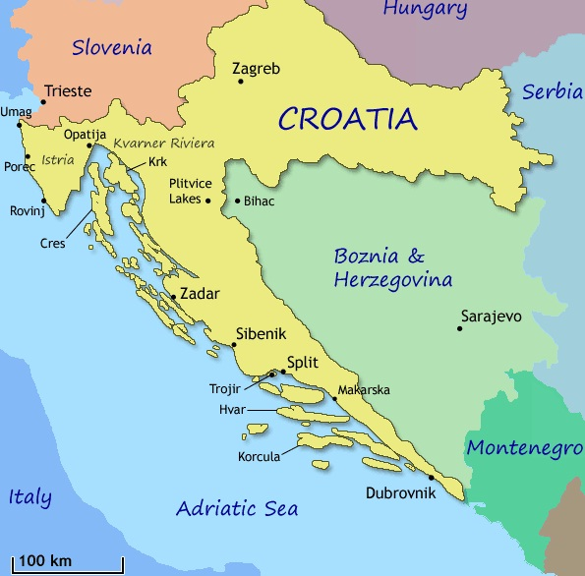
Introduction
Croatia has a population of about 4 million and 500 thousand people.There are about 4 million Croatians and the rest are national minorities.
The president is Ivo Josipović.

Slide 3
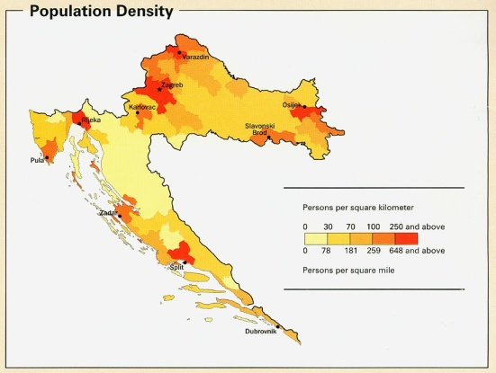
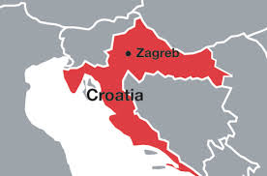
Distribution and composition of the population
Distribution of the population is another important demographic characteristic.
Almost two thirds of the population today live in a little more than one third of the territory of the Croatia.
The greatest population concentration is in Zagreb.The smallest concentration is in Senj.

Slide 4
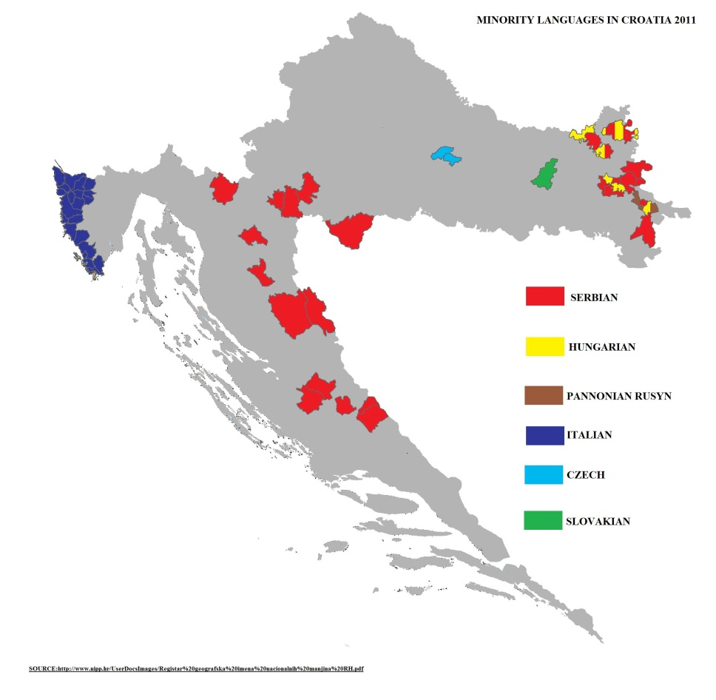
Languages
The official language is Croatian, and the script is Latin.
Other languages are:
Serbian
Italian
Hungarian
Slovakian
and others.

Slide 5
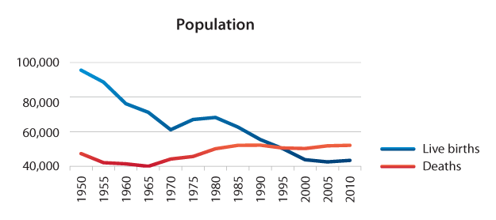
Populaton growth
17% of people are older than 65 years and each year more people die than are born, so population growth is a big problem.

Slide 6
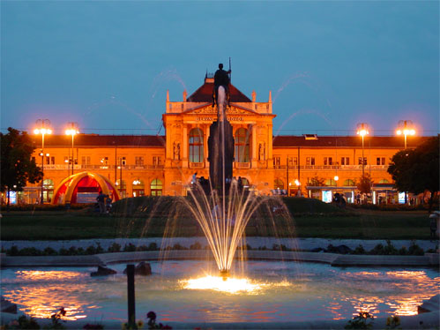
Cities
The capital city is Zagreb. In Zagreb lives almost 1 million people.
The other big cities:
Split
Osijek
Šibenik
Rijeka
Dubrovnik
Zadar

Slide 7
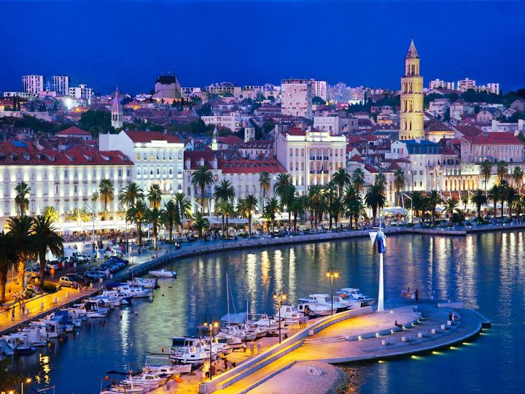
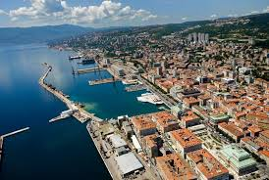
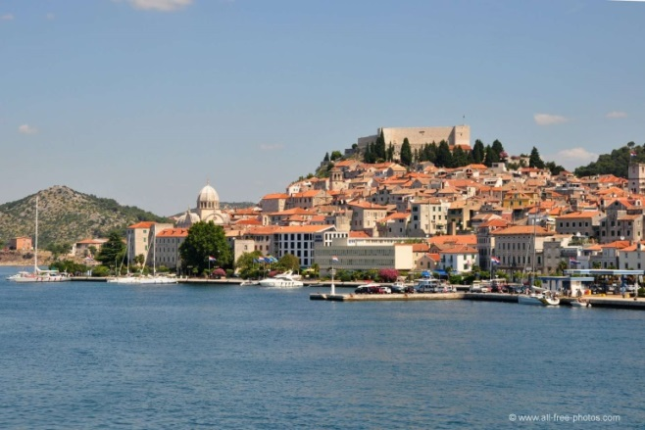
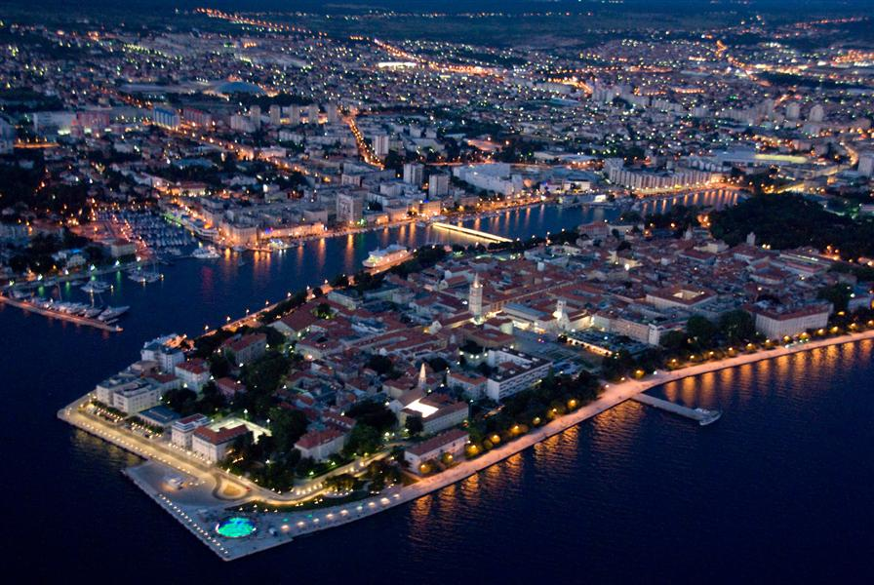

Slide 8
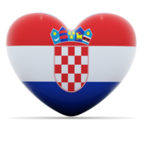
National minorities
National minorities in Croatia are the next :
Serbian
Bosnian
Italian
And the rest are Croatian

Slide 9
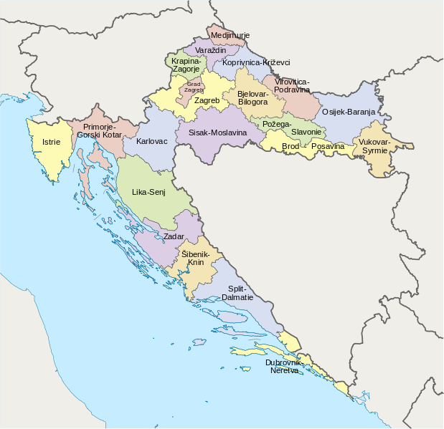
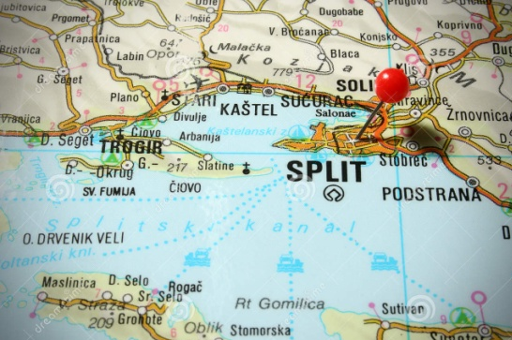
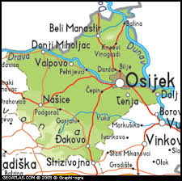
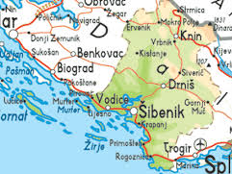
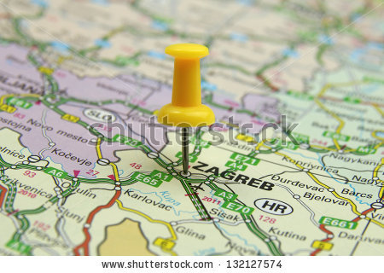
Counties
Croatia is divided into twenty counties and the
capital city named Zagreb.

Slide 10
References
file:///G:/Croatia/Croatia.eu%20-%20Distribution%20and%20composition%20of%20the%20population.htm
http://countrymeters.info/en/Croatia
Wikipedija

