Slide 1
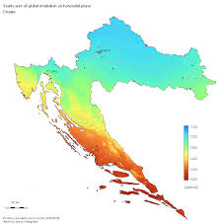
CLIMATE

Slide 2
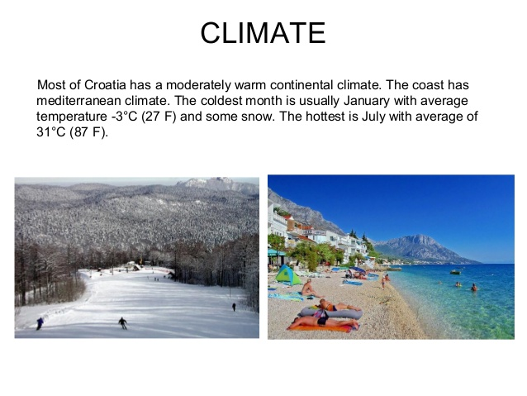
CLIMATE
A continental climate prevails in the north of Croatia.Summers are hot and winters are cold and humid.Along the Adriatic coats,the climate is Mediterranean.Summers are very hot and dry,and winters are mild with temperatures rarely dropping below 5°C.The Adriatic coast is one of the sunniest in the Mediterranean,which makes it very attractive for tourists from all over the world.

Slide 3
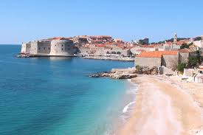
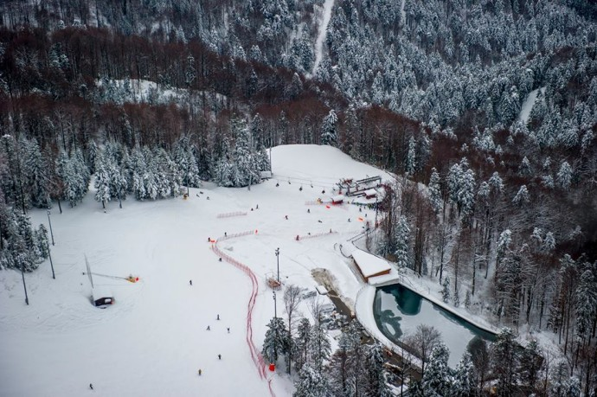
Summers and winters

Slide 4
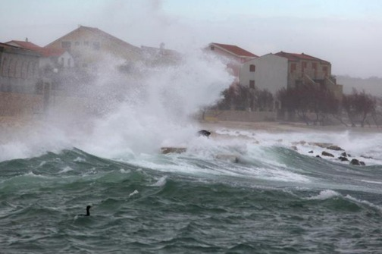
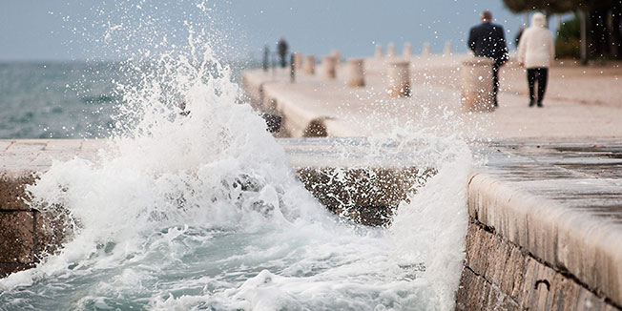
Winds in Croatia are different, but the two most famous are bora and sirocco,a warm wind blowing from the sea to the mainland,bringing moist air. Bora is cold and dry wind that brings nice and bright weather.
Bora
Sirocco

Slide 5
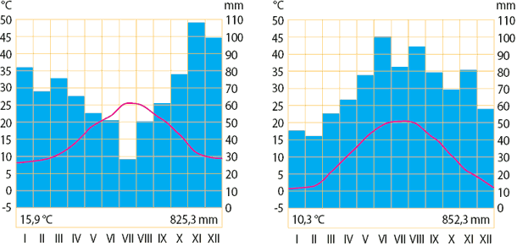
Rainfall in Croatia

Slide 6
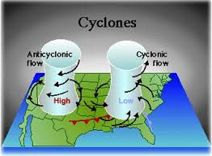
Cyclone and Anticyclone

Slide 7
Cyclone brings bad weather and low air pressure and anticyclone brings good weather and high air pressure.

Slide 8
Climate
Made by:
Mia Sanader,Antonija Novakovic,Lorena Zoko,Ivana Kalinic

