Slide 1
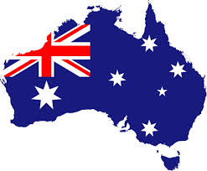
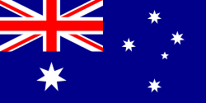

Australia

Slide 2
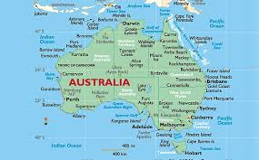
Geographical position
The world's smallest continent and the sixth largest country is Australia.
Australia is also called „Down Under”

Slide 3
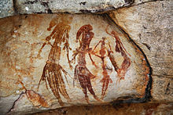
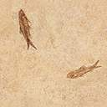
History
The first inhabitants of the Australian continent came between 42,000 and 48,000 years ago.
Native Aborigines were hunters until Europeans arrived.
Europeans expalled Aborigines out of their natural habitats.
Aboriginal rock art in the
Western Australia

Slide 4
Politics
Australia is a federation consisting of six states, three federal territories and seven external territories.
Australia, today, is very democratic country.
Equality is on high level.
Australia takes high place in world politic.

Slide 5
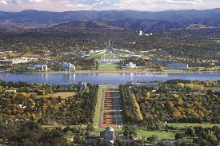
Capital City
Canberra is the capital city of Australia. With a population of 381,488, it is Australia's largest inland city and the eighth-largest city overall.
A resident of Canberra is known as a "Canberran".

Slide 6
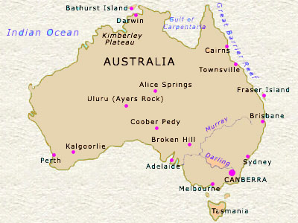
Other Cities
Sydney
Melbourne
Brisbane
Perth
Adelaide

Slide 7
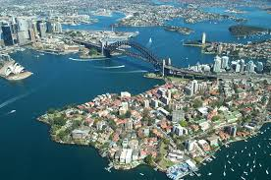
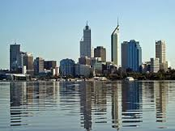
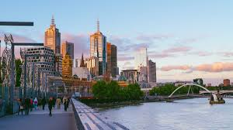
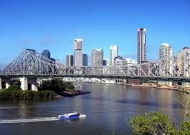
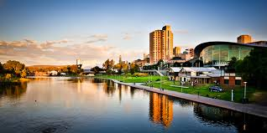

Slide 8
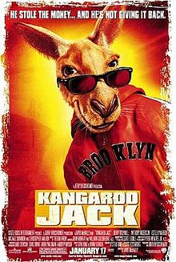
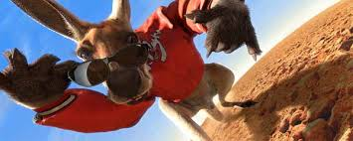
Kangaroo Jack
Kangaroo Jack,American-Australian buddy-action black comedy, filmed by Warner Bros is one of the most popular films in Australia.

Slide 9
Fun facts!
Australia recognizes Queen Elizabeth II as their ruler, the Queen of Australia. We say that it is ”under the British crown”
Uluru,also known as Ayers Rock is a large sandstone rock formation in the southern part of the Northern Territory in central Australia.
Maybe the most famous building in Australia is famous „ Sydney Opera House”. It’s famous because of unusual shape - it look like a shell.

Slide 10
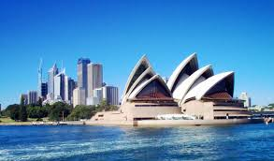
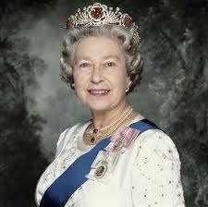
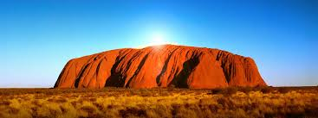
Sydney Opera House
Queen Elizabeth
Uluru

Slide 11
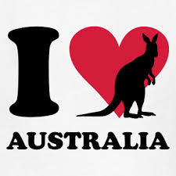
References
https://en.wikipedia.org/wiki/Australia
https://en.wikipedia.org/wiki/Kangaroo_Jack
https://en.wikipedia.org/wiki/Uluru
Thanks for your attention!
Teacher: Gordana Čović
Made by: Bruna Dujmović
& Dora Rađa

