Slide 1
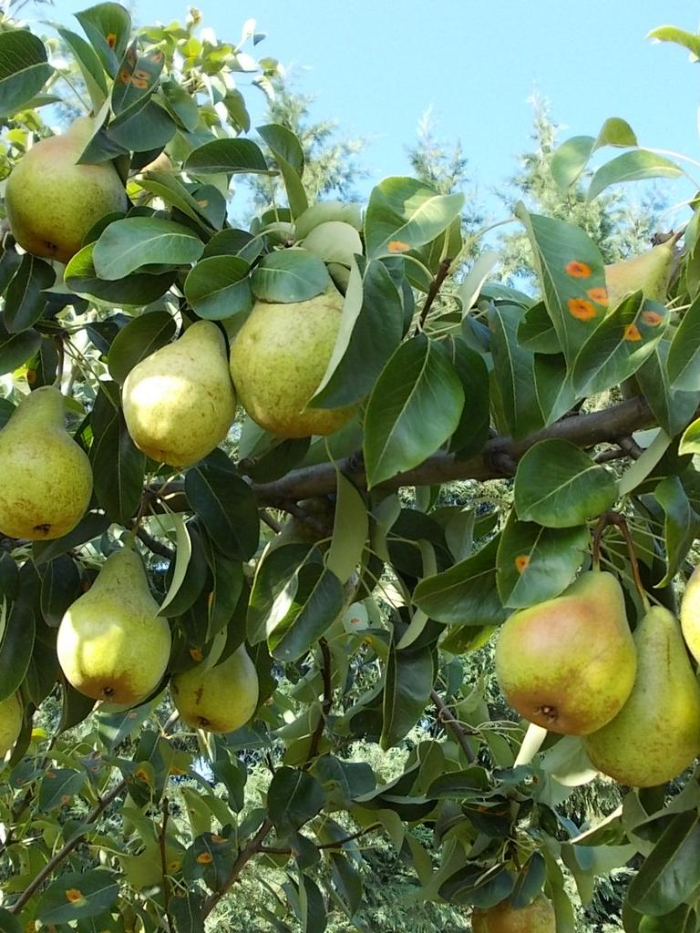
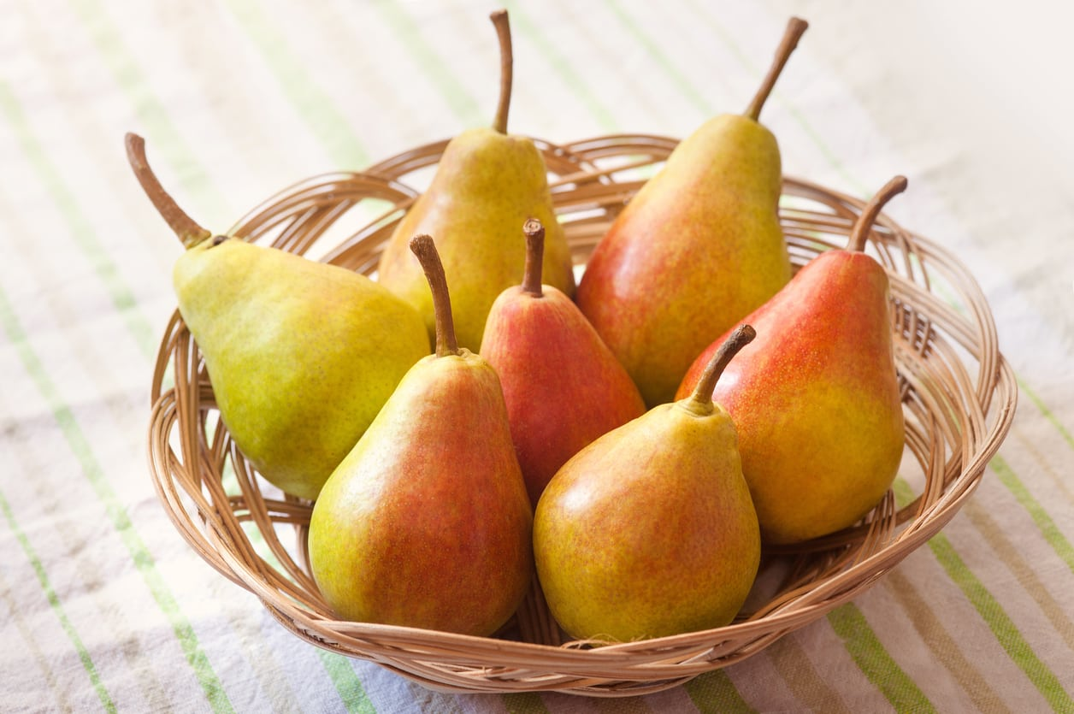
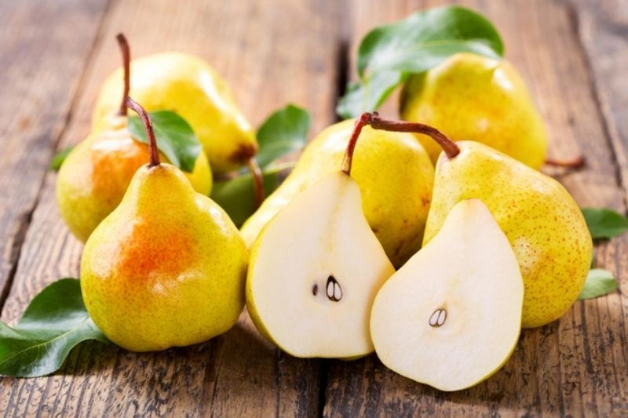
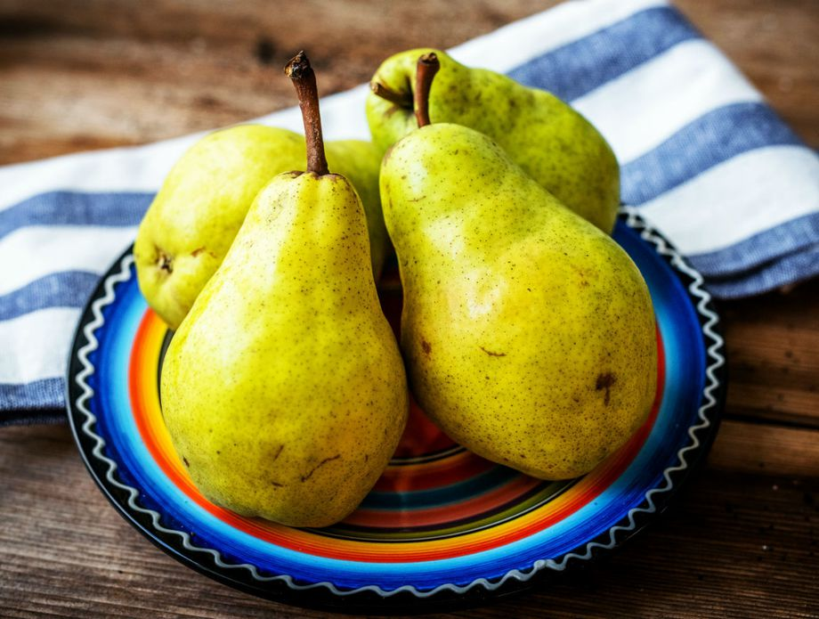
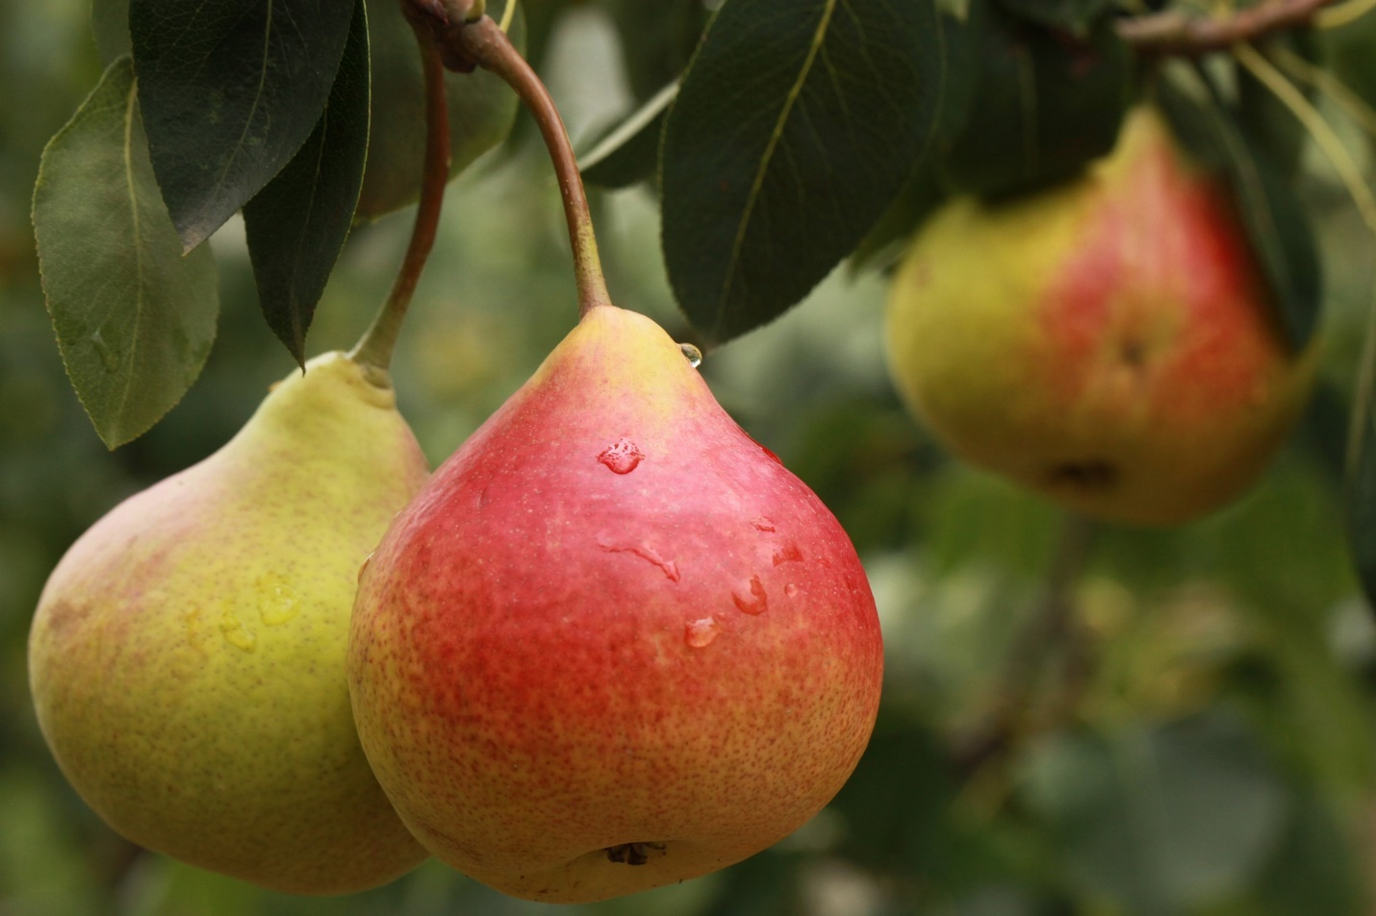
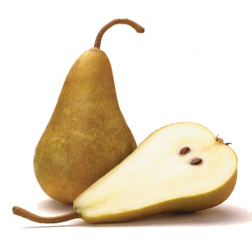
PEARS
Made by: Jure Svalina

Slide 2
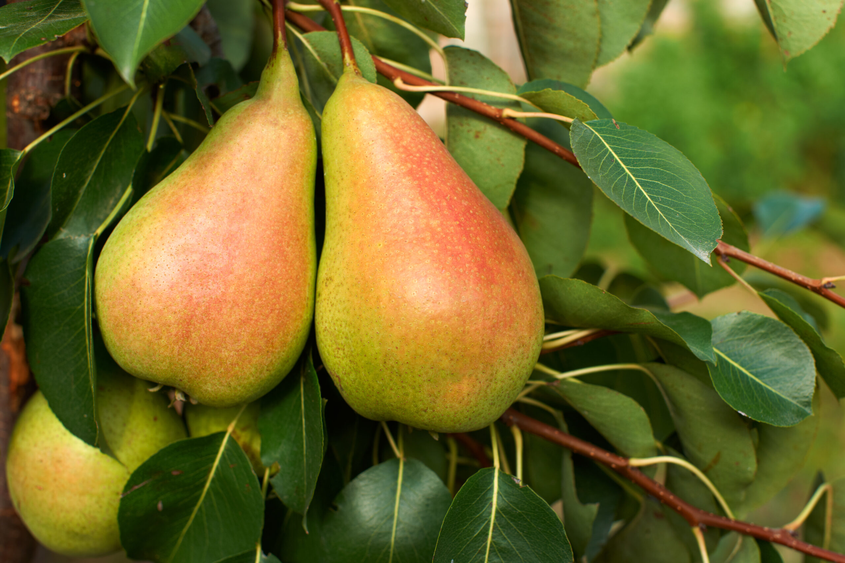
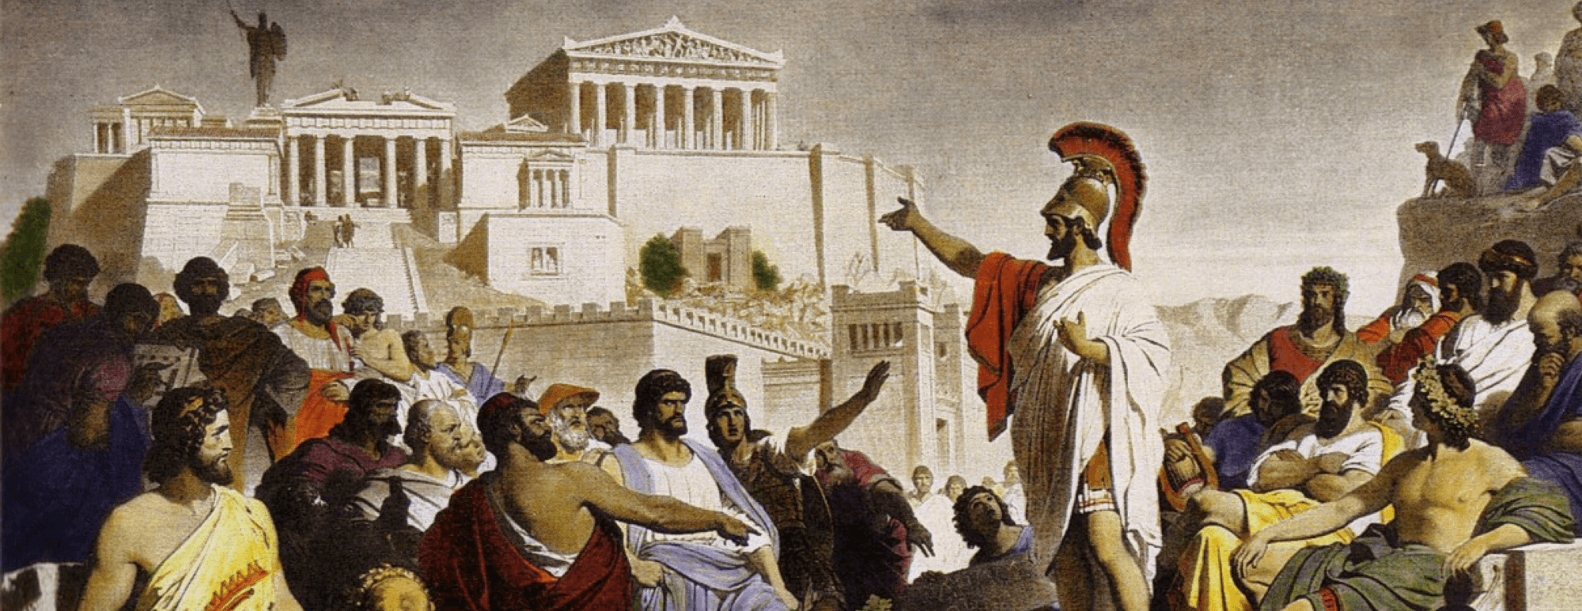
BASIC INFORMATIONS
There are between 1000 to 10000 types of peras
Pears have been cultivated for more than 4000 years
The anicent Greeks considered it as gift from the gods

Slide 3
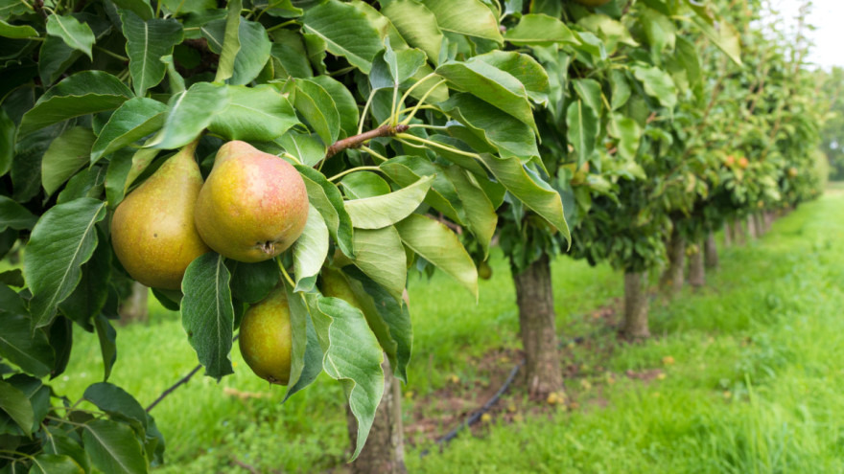
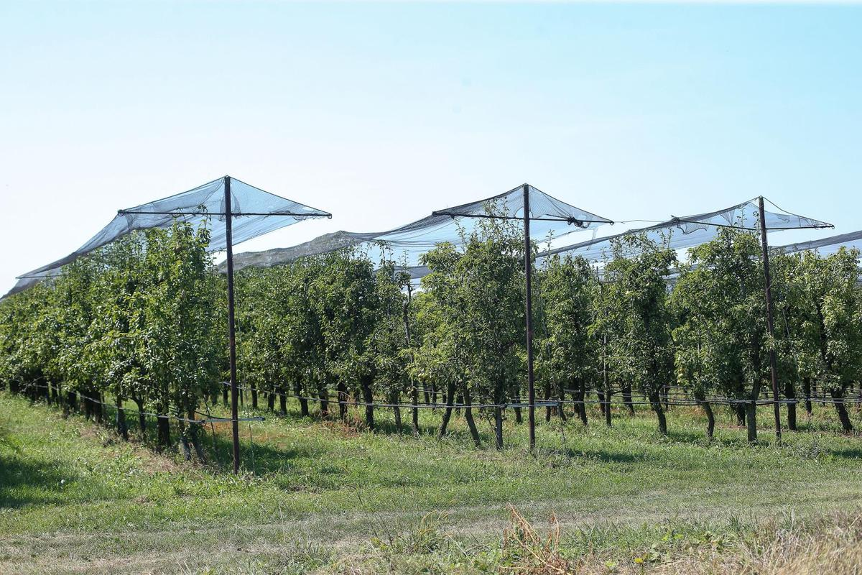
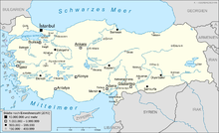
PRODUCTION IN THE WORLD
The largest producer of pears in the world is Turkey
Annual production in Turkey is 16 tons
Turkey is also the largest exporter of pears

Slide 4
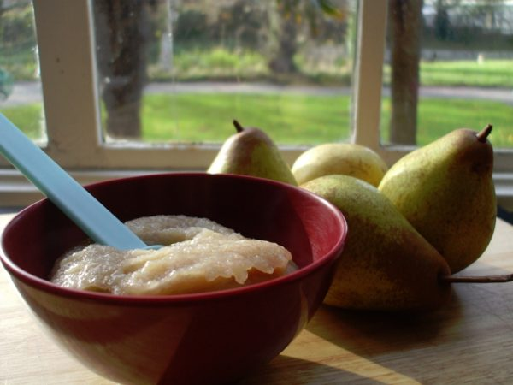
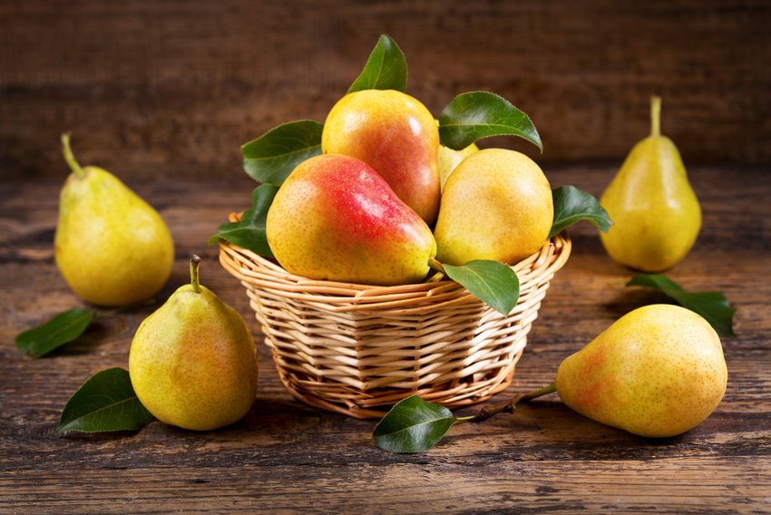
INTERESTING FACTS ABOUT FRUIT
Pear has medicinal properties
Pear are one of the first fruits that babies can eat
A pear tree can live up to 150 years

