Slide 1
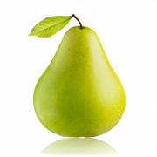
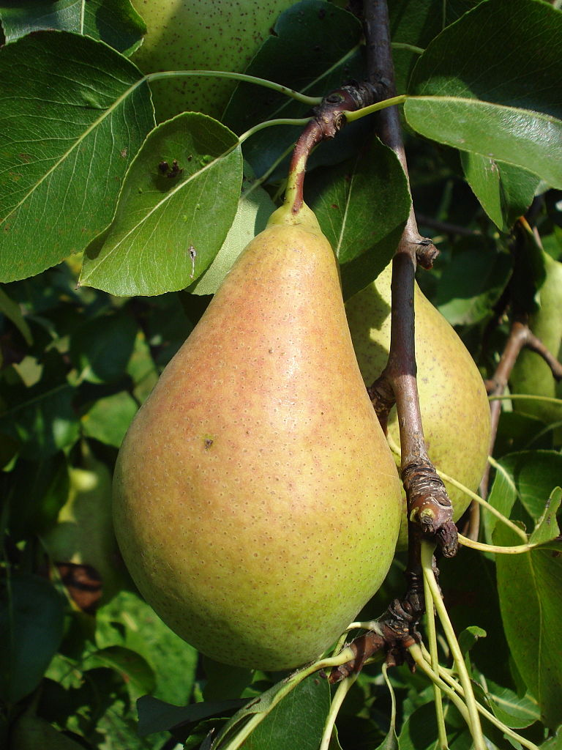
Pears
Ana Juričin, 8.a, osnovna škola Petra Kružića, Klis

Slide 2
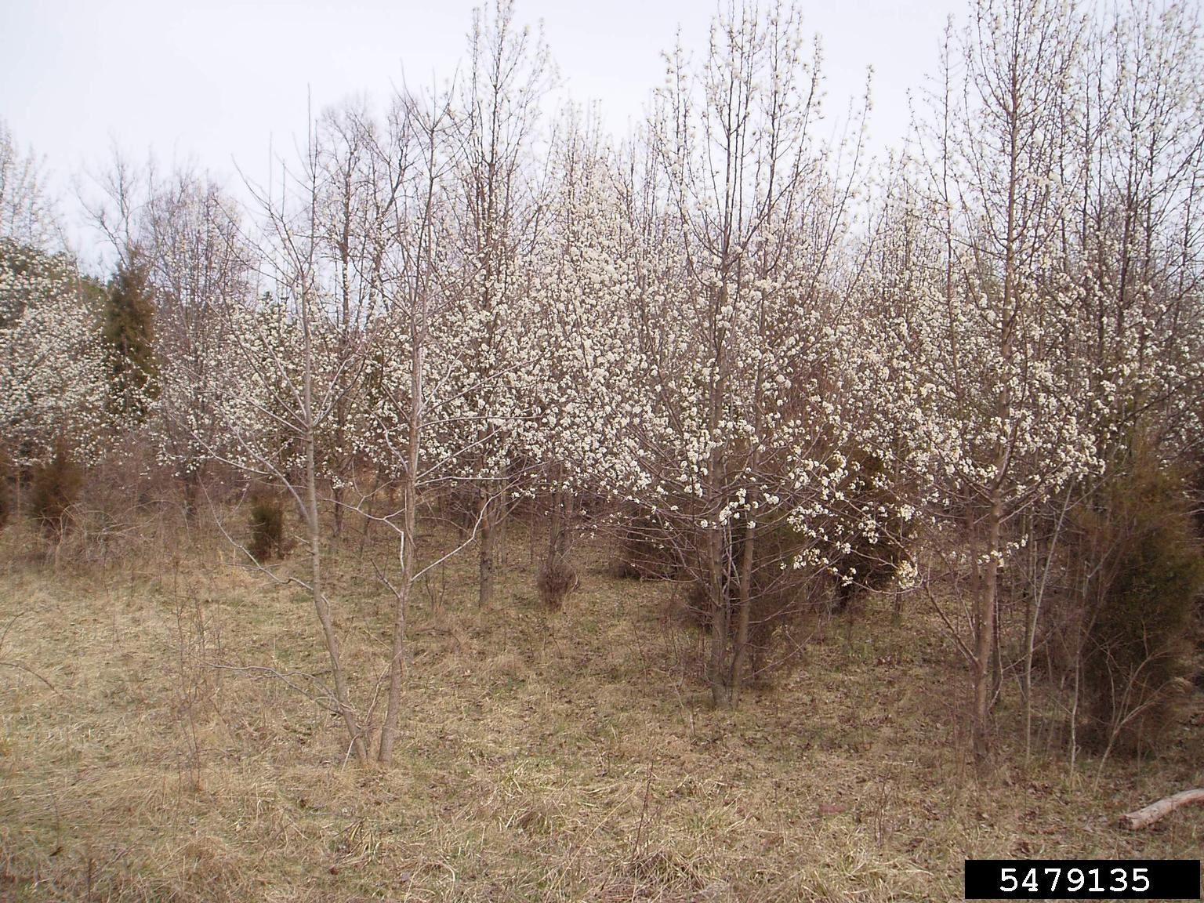
The inner structure of the pear and some facts
Pears have got a flower seed set at pestle, and it's, in fact, hidden
Pear fruit consists of a petiole, neck and body
At the bottom there is a cup
There are 72 types of pears today
Several types of pears are valuable because of their edible fruit and juice
-A picture of pear woods

Slide 3
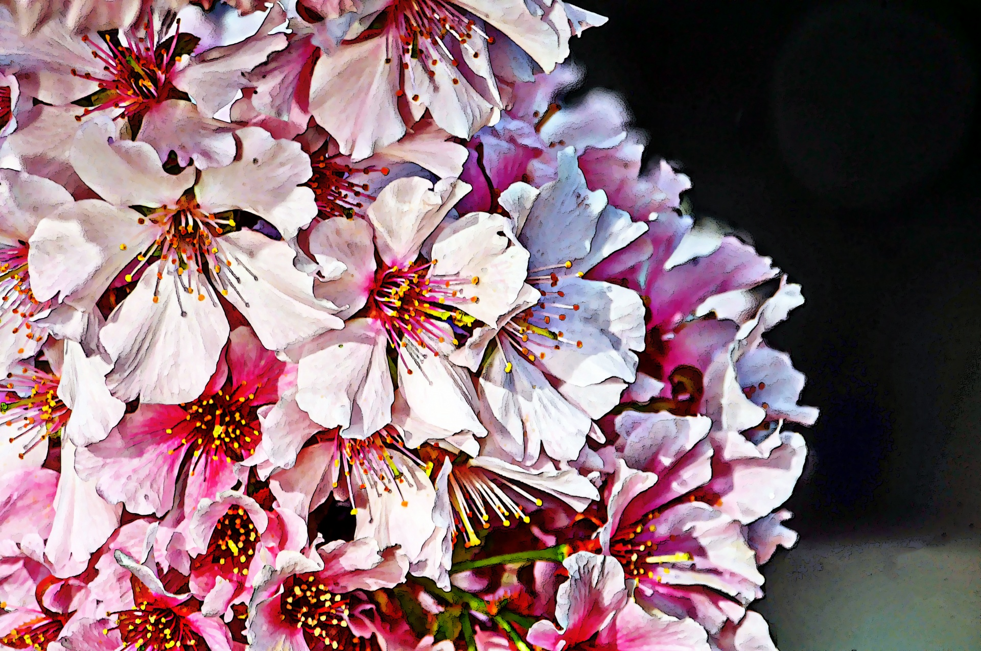
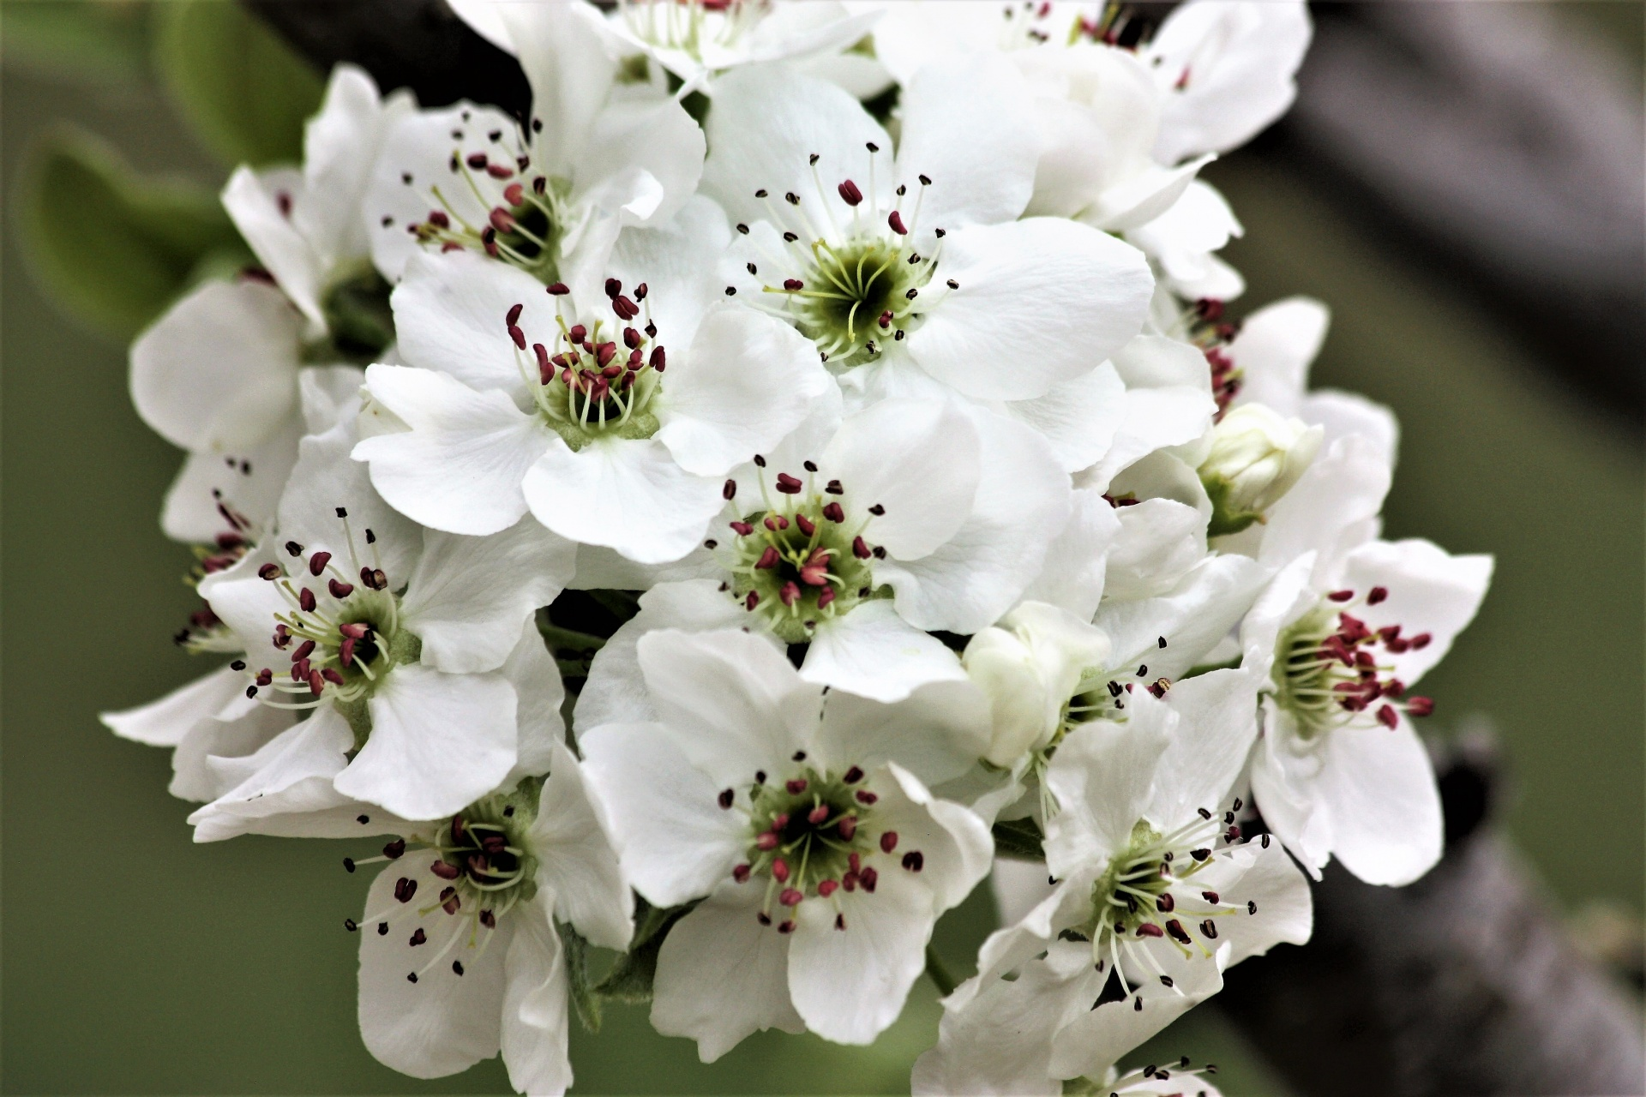
Pear blossoms
Something that looks very interesting to me is pear blossom
Those trees can reach a height of 10 to 17m
Leaves of pear blossoms are long and glossy green
These blossoms are cold hardy
Flowers are white, rarely yellow or pink

Slide 4
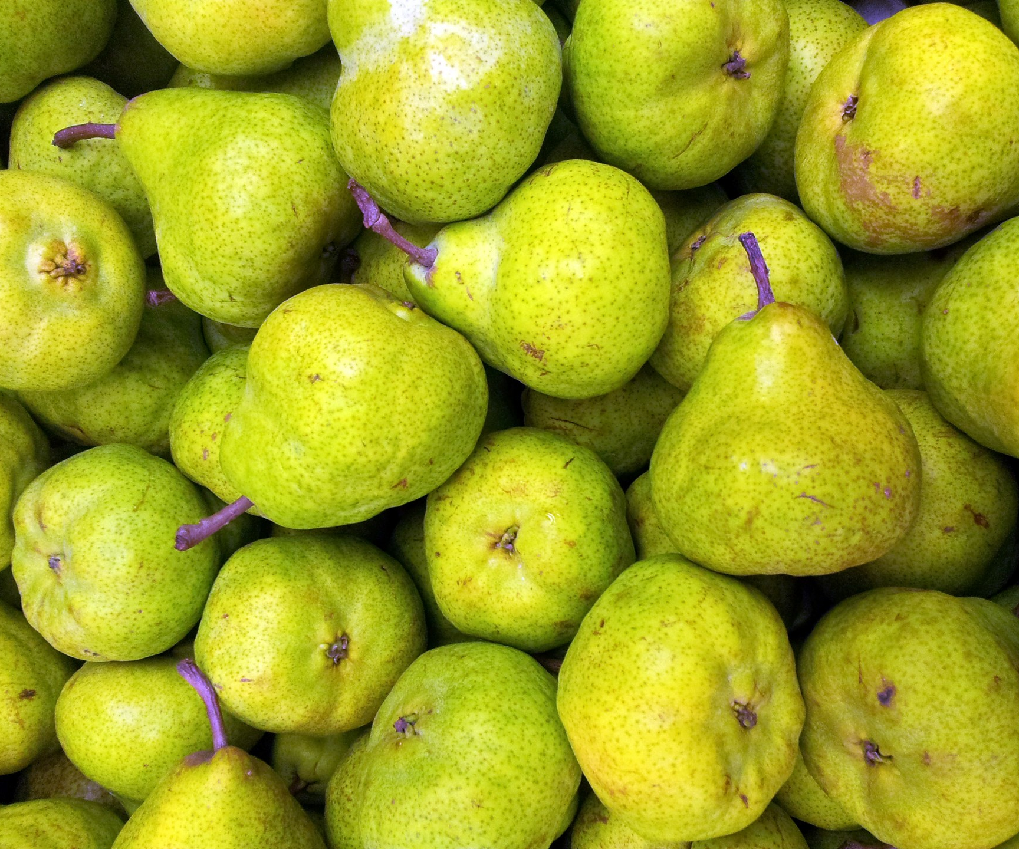
Thank you for reading!

