Slide 1
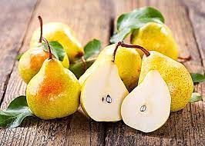
Pear
Anamari Marović 8.a
OŠ. Petra Kružića Klis
Subject:english
Date:06.10.2022

Slide 2
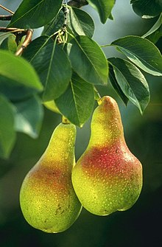
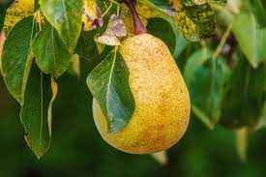
About pear
Pear is a genus of plants from the Ružovka family
Pear juice is good for newborns because it has a mild taste
contains vitamins: A, B1, B2, C, E
They can grow up higher than 20m

Slide 3
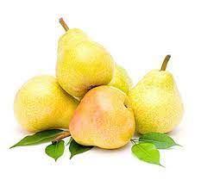
The benefit of the pear
There is a famous saying "one apple a day, the doctor out of the house“
one fist-sized pear contains about six grams of fiber, or almost a quarter of the recommended daily amount of 25 to 38 grams.
They help the digestive system to function well and digestion to be regular
it is easily digested

Slide 4
Thank you for your attention and I hope you learned something new

