Slide 1
Erasmus Days 2021 in Primary School „Petar Zoranić” Nin, Croatia
Project Team
October 14, 2021

Slide 2
Ivana Milin
an English language teacher working at Primary school Petar Zoranić in Nin.
students 7-14 years old
job shadowing in St. Catherine‘s High School in Pembroke, Malta
partners‘ meeting in Chirpan, Bulgaria
wearable methodology classroom

Slide 3
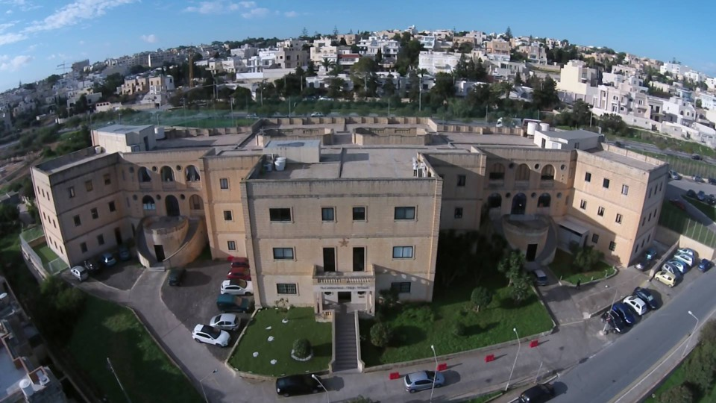
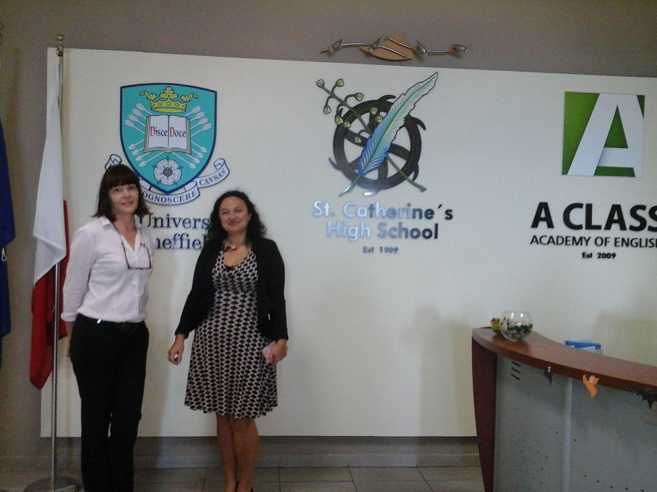
JOB SHADOWING-Malta, October 2017
St Catherine‘s High school
private school
differentiation
gifted children

Slide 4
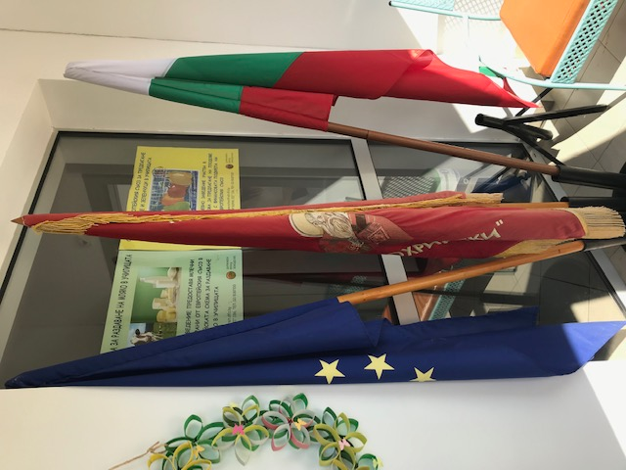
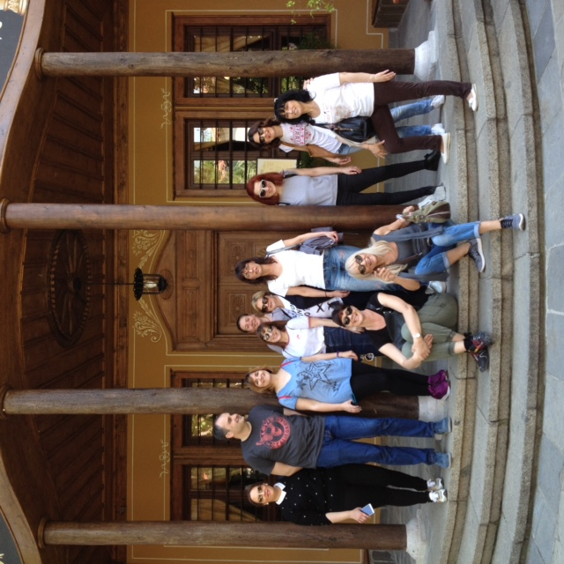
PARTNERS‘ MEETING-Bulgaria, April 2018
wearable methodology
meeting in Chirpan
partners: Croatia, Bulgaria, Spain

Slide 5
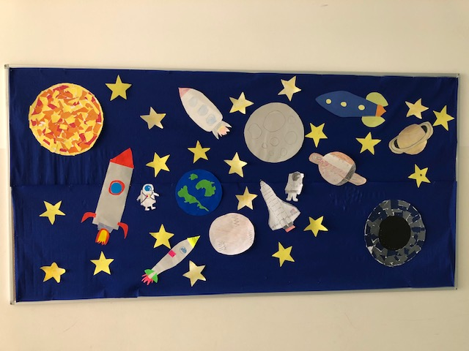
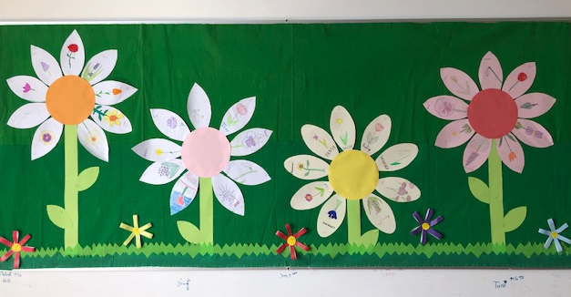
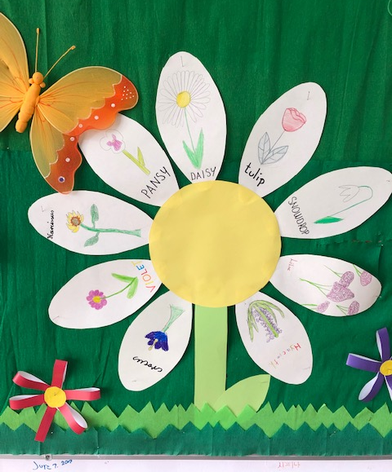
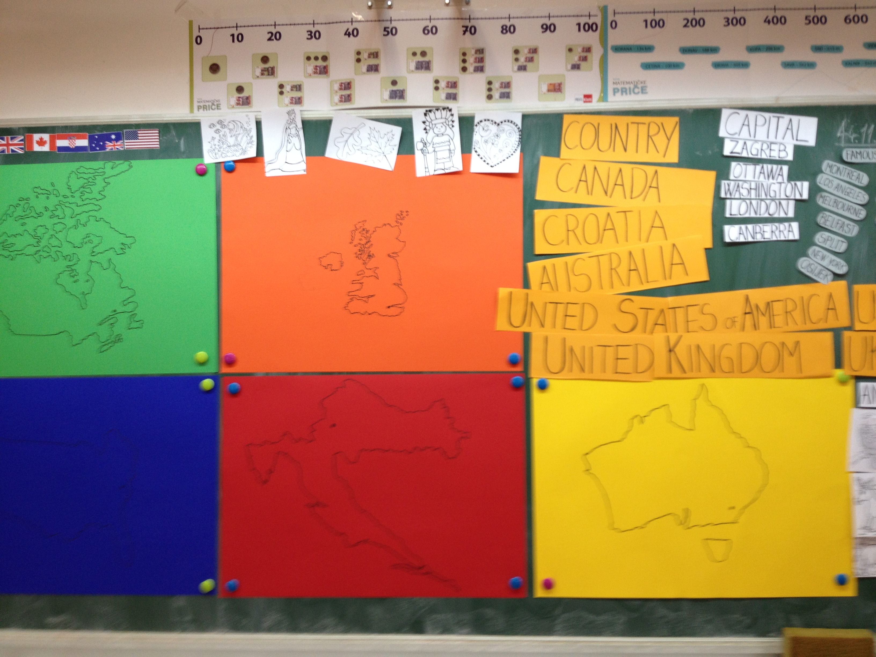

Slide 6
INTERESTED IN
Montessori job shadowing
CLIL structured course

Slide 7
This publication [communication] reflects the views only of the author, and the Commission cannot be held responsible for any use which may be made of the information contained therein.

