Slide 1

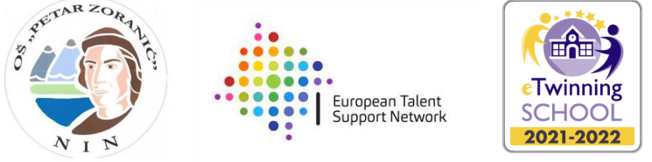

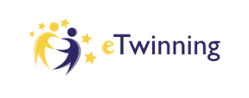

Erasmus Days 2021 in
Primary School „Petar Zoranić” Nin, Croatia
Project Team
October 14, 2021

Slide 2
Kata Knežević
Director
Interests:
Soft skills
Schools successfull in EU projects and education of gifted

Slide 3
This publication [communication] reflects the views only of the author, and the Commission cannot be held responsible for any use which may be made of the information contained therein.

