Slide 1

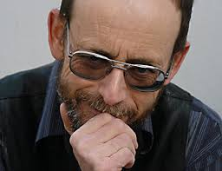

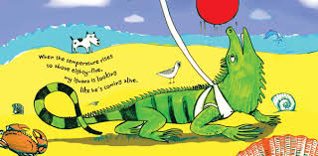
Croatia
7th May 2021

Slide 2
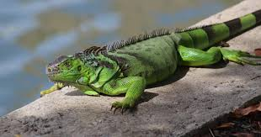
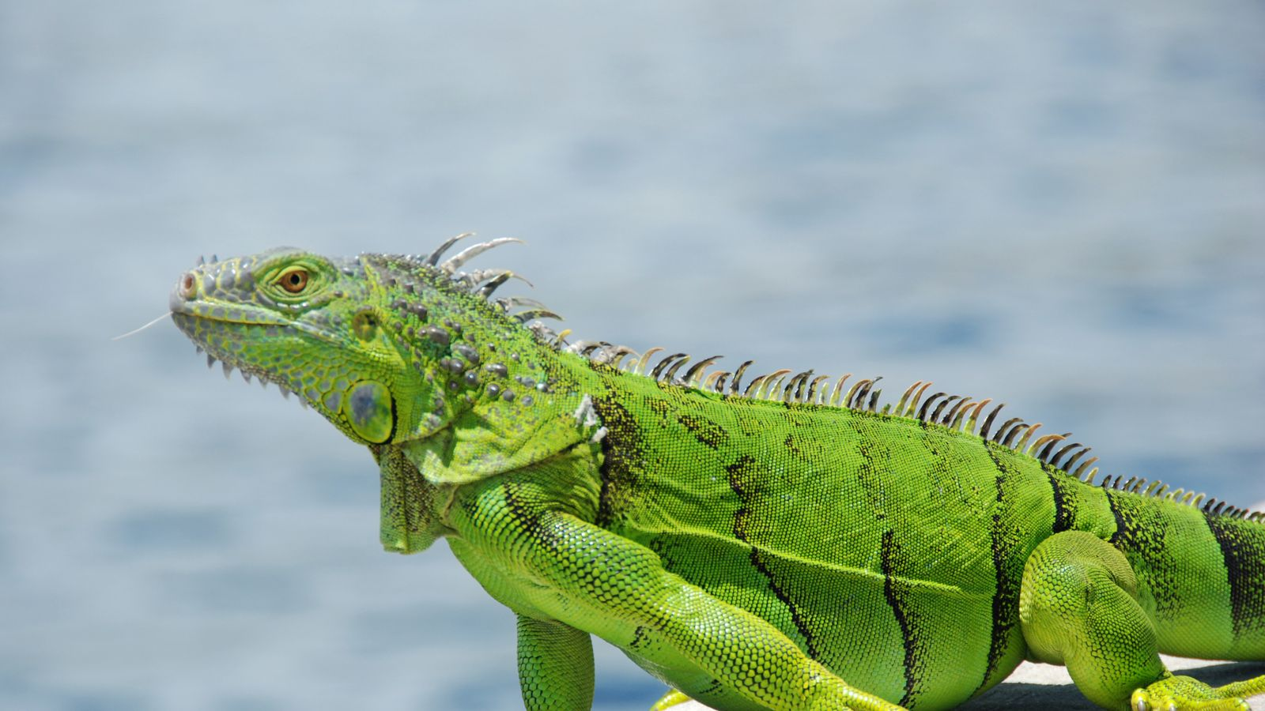
What is an Iguana?
Iguana = Iguana

Slide 3
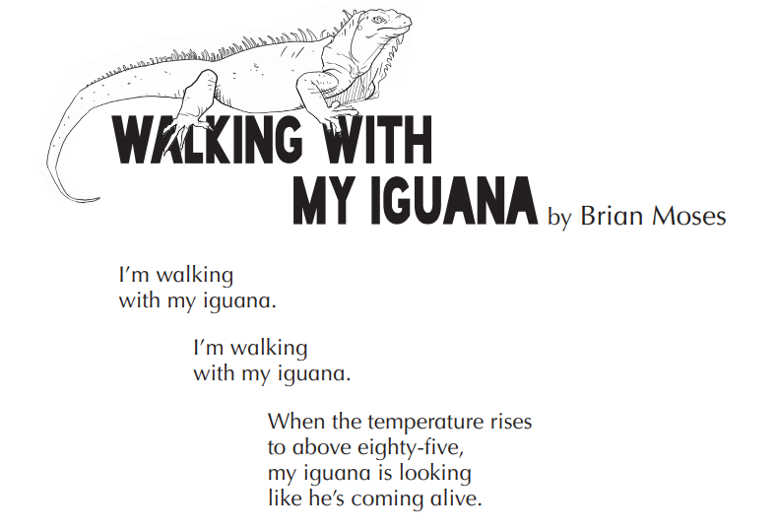
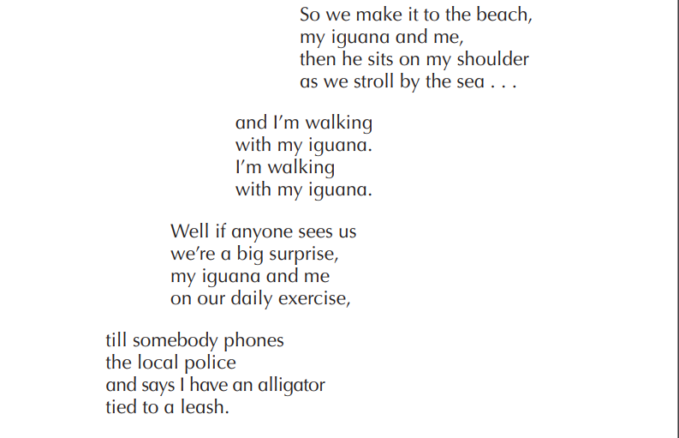
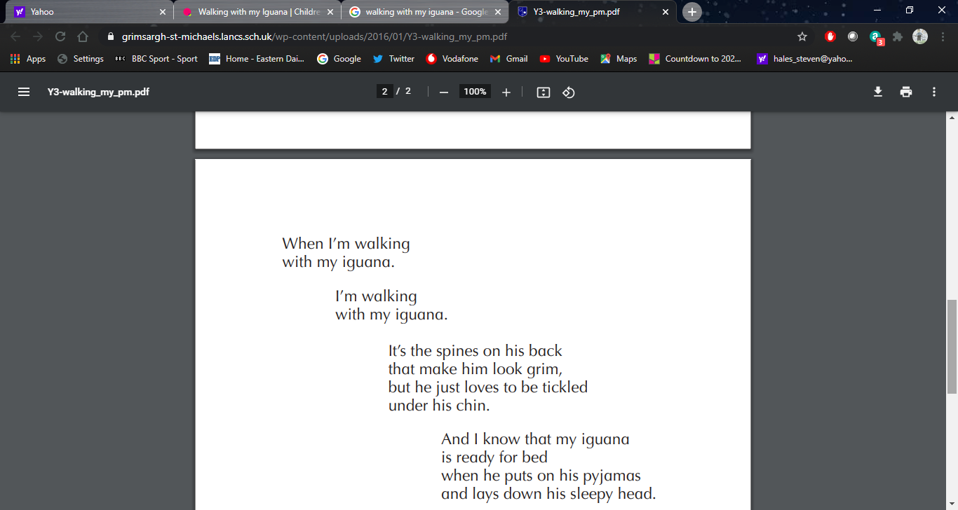
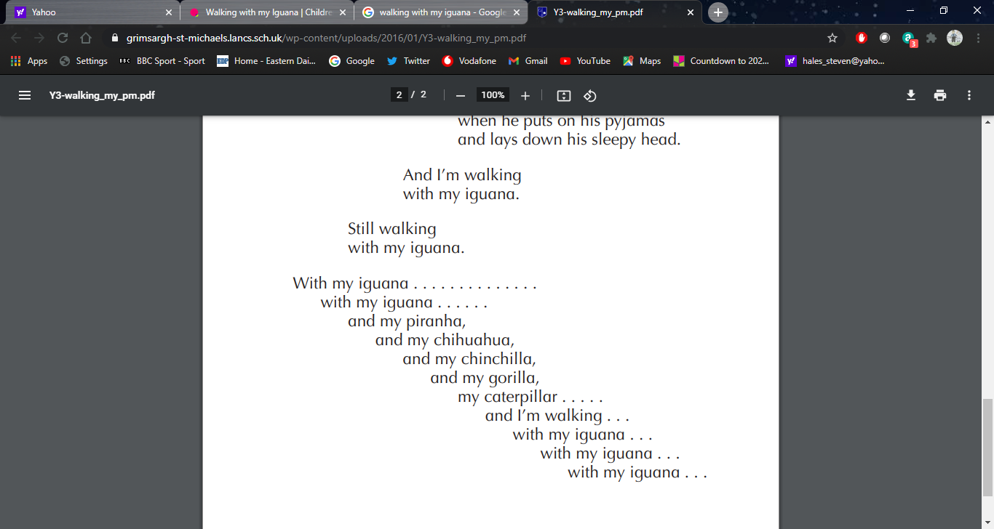
1
2
3
4

Slide 4
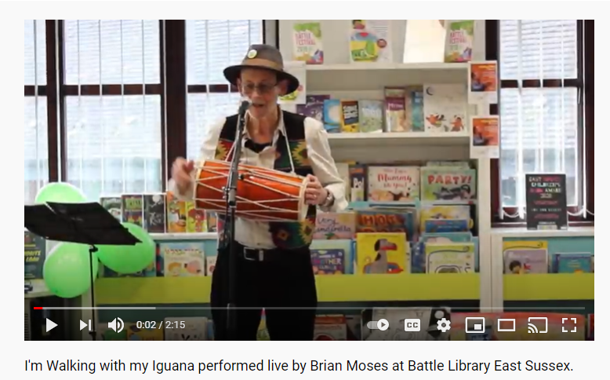
https://youtu.be/VoqCyDyc5Rc

Slide 5
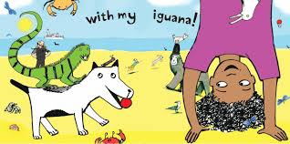
YOUR CHALLENGE:
Choose your animal you would take a walk
See if you can write a poem in a similar style
Try to write your poem in an animal shape
Be ready to perform your poem for younger children

Slide 6
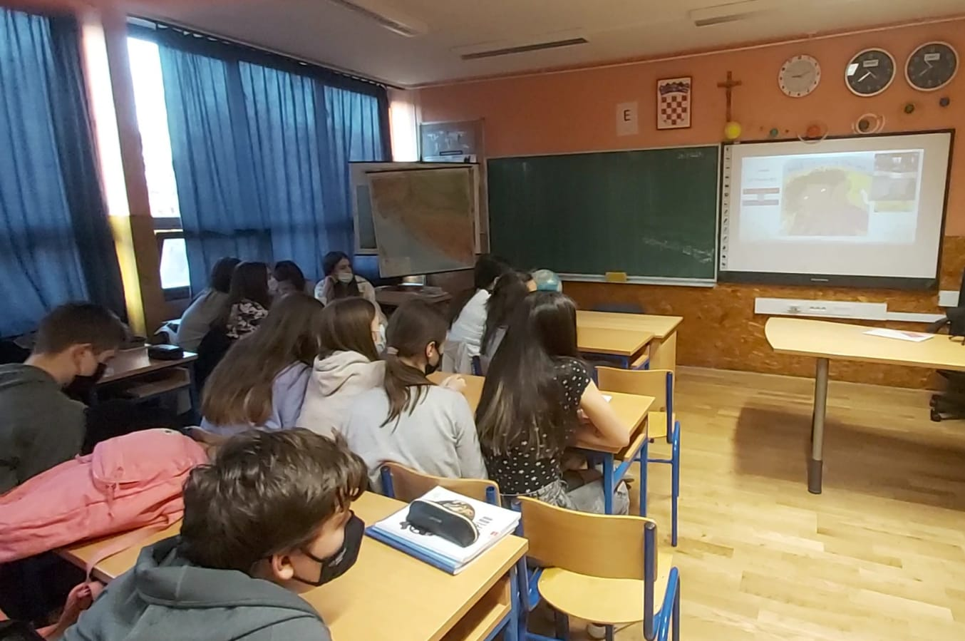
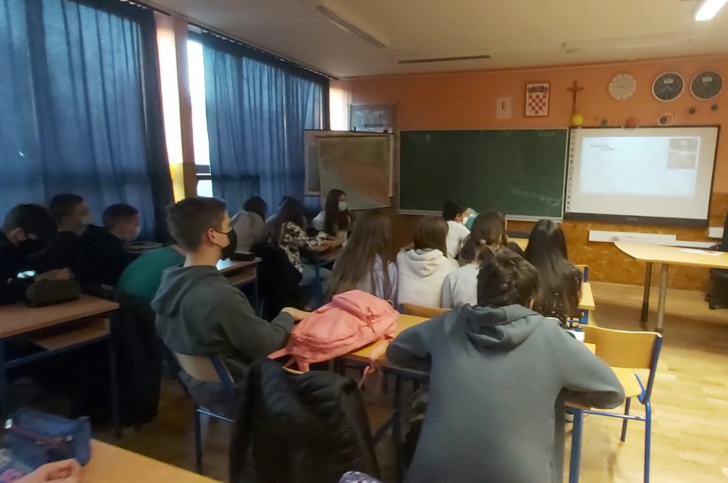
Students in Zagreb, Croatia

Slide 7
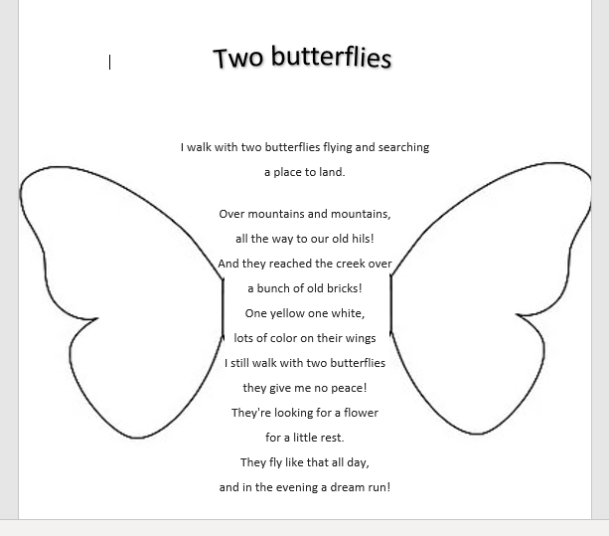
Borna Sabol

Slide 8
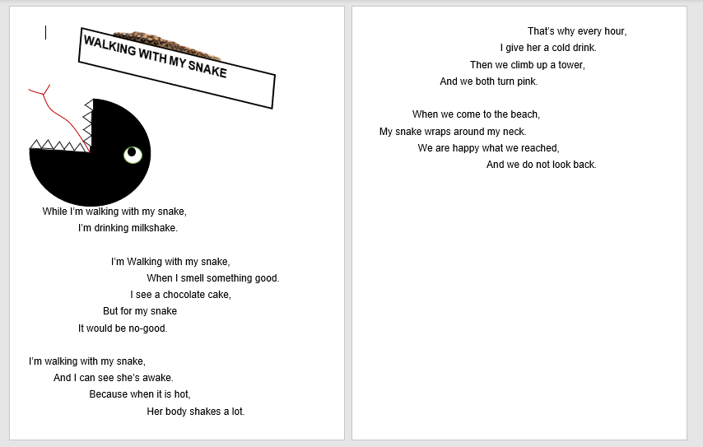
Matija Milas

Slide 9
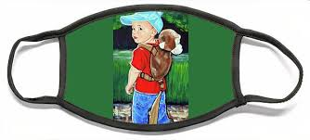
Walking With My Monkey
In the forest
With no people
To judge me,
Here I am walking
With my monkey
People see it as
A hysterically funny animal,
But to me it's a friend
That doesn't pretend
Walking with my monkey
Makes me feel blessed
And my mind with him
Is never stressed
He's never rude
But sometimes just
Isn't in the mood
His heart is pure gold
It isnt cold
Like it was with people i was surrouned
With before
The life here is the best
But soon I need go back to the west.
Iva Krešić

Slide 10
