Slide 1
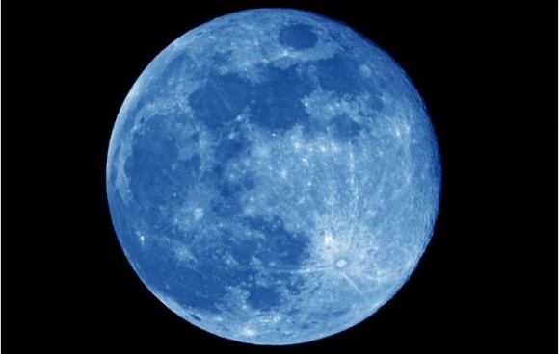
Mjesec

Slide 2
Mjesec je prirodni satelit. Umjetne je napravio čovjek.
Korištenje umjetnih satelita:
  komunikacije
  praćenje vremena
  promatranje Zemlje i svemira

Slide 3
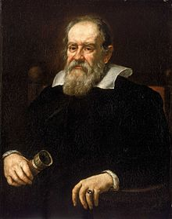
Ime Mjesec
grčki jezik – Selene , latinski – Luna
Stare civilizacije nisu poznavale mjesece sve do Galilea Galileija.

Slide 4
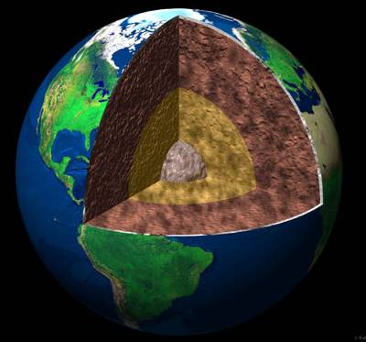
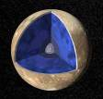
Usporedba Zemlje i Mjeseca
Zemlja
Mjesec
nema magnetsko polje
slabi potresi
mala jezgra
Notes:
http://www.windows.ucar.edu/tour/link=/earth/moon/earthmoon_interior_gif_image.html

Slide 5
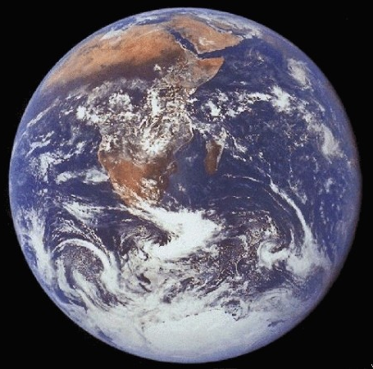

Zemlja
Mjesec
promjer - 12 756.3 km
nagib osi - 23º (g. doba)
površinska temperatura od
–89ºC do 48ºC
atmosfera – gusta, blagi efekt staklenika
voda – goleme količine, sva agregatna stanja
3476 km
7º (nema g. doba)
od –153º C do 120ºC
nema atmosfere
moguć led na polovima u sjeni
Notes:
antwrp.gsfc.nasa.gov

Slide 6
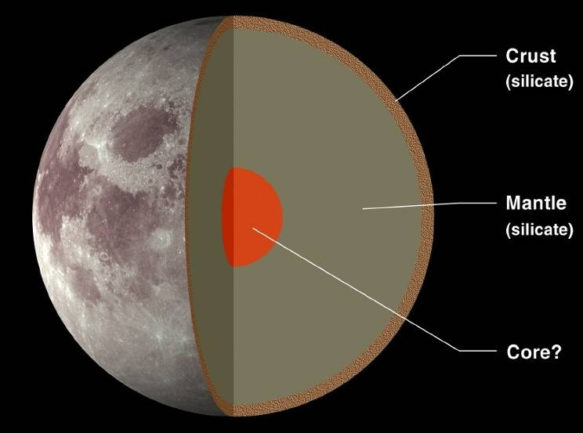
Unutarnja građa Mjeseca
Copyrighted, LPI
Notes:
A cross section view of the Moon’s internal structure. The outer, rocky crust averages about 60 km thick. Most of the Moon is the mantle, which is also rocky but of somewhat different composition than the crust (more magnesium, less iron and aluminum). There is probably also a small, iron rich core, a few hundred km in size at the center of the Moon.

Slide 7
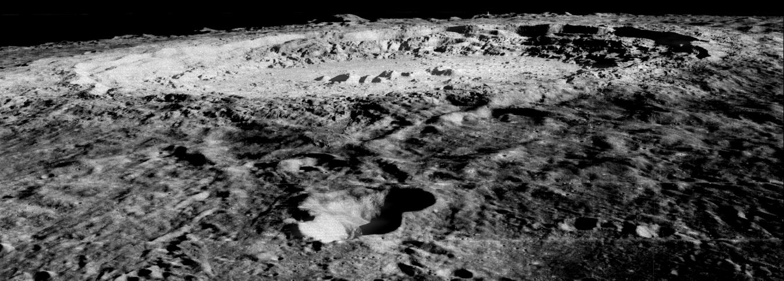
Nastanak Mjeseca
Notes:
http://photojournal.jpl.nasa.gov/catalog/PIA00094

Slide 8
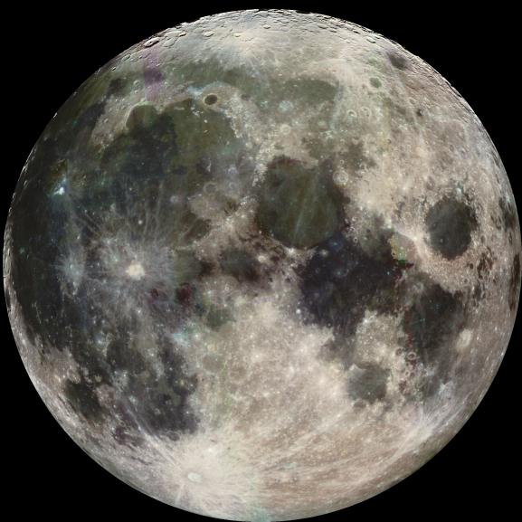
Što znamo?
gustoća manja od Zemljine
manje željeza, ali više aluminija i titana nego na Zemlji – sastav vrlo sličan Zemljinom plaštu
Notes:
http://photojournal.jpl.nasa.gov/catalog/PIA00405
The moon is enriched in Titanium, Aluminum, and related elements and depleted in iron and volatile elements (and compounds - DRY!)
The moon (~3.3) has a low density compared to earth (~5.5)
Earth/moon has anomalously large amount of angular momentum compared to other planets - conservation of momentum. Angular momentum is the measure of rotation in a system.
The combined momentum of these two closely related bodies must stay the same over time. If moon closer earlier, then earth must have been rotating faster (shorter days).
Momentum = mass x velocity
Angular momentum = mass x velocity in a circle
Earth’s high because earth + moon + impact = higher momentum
Old highlands (cratered), young basalt “seas”. 4.5 billion years ago.
Formation of the Moons's geosphere
(fig p179 McSween) The moon too developed a magma ocean during its formation due to the same sources of heat, impact, internal compression, radiogenic decay and gravitational tides. We know this because when the first moon rocks were brought back to Earth during the Apollo program they were composed almost entirely of one mineral -- Feldspar. The only way to form such a rock (called Anorthosite) is to precipitate crystals from a molten lava and then separate the cystals according to differences in density -- a process known as fractional crystallization. This would happen if feldspar crystals intially crystallized with other minerals but then floated to the surface of a large magma ocean. The denser minerals would sink and the less dense minerals would float. Eventually, when the magma ocean cooled and solidified the crustal surface would be dominated by feldspar and the rock would be Anorthosite. This separating out of minerals of different density is known to occur in magma chambers within the continetal crust on Earth, but the planetary scale of this process on the moon is mind-boggling.
(fig p178 Mc Sween) Estimates of the thickness of the Anothosite crustal layer on the moon indicate that it is ~20 km thick. To separate out a 20 km thick layer of feldspar from a molten magma requires a magma ocean that was at least 1000 km thick. So far measurement of radiometric ages of the Anorthosites indicates that the lunar crust solidified 4400 Ma ago, only 200 Ma after the formation of the solar system.

Slide 9
Teorije o nastanku Mjeseca
Nastao u Zemljinoj blizini istovremeno s nastankom Zemlje
Nastao negdje drugdje u Sunčevom sustavu, privukla ga Zemljina gravitacija
Proto Zemlja vrtila se toliko brzo da se dio odvojio i formirao Mjesec
Zemlju je udarilo nebesko tijelo veličine Marsa
Notes:
http://www.psi.edu/projects/moon/moon.html
The moon is a sister world that formed in orbit around Earth as the Earth formed. This theory failed because it could not explain why the moon lacks iron.
A second early idea was that the moon formed somewhere else in the solar system where there was little iron, and then was captured into orbit around Earth. This failed when lunar rocks showed the same isotope composition as the Earth.
A third early idea was that early Earth spun so fast that it spun off the moon. This idea would produce a moon similar to Earth's mantle, but it failed when analysis of the total angular momentum and energy involved indicated that the present Earth-moon system could not form in this way.
These were the three main models for the formation of the Moon at the time of the Apollo program. It turns out that each fails to explain some major observation about the Moon. For more about these models, see the Scientific American article by Jeff Taylor cited in the notes for slide 2. Artwork is from Taylor’s article.
Fission – 10 hour rotation worked out for E + M … to spin Moon off would have to be rotating every 4 hours
1) Moon / Earth accreted as two-planet system.
Problem: Dissimilar compositions.
2) Moon accreted separately, captured by Earth.
Problem: mechanics of orbital capture.
3) Moon spun off from Earth during Earth’s differentiation. Pacific Ocean is hole left by Moon.
Problem: Moon could not reach escape velocity.
Okay and the Pacific thing doesn’t work on fist blush - plate tectonics ...
4) Impact by a Mars-sized protoplanet bounced Moon off Earth (after Earth’s core partially formed.
Explains difference in composition, relative sizes.

Slide 10
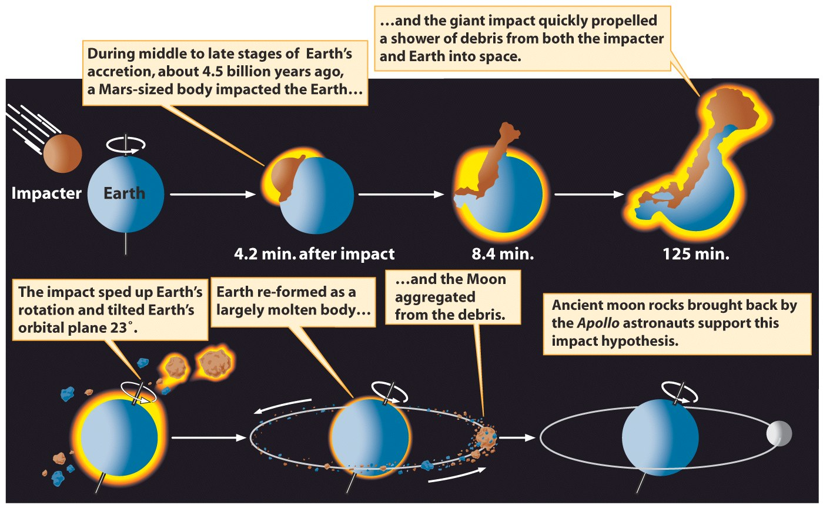

Slide 11
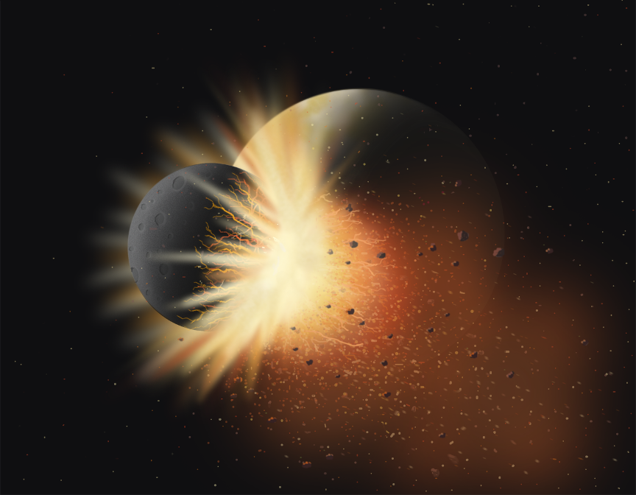

Slide 12
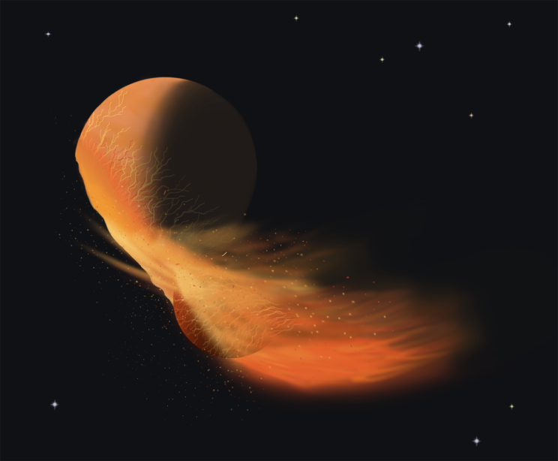

Slide 13
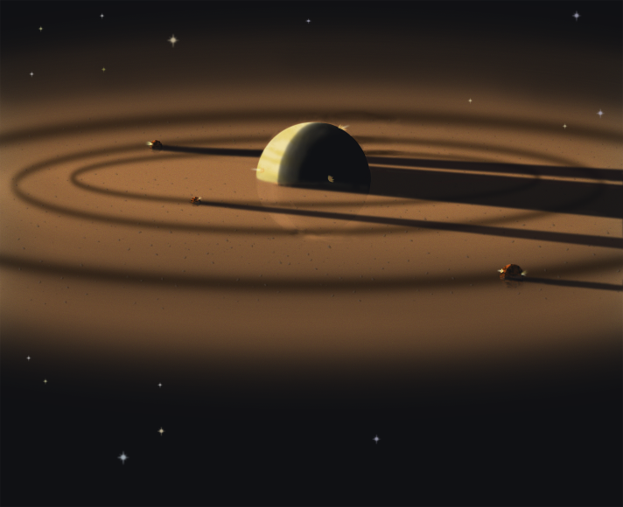

Slide 14
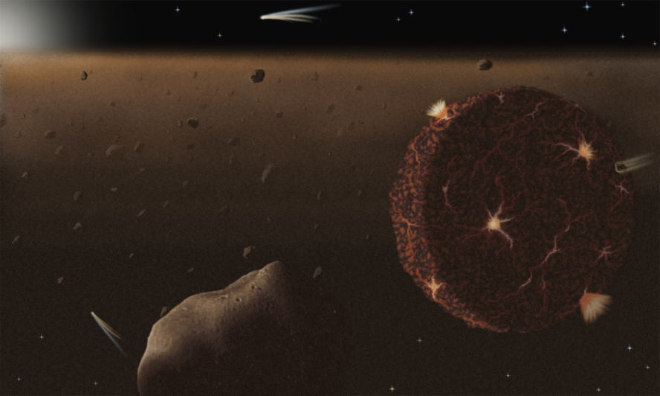
I

Slide 15
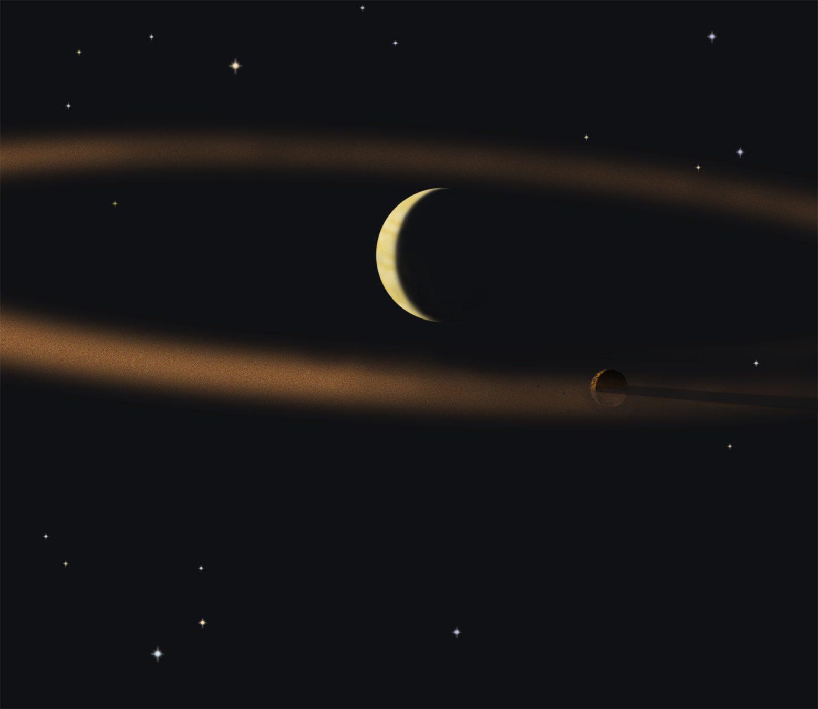

Slide 16
Mjesečeva geološka prošlost
Notes:
http://photojournal.jpl.nasa.gov/catalog/PIA00405
Of course, history is more complex
Lunar highland rocks can be divided into those that are slightly iron rich (formed soon after Moon formed – oldest is 4.5 billion years) and those that are magnesium rich and range in age from 4.5 to 4.3 – indicates different magma sources
Cooled by about 4.3 – KREEP rocks – consistent in mineralogy but scattered across highlands (potassium, rare earth elements, phosphorous)

Slide 17
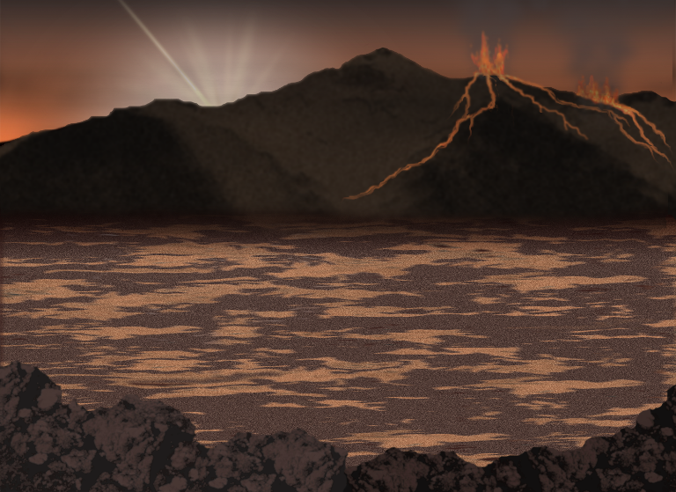
Ocean magme

Slide 18
visoravni – svjetlije, tvrđe
„mora” – tamnija, uravnjenija, niža

Slide 19
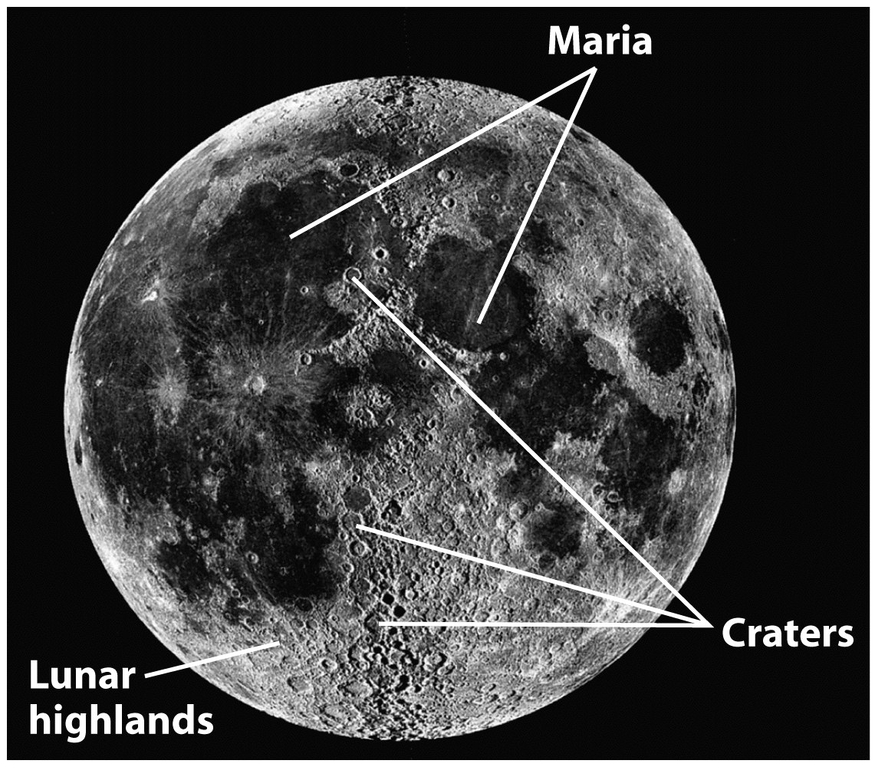

Slide 20
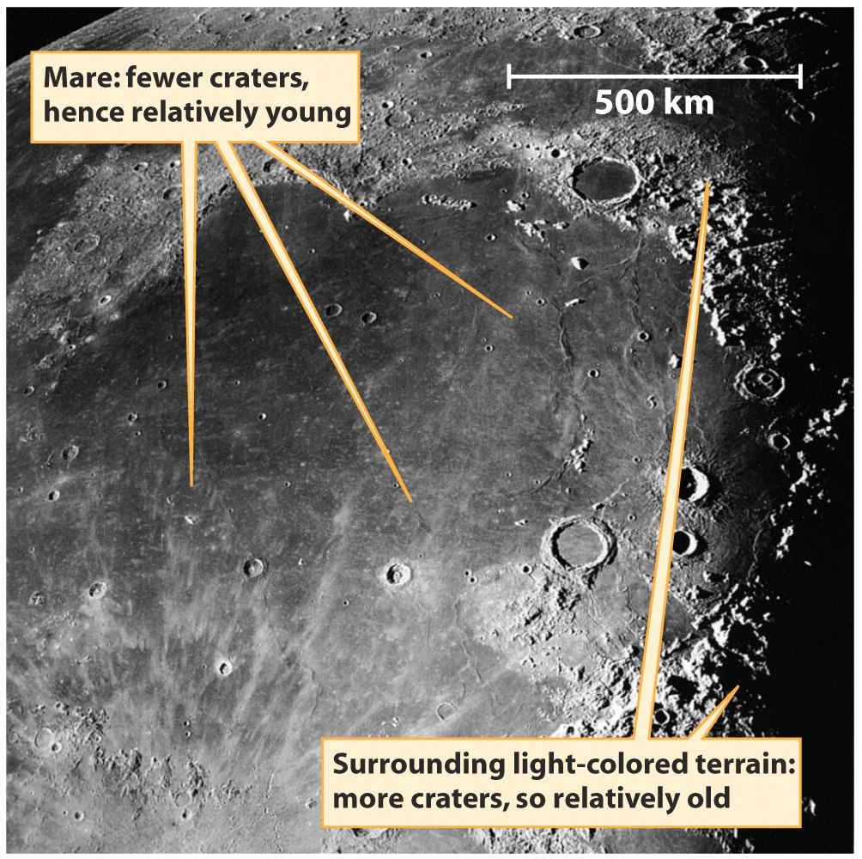
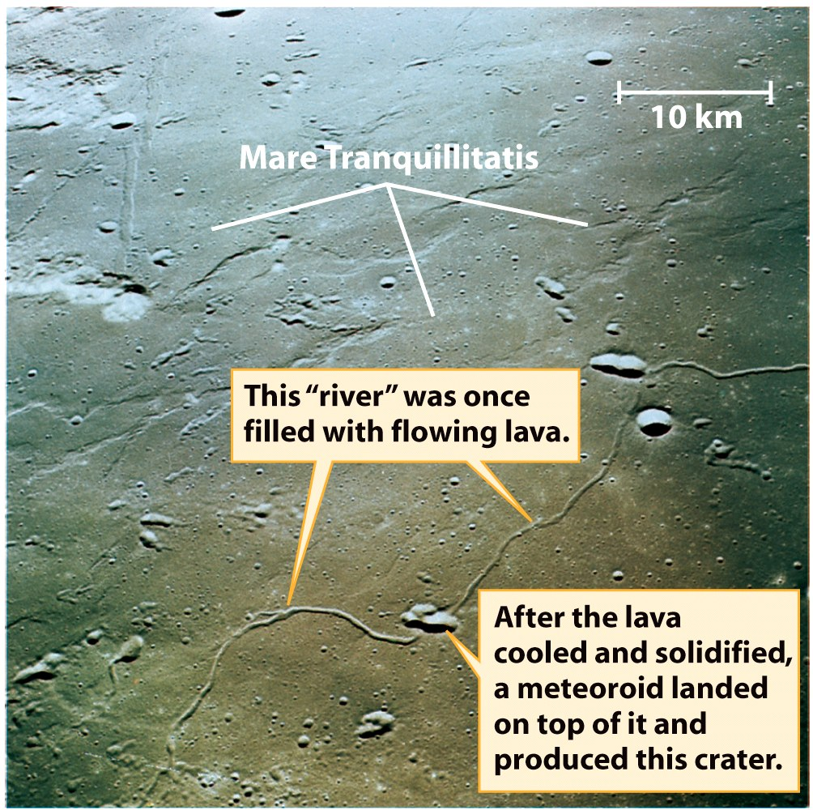
Mora su se formirala nakon jačeg meteorskog bombardiranja, zato imaju uravnjeniju površinu i manje kratera

Slide 21
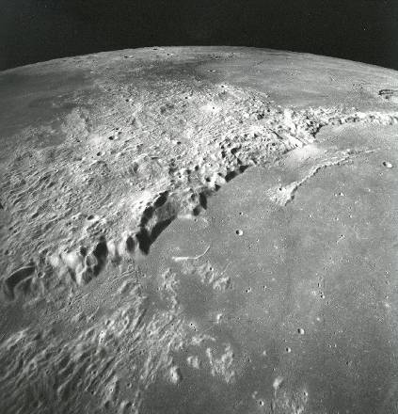
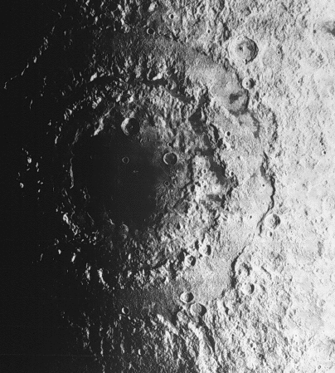
Mjesečevi udarni krateri
Imbrium Rim
Orientale Basin
Notes:
NASA/LPI
Both Earth and Moon were struck by numerous large asteroids and comets in their early history. These impacts produced deep basins up to 1000 km across surrounded by high rings of mountains on the Moon and are visible to the human eye as prominent circular structures. Left: A view of the mountains that surround the Imbrium impact basin. The smooth, dark region on the right side of the image is younger lava flows. Right: Three mountain rings surround the Orientale impact basin. Both the Imbrium and the Orientale impacts occurred around 3.8 billion years ago, roughly 4 am on our 24 hour clock.

Slide 22
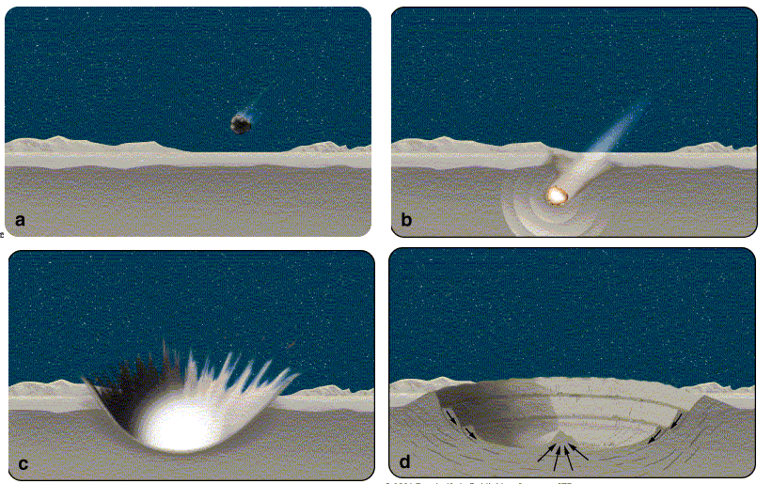
Nastanak udarnih kratera
Notes:
http://www.astro.psu.edu/users/niel/astro1/slideshows/class41/slides-41.html

Slide 23
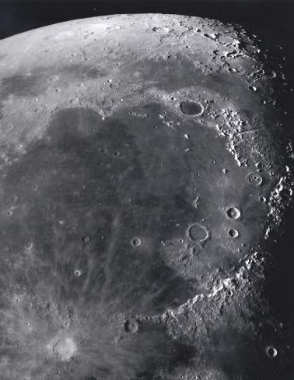
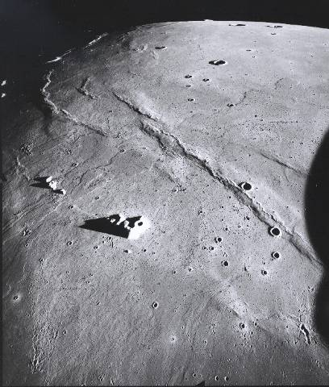
Vulkanizam na Mjesecu – većinom prestao prije 3 milijarde godina
Mare Imbrium
JZ Mare Imbrium
Notes:
Portions of the Moon’s interior remained hot enough to produce magma for more than a billion years after it formed. Molten rock flowed onto the lunar surface through cracks in the crust, spreading out and filling the low regions in the impact basins. The lava cooled quickly, forming the fine-grained, dark rocks — basalt — sampled during the Apollo missions. The dark areas seen on the Moon are basaltic lava plains 4.2 to 1 billion
(place at 3.5)
Moon Becomes Geologically Inactive
Lunar volcanism decreased significantly by 3 billion years ago and ceased completely by about 1 billion years ago as the interior of this small body cooled. 3.0 Ga

Slide 24
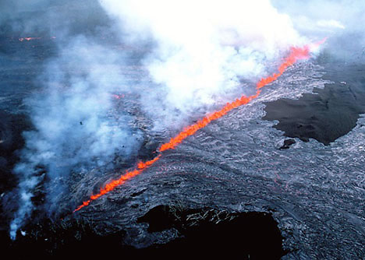
Kanali lave na Zemlji
Notes:
http://hvo.wr.usgs.gov/gallery/kilauea/erupt/24ds182_caption.html
Heat to melt the mantle rock came from radioactive decay of elements. Basins are areas where crust is thinned and fractured by impact – logical places for magma to work its way into….. And they are low – liquids fill low areas
Lunar Volcanism
Portions of the Moon’s interior remained hot enough to produce magma for more than a billion years after it formed. Molten rock flowed onto the lunar surface through cracks in the crust, spreading out and filling the low regions in the impact basins. The lava cooled quickly, forming the fine-grained, dark rocks — basalt — sampled during the Apollo missions. The dark areas seen on the Moon are basaltic lava plains 4.2 to 1 billion
(place at 3.5)
Moon Becomes Geologically Inactive
Lunar volcanism decreased significantly by 3 billion years ago and ceased completely by about 1 billion years ago as the interior of this small body cooled. 3.0 Ga
Fissure eruption -- Fissure eruption generating a "curtain of fire" on the Kilauea volcano, Hawaii in 1992. The Pu'u O'o volcano is located just beyond the photograph to the lower left. Courtesy of USGS.
http://www.geology.sdsu.edu/how_volcanoes_work/Thumblinks/Puuoorift_page.html

Slide 25
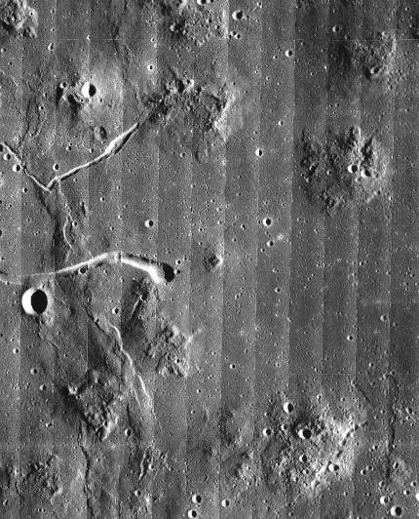
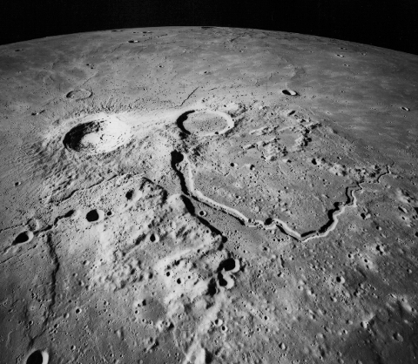
Kanali lave na Mjesecu
Aristarh plato
Marijeve planine
Notes:
NASA / LPI
Rare volcanic domes
Rilles – lava channels
Volcanism finished by 1 billion years ago
These images from orbit around the Moon illustrate some other areas produced by volcanism. Both would be interesting areas for future exploration.
Although eruption of most mare basalts did not produce volcanic mountains, there are a small volcanic domes in a few places. This shows the Marius Hills, a collection of relatively low domes. Rilles (sinuous lava channels) are also visible, one of which cuts across a mare ridge. (Lunar Orbiter V-214-M)
11. Marius Hills, Moon
Although most lunar volcanism produced the broad lava flows that infill the lunar maria, in a few places, such as the Marius Hills (14°N, 56°W), it is possible to find volcanic domes. In this scene we can see several lunar domes. Some of these domes are quite smooth and low, while others are more rugged and heavily cratered. Two large sinuous rilles similar to Hadley Rille (slide #12) can also be seen cross-cutting a mare ridge.

Slide 26
Nakon prestanka vulkanizma...
Sve se utišalo.

Slide 27
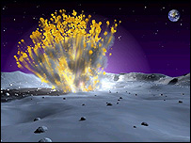
Osim udara manjih nebeskih tijela...
Zašto se površina Mjeseca ne mijenja?
Notes:
http://science.nasa.gov/headlines/y2005/22dec_lunartaurid.htm
The blast was equal in energy to about 70kg of TNT and was seen near the edge of Mare Imbrium (the Sea of Rains).
The object that hit the Moon was probably part of a shower of "taurids" which peppered Earth in late October and early November.
Understanding lunar impacts could help protect astronauts when Nasa sends humans back to the Moon.
Meteoroids are small rocky or metallic objects in orbit around the Sun, or another star. One of the astronomers who observed the impact estimates that it gouged a crater 3m wide and 0.4m deep.
Rob Suggs of Nasa's Marshall Space Flight Center in Huntsville, US, was testing a new 10-in telescope and video camera assembled to monitor the Moon for space strikes.
On 7 November, his first night using the telescope, he observed one.
Renewed interest
"People just do not look at the Moon anymore," said Dr Suggs, of Marshall's engineering directorate.
"We tend to think of it as a known quantity; but there is knowledge still to be gained here."
Dr Suggs used commercial software to study the video he took, and spotted a very bright flash. The burst of light diminished gradually over the course of five video frames, each 1/30th of a second in duration.
The explosion can be seen in these video framesHe and Nasa astronomer Bill Cooke consulted star charts and lunar imaging software, and determined the meteoroid was probably a taurid, part of an annual meteor shower active at the time of the strike.
Like Earth, the Moon was peppered by taurids in late October and early November.
But unlike our planet, the Moon has no atmosphere to intercept and vaporise them, so they explode on the surface.
Since the Leonids of 2001, astronomers have not spent much time hunting for lunar impacts.
However, as Nasa plans to return to the Moon by 2020, the agency says it needs to understand what happens after lunar impacts in order to protect astronauts.
Dr Suggs said planetary scientists wanted to know how often big meteoroids hit the Moon and whether they only happened during showers like the taurids or were a more common occurrence.
Bill Cooke said that while the odds of a direct hit with a big meteoroid were almost nil for an individual astronaut, they might be shorter for an entire lunar outpost.

Slide 28
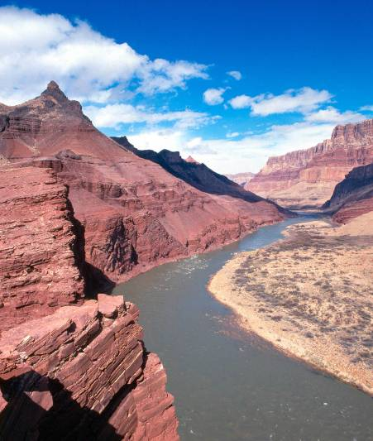
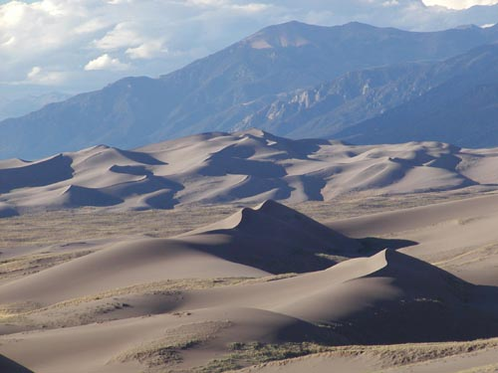
Nema vjetra.
Nema tekuće vode.
Nema erozije.
Notes:
www.nps.gov/grsa/ resources/photos_dunes.htm
http://www.nps.gov/grca/photos/index.htm
Public Domain

Slide 29
Zemlja
Mjesec
Vjetar i erozija vode
Udari meteora
Aktivni vulkani
Potresi
Aktivno magnetsko polje
Nekoliko kratera
Geološki aktivna!
?
?
?
?
?
?
?

Slide 30
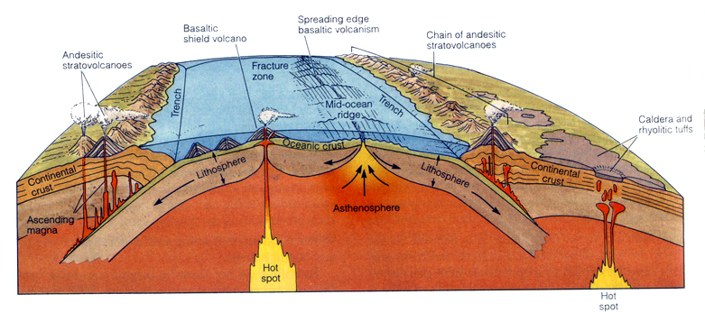
Zemlja
Mjesec
Tektonika ploča
Reciklaža ploča
?

Slide 31
Gibanje Mjeseca
Mjesecu je potrebno oko 27 dana i 8 sati da obiđe oko Zemlje. Isto vrijeme mu je potrebno da se rotira oko svoje osi, zato uvijek vidimo samo jednu njegovu stranu.
Mjesec je različito obasjan od Sunca, zato na noćnom nebu uvijek vidimo Mjesečeve mjene.

Slide 32
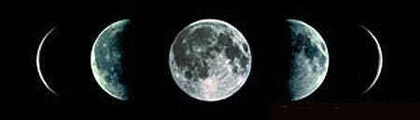
Mjesečeve mijene

Slide 33
Ljudi žele doći na Mjesec – zašto?
Po prvi puta bi se napravilo naselje izvan Zemlje
Testirala bi se napredna odijela i vozila
Naučili bi se zaštititi se od Sunčeve radijacije
Naučili bi se uzgajati hranu, reciklirati kisik i vodu za eventualan život na Marsu
Uvidjeli bi utjecaj drugačije gravitacije na ljude
Razvijala bi se nova tehnologija

Slide 34
Zašto bi bilo zanimljivo živjeti na Mjesecu?
Slabiji potresi
Slabija gravitacija – lakša gradnja
Nema smetnje atmosfere – astronomija
Nema radija ni tv-a – nema smetnji za radio astronome

Slide 35
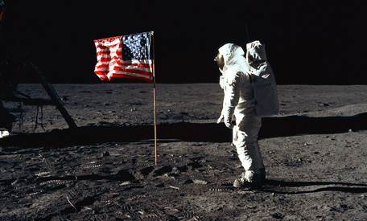
Prvi ljudi na Mjesecu
1969. Neil Armstrong je bio prvi čovjek koji je stupio nogom na Mjesec. Tom prilikom j rekao čuvenu rečenicu „Ovo je mali korak za čovjeka, no veliki za čovječanstvo.„

Slide 36
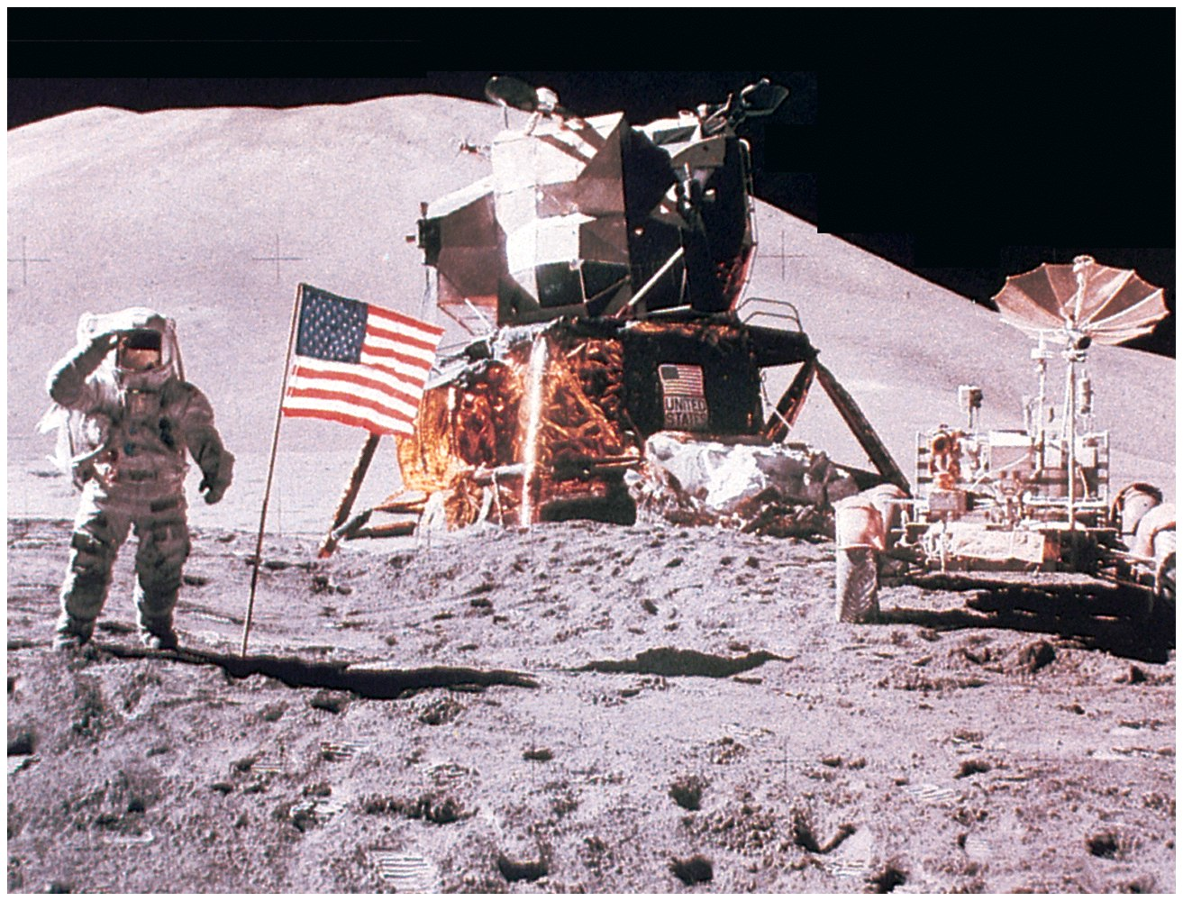
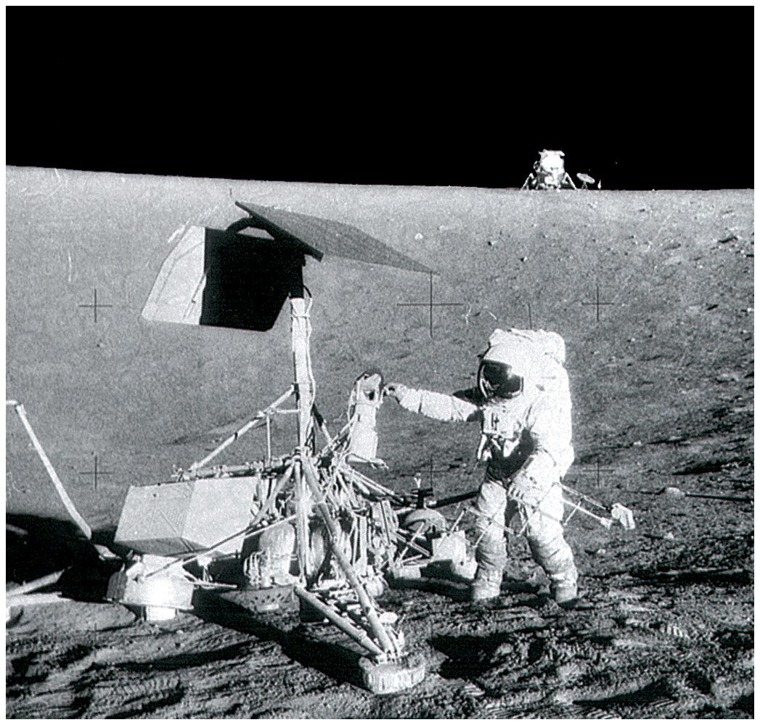
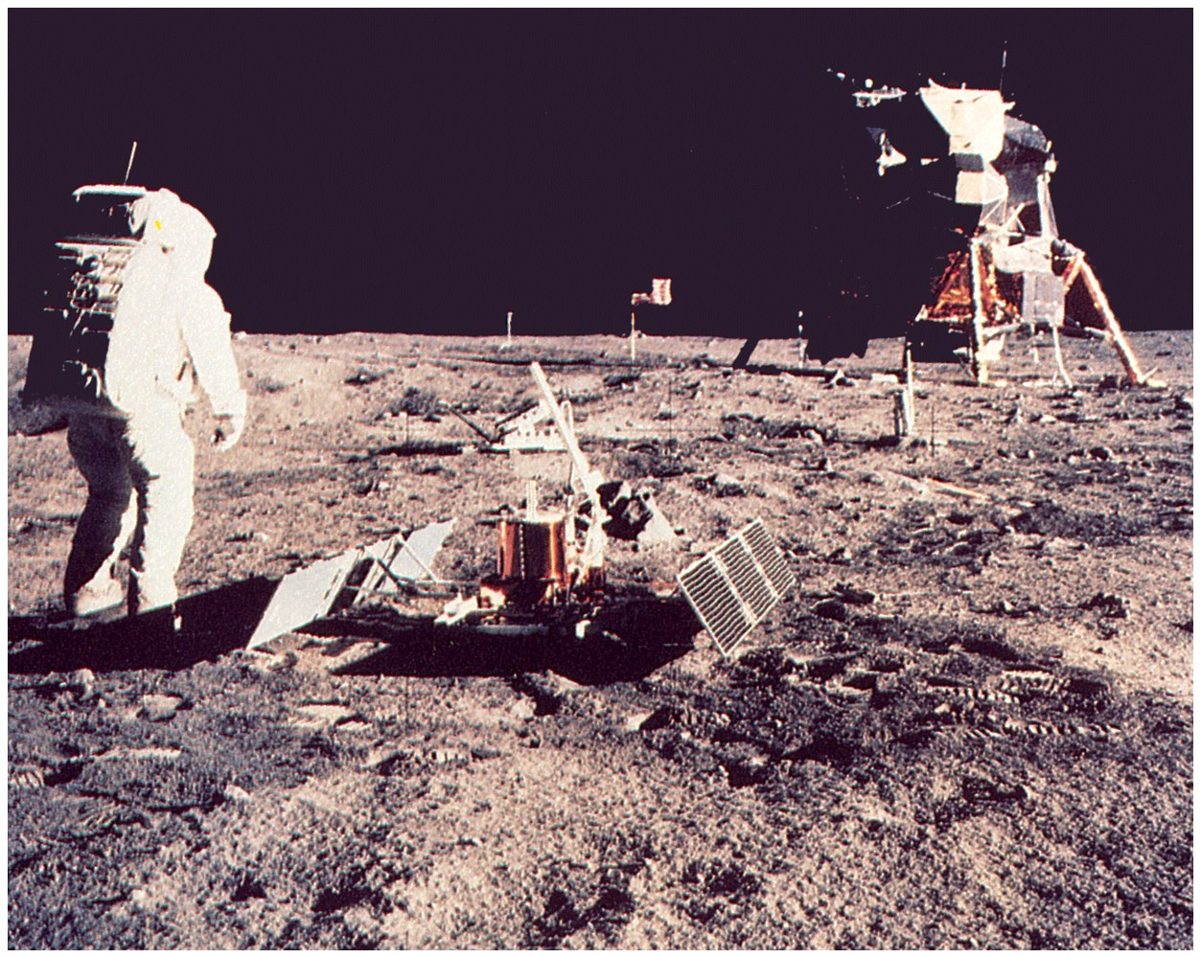
Većina našeg znanja o Mjesecu datira iz sredine 20.st te novijim promatranem iz letjelica.

Slide 37
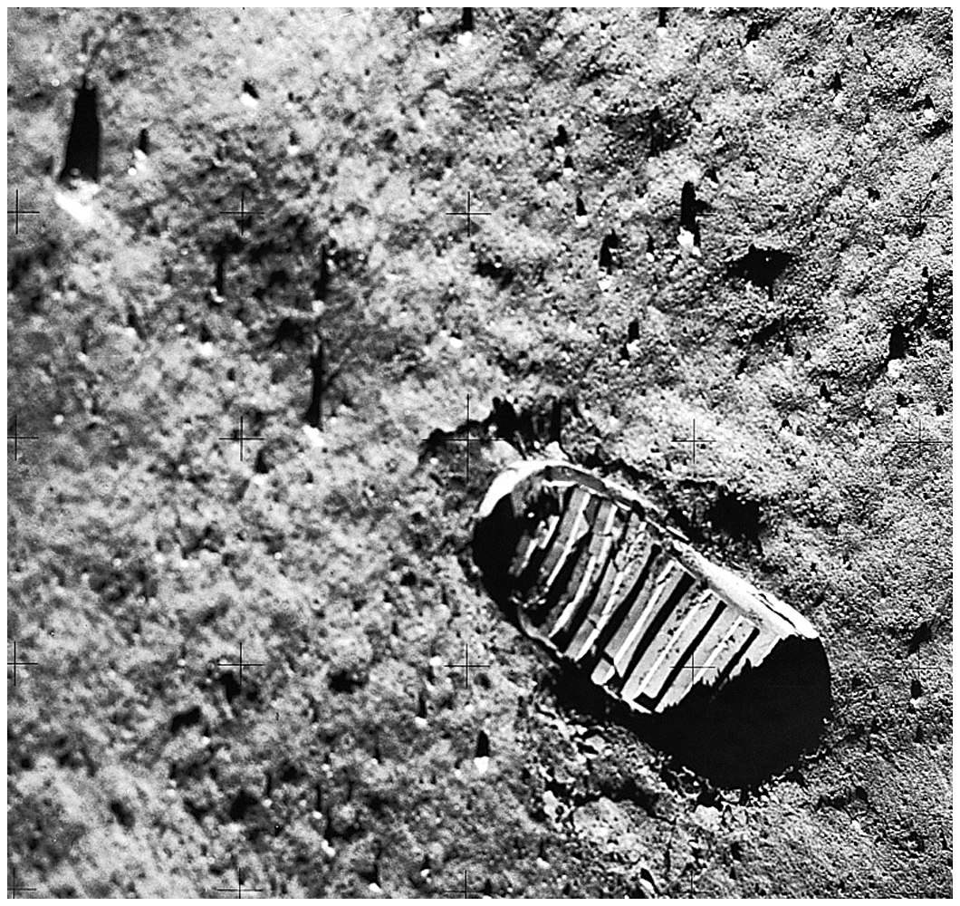
Otisak stopala na Mjesecu.
Regolit, usitnjeni materijal koji prekriva površinu Mjeseca, nastao je radom meteora.

Slide 38
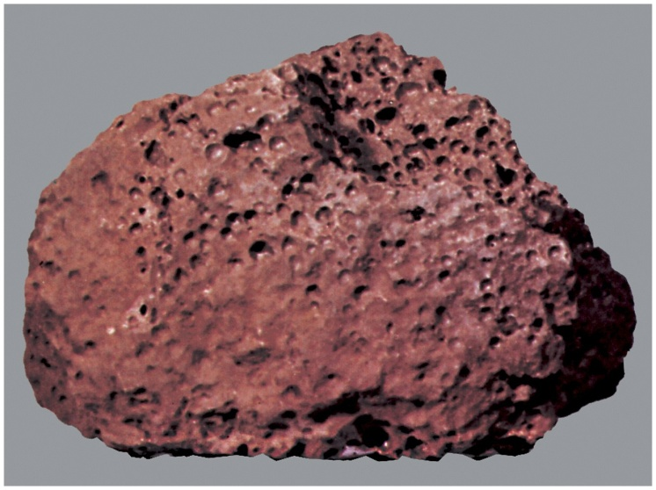
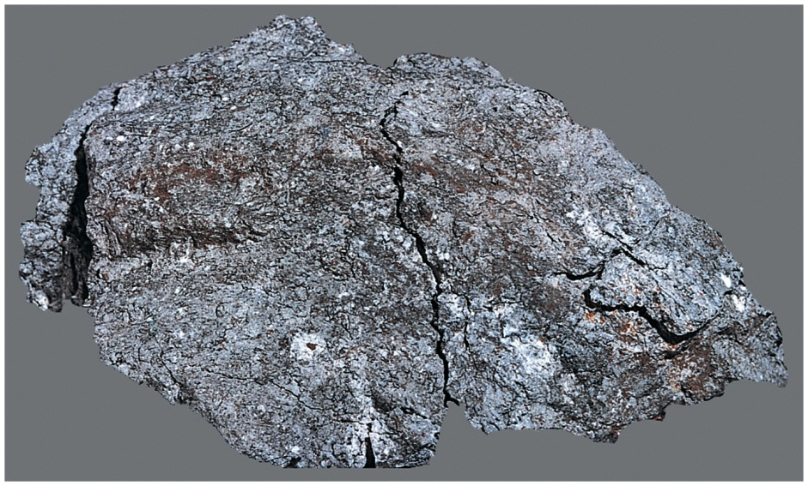
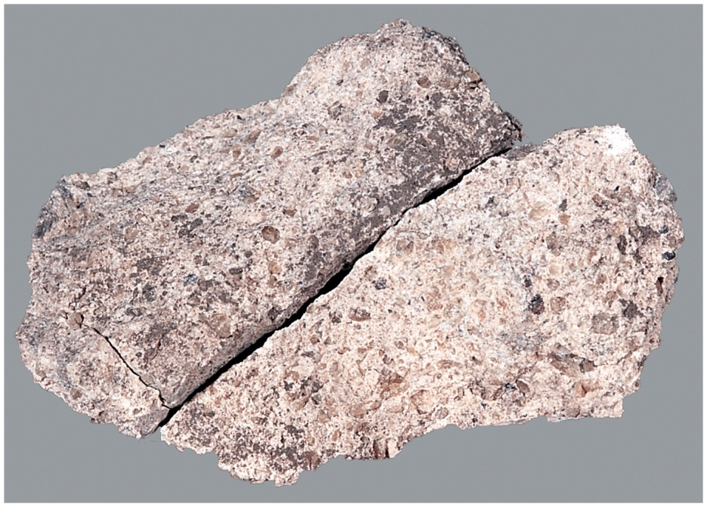
Većina stijena donesenih sa Mjeseca ima sličan sastav kao stijene sa Zemlje
Stijene sa Mjeseca ne sadrže vodu

Slide 39
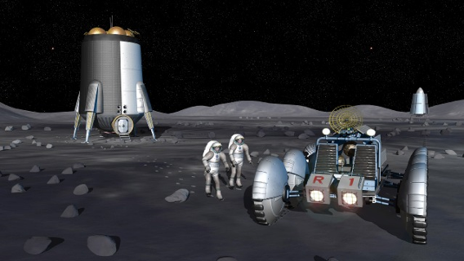
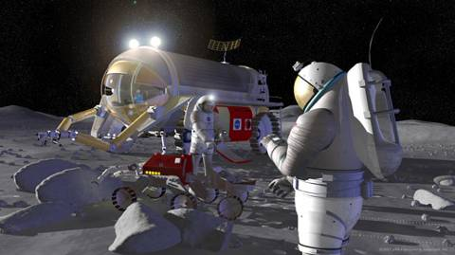
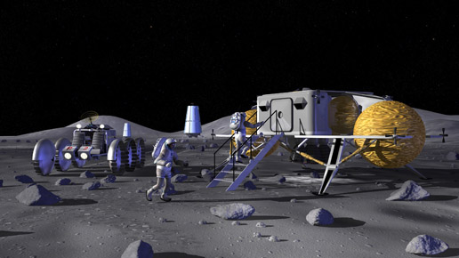
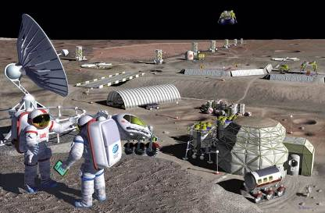
2018 – dolazak ljudi na tjedan dana
sljedeće – dulji boravak

Slide 40
Utjecaj Mjeseca na Zemlju
Mjesečina, tamne noći, pomrčina
Plima i oseka
Nagib Zemljine osi
Brzina rotacije Zemlje

