Slide 1
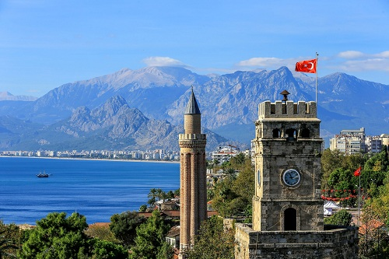
MY LİFE
Hello i am Rabia tame i am 13 years old.
I have a sister named Filiz
My father`s name is Mehmet Ali,if my father is a security mother`s name Şerife is a housewife
I live in Turkey`s Antalya province with a famoustourism city

Slide 2
My hobbies
My hobbies are reading books,listening to music, waching thrillers and animated movies ets.

Slide 3
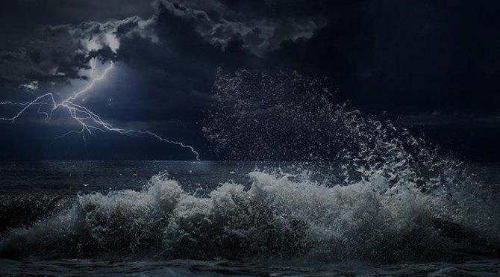
MY PHOBİAS
I don´t have much phobia but I don´t like storms.

Slide 4
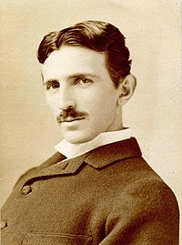
My goals
Iwant tobe successful in the LGS exam go to Yusuf Suggest Science High School and from there I want to go to Surgeon Pasha Faculty of medicini
My goal is to be a good physicist like Nikola Tesla.
I want to contribute to the word of science

Slide 5
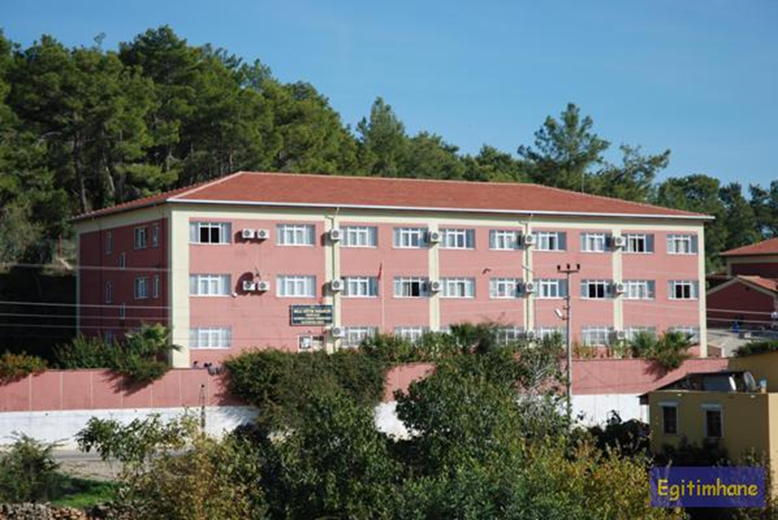
My school
I am studying at Okurcalar BHC secondary school.

Slide 6
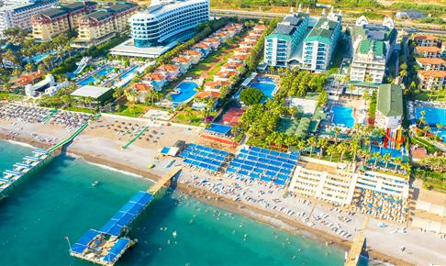
£
Where i live Okurcalar
Tourism is widespread in Okurcalar although there is not much history it is rich in naturel beaty.

Slide 7
GOOD
BYE

