Slide 1
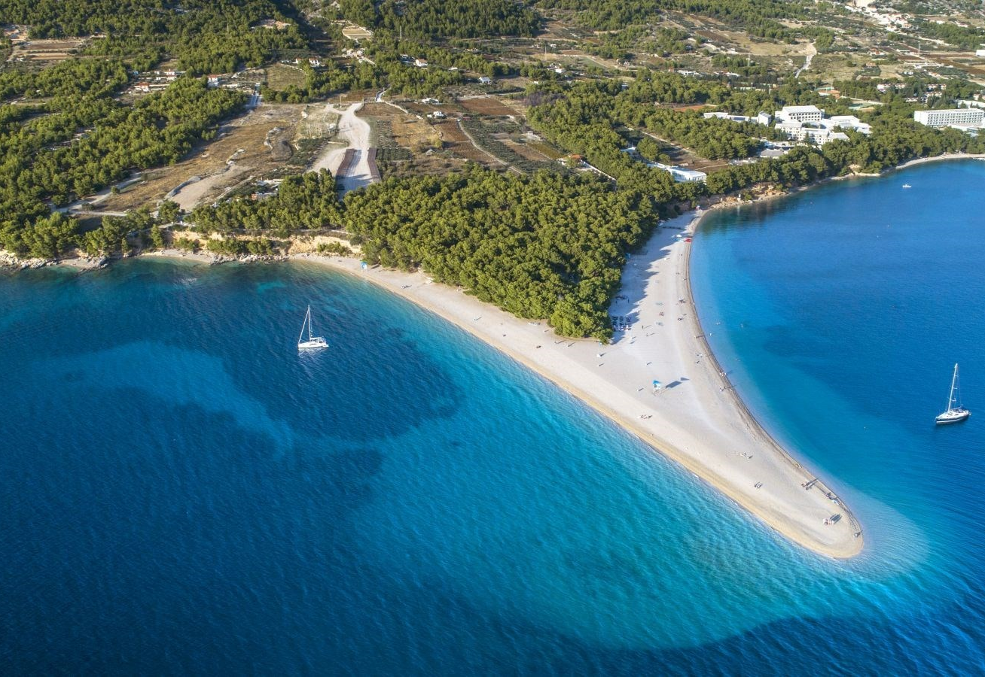
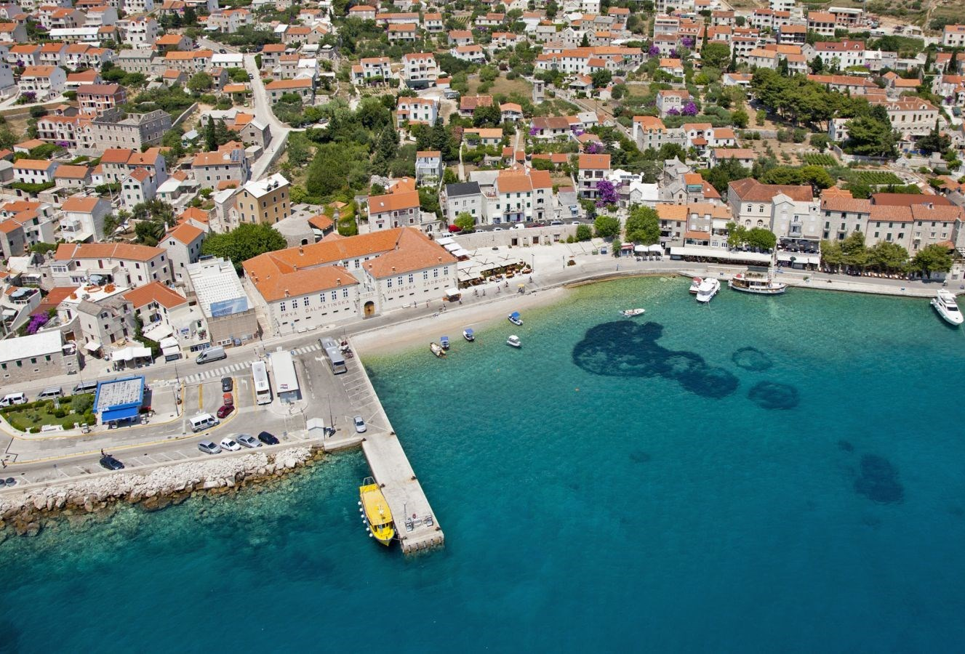
An interview with Mr Markito Marinković, director of Tourist Board Bol
Bol High School, Croatia

Slide 2
Waste and sustainability
Mr Marinković, what is in your opinion in our power to sustain the island of Brač clean, without contributing to its further pollution ?
MR MARINKOVIĆ: Our island has issues with garbage, garbage collection and landfills. There are two landfills on the island and they are half-illegal. I see the solution in transporting waste off the island, constructing a common wasteland or recycling and energy production. These solutions would contribute to the island’s sustainability because current approaches create problems like bad smell and smoke.

Slide 3
We have heard that there are cards for garbage disposal here in Bol, how do they function?
MR MARINKOVIĆ: These cards open dumpsters and it is allowed to throw garbage a fixed number of times, if that number is exceeded, you have to pay a certain amount of money every time a dumpster is opened, it costs one euro according to the price list.

Slide 4
Attractions
What do you think, is our island appealing to tourists because of our culture, tradition, nature or something else?
MR MARKITO: Everything of the above, but the dominant attractions are beautiful natural spots,followed by culture, tradition and gastronomy.
Apart from Golden Cape, what are other factors which make Bol a more attractive tourist destination than other places on the island?
MR MARINKOVIĆ: The unique shape of the Golden Cape enabled us to create a visual and verbal identity ( symBOL of the Adriatic). There are many activities tourists in Bol can enjoy: wind surf, tennis, scuba diving, cycling, hiking and trekking). Our movie about Wind Surf has won an award on the fair in Berlin. There are two cycling and three hiking routes.

Slide 5
Things to improve
According to you, what would be disadvantages of tourist activities in Bol?
MR MARINKOVIĆ: The biggest disadvantage is that high season is very short, lasting from mid July tillmid August. There is also a problem with work labour because we need to hire wokers from the neighbouring countries and then we face the problem of service and prices.

Slide 6
Mass tourism and its dangers
Which parts of Brač face the biggest devastation danger caused by mass tourism?
Mr Marinković: Those parts of the island which are struck by mass construction resulting from mass tourism. When it comes to Bol, there is still space for construction, but in my opinion, there have been constructed certain houses and buildings which are not typical of a small Dalmatian place and they have affected the visual appearance of Bol negatively.

Slide 7
The pandemic and tourism in Bol
How much has tourism in Bol been affected by the pandemic and are you optimistic concerning the upcoming season?
MR MARINKOVIĆ: Tourism in general has been greatly affected by it. In 2020 only 38% of the tourist numbers from 2019 was reached. The upcoming season depends on many factors like vaccination rate in the EU and other factors we cannot influence. I don’t think that tourism we used to know will come back soon because of big global phenomena like the ruin of air industry and entertainment industry which hasn’t operated for a year now. Thanks to the pandemic, we have realized that many people offering tourist services in Bol weren’t local people capable of providing guests with the true charm of the island and making them feel comfortable. Guests wanted to feel an authentic host approach and local atmosphere. Also, it has made us realize that tourism in Bol had grown into real estate business only and reminded us of the charm of tourism.

Slide 8
Brač airport and tourism in Bol
How important is Brač Airport for tourism in Bol and do you think there is space for further development of tourism in Bol?
MR MARINKOVIĆ: Of course there is space for development. Bol profits a lot from the airport due to the fact it is situated close to it. However, there is a problem with the length of the runway because of which bigger planes can’t land there. The airport was built as a sport airport. Extending the runway means financial problems due to the fact that the airport has a private owner. On the other hand, if the runway was extended, it would bring problems like accommodation and environment pollution.

Slide 9
The best tourist year in Bol
Do you know which year was the best one referring to tourism in Bol?
MR MARINKOVIĆ: It was the year 2018, and in 2017 we had 100.000 arrivals in one year.

Slide 10
Winter tourism and traffic communication network
Is it possible to attract tourists to Bol in winter also and how?
MR MARINKOVIĆ: I don’t think so because it’s not affordable to open hotels for a small number of guests and our destinations aren’t ready to whole-year arrangements.
Is it easy to access Bol and is it necessary to work on traffic communication network?
MR MARINKOVIĆ: It is definitely necessary to work on traffic communication network because tourists lose a lot of time coming to Bol and going back, which leads to a shorter staying in Bol. Brač is the only Croatian island with its airport, but its advantages haven’t been fully exploited.

