Slide 1
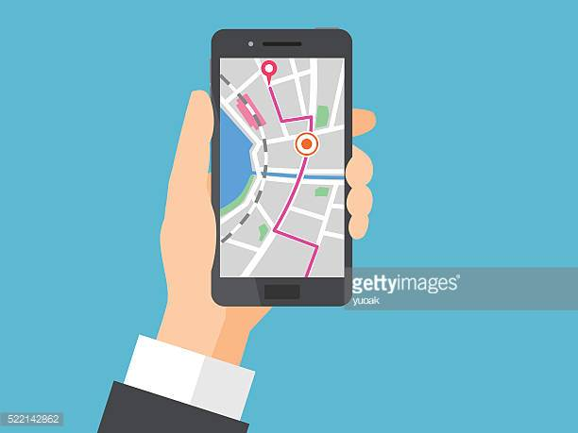
GPS
(Global positioning system)
By:Luka Barižon

Slide 2
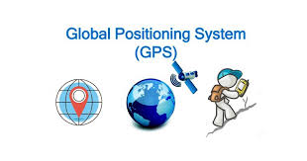
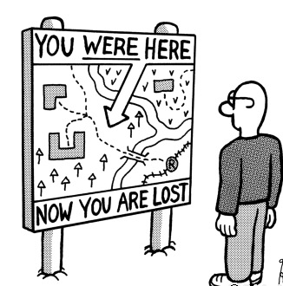
Introduction
We have all been lost before, and have had trouble in finding our way to where we want to get to. Now technology is helping us find our way. This technology is called Global Positioning System (GPS).

Slide 3
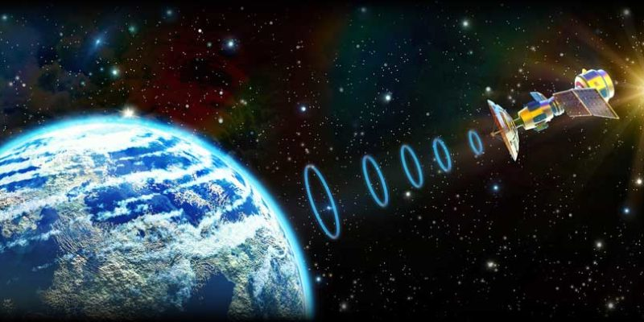
What is GPS?
Global Positioning System technology has been used by the military for about ten years now, and is just starting to be given practical uses in society today.
GPS is a satellite-based navigation system made up of at least 24 satellites. GPS works in any weather conditions, anywhere in the world, 24 hours a day, with no subscription fees or setup charges.

Slide 4
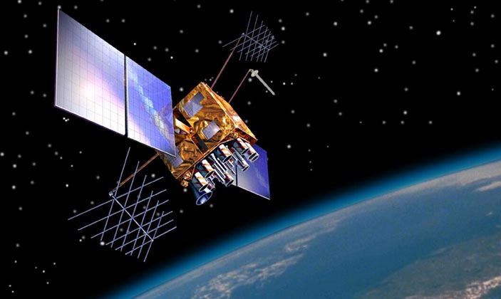
How GPS works?
GPS satellites circle the Earth twice a day in a precise orbit. Each satellite transmits a unique signal and orbital parameters that allow GPS devices to decode and compute the precise location of the satellite.

Slide 5
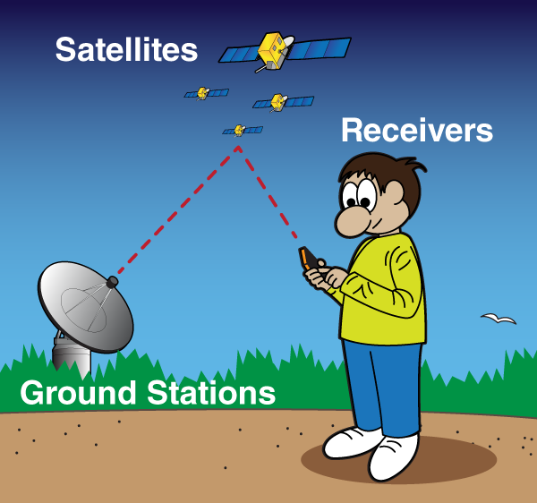
Recently is GPS being used outside the military it takes three satellites to find your position. Each of the satellites sends a radio signal down to your GPS receiver, and the receiver measures how long it takes the signals to get there. This happens very fast because the radio signals travel at the speed of light.
It is very useful method in which this GPS technology is helping us find our way.

Slide 6
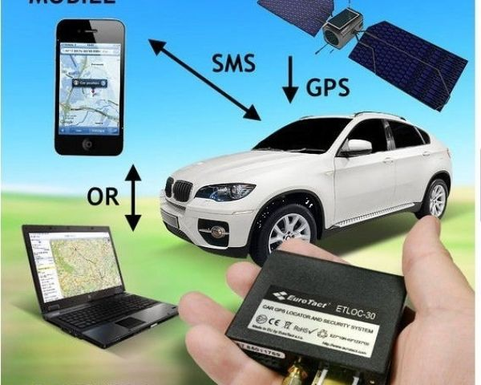
GPS has many different uses, and it doesn’t just have to be used to help you find your way. GPS can also be used with computer software for practical uses, such as in farming, and has safety applications as well.

Slide 7
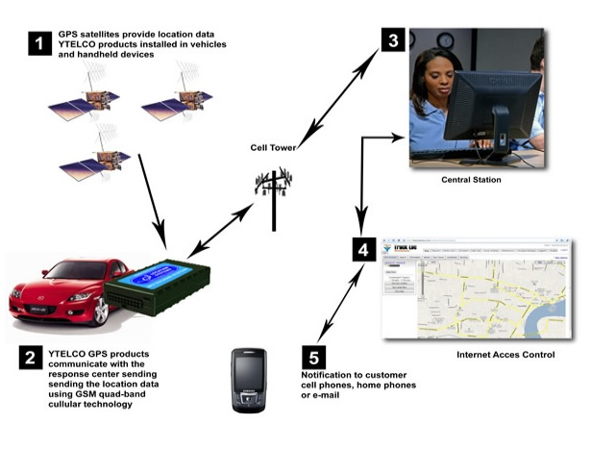

Slide 8
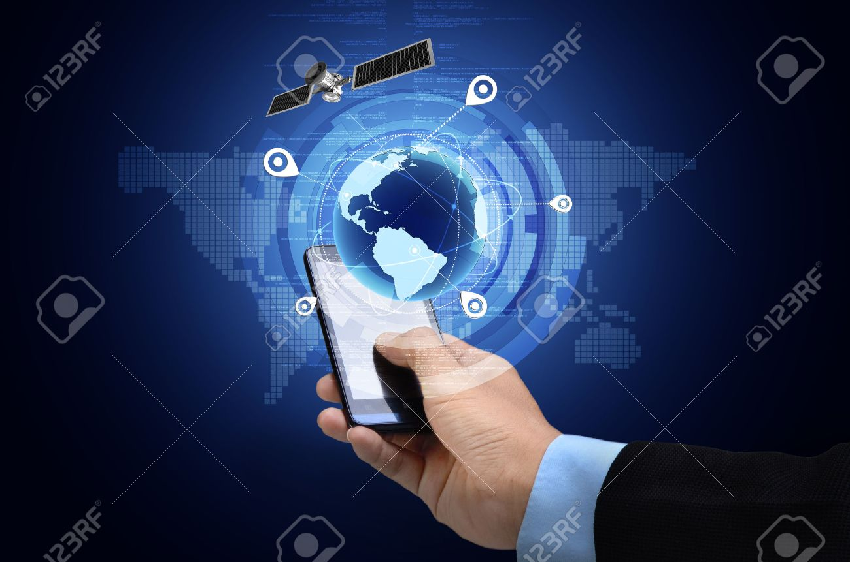
How accurate is GPS?
Today's GPS receivers are extremely accurate, thanks to their parallel multi-channel design.Certain atmospheric factors and other error sources can affect the accuracy of GPS receivers.GPS receivers are typically accurate to within 10 meters. Accuracy is even better on the water.

Slide 9
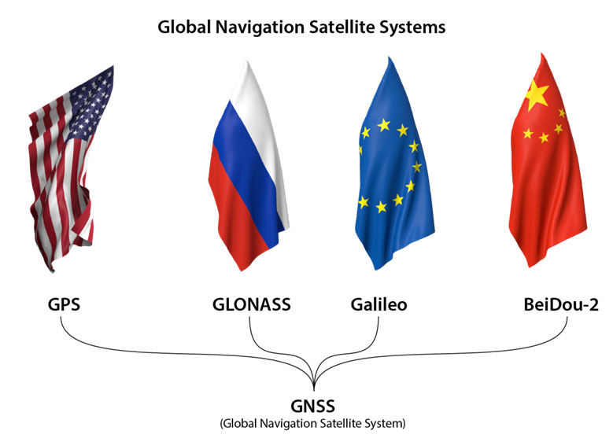
Other GPS Systems
There are other similar systems to GPS in the world, which are all classified as the Global Navigation Satellite System (GNSS). GLONASS is a satellite constellation system built by Russia. The European Space Agency is creating Galileo, while China is creating BeiDou.

Slide 10
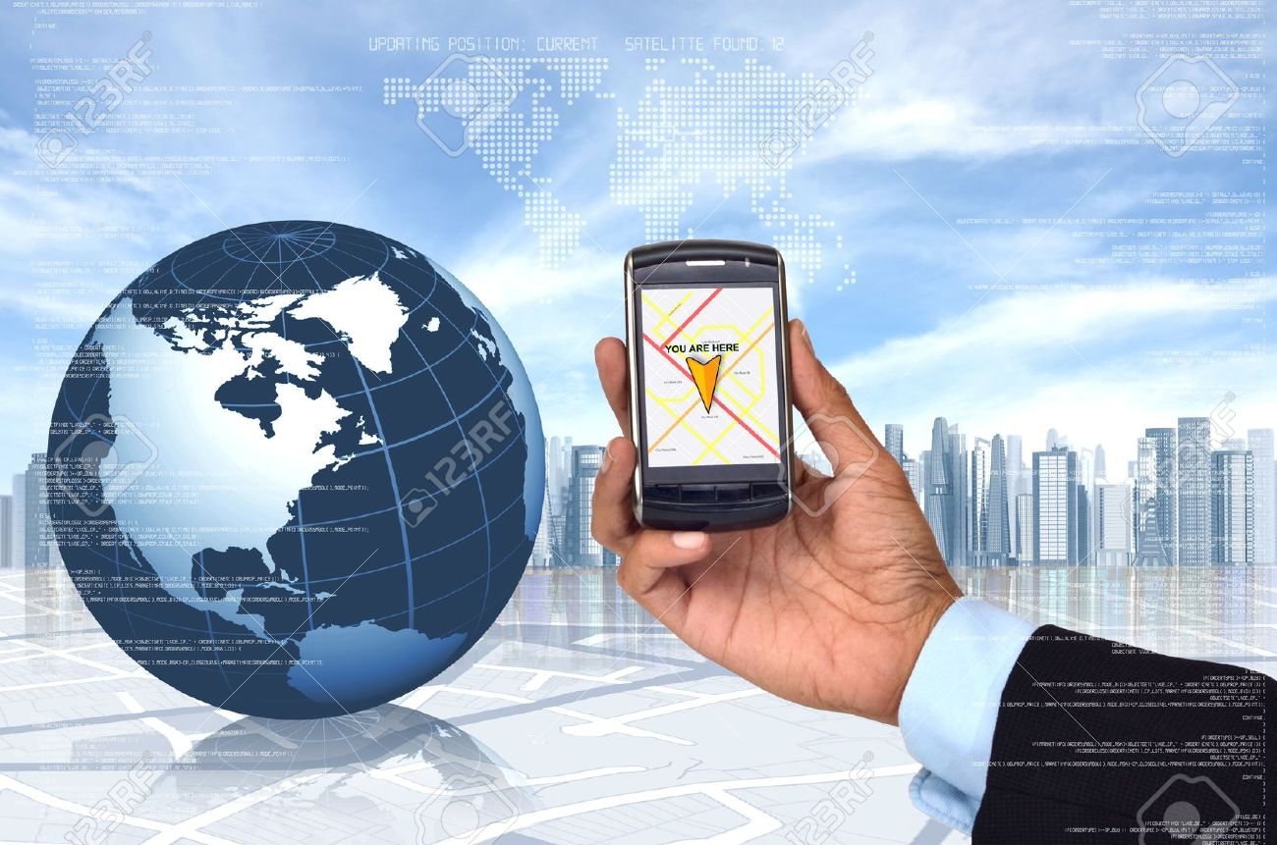

What's the signal?
GPS satellites transmit at least 2 low-power radio signals. The signals travel by line of sight, meaning they will pass through clouds, glass and plastic but will not go through most solid objects, such as buildings and mountains. However, modern receivers are more sensitive and can usually track through houses.

Slide 11
Conclusion
GPS has become widely used navigation assistance around the world and a useful tool for mapping, land survey, trade, scientific purposes, tracking and surveillance.
GPS has become the mainstay of transport systems around the world, providing navigation for aviation, land and sea operations. Emergency services depend on the GPS in terms of location and time features necessarily needed in their life-saving missions.

Slide 12
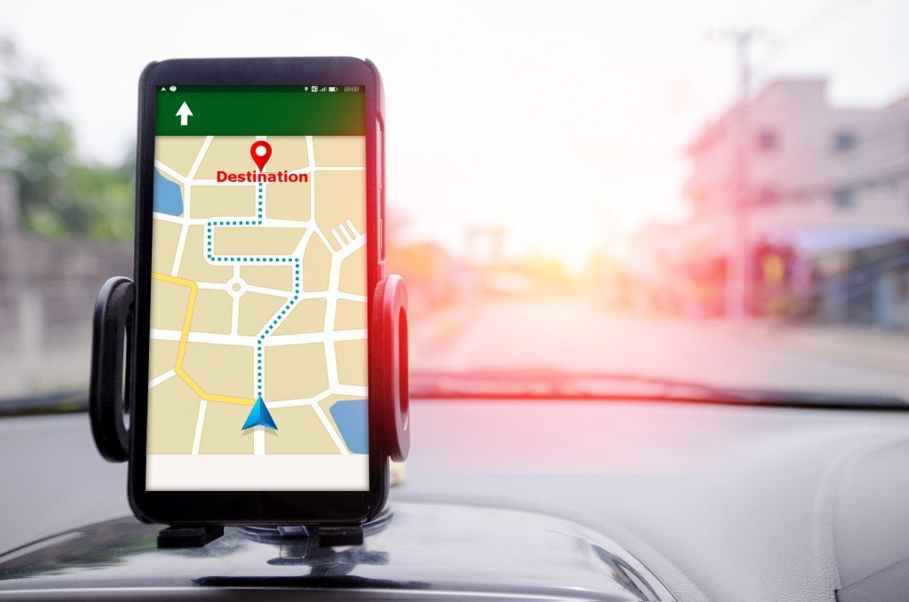
Precise time provided by GPS facilitates everyday activities such as banking, mobile phone operation, and even supervision over the power grid. Farmers, geodesists, geologists and a multitude of other experts are doing their job more efficiently, safer, more economically and more accurately using the free and available GPS signals.

Slide 13
The end...

