Slide 1
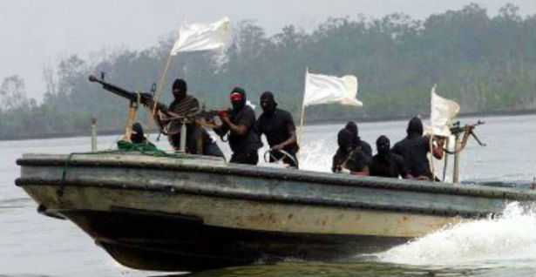
PIRATES TODAY

Slide 2
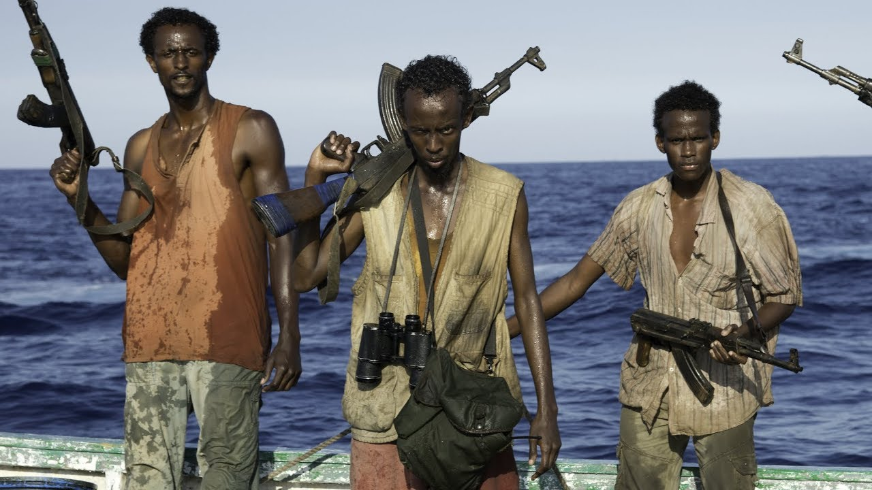
In recent years, the problem of piracy has emerged as a major threat to sea transportation in some parts of the world. According to some estimates, pirate attacks have increased by a whopping 75% in the last decade alone. As per IMO data, there were 489 reports of piracy and armed robbery against ships in 2010, which were 20% more in comparison to 2009.

Slide 3
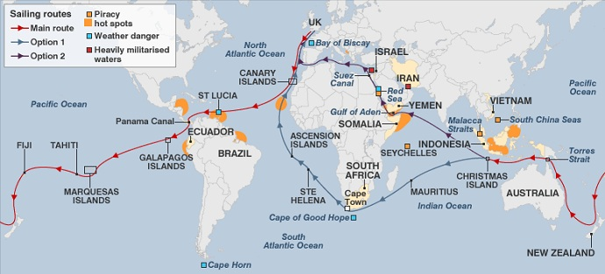
Hot Spots of Modern Piracy
The hot spots of piracy today are the Indian Ocean, East Africa and the Far East, including the South China Sea, South America and the Caribbean. More recently, pirates have been found very active in the waters between the Red Sea (especially in the Gulf of Aden) and the Indian Ocean, the Somali Coast and the Malacca Straits. There are also reports of pirate attacks on the Serbian and Romanian Danube area since 2011. According to some estimates, the world's losses due to piracy may amount to as much as $ 13-16 billion a year.

Slide 4
MODERN PIRATES
Modern pirates now don night-vision goggles; carry AK-47s, heavy machine guns, and rocket launchers; navigate with GPS devices; and use sophisticated speedboats mounted with heavy mortars to target ships. According to reports, Somali pirates were found attacking ships with Russian made 82mm mortars that could target a ship as far as 5 kilometers from shore. Modern pirates today are part of organized crime gangs that target big and small cargo vessels, and even cruise ships and private yachts.

Slide 5
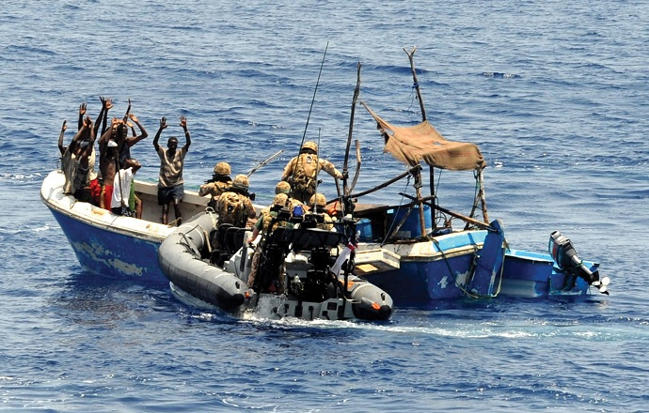
In recent times, there have been several incidences of brutal hijacking of ships off the Somali coast by Somali pirates, which grabbed the global media headlines. As a result, the US has started a multi-national effort to patrol the waters near the Horn of Africa to prevent future attacks on ships.

Slide 6
KRAJ
Izradio:Šime Bajlo i Ivan Aleksić 2.c

