Slide 1
Piracy
Made by:Ivan Aleksić
Šime Bajlo

Slide 2
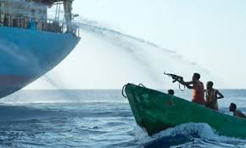
Piracy
Piracy is an act of robbery or criminal violence by ship or boat-borne attackers upon another ship or a coastal area, typically with the goal of stealing cargo and other valuable items or properties.
Those who engage in acts of piracy are called pirates.

Slide 3
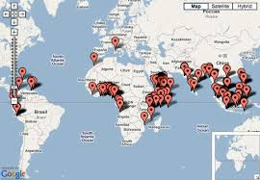
Piracy
Piracy mostly occures in waters of countries that are too poor to control it, but they do not allow control in their waters by 3rd party.
Most famous piracy places are near Suez canal and Indonesia.

Slide 4
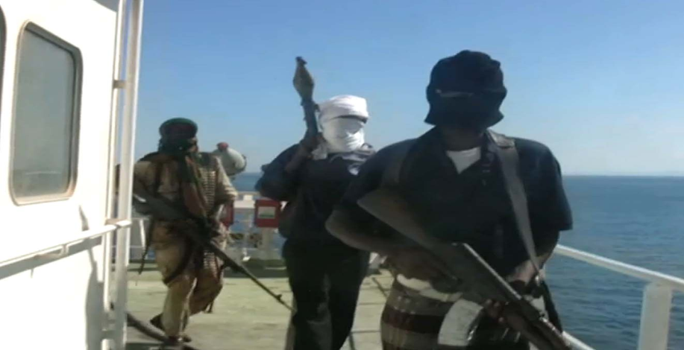
Piracy methods
Pirates often attack bigger ships.
They do not take ships goods instead they capture crew onboard and request ransom from ships company or their countries.

Slide 5
Piracy counter method
In order to counter piracy we need to secure ship and ships surrounding.
We do so by getting private ships security, or by requesting navys backup.
These methodes are proven to be very efficient as piracy drops from year to year.

Slide 6
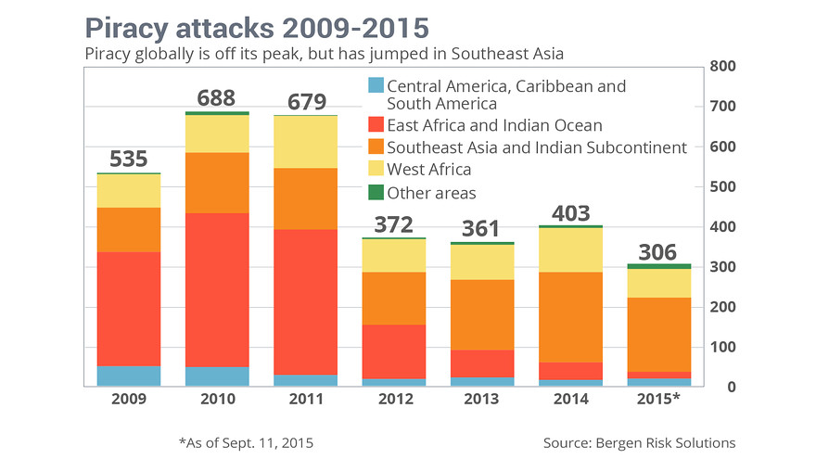

Slide 7
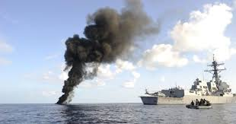
Piracy casualties
Piracy casualties are often, beacuse in some cases it takes too long to pay for the kidnapped ships crew in which case crew will be kept on board for months, or until death.
In most cases hostage situation is solved quickly with an intervention of navy.

Slide 8
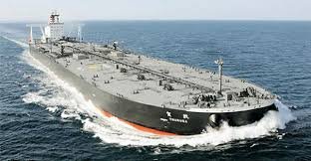
Aftermath of piracy onboard
Firstly we need capture or eliminate pirates.
Secondly we need to provide medical care for the crew.
Thirdly we need to disinfect the ship.
And at last we have a safe ship.

Slide 9
The end

