Slide 1
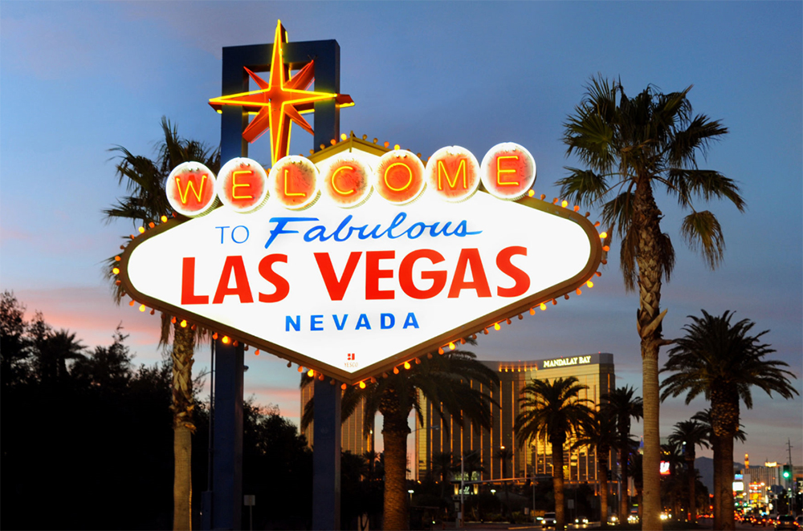

Slide 2
The City of Las Vegas and often known as simply Vegas, is the most populous city in the U.S. state of Nevada.
Las Vegas is known primarily for gambling, shopping, luxury and nightlife.

Slide 3
Las Vegas Strip is internationally known for the concentration of resort hotels and casinos along its route. The Strip is approximately 6.8 km in length. The largest hotel, casino, and resort properties in the world are located on the Las Vegas Strip.

Slide 4
The city's tolerance for different forms of adult entertainment earned it the title of Sin City Examples of vices include prostitution, gambling, drug, excessive organized crime and gang activity
Notes:
The city's tolerance for different forms of adult entertainment earned it the title of Sin City Examples of vices include prostitution, gambling, drug, excessive organized crime and gang activity

Slide 5
HISTORY
The Las Vegas oasis was first noticed in 1829 by Spanish explorers. They named this valley "Las Vegas" which means "the meadows."

Slide 6
Early Vegas

Slide 7
Fremont Street is home to most of downtown's hotels and casinos. These are the original casinos of Las Vegas, which existed before the more famous Las Vegas Strip.

Slide 8
Las Vegas today

Slide 9
Each year more than 90,000 people get married in Las Vegas

Slide 10
Las Vegas is famous for many reasons, included in the long list or reasons would be the movie industry.

Slide 11
Over the years, Las Vegas have had many full length feature movies filmed in Las Vegas.

Slide 12
POKER A dollar won is twice as sweet as a dollar earned.

Slide 13
Gambling is not about how well you play the games, it's really about how well you handle your money.

Slide 14
Casinos in Vegas have over 115000 gaming machines and over 4000 total table games

Slide 15
The Entertainment Capital of the World

Slide 16
NIGHTLIFE

Slide 17
POOL PARTY

Slide 18
HOTEL-CASINO
A mafia boss Benjamin Bugsy Siegel built the first hotel and casino “Flamingo “ in 1946
It is the oldest resort on the Strip still in operation today. “Flamingo” was renovated for years in the same place

Slide 19
Bellagio, More than 1,000 fountains dance in front of the hotel Caesars Palace, is a replica of ancient Rome with marble columns, statues, fountains, and a golden chariot

Slide 20
The MGM Grand is the largest hotel resort complex in the U.S. Mandalay Bay is owned by MGM Resorts International

Slide 21
Luxor Las Vegas Monte Carlo

Slide 22
Wynn and Encore Trump

Slide 23
Rio The Paris

Slide 24
New York, New York The Venetian

Slide 25
Excalibur Circus Circus

Slide 26
Mirage Aria

Slide 28
Prezention by: Carolina Sara Kale

