Slide 1
Wind

Slide 2
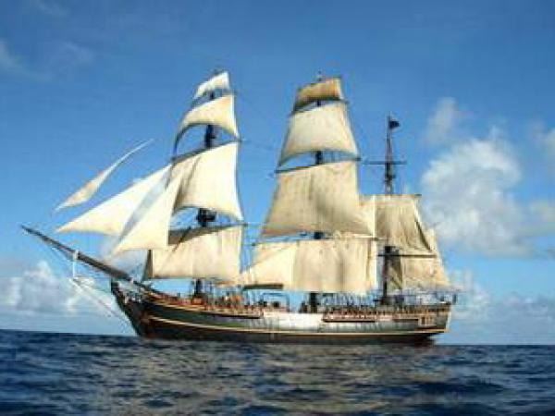
Definition and history
Wind is horizontal moving of the air
Throughtout history wind was used in many things like windmills and expecialy in maritime

Slide 3
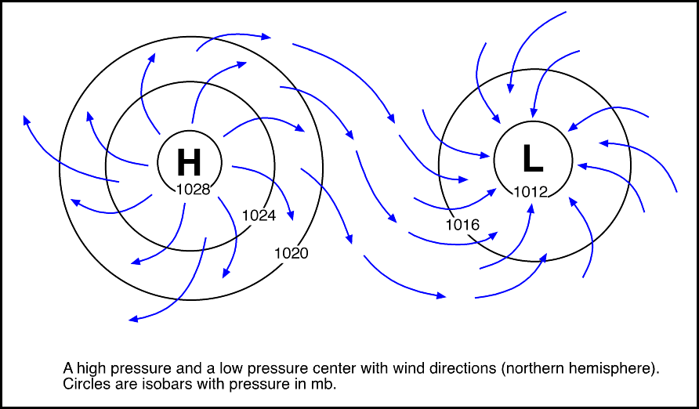
Creation
Wind is created by diffrence in pressure between high pressure-area to a low-pressure area
Low pressure area is called cyclone
High pressure area is called anticyclone

Slide 4
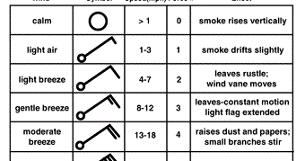
Defining of the wind
  We define wind in two ways:
    By speed which is measured in knots or in beauforts
    By direction from witch it is coming from (north,northeast,southwest...)

Slide 5
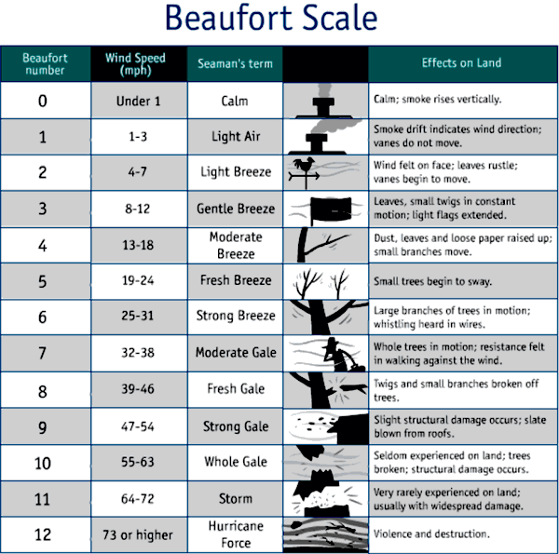

Slide 6
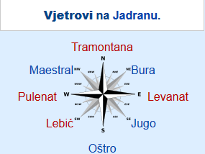
Vijetrovi na jadranu

Slide 7
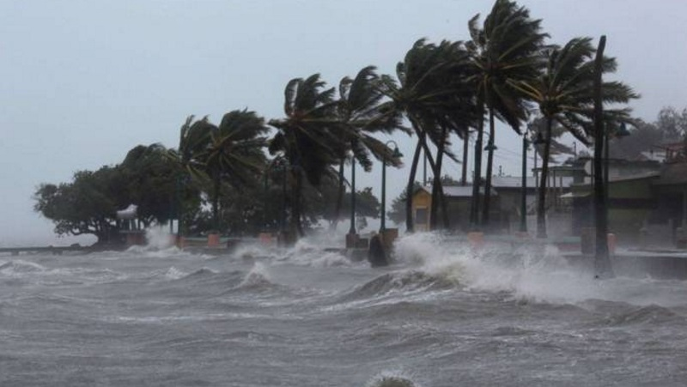
Danger
Wind altho proven useful it can be very dangerus
Dagner from wind can come in ways of huricane,tornados, typhoons...

Slide 8
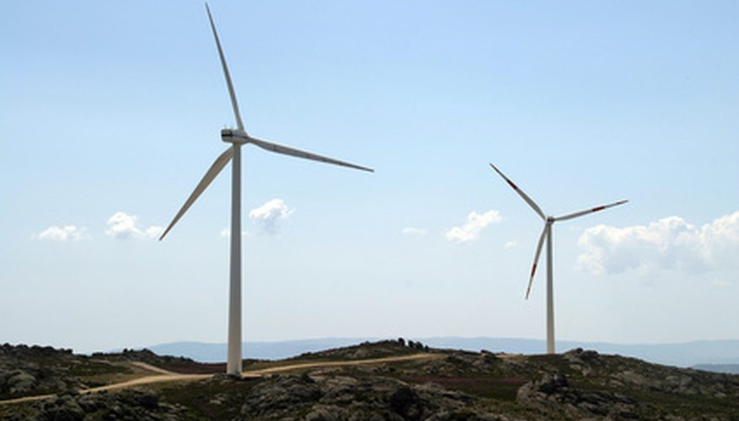
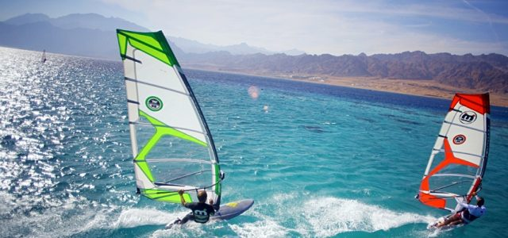
Modern applications
Nowdays wind is mostly used in:
  Creating energy
  Sports like windsurfing, kite surfing and sailing
  Modern sailing ships

Slide 9
Closure
Wind is both good and bad natural occurrence
It all depends of how much we know about it and how we use that knowledge

Slide 10
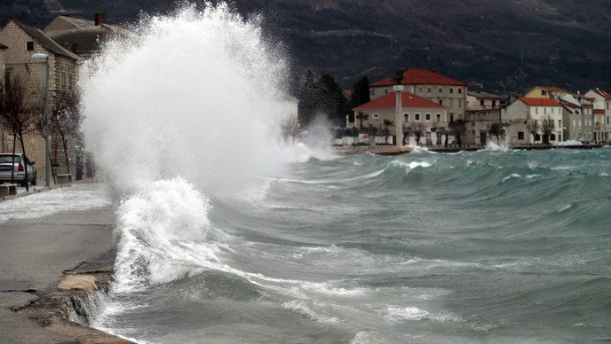
The end made by Igor Dukić

