Slide 1
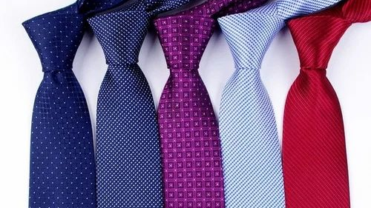
The Tie
Made by Niko Brdar 2.b

Slide 2
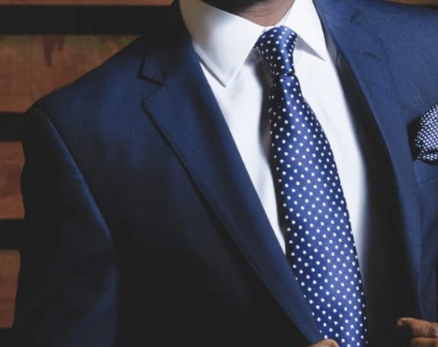
Definition
A necktie, or simply a tie, is a piece of cloth worn for decorative purposes around the neck, resting under the shirt collar and knotted at the throat, and often draped down the chest.

Slide 3
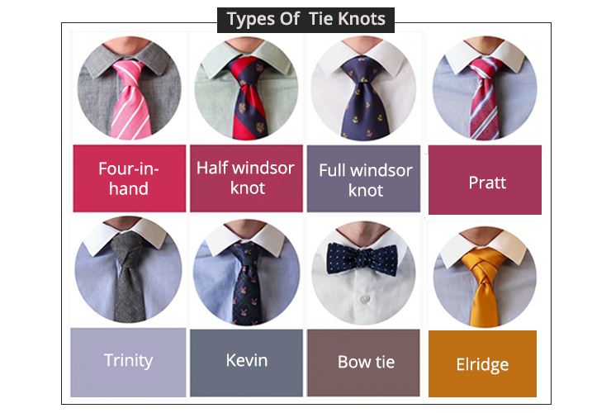
Types of knots
There are over 170000 types of tie knots, but the most common types of knots are:
The four-in-hand knot
The half-Windsor knot
The Windsor knot
The Pratt knot

Slide 4
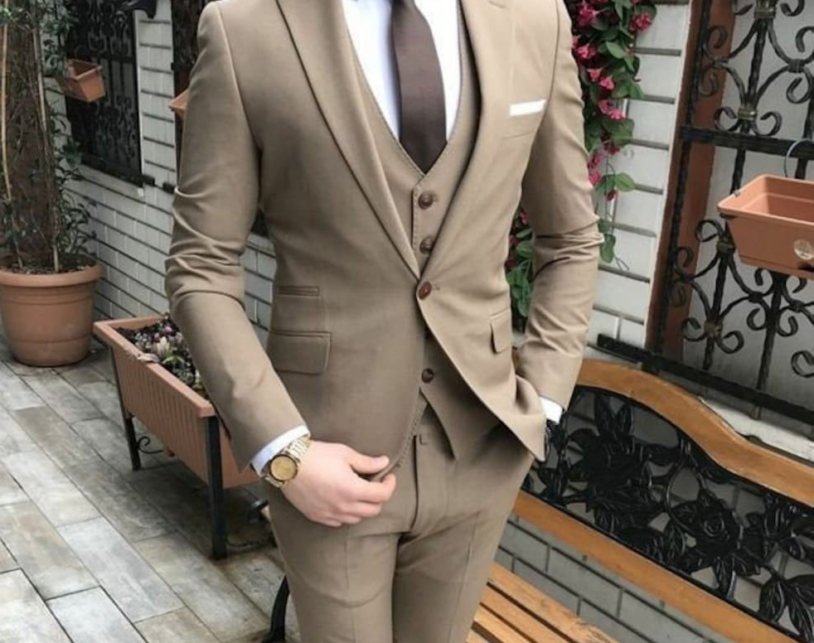
Purpose
The purpose of a necktie is to show elegance, respect and dignity, and to make the wearer look more civilized and proper.

Slide 5

Utilization
Ties are utilized in many settings:
Weddings
Job interviews
Ceremonies
Networking events
Many other formal gatherings

Slide 6
Thank you for watching

